Slide 1
SUPPLY CHAIN ANALYSIS

Slide 2
Company’s Background

Slide 3
Company’s Background
FMCG Manufacturer
Gujarat, India

Slide 4
Company’s Background
FMCG Manufacturer
Gujarat, India
Surat
Vadodra
Ahmedabad

Slide 5
Problem Statement
Few customers didnt renew their annual contract due to service issue.
Suspected reasons:
Late delivery
Not delivery in full

Slide 6
Expectations
Clear understanding of key metrics
on time delivery
in full delivery
ontime in full delivery

Slide 7
Indroduction
This dashboard provides a comprehensive overview of key supply chain performance metrics including:
- OT (On Time Delivery)
- IF (In Full Delivery)
-OTIF(On Time In Full Delivery)
- LIFR (Line Fill Rate)
- VOFR (Volume Fill Rate)
It enables stakeholders to assess performance trends, customer service levels, and product delivery efficiency.

Slide 8
KPI Overview
The top section displays five main KPIs:
- OTS: 72% (Target: 94%)
- IPK: 100%
- LIFR: 66%
- VOFR: 97%
These values highlight strengths and areas needing improvement in the delivery process.

Slide 9
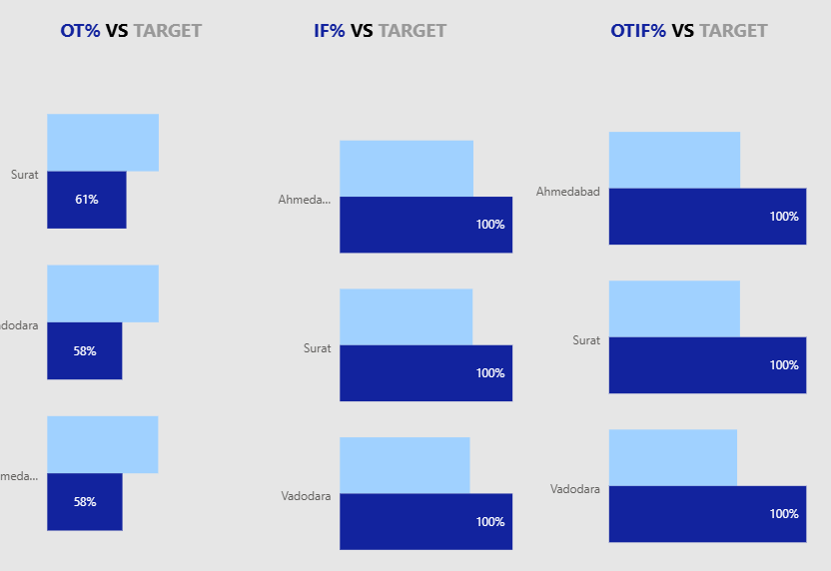
Performance by City
Bar charts compare OT, OTIF, and IF performance across key cities.
This allows for geographic insights into delivery reliability and operational consistence.

Slide 10
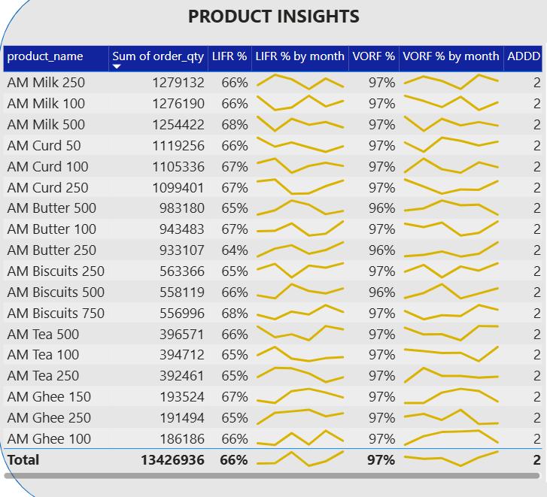
Product Insights
This section lists individual products with their delivery performance over time.
Sparklines show monthly trends in ADD,LIFR, and VOFR for each product, helping identify supply or demand issues.

Slide 11
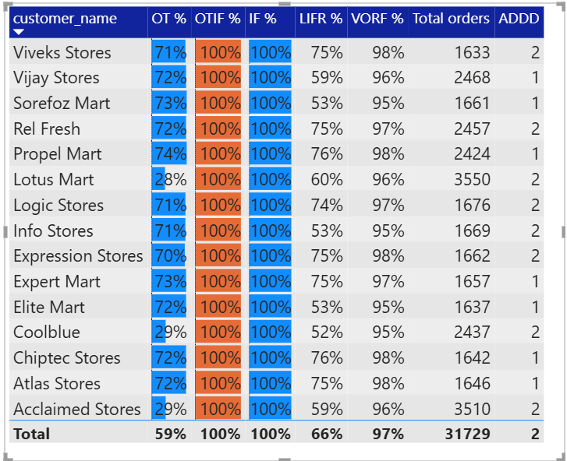
Customer Insights
Customer-wise performance is analyzed in terms of all major KPIs.
This supports customer relationship management by highlighting high- and low-performing delivery metrics by client.

Slide 12
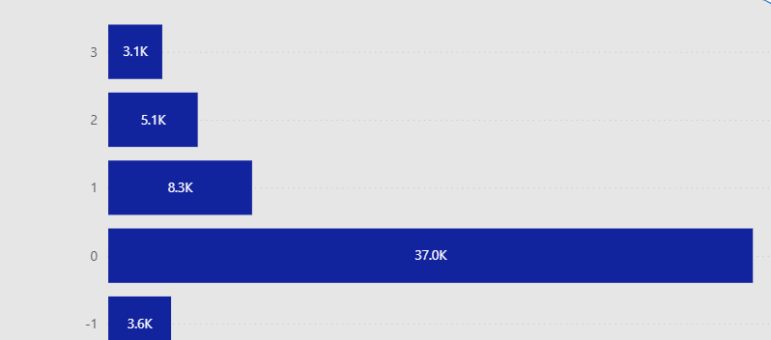
Order Delay Analysis
Charts analyze the number of orders delayed by various time intervals (1–15+ days).
This helps pinpoint systemic issues causing delays and enables root-cause analysis.

Slide 13
Conclusion
This dashboard empowers teams to:
- Monitor operational efficiency
- Improve service levels
- Reduce delivery delays
- Strengthen customer satisfaction
Continuous tracking and response to these KPIs are essential for supply chain optimization.

Slide 14
