Slide 1
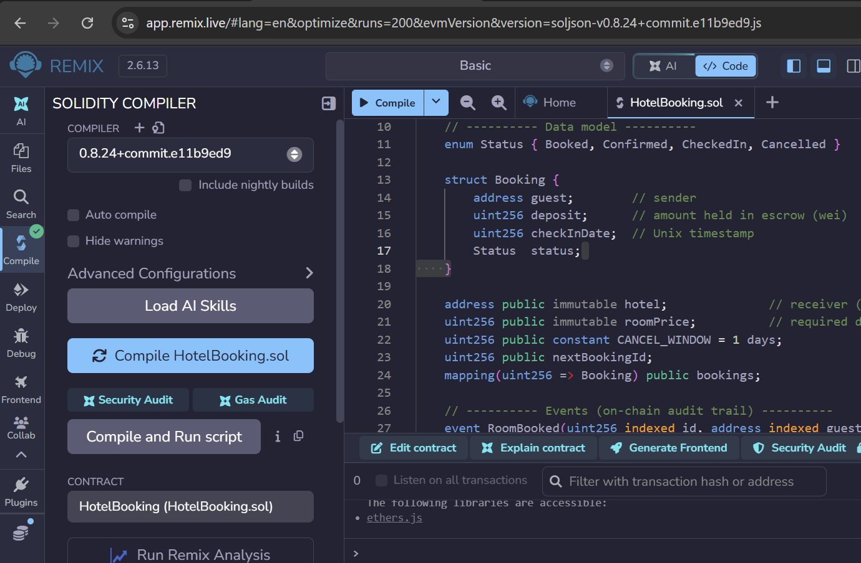
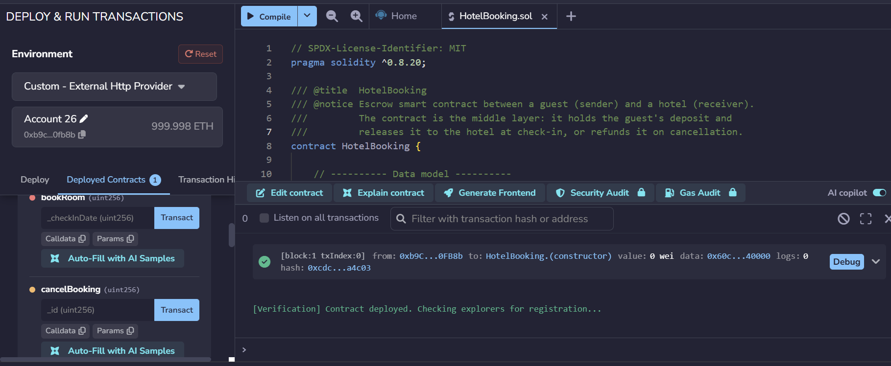






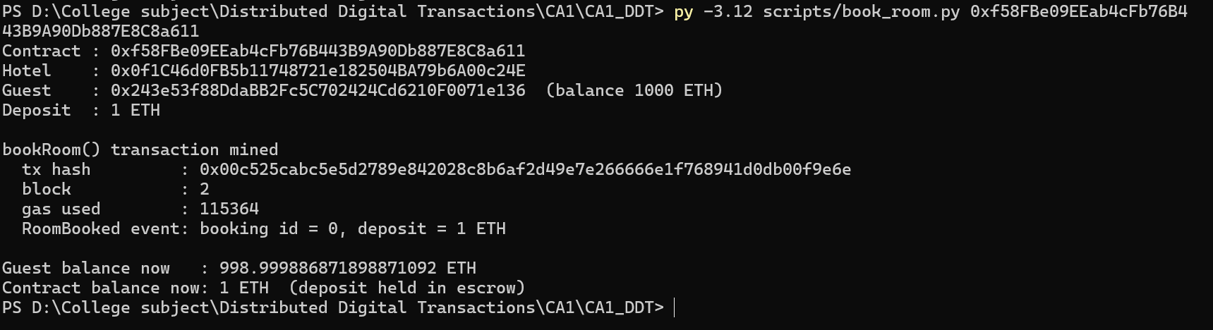
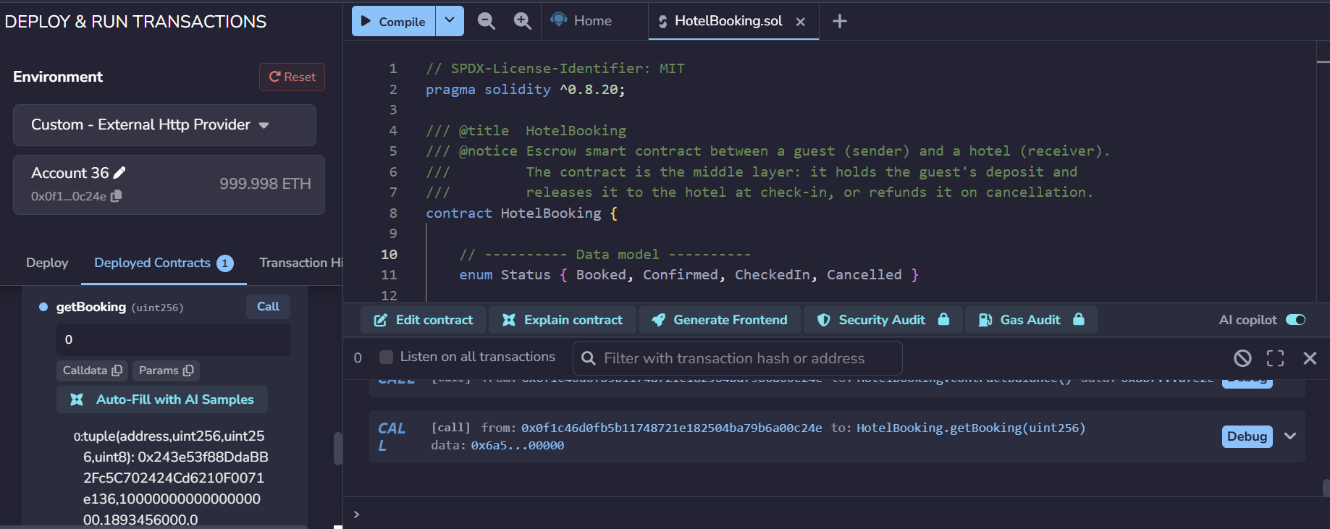






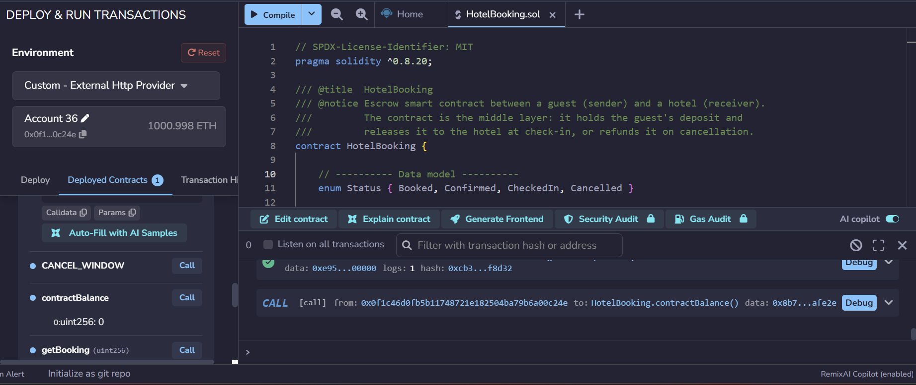
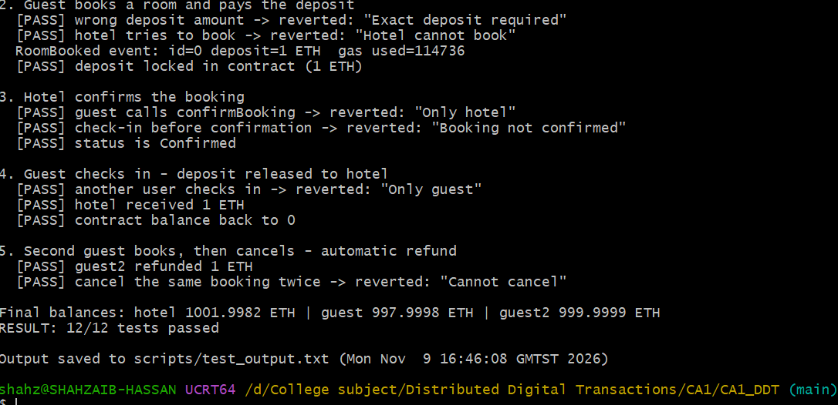






Blockchain-Based Hotel Booking:
A Trustless Escrow Smart Contract on Ethereum
Shahzaib Hassan (2024669) · CCT College Dublin · DDT CA1 · Nov 2026
INTRODUCTION
BUSINESS MODEL & DISRUPTION
CRYPTOGRAPHIC SECURITY
IMPLEMENTATION & TESTING
Hotel bookings today pass through online travel agencies (OTAs) that sit between guests and hotels, holding payments and charging commission. This project proposes a blockchain-based booking system in which an Ethereum smart contract replaces the middleman: it holds the guest's deposit in escrow and releases it automatically by rules both parties can see.
Guests book directly with the hotel through a smart contract. Instead of a 15–30% platform commission, each booking costs only a small network (gas) fee, shifting power from intermediaries back to independent hotels and their guests.
Every booking transaction is signed with ECDSA on the secp256k1 curve and linked by Keccak-256 hashes. Only the guest's private key can sign; anyone can verify with the public key (Wood, 2014).
Development environment: Remix IDE (Solidity) connected to a Ganache v7.9.2 local Ethereum blockchain (chain ID 1337, Shanghai hardfork) via http://127.0.0.1:8545.
CURRENT SYSTEM & ITS PROBLEMS
Aspect | Traditional | Blockchain
Payment held by | OTA / payment provider | Smart contract (escrow)
Fees | 15–30% commission | Small gas fee
Refunds | Manual, days | Automatic, by code
Booking record | Private database | Shared, tamper-proof ledger
Trust placed in | Intermediary | Code + cryptography
Authentication
Integrity
Non-repudiation
15–30%
commission charged to independent hotels by OTAs (Martin, n.d.)
Refund and cancellation disputes
Guest data held in one central database
Booking data
Keccak-256 hash
Signed with private key
Verified & added to block
1
Compiled in Remix (Solidity 0.8.24)
2
Deployed to Ganache by the hotel
Guests and hotels must trust a third party to hold money, settle disputes and protect personal data – adding cost, delay and a single point of failure.
GDPR: personal data stays off-chain – only its hash is stored.
RECENT ADVANCEMENTS
SMART CONTRACT DESIGN
PROPOSED BLOCKCHAIN SOLUTION
Layer-2 rollups
Arbitrum and Optimism batch transactions off the main chain, cutting booking fees (Ethereum Foundation, n.d.).
Guest = sender · Hotel = receiver · Contract = middle layer
A smart contract becomes the trusted middle layer:
Function | Called by | What it does
bookRoom() | Guest | Pays deposit, creates booking
confirmBooking() | Hotel | Accepts the booking
checkIn() | Guest | Releases deposit to hotel
cancelBooking() | Guest | Refunds deposit before deadline
3
bookRoom() via web3.py: guest pays 1 ETH
4
getBooking(0): booking stored on-chain
Account abstraction (ERC-4337)
Guests pay with familiar logins instead of managing seed phrases (Buterin et al., 2021).
1. Guest books & pays deposit
2. Deposit locked in contract
3. Guest checks in
4. Hotel is paid automatically
Zero-knowledge proofs
Prove a valid booking or ID without revealing personal data (Goldwasser, Micali and Rackoff, 1989).
Cancelled before deadline? Deposit refunded to guest automatically.
5
checkIn(): hotel paid, escrow back to 0
6
Invalid actions rejected with reasons
System Architecture (UML)
BENEFITS & CHALLENGES
HotelBooking.sol
12/12
automated tests passed (web3.py on Ganache)
booking, confirmation, check-in payment, refund and 6 rejected invalid actions
struct Booking {
address guest; // sender
uint256 deposit; // held in escrow
uint256 checkInDate;
Status status;
}
function bookRoom(uint256 _checkInDate)
external payable returns (uint256 id)
{
require(msg.sender != hotel,
"Hotel cannot book");
require(msg.value == roomPrice,
"Exact deposit required");
id = nextBookingId++;
bookings[id] = Booking(msg.sender,
msg.value, _checkInDate, Status.Booked);
emit RoomBooked(id, msg.sender,
msg.value, _checkInDate);
}
function checkIn(uint256 _id)
external onlyGuest(_id)
{ ...
b.status = Status.CheckedIn; // CEI
b.deposit = 0;
(bool ok, ) = payable(hotel)
.call{value: amount}("");
}
Guest
Sender – books room, pays deposit
Benefits
Challenges
bookRoom()
+ deposit
No middleman commission
Gas fee and ETH price volatility
cancelBooking()
refund
CONCLUSION
Blockchain layer (Ganache)
Automatic, rule-based refunds
GDPR right to erasure vs immutable ledger
HotelBooking.sol
Holds deposit in escrow
Enforces booking rules
Records every step on-chain
Tamper-proof booking history
Contract bugs are permanent
Transparent to guest and hotel
Oracle problem: contract can't see a guest arrive
REFERENCES
checkIn()
payment released
Buterin, V. et al. (2021) ERC-4337: Account abstraction using alt mempool. Ethereum Improvement Proposals. Available at: https://eips.ethereum.org/EIPS/eip-4337 (Accessed: 8 November 2026).
Ethereum Foundation (n.d.) Layer 2. Available at: https://ethereum.org/layer-2/learn/ (Accessed: 8 November 2026).
Goldwasser, S., Micali, S. and Rackoff, C. (1989) 'The knowledge complexity of interactive proof systems', SIAM Journal on Computing, 18(1), pp. 186-208.
Martin, S. (n.d.) How much commission does Airbnb, Expedia and Booking.com take (+ others). Preno. Available at: https://prenohq.com/blog/ota-commission-rates-expedia-booking-com-more/ (Accessed: 6 November 2026).
Wood, G. (2014) Ethereum: A secure decentralised generalised transaction ledger (Yellow Paper). Available at: https://ethereum.github.io/yellowpaper/paper.pdf (Accessed: 9 November 2026).
confirmBooking()
hotel accepts
Hotel
Receiver – confirms booking, receives payment
Instant settlement at check-in
Wallets are new to most guests
Excerpt from contracts/HotelBooking.sol

