Slide 1
Quiz Builder App – Toptal Demo
Shahzaib Ibrahim

Slide 2
Functional Requirements
● Users need to be able to authenticate in order to create a quiz. Users can create as many quizzes as they want to.
● Every user only has access to their own list of quizzes. (But they can still take other people’s quizzes as regular visitors).
● A quiz consists of a quiz title and a list of questions.
● Every question contains question text and a list of possible answers.
● Questions can be either with a single or multiple correct answers. Visitors should be aware of that. They should not be able to select multiple answers to a single-answer question.
● Every quiz can be published. Once published, it gets a permalink assigned, which can then be shared with anyone.
● Permalink is a randomly generated sequence of 6 alphanumeric characters.
● Published quizzes can’t be edited anymore by the author, only deleted.

Slide 3
User Functionality
User Sign up using Email and password and directed to dashboard.
Password is hashed and saved in db.
Edge Case:
Email already exist
Email is empty
Email is invalid (no @)
Password is empty
Password length is less than 8

Slide 4
User Functionality Continue…
User Sign in using Email and password and directed to dashboard.
Password is compared with hash value saved in db and authentication token is generated to maintain session.
Edge Case:
Email or password is invalid

Slide 5
Quiz Functionality
After user sign in. User can see the list of its own created quiz with available actions of delete, copy link and open in new tab.
Logged in user can create a new quiz with create quiz button.

Slide 6
Quiz Functionality Continue…
To create a new quiz. User need to add Quiz title and add (1-10) questions.
To add a question user will click add question button where they can add (1-5) options with at least one correct option.
Finally, user will click publish button and a permalink with 6 random alpha numeric text permalink will be generated that can be shared with anyone.
User can share permalink with anyone, and other users can take quiz without need of a login.

Slide 7
Quiz Functionality Continue…
Edge Cases:
Quiz title can not be empty.
User need to add at least one question before publishing the quiz.
Upon adding question user need to add question title and at least one correct option.
Correct option need to have a text.

Slide 8
Quiz Functionality Continue…
Quiz Attempt page
User can take/attempt quiz by opening permalink. No need of logging in.
There can be question where user need to select multiple options (all options need to be correct)
User need to select at least one option for each question in the quiz to submit it.
After submitting quiz score will be displayed to user.

Slide 9
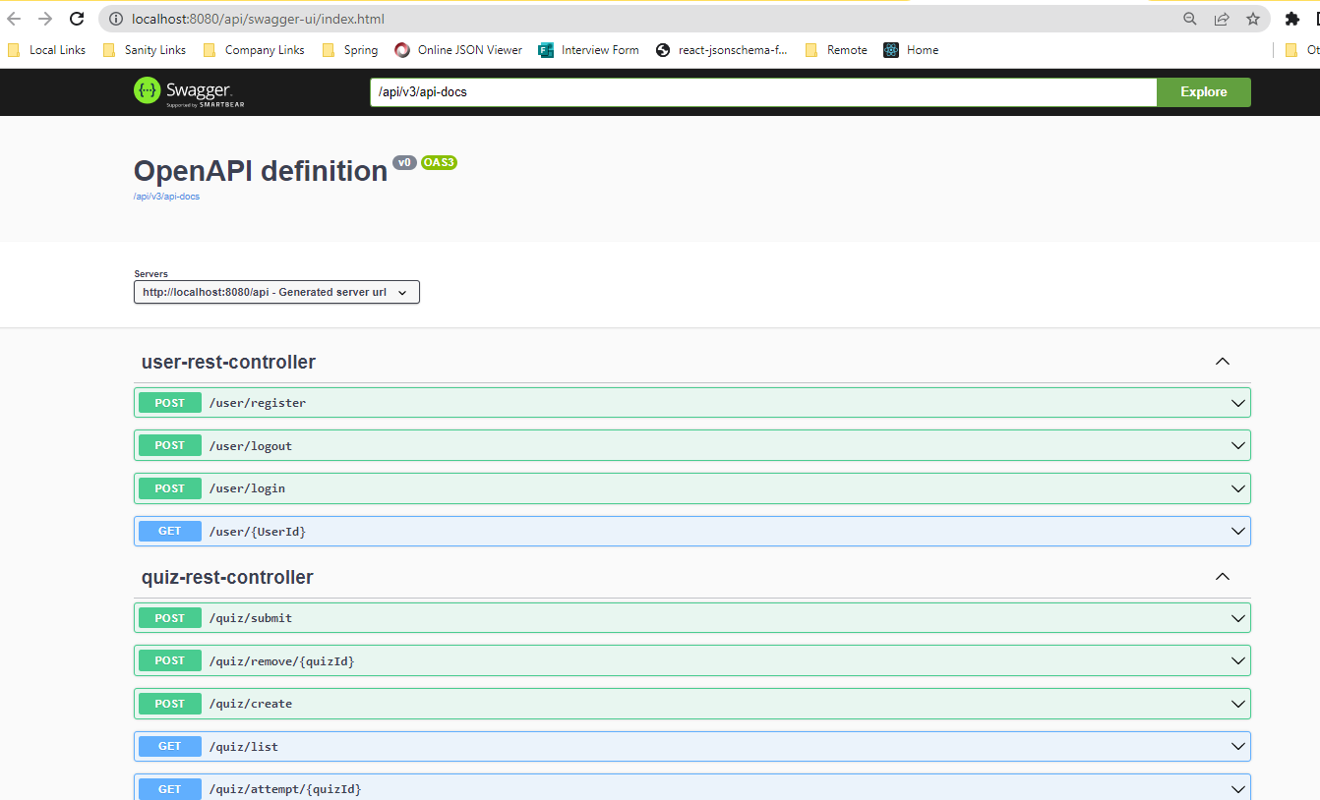
Technical Requirements
Rest Api is exposed in a way where multiple client applications can connect and create their own front-end. To see the documentation please visit: http://localhost:8080/api/swagger-ui/index.html

Slide 10
Thank you
Shahzaib Ibrahim

