Slide 1
N8N COMPLETE COURSE · ZERO TO AI AUTOMATION EXPERT
What is Automation
& Why n8n?
Lesson 01 · Module 1 — Foundations
Beginner Friendly
100% Hands-on
Free Notes on GitHub
SolutionsWithShahzain
Notes:
Energy high rakho. Hook: 'Agar aap roz wahi kaam baar baar karte ho — yeh video aapki zindagi badal sakti hai.' Course ka promise batao: 42 lessons, bilkul zero se.

Slide 2

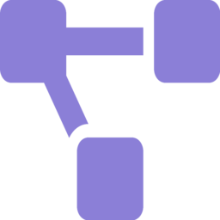


LESSON 01 · AGENDA
What You'll Learn Today
What automation really is
Workflows, triggers & actions
A plain-language definition with a real-life analogy
The 3 building blocks behind every automation
n8n vs Zapier vs Make
Your roadmap & career path
An honest comparison — and why we chose n8n
6 modules from zero to AI automation expert
SolutionsWithShahzain · n8n Complete Course
Lesson 01
Notes:
Har point per 1 line bolo, detail nahi — expectations set karo. 'End tak aapko pata hoga automation kya hai aur kyun n8n.'

Slide 3

CONCEPT
What is Automation?
“Software doing your repetitive tasks — automatically, on a trigger, without you.”
Analogy: A Foodpanda Order
You tap Place Order → the TRIGGER
Cooking, pickup, delivery updates → the STEPS
Hot food at your door → the RESULT
You define the steps once
It runs every single time — 24/7
You only step in for exceptions
Your time goes to work that actually needs you
You don't call the restaurant, the rider, or the kitchen.
Every step runs itself. That's automation.
SolutionsWithShahzain · n8n Complete Course
Lesson 01
Notes:
Foodpanda analogy Roman Urdu mein sunao — sab relate karenge. Phir business examples do: order confirmations, invoices, follow-up emails.

Slide 4


THE DIFFERENCE
Manual Work vs Automated Work
Manual
Automated with n8n
Hours lost every single week
Human errors creep in when tired
Can't scale beyond your own hands
Boring work drains your energy
Runs 24/7 — nights, weekends, Eid
Same steps, zero mistakes, every time
Handles 10 items or 10,000 the same
You focus on growth, not grunt work
Businesses pay real money for exactly this difference.
SolutionsWithShahzain · n8n Complete Course
Lesson 01
Notes:
Yahan personal story ya local business example do — e.g., ek dukaandar jo raat ko manually orders likhta hai.

Slide 5
CORE CONCEPT
Anatomy of a Workflow
TRIGGER
STEP 1
STEP 2
RESULT
New order
arrives
Save to
Google Sheets
WhatsApp
confirmation
Happy customer,
zero manual work
Every automation = one trigger + a series of actions. That's it.
SolutionsWithShahzain · n8n Complete Course
Lesson 01
Notes:
Diagram left se right walk-through karo. Bolo: 'Aage har cheez isi pattern per banegi — sirf trigger aur steps badalte hain.'

Slide 6
THE TOOL
Meet n8n
Your automation Swiss Army knife
$2.5B
Visual canvas — drag, drop, connect nodes
1,200+ app integrations out of the box
AI-native — Agents, RAG & MCP built in
Open source — self-host completely free
Code when you need it (JavaScript & Python)
company valuation (2026)
230K+
active users worldwide
150K+
GitHub stars
SolutionsWithShahzain · n8n Complete Course
Lesson 01
Notes:
Stats per zor do — yeh koi chota tool nahi hai. NVIDIA/Sequoia backing mention kar sakte ho. 'Yeh skill 2026 mein seekhne layak hai' ka proof.

Slide 7
HONEST COMPARISON
n8n vs Zapier vs Make
 | n8n | Zapier | Make
Pricing | Free & unlimited (self-hosted) | Per task — costly at scale | Per credit (since 2025)
Self-hosting | Yes — full control | No | No
AI capabilities | Native AI Agents, RAG, MCP | Agents & MCP — usage-priced | AI Agents (beta) + MCP
Custom code | Full JavaScript & Python | Code steps, with limits | Metered — 2 credits/sec
Best for | AI + complex automations | Quick simple zaps | Visual mid-level flows
All three now have AI agents — the difference: n8n gives them to you unlimited, self-hosted, free. (Verified July 2026)
SolutionsWithShahzain · n8n Complete Course
Lesson 01
Notes:
Fair raho — Zapier ko bura mat bolo, warna credibility jati hai. Sirf yeh dikhado ke hamare use-case (AI + freelancing + zero budget) ke liye n8n best hai.

Slide 8
THE OPPORTUNITY
Why Learn n8n in 2026?
$40–65/hr
800+
174+
average n8n freelance rate (US market)
open n8n jobs on Upwork alone
remote n8n jobs listed on Glassdoor
Every business has repetitive work. Very few people can automate it. You're about to become one of them.
SolutionsWithShahzain · n8n Complete Course
Lesson 01
Notes:
Pakistan/local context do: dollar rates ka matlab yahan kya hai. Realistic raho — 'pehle skill, phir income. Shortcuts nahi.'

Slide 9


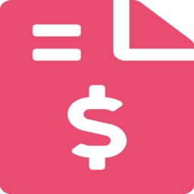
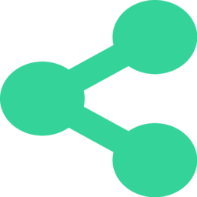


REAL PROJECTS FROM THIS COURSE
What You'll Be Able to Build
WhatsApp AI bots
Lead capture pipelines
Invoice & report automation
Auto-reply, book orders, answer FAQs
Form → CRM → instant follow-up
Documents that create themselves
Social media auto-posting
AI customer support agents
Daily business dashboards
One post → every platform
RAG-powered, knows your business
Numbers in your inbox every morning
SolutionsWithShahzain · n8n Complete Course
Lesson 01
Notes:
Excitement build karo — 'yeh sab hum is course mein banayenge, scratch se.' Har card ek real lesson/project se linked hai.

Slide 10
THE ROADMAP
Your 6-Module Journey
1
2
3
Module 1 — Foundations
Module 2 — Data Mastery
Module 3 — APIs & Webhooks
Setup & your first workflow
Expressions, logic & debugging
Connect anything to anything
4
5
6
Module 4 — Business Integrations
Module 5 — AI Agents, RAG & MCP
Module 6 — Production & Freelancing
Real client-grade workflows
The 2026 superpower
Docker, clients & income
42 lessons · 3 mini projects · 1 capstone: a complete AI business automation system
SolutionsWithShahzain · n8n Complete Course
Lesson 01
Notes:
Roadmap jaldi cover karo — 30 seconds. Message: 'structured hai, random videos nahi.' Yehi hamara differentiator hai.

Slide 11


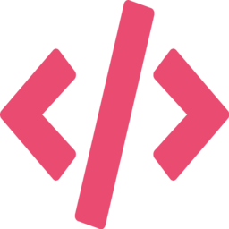

PREREQUISITES
What You'll Need (Spoiler: Not Much)
A laptop + a browser
n8n Cloud free trial
4 GB RAM is plenty — n8n Cloud runs in the browser
We set it up together in Lesson 2
Zero coding background
30 minutes a day
Everything explained from absolute scratch
Consistency beats intensity — every time
Minimum config — Cloud: any PC, 4 GB RAM · Self-hosting (Module 6): 2 cores, 4 GB RAM, 20 GB SSD. (Verified July 2026)
SolutionsWithShahzain · n8n Complete Course
Lesson 01
Notes:
Barriers todo — 'coding nahi aati? Perfect, yeh course aapke liye hi hai.' Yeh moment beginners ko rok leta hai ya bhaga deta hai.

Slide 12

HOMEWORK
Your First Assignment
Find 3 repetitive tasks — in your work, your studies, or any business around you.
1
2
3
What starts the task?
What are the exact steps?
How much time does it eat weekly?
Identify the trigger — a message, an order, a date?
Write them in order, like a recipe
That number = the value of automating it
Drop your best one in the comments — we might automate it live in this course.
SolutionsWithShahzain · n8n Complete Course
Lesson 01
Notes:
Yeh engagement hack bhi hai — comments = algorithm boost. Seriously promise karo ke best ideas live automate karoge.

Slide 13
RECAP
Key Takeaways
Automation = a trigger + steps, running without you, 24/7
1
n8n: open-source, AI-native, free to self-host — built for 2026
2
Real career path: freelancing, automation services, AI agents
3
This course: 42 structured lessons, zero to AI automation expert
4
SolutionsWithShahzain · n8n Complete Course
Lesson 01
Notes:
Har takeaway ek line mein repeat karo. Retention ke liye yeh slide zaroori hai — skip mat karna.

Slide 14





COMING UP NEXT
Lesson 02 — Setting Up n8n
Free notes + workflows
github.com/Shahzain-Ali/
n8n-mastery
Cloud vs Self-Hosted — which one for you?
Create your free n8n Cloud account (together, step by step)
First look at your automation dashboard
Docker self-hosting — what it is & when we'll do it
Subscribe — 2 lessons
every week, free forever
SolutionsWithShahzain — the free n8n course that feels premium
linkedin.com/in/shahzain-ali1
instagram.com/shahzainalibangash1
facebook.com/shahzainalibangash1
SolutionsWithShahzain · n8n Complete Course
Lesson 01
Notes:
Clear CTA - ek hi baar bolo. Socials screen per hain, verbally sirf GitHub + subscribe bolo.

