Slide 1



Library Management
System
OOP Project | C++
C++ • Object-Oriented Programming • Console Application

Slide 2

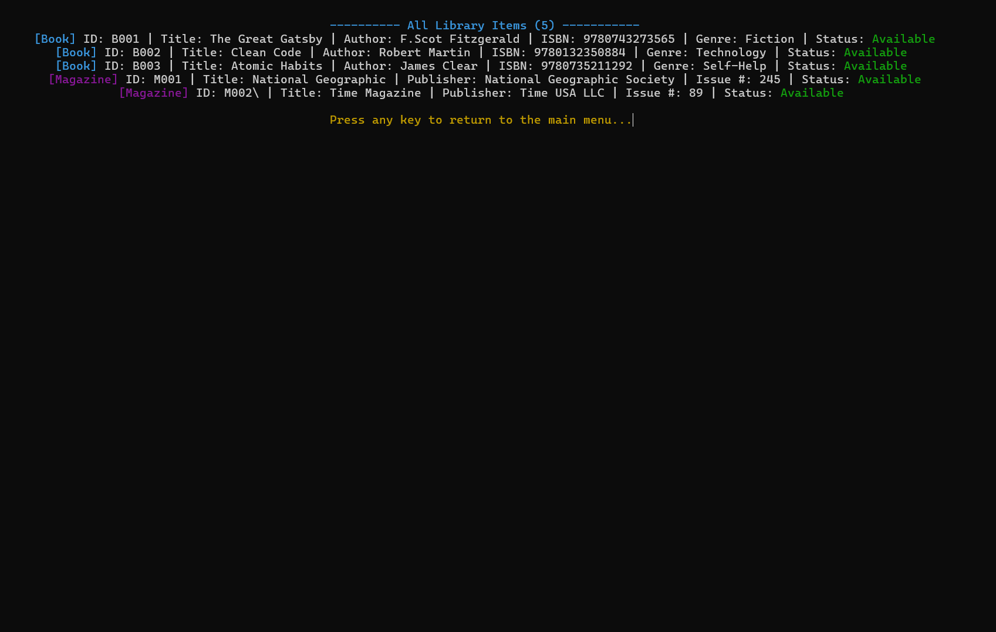




Project Overview
Key Features
Books & Magazines catalogue
Members borrow up to 3 items
Issue & Return tracking
CSV file-based persistence
12-option ANSI color menu

Slide 3



4 OOP Pillars
Abstraction
Encapsulation
Inheritance
Polymorphism
LibraryItem & Person are abstract
Pure virtual functions
Hides internal complexity
All data members private
Getters & setters only
Library wraps all logic
Book / Magazine → LibraryItem
Member / Librarian → Person
Promotes code reuse
displayDetails() overridden per type
Runtime type resolved
Operator << overloaded

Slide 4
Abstraction & Encapsulation
Abstraction
Encapsulation
▸ LibraryItem — abstract base for all items
▸ Person — abstract base for all users
▸ Pure virtuals: displayDetails(), getType(), serialize()
▸ Subclasses MUST implement all pure virtuals
▸ Hides complexity behind a clean interface
▸ All data members are private
▸ Accessed only via getters / setters
▸ Library class wraps all data & logic
▸ borrowedItemIDs managed through safe methods
▸ Prevents unauthorized data changes

Slide 5
Inheritance & Polymorphism
Inheritance
Polymorphism
LibraryItem (abstract)
▸ displayDetails() in Book vs Magazine
▸ displayInfo() in Member vs Librarian
▸ vector<LibraryItem*> iterated at runtime
▸ Correct type auto-resolved dynamically
▸ Operator << overloaded for Book class
Book
Magazine
item→displayDetails()
📘 Book: Title | Author | ISBN
Person (abstract)
📰 Magazine: Title | Publisher | Issue
Member
Librarian

Slide 6

Exception Handling
LibraryException (base)
What Each Handles
📂 FileException
→ File read/write failures
FileException
❌ InvalidInputException
→ Bad or empty user input
InvalidInputException
ItemNotFoundException
🔍 ItemNotFoundException
→ Item ID not in catalogue
MemberNotFoundException
👤 MemberNotFoundException
→ Member ID not found
BorrowLimitException
DuplicateEntryException
📚 BorrowLimitException
→ Max 3 items per member
🔁 DuplicateEntryException
→ Duplicate ID detected

Slide 7
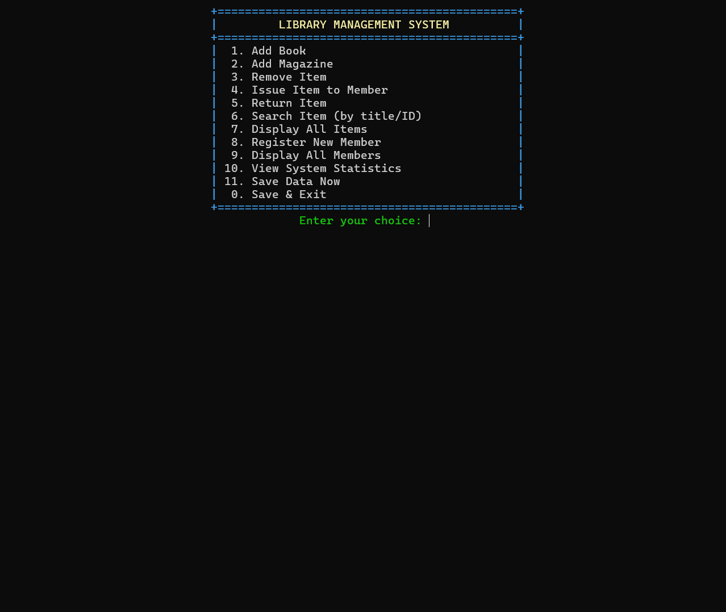
File Persistence & System Menu
📁 File Persistence
🖥️ 12-Option Menu
📄 books.csv
Stores Books & Magazines
📄 members.csv
Stores Members + borrow list
📄 transactions.txt
Logs every action taken
▸ Auto-loaded on startup
▸ Auto-saved on exit
▸ Corrupted lines skipped safely

Slide 8

Class Structure
LibraryItem (abstract)
Library
(Controller)
Book
Magazine
uses LibraryItem*
Person (abstract)
uses Member
LibraryException (hierarchy)
Member
Librarian
▸ Static counters: totalItems, memberCount
▸ Operator << overloaded on Book

Slide 9
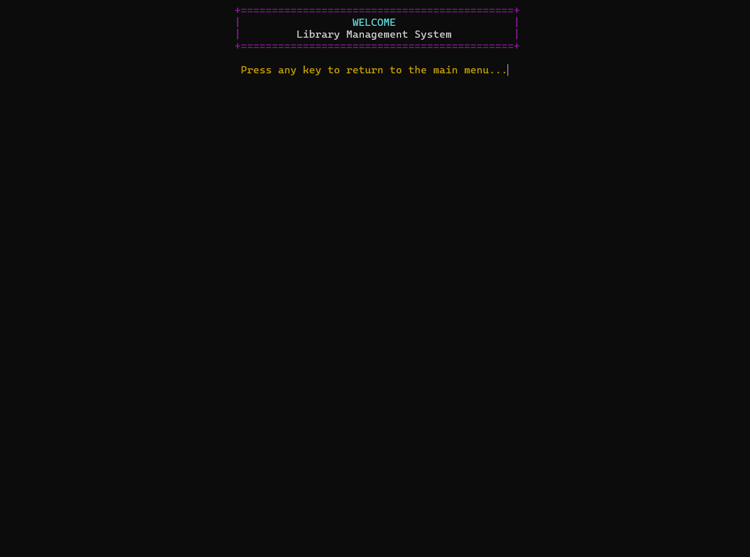
Live Demo — Terminal Output
① Welcome Banner
② Main Menu
③ All Library Items
Colorful ANSI welcome screen
12-option interactive menu
Color-coded Books & Magazines

Slide 10

Implementation of OOP:
Abstraction
Encapsulation
Inheritance
Abstract classes & pure virtuals
Private data with controlled access
Clean class hierarchy & reuse
Polymorphism
Exception Handling
File Persistence
Runtime-resolved virtual dispatch
Custom 6-type exception hierarchy
CSV storage + transaction log
Real-world C++ OOP — Console Application | Books · Magazines · Members

