Slide 1
“Can data analysis of electricity usage in the home be effective in identifying circumstances in which elderly or disabled residents may require aid”
“The use of data analytics to identify circumstances in which elderly or disabled residents may require aid through changes in electricity usage patterns.”

Slide 2
Problem
Seniors – Disabled
Might have fallen over – unable to inform – no way to notify
Existing Solutions
Care homes – Carers – Nurses – Sensors
Too expensive – small income – pension

Slide 3
My project

Slide 4
Abstract
Widespread – smart meters – workable electricity data
Can be mined – for patterns trends – Normal every day data
Various data mining algorithms
Anomalies – something is wrong – (Notify someone)

Slide 5
Implemetation
Various Data mining algorithms
Clustering (Kmeans)
Neural Networks – back propagation – gradient descent
Linear regression

Slide 6
Project initial VS now
Initial
Now
One data mining algorithm (Clustering)
Mine the electricity data
Notify when an anomaly occurs
Some parts too simple some too advanced
Various methods
Mine the electricity data
Precision/accuracy measure
Which one works best?

Slide 7
Coding
Basics of Kmeans, Linear regression and NN done
Understood the theory of it all
Not perfected and complete at the moment

Slide 8
Write up
Part | Word | Total | %
Abstract | 300 | - | -
Introduction | 709 | 1000 | 70%
Literature review | 576 | 3000 | 19%
Methodology | 780 | 1500 | 52%
Findings/Results | 0 | 500 | 0%
Analysis | 0 | 3000 | 0%
Conclusion | 0 | 1000 | 0%
TOTAL | 2065 | 10000 | 20.7%

Slide 9
Problems encountered
Code
Write - up
Dataset – importing - playing around
0 in the “athome” variable not being recognised in regression
Rodeo libraries (sklearn) not being installed
Plots overlapping
Lit review, struggling to find relevant studies
Still find myself unsure on prose and stance
Tend to get informal

Slide 10
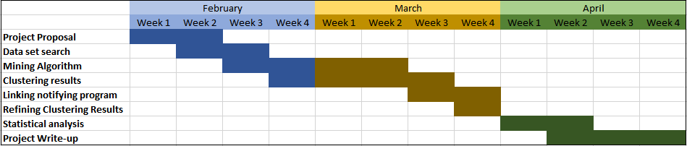
Time management
Initial Expected Gantt Chart

Slide 11
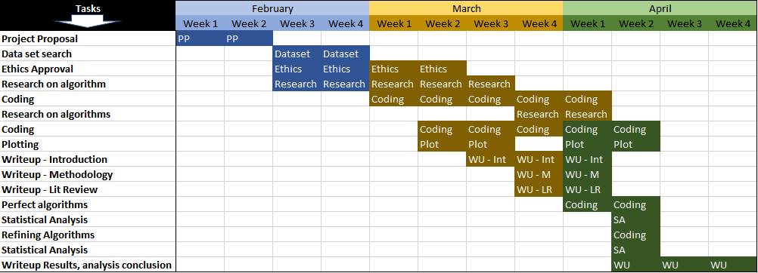
Time management
Actual Gantt Chart

