Slide 1
Really quick saspy reference

Slide 2
First thing’s first
You don’t need to configure anything in Viya other than enabling lockdown access
You will need the following information to connect to Viya
1) the Viya host URI. This does not include “https”
Ex: viya.unx.sas.com
2) the name of a valid Viya compute context
Ex: SAS Studio Compute Context
3) an auth token
Ex: a big long string of characters

Slide 3

Using custom config
The config is just a python file located anywhere your code has access to. It is NOT a config that comes with saspy or that is required by Viya
Place your config anywhere you want
1) include it in a place defined within the system path variable
2) just point directly to the file (use the ‘cfgfile’ parameter)
Direct path to file
The name of the config you want to use, which is defined in that file
Ref: https://sassoftware.github.io/saspy/configuration.html

Slide 4
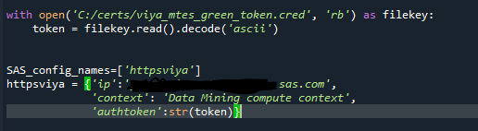
Setting up the custom config
Since the config is actually just a python script, you can put whatever you want inside
The SASsession command runs the file as a python script
So you can put custom code as well as definitions
For example: I have code that pulls the authtoken from a secure file location that only I can access
Reads token from file (this could be an encrypted file)
Defines the valid sas config file names. This can be any name, but it must be defined as a dictionary in the same file
Dictionary defining connection parameters

Slide 5
authentication
Easiest is to generate an access token
This requires admin access
Tokens should be one per individual user, although tokens can be shared and do not require any other info to be used so “with great power comes great responsibility…”
Does not require a .pem file
If SSO is configured, I don’t believe the user/pwd option works
Ref: https://sassoftware.github.io/saspy/configuration.html#choosing-an-access-method

Slide 6
Connection – VPNs
If your organization uses a VPN, then access to Viya requires that VPN and saspy will NOT work without the VPN active.
For using without VPN -> Talk to Tech Support or SAS hosted admin
Ie, connection from databricks. You probably need to add your databricks IP be allowed into your Viya environment. You may also need to configure your databricks environment to allow the Viya IP

Slide 7
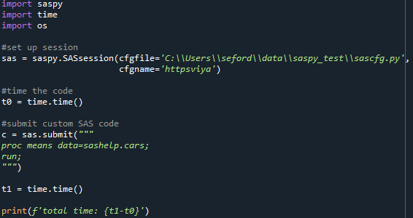
Quick example – submit custom SAS code to Viya
Description:
Create the SASsession using the custom config file
Start a timer
Submit Proc means on sashelp.cars dataset
Stop the timer
1
2
3
4

Slide 8
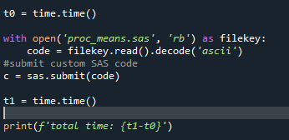
Submit SAS code from .sas code file
Read the sas code file as ascii text
Directly submit the code you just read
Note: there’s probably a better way to do this, but this is an easy and very flexible way

Slide 9
Performance considerations
Using saspy “costs” time
1) it takes about 10-15 seconds to make the connection and start up the compute context.
You pay this time “fee” once every time you create a SASsession
2) it takes time to submit the code and get the response, depending on your internet connection speeds, the code run, size of code, etc
You pay this time “fee” every time you submit code
 | saspy | Viya
Proc means data=sashelp.cars; run; | 1.7s | 0.11s

