Slide 1
Howler Pulse · the sales website, element by element
howler-pulse-v2.onrender.com/sales · assets for the marketing team · July 2026
Every image is a real capture of the live site. Animated sections are stills; see the site for motion.

Slide 2
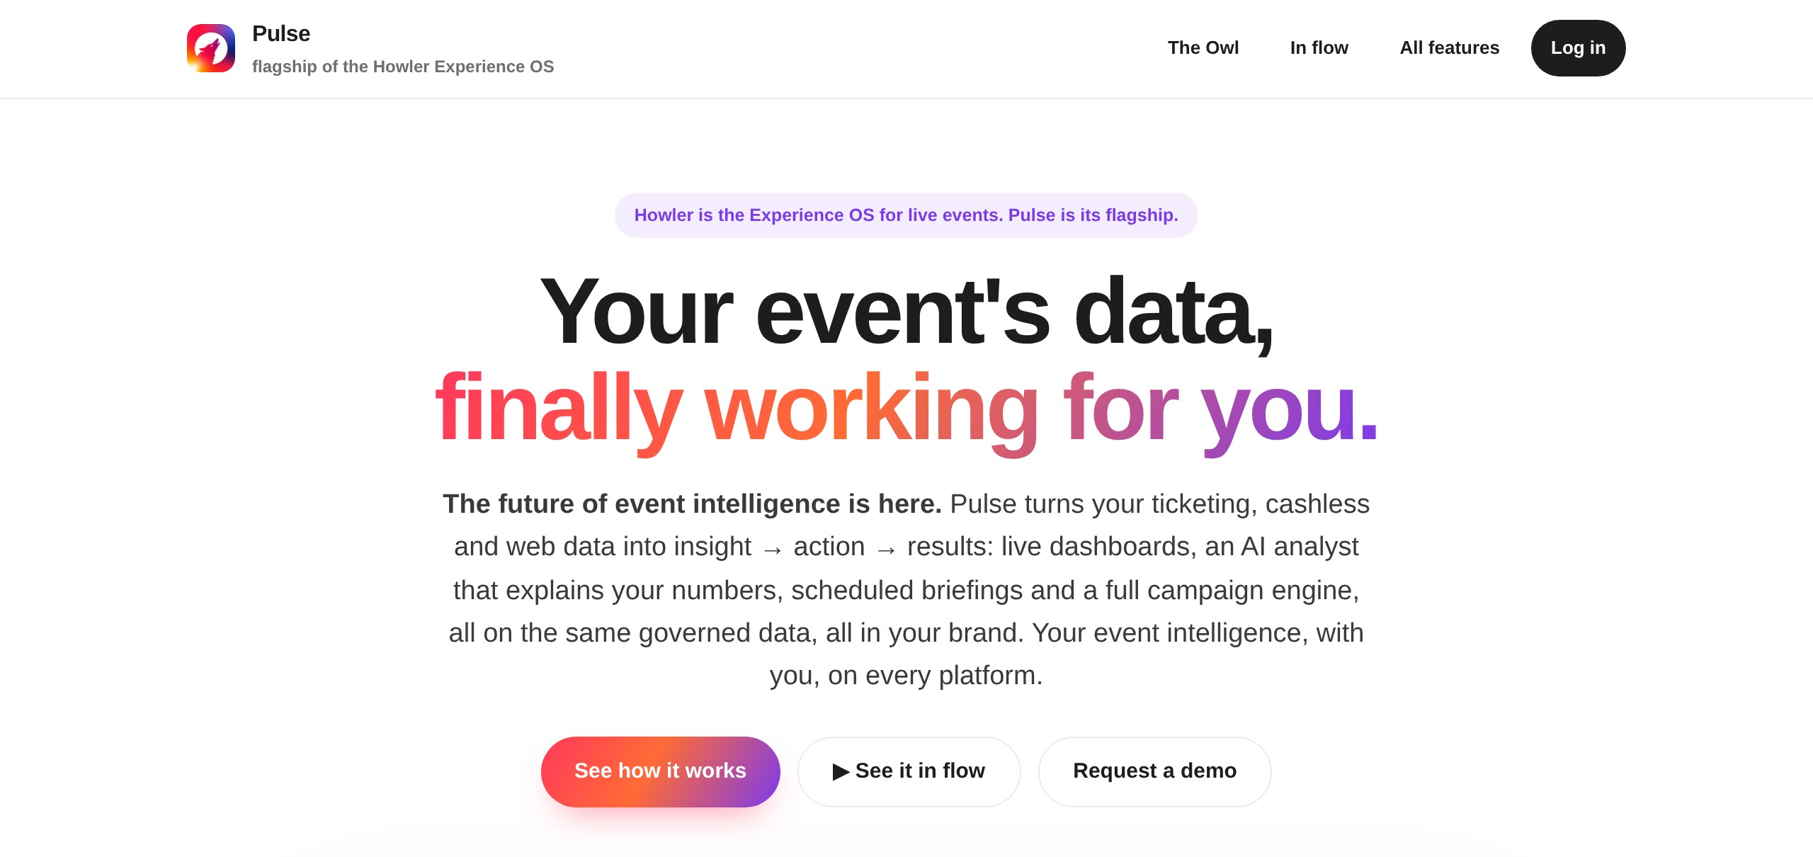
Hero
The future of event intelligence is here. Opening statement, three CTAs, straight into a live product demo.

Slide 3
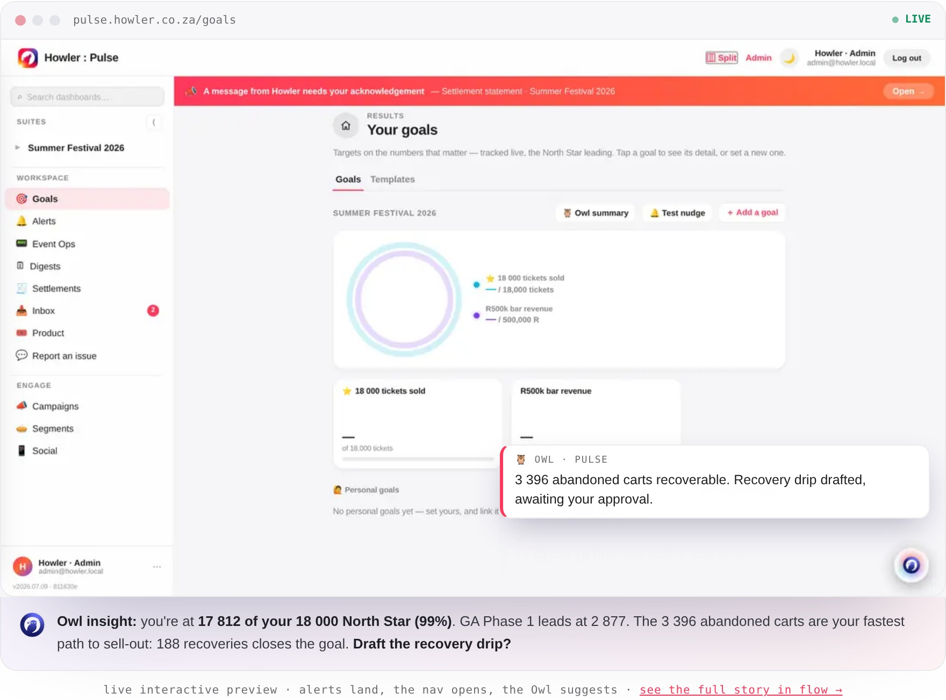
Interactive product demo
A live, self-driving preview: alerts land, the nav opens, the Owl suggests. Tours Goals, Alerts, Inbox, Engage and the live dashboard.

Slide 4
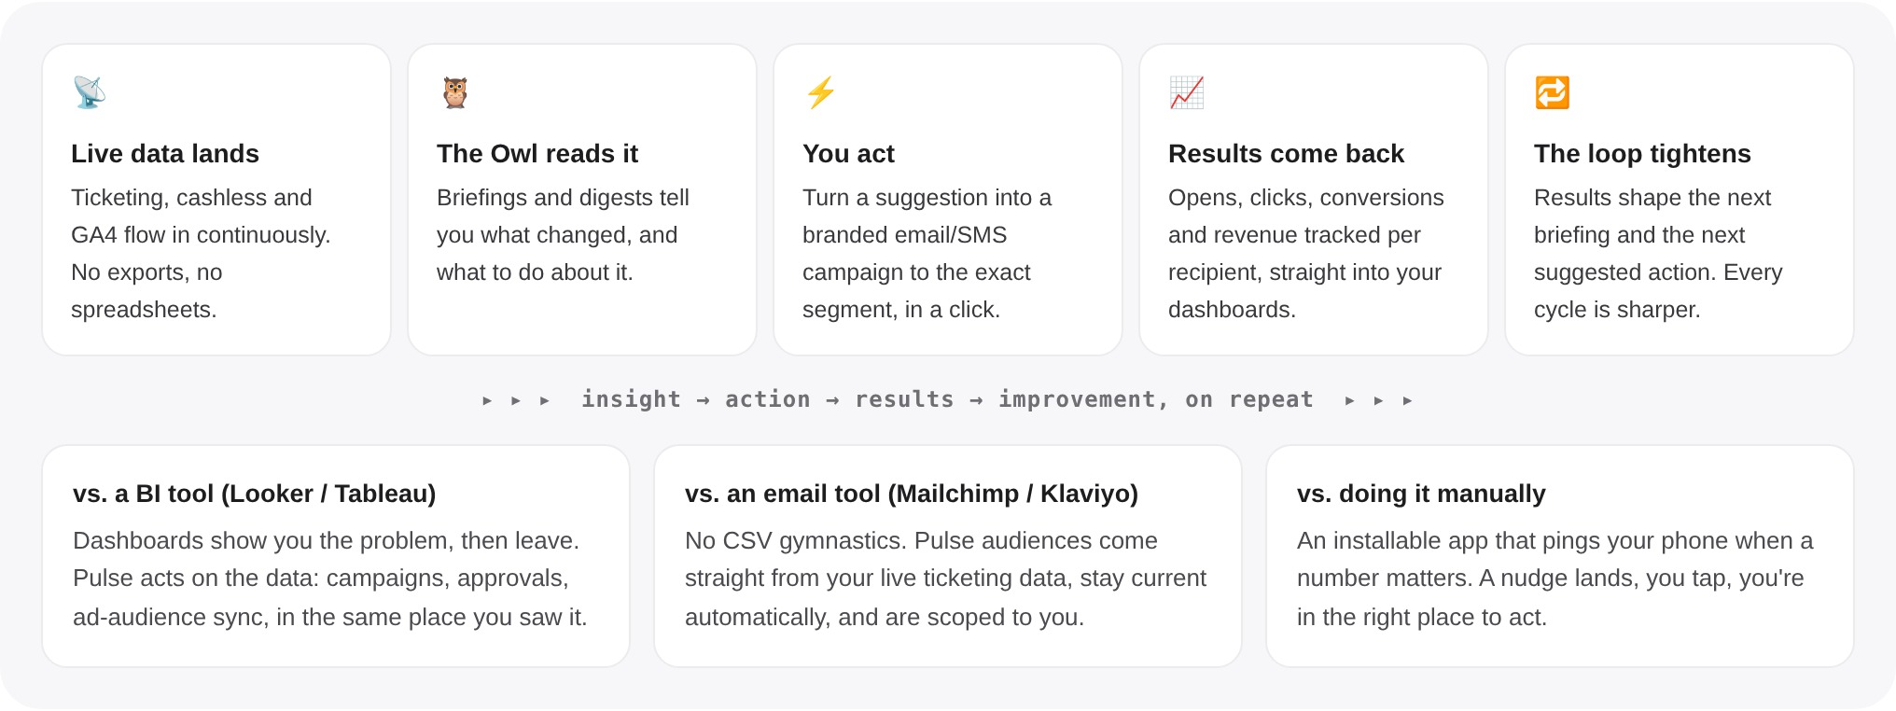
The loop
Data in, insight out, action taken, results measured. The story the whole site hangs on.

Slide 5
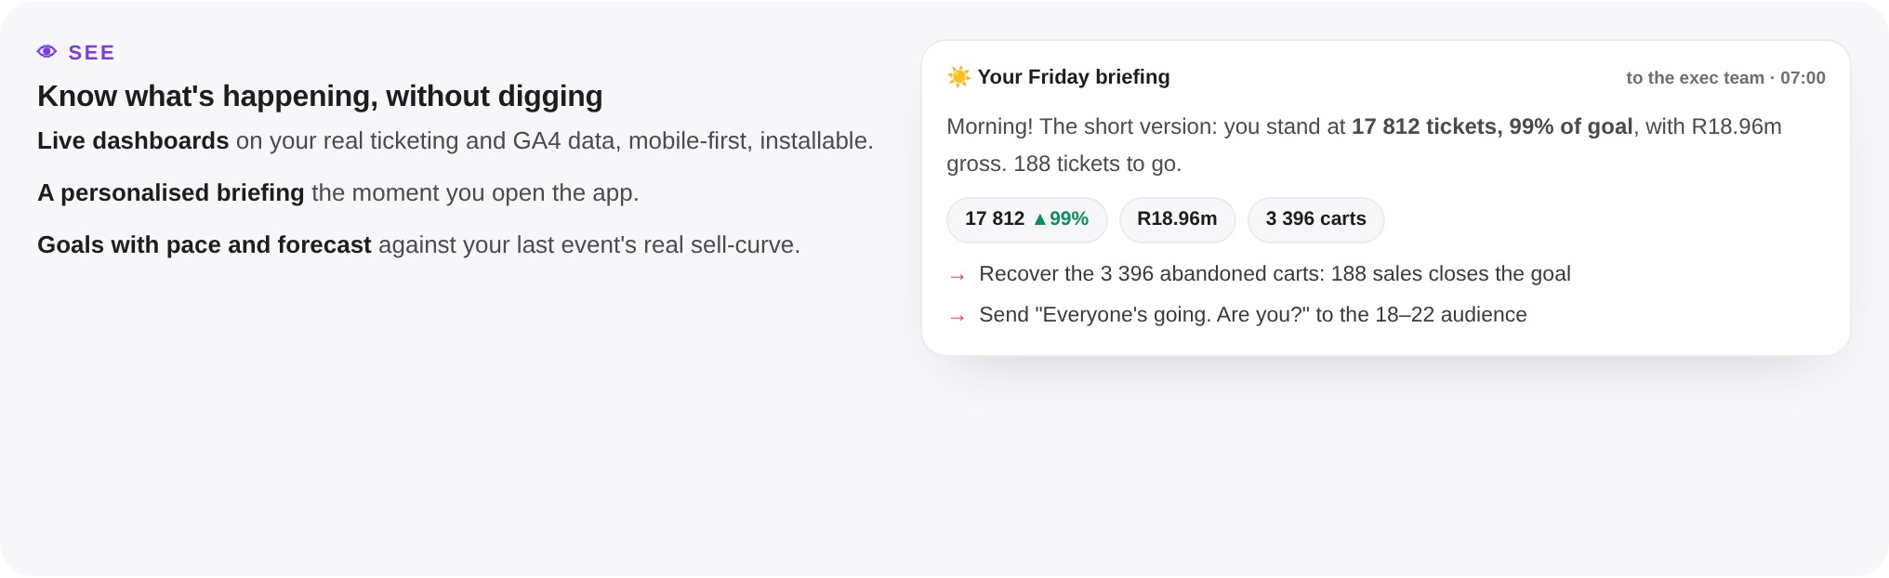
See it
Live dashboards and real renders of the product, phone-first.

Slide 6
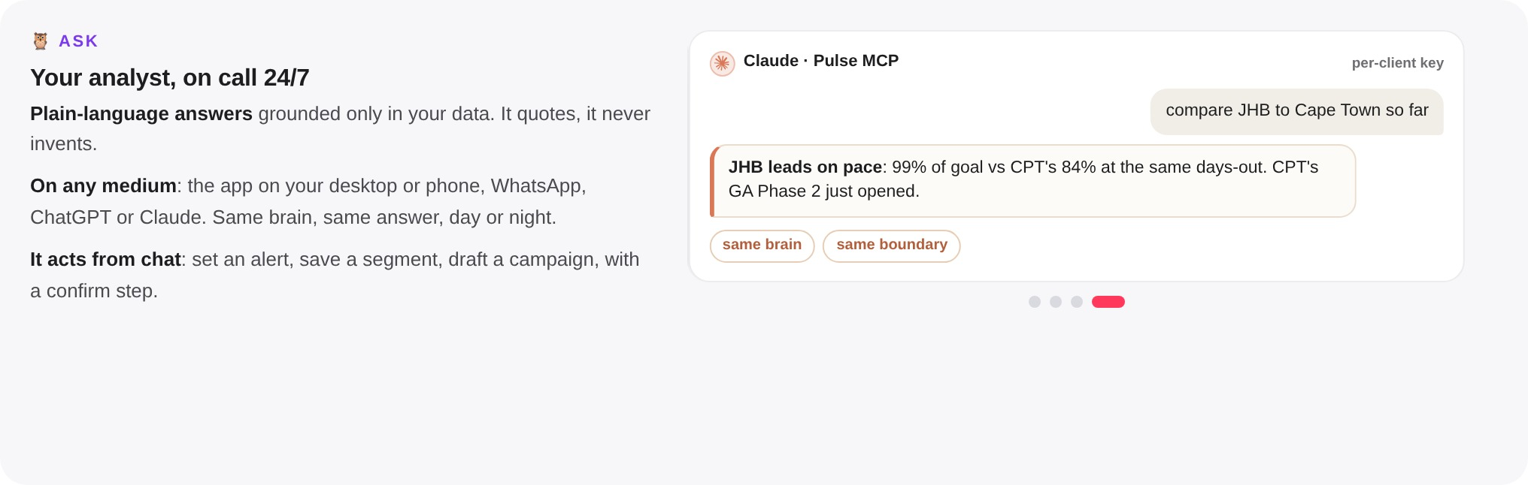
Ask it
Your analyst on call 24/7, on any medium: WhatsApp, the app, ChatGPT, Claude. Sliding carousel of mediums.

Slide 7
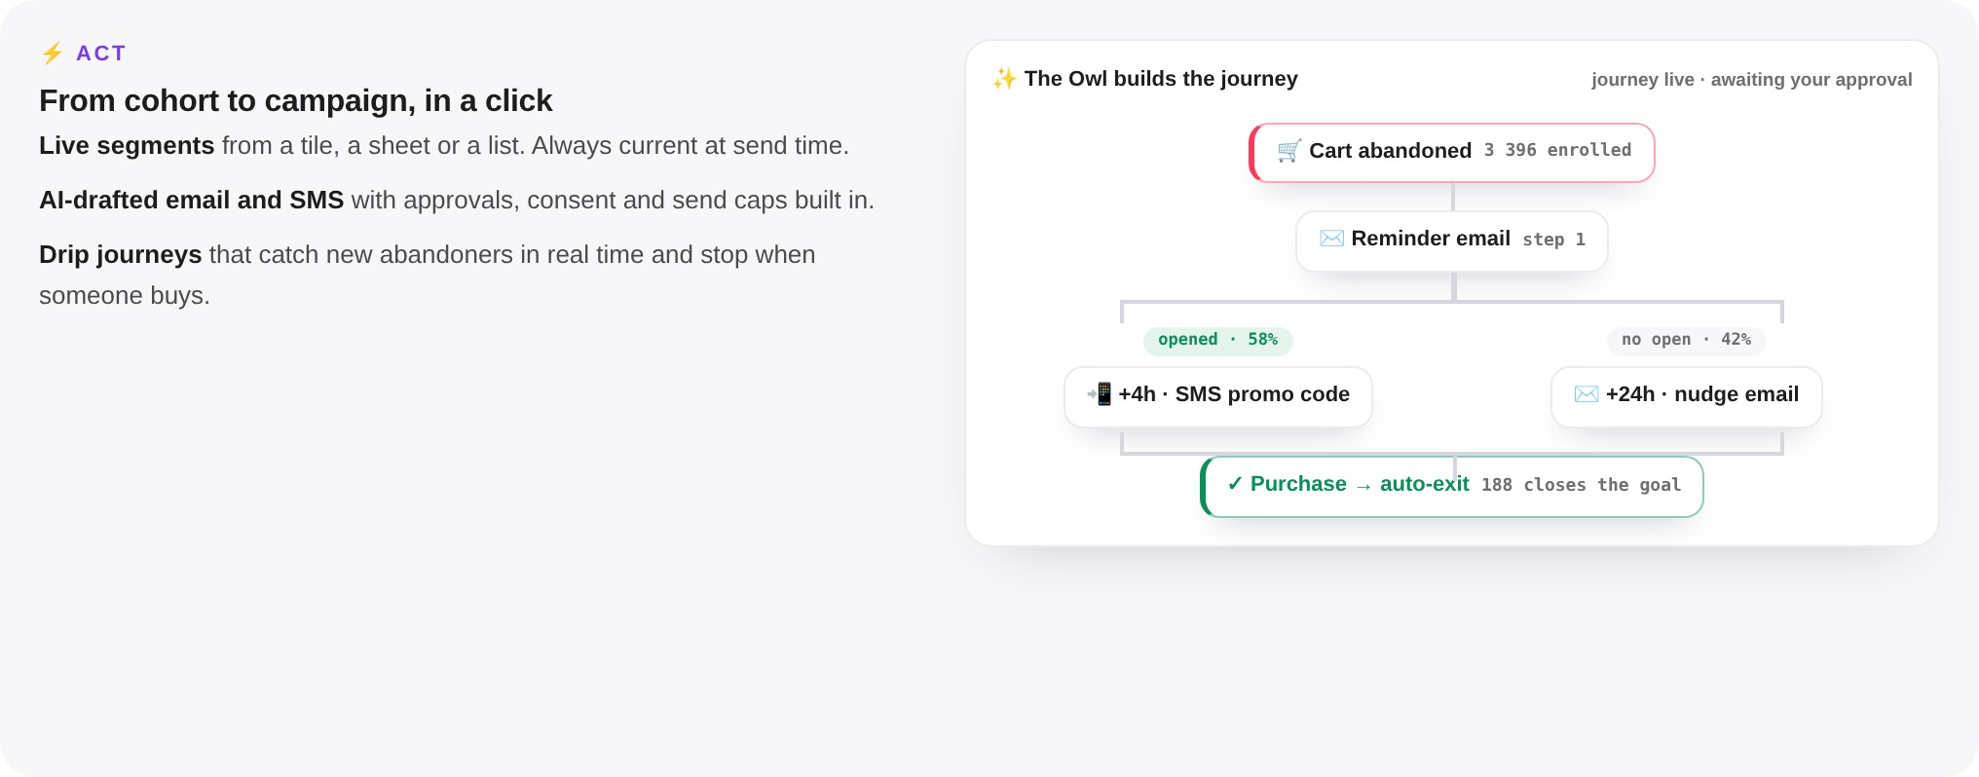
Act on it
The Owl builds a journey live as a branching tree: trigger, email, opened / no-open branches, purchase auto-exit.

Slide 8
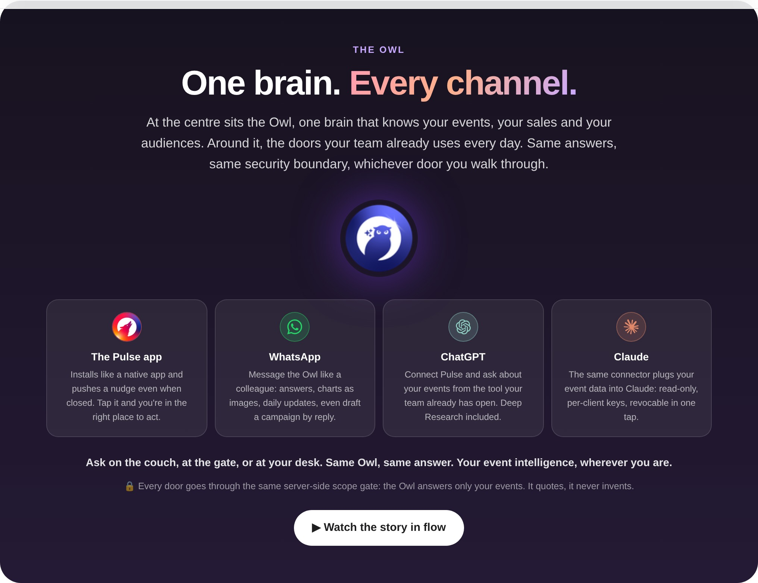
One brain, every channel
The Owl at the centre; real channel logos (Pulse web app, WhatsApp, ChatGPT, Claude).

Slide 9
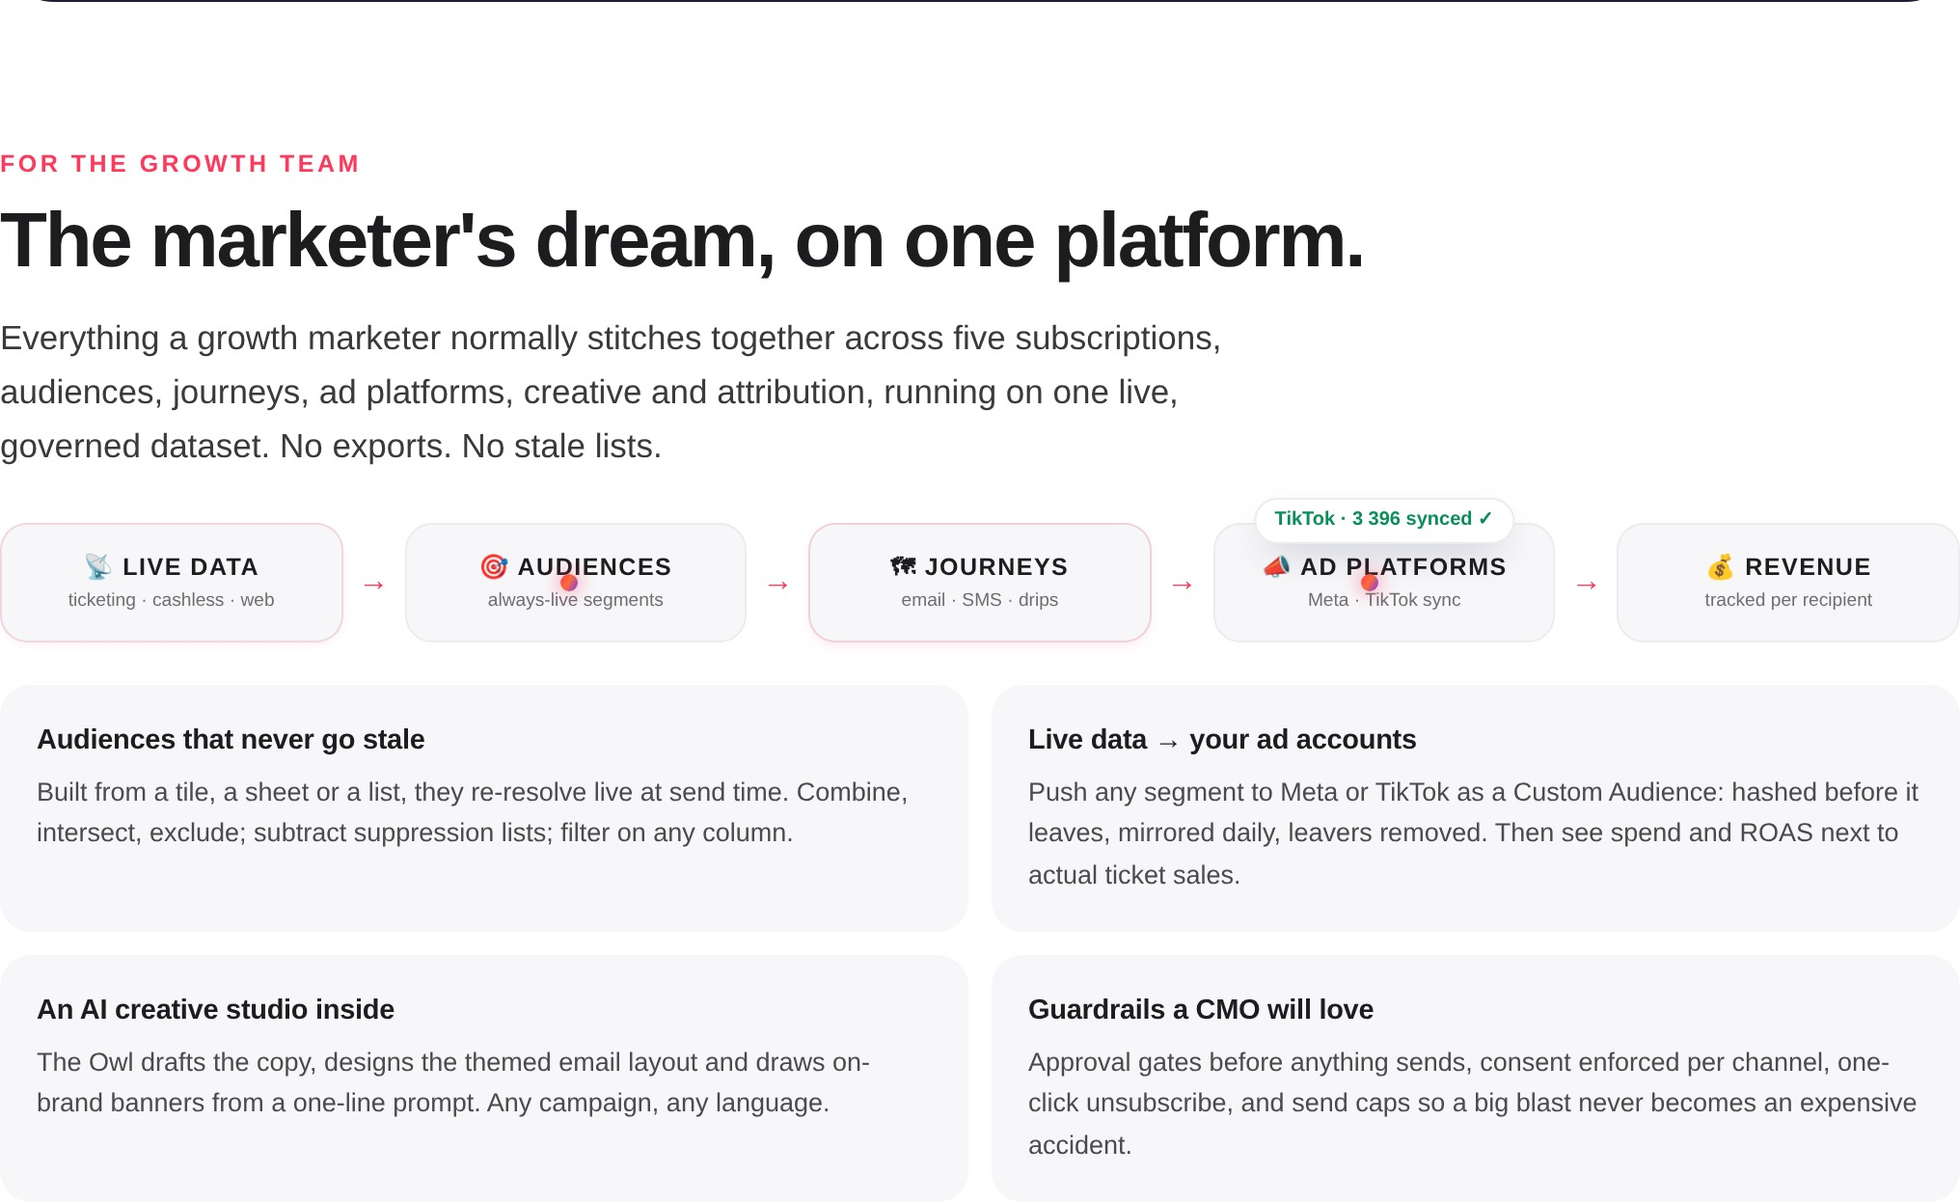
The marketer’s dream
Animated pipeline: dots flow across phases, ad audiences sync to Meta and TikTok.

Slide 10
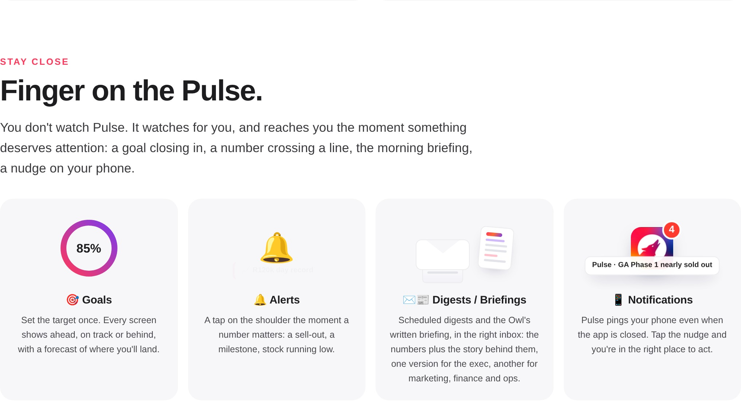
Finger on the Pulse
Goals (animated ring), Alerts (live alert), Digests / Briefings (mail + briefing), app Notifications (badge).

Slide 11
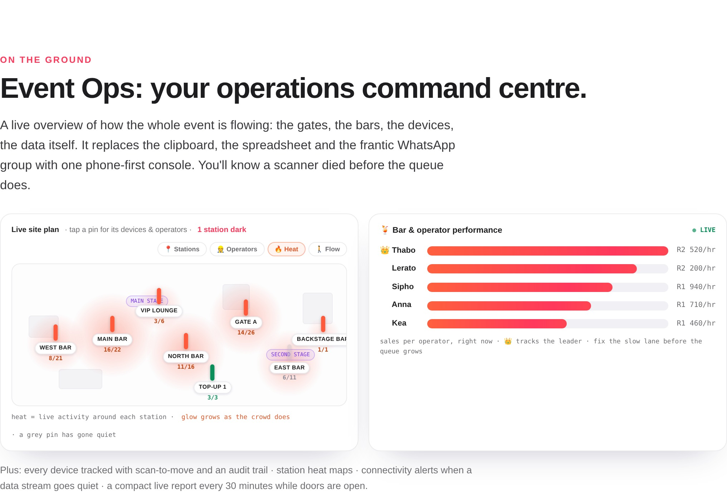
Event Ops command centre
The animated site plan: station health, breathing crowd blobs, a station going dark and recovering.

Slide 12
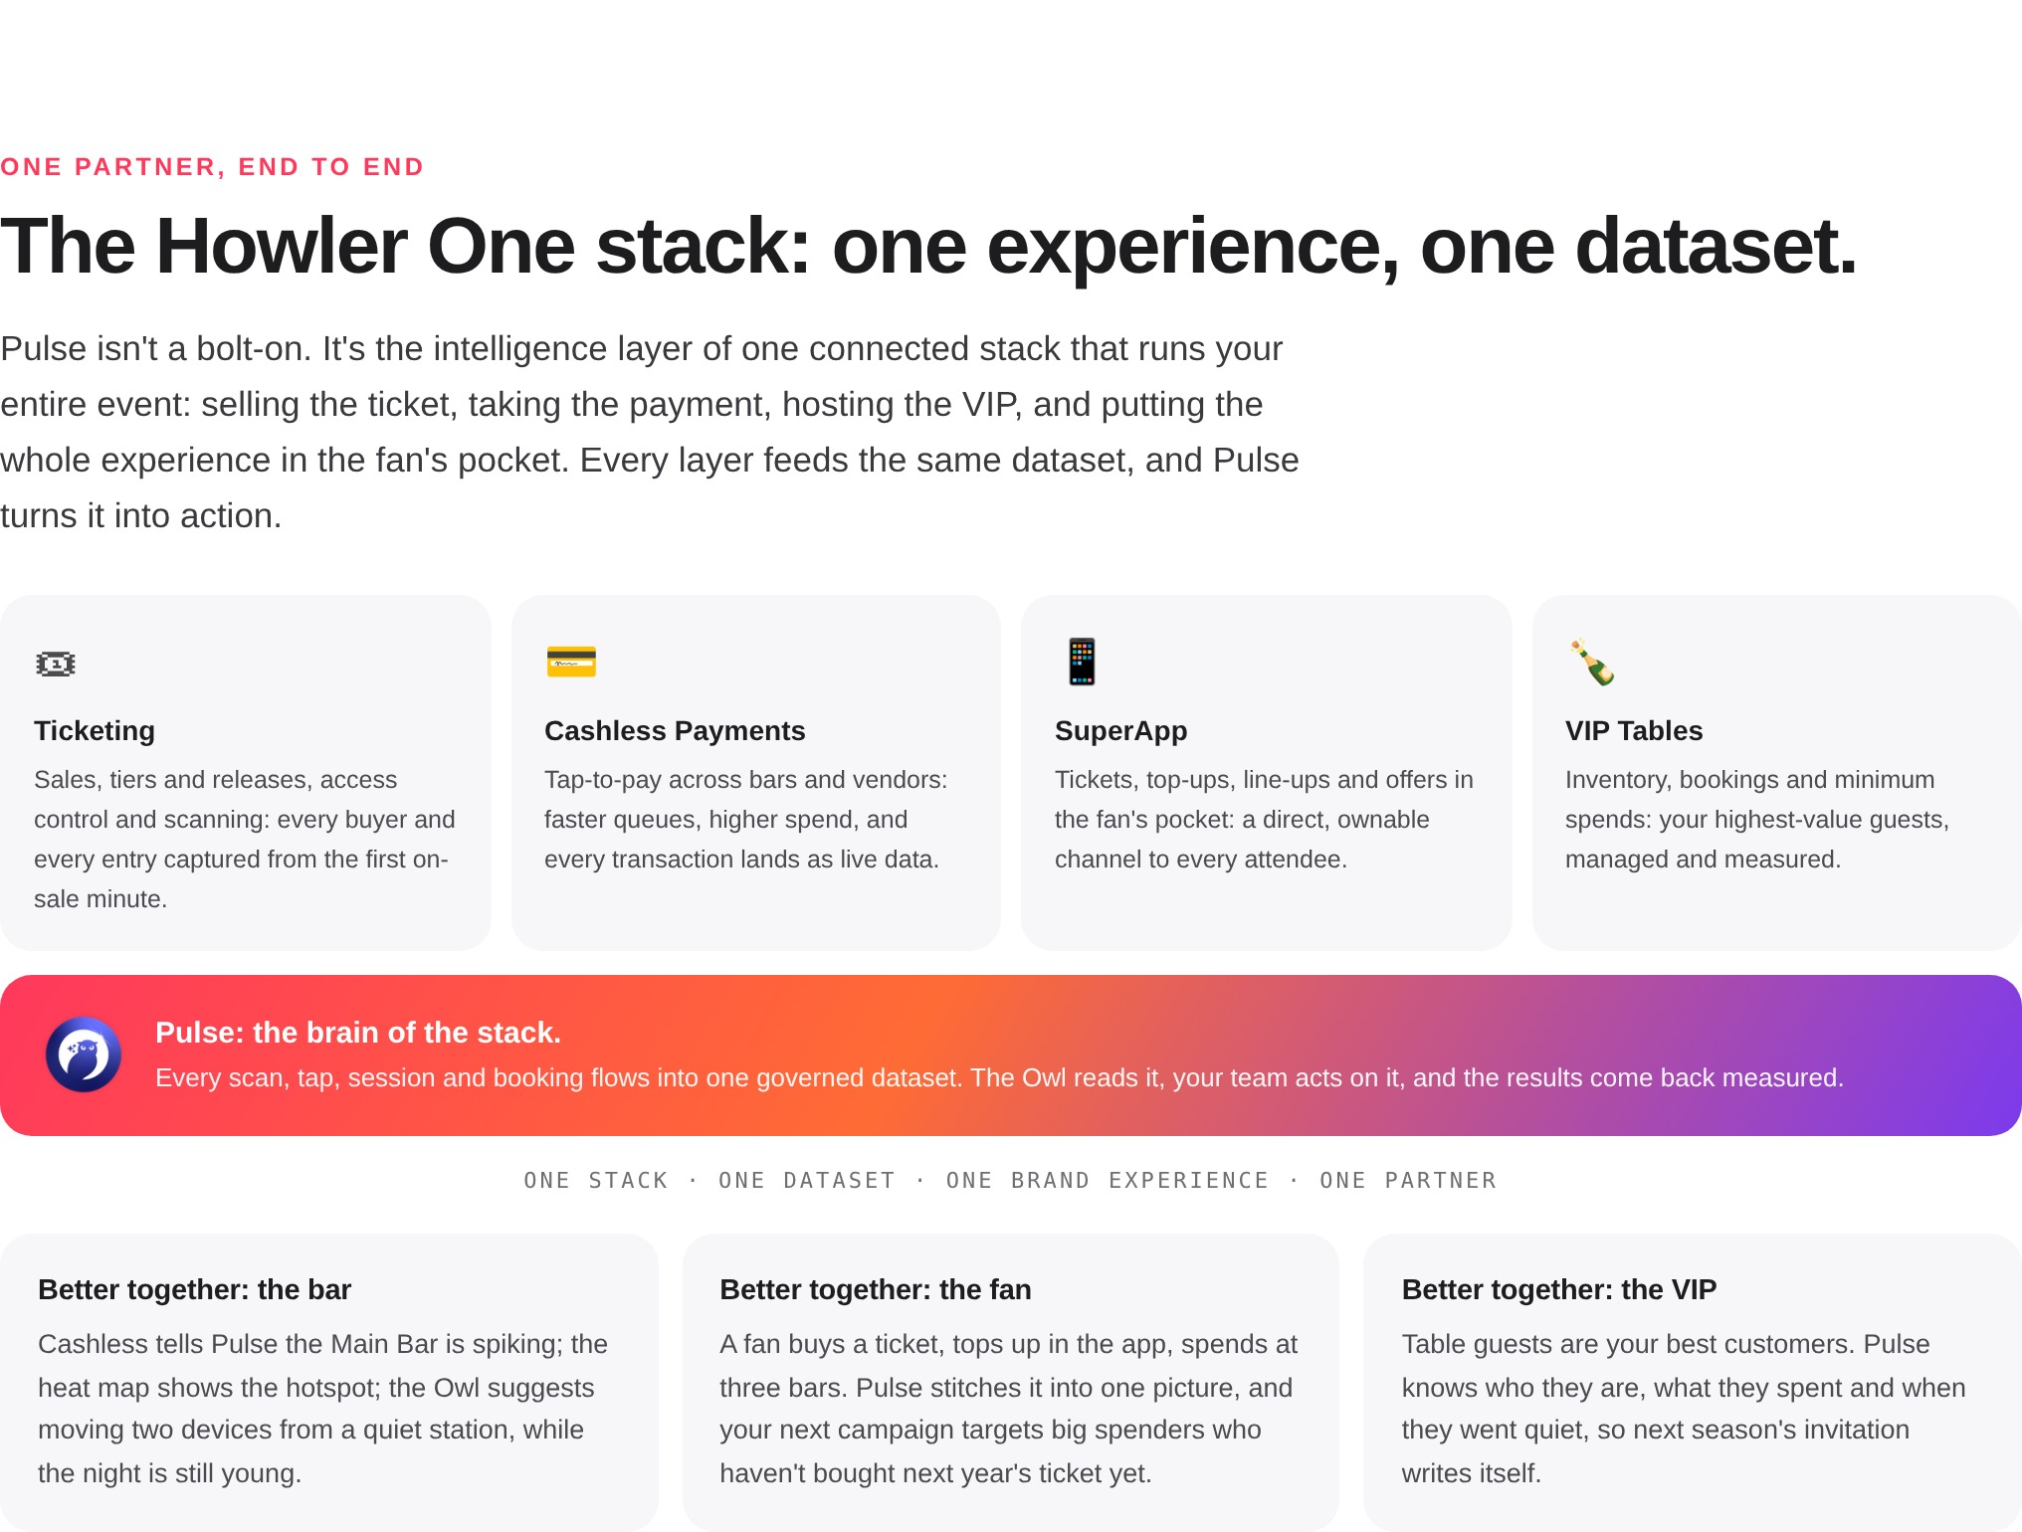
The Howler One stack
One experience, one dataset. Better-together stories for the bar, the fan, the VIP.

Slide 13
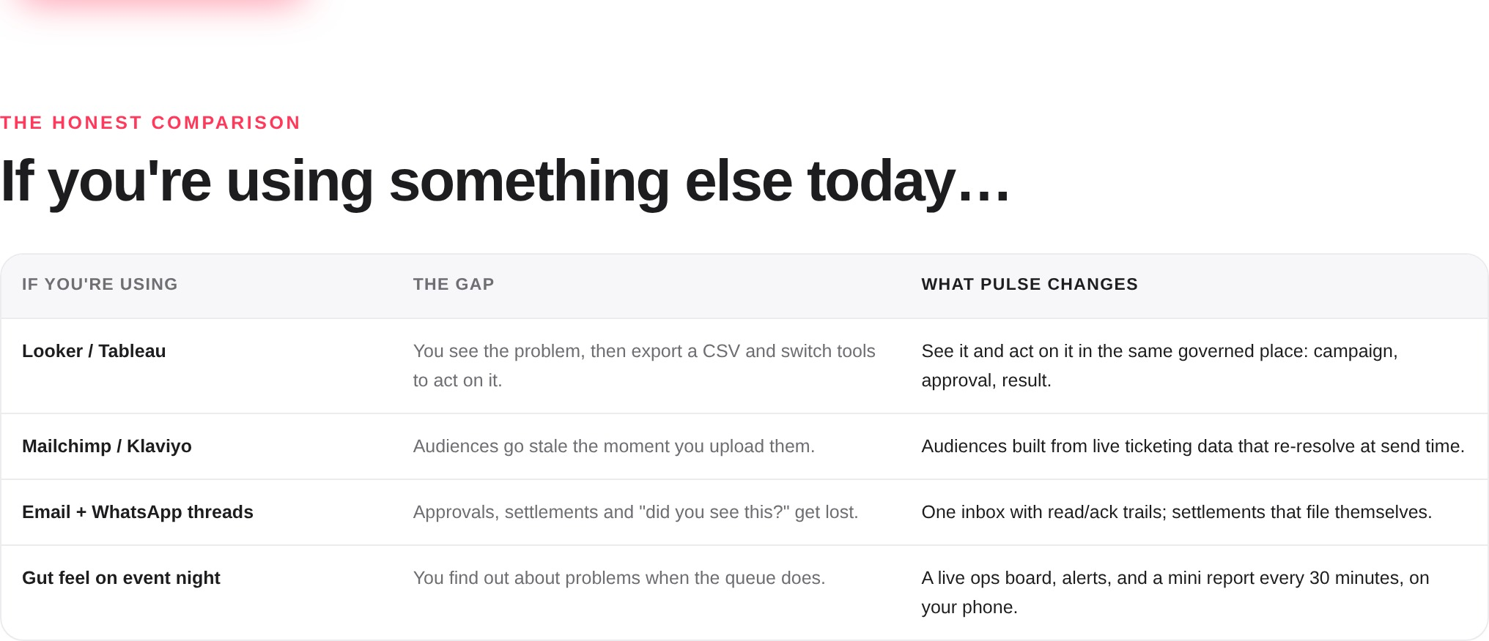
The honest comparison
If you’re using Looker, Mailchimp, WhatsApp threads or gut feel: the gap, and what Pulse changes.

Slide 14
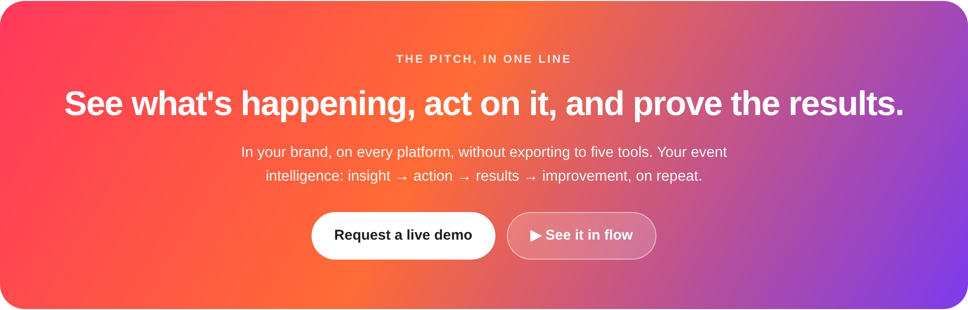
Closing
The pitch in one line, with demo and in-flow CTAs.

Slide 15
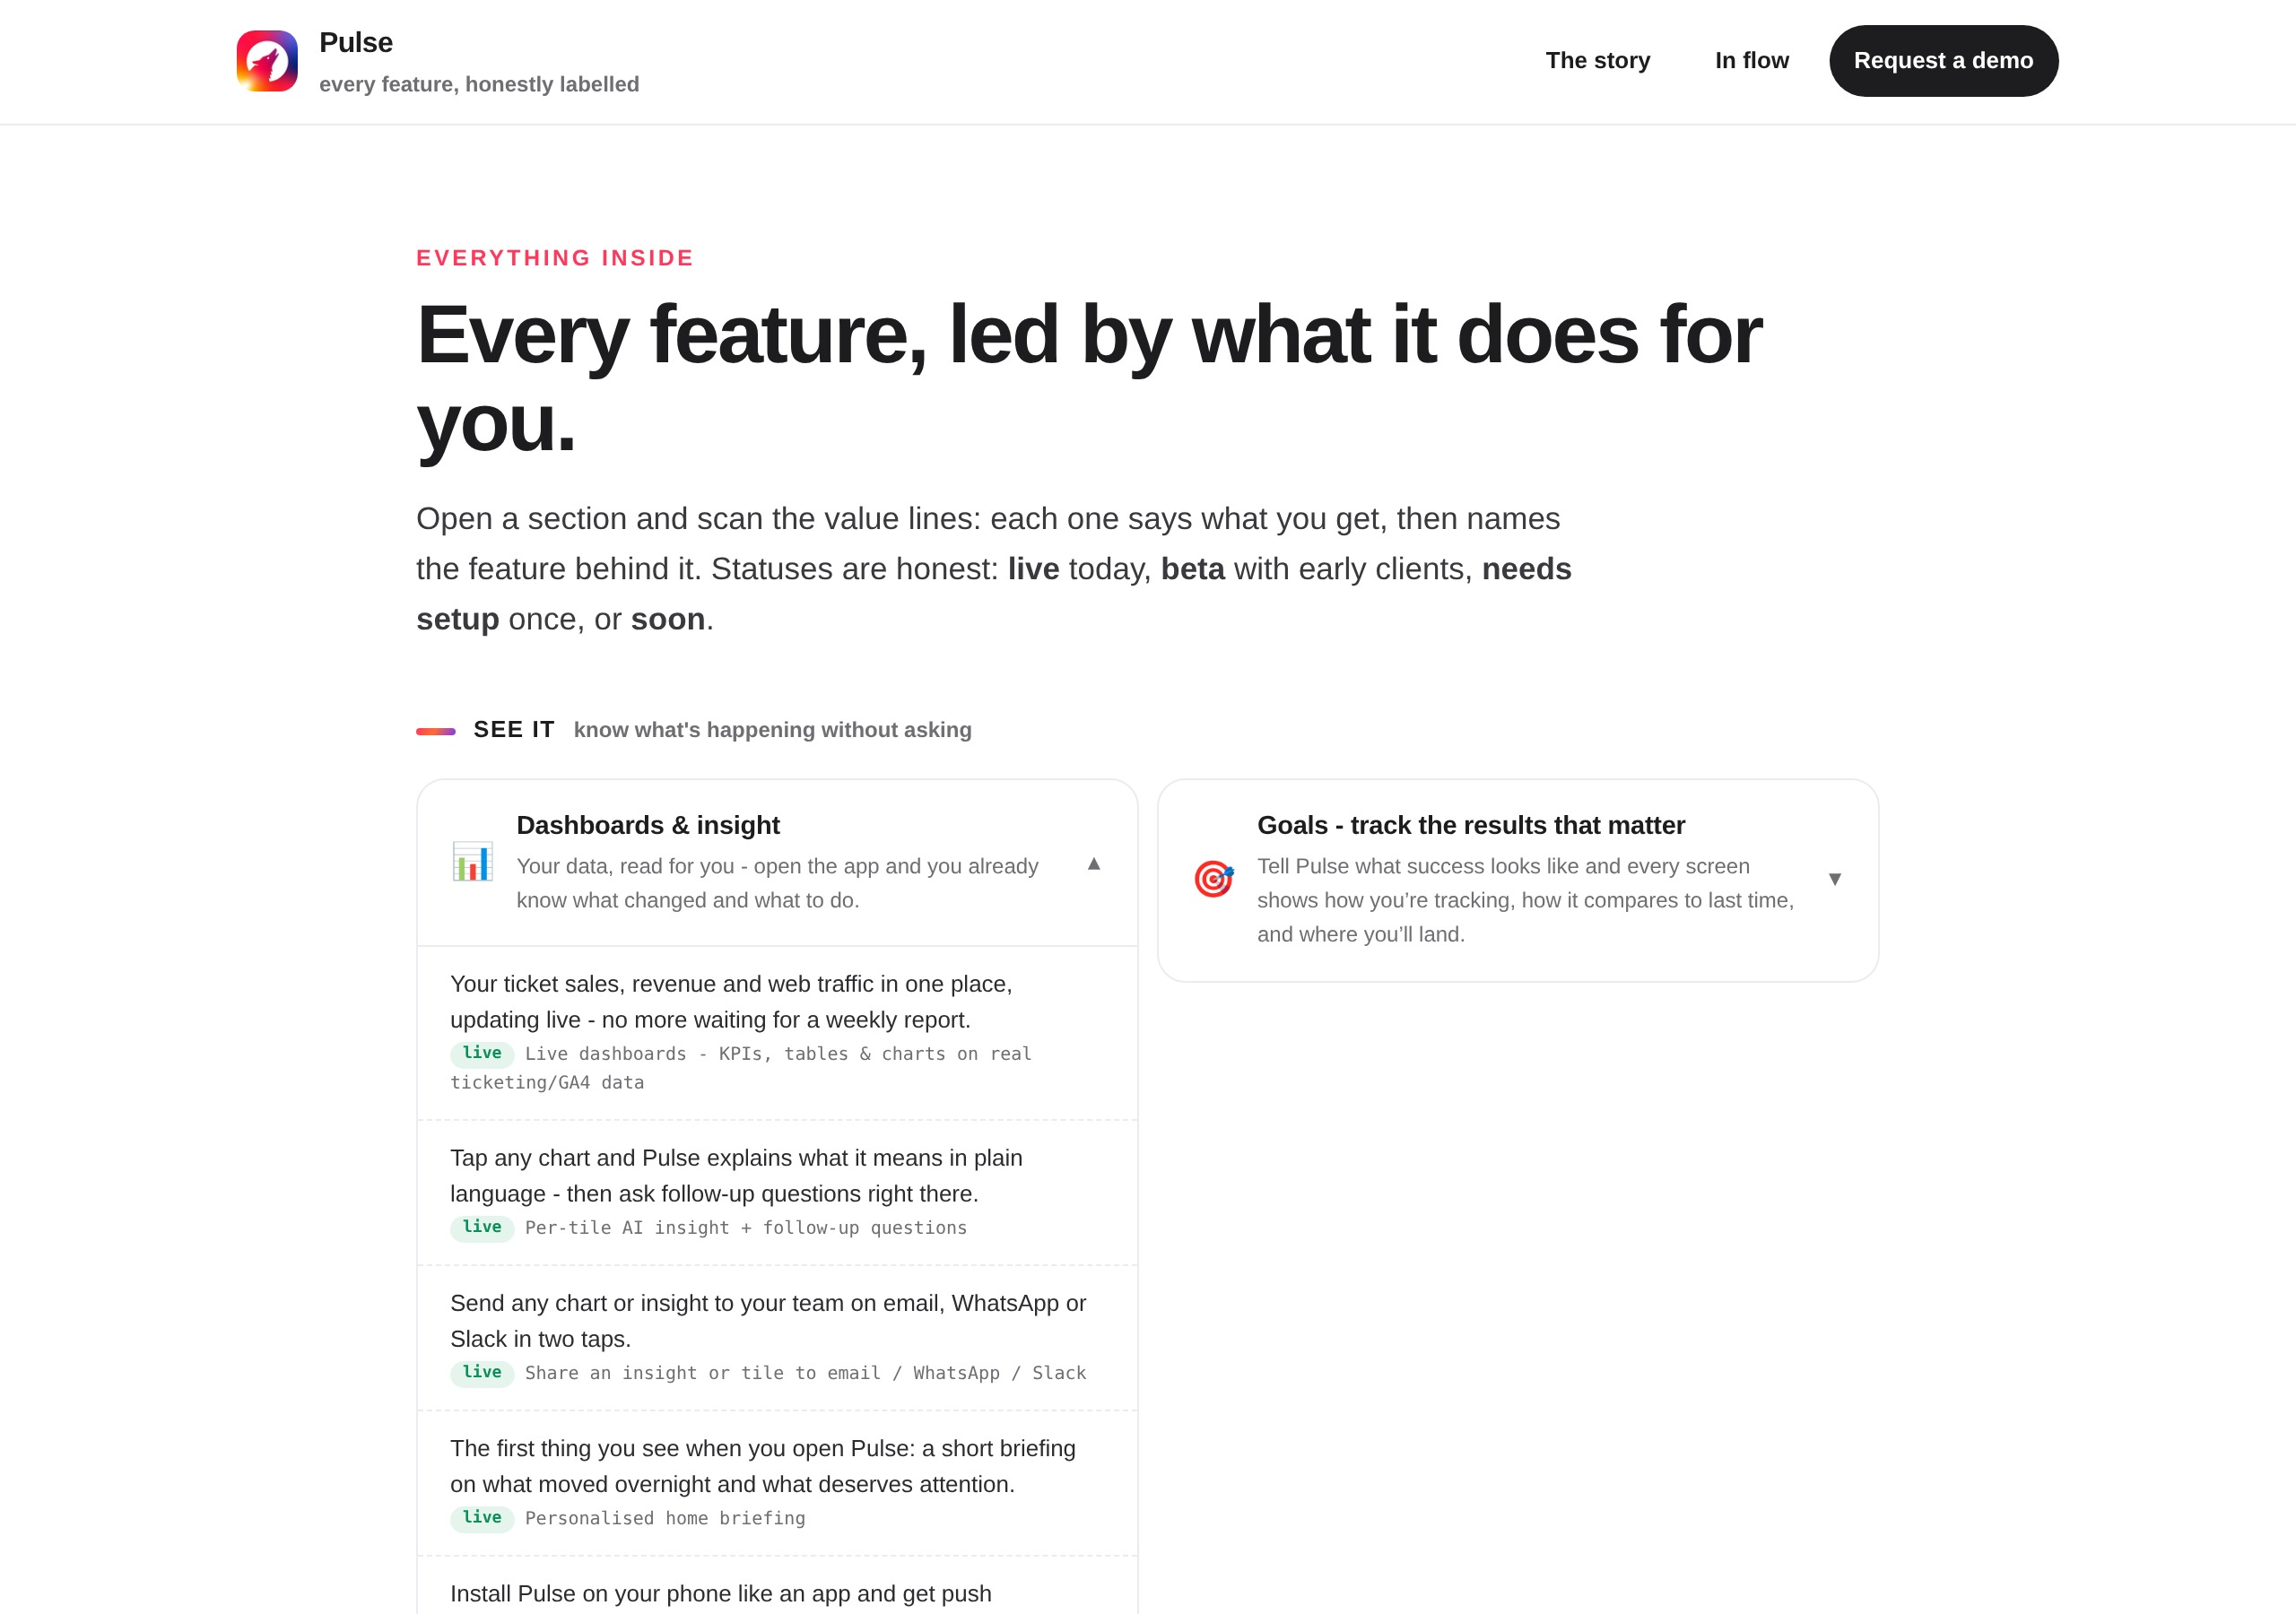
Features page
Every feature led by value, grouped: See it / Ask it / Act on it / Run the event / Yours, and trusted. Honest status labels.

Slide 16
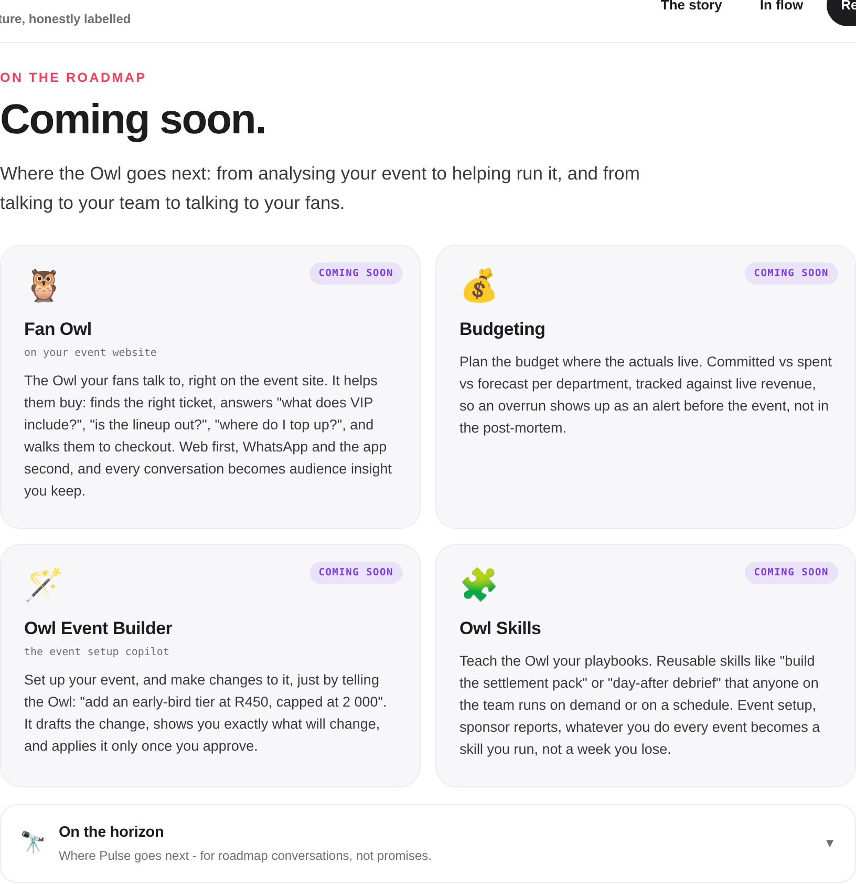
Coming Soon roadmap
Fan Owl (web-first, helps fans buy), Budgeting, Owl Event Builder, Owl Skills.

Slide 17
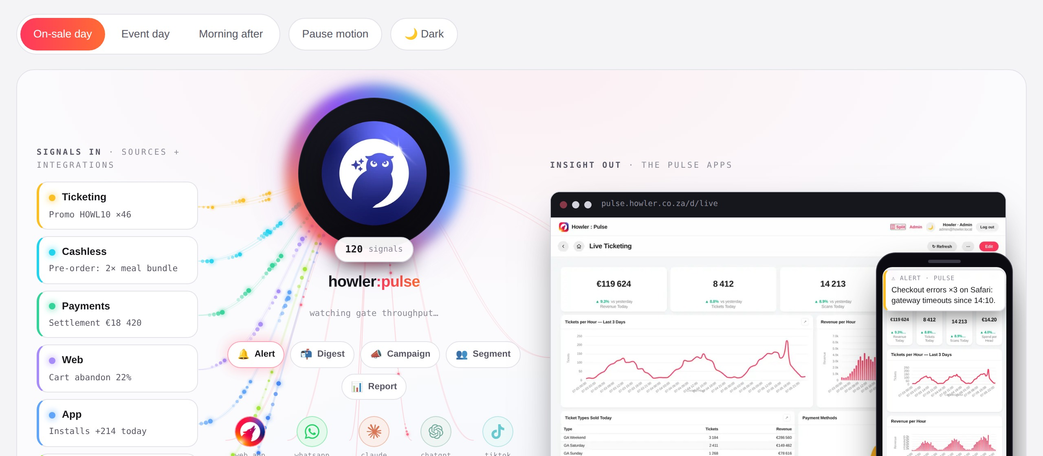
"In flow" concept
Every signal flows in, insight flows out. Animated concept at /sales/experience.

Slide 18
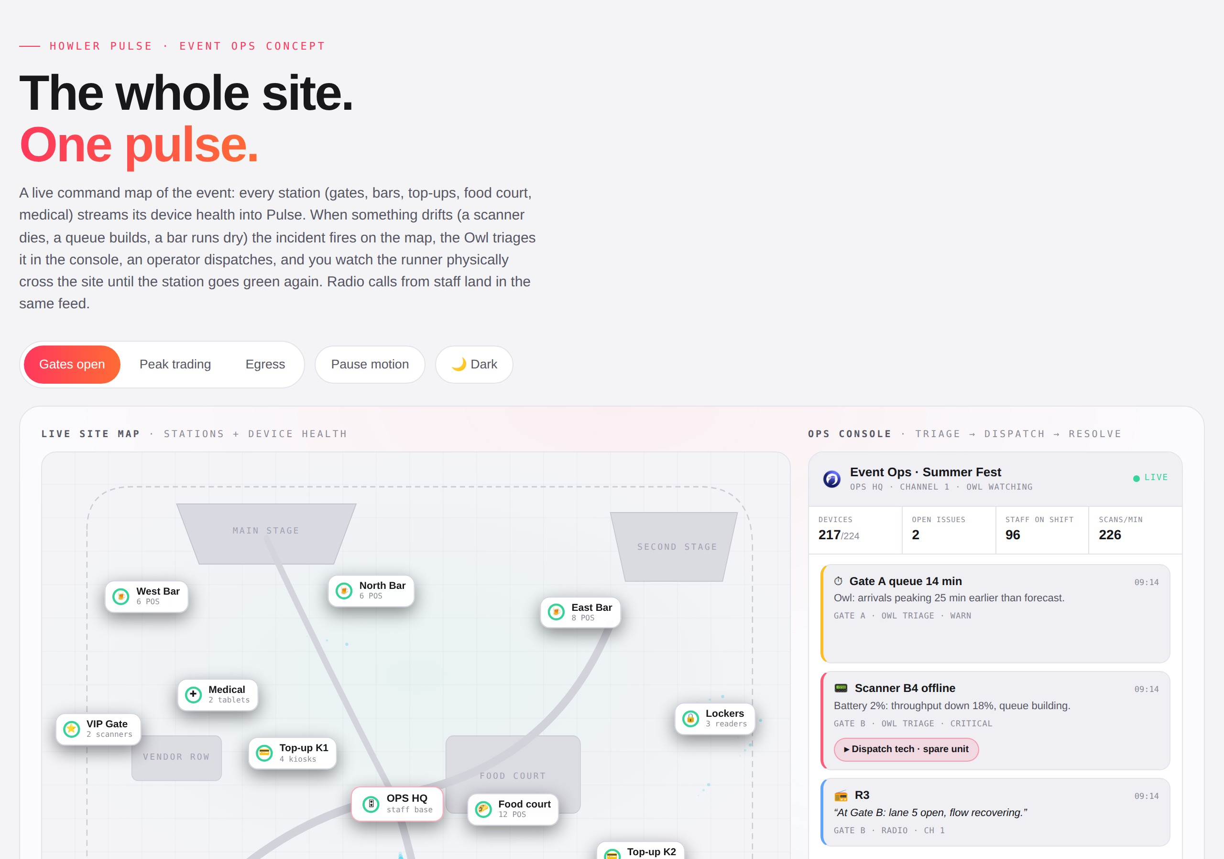
Event Ops live map concept
Festival map with device health, incidents dispatched and resolved, radio calls.

Slide 19
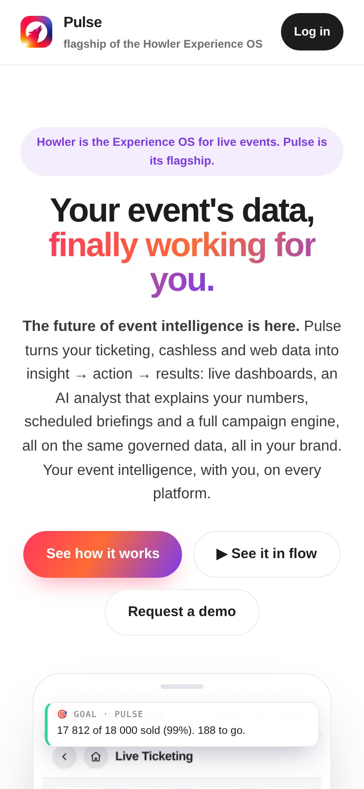
Mobile-first
The same story on a phone: the demo becomes a phone frame. Clients live on their phones.

Slide 20
Where to see it live
The story
https://howler-pulse-v2.onrender.com/sales
Every feature
https://howler-pulse-v2.onrender.com/sales/features
In flow (animated concepts)
https://howler-pulse-v2.onrender.com/sales/experience

