Slide 1
Pulse element library
Every element on this deck is native shapes and real text: click any card, edit the copy, change the colours, resize. Nothing is a screenshot unless marked.
Howler Pulse · marketing element kit · July 2026

Slide 2
Brand colours & type
Click a swatch to reuse its fill. Hex values below each.
Brand pink
Orange
Violet
Ink
Muted
Line
Soft bg
Success
#FF385C
#FF6B35
#7C3AED
#1D1D1F
#6E6E73
#ECECEF
#F7F7F9
#0A8F5B
Your event's data, finally working for you.
EYEBROW STYLE · 12px bold caps, brand pink, letterspaced
Body: The future of event intelligence is here. Pulse turns your ticketing, cashless and web data into insight, action and results.

Slide 3
Buttons & pills
All editable: change the text, keep the shape.
Request a live demo
See it in flow
See how it works
Primary · ghost · solid dark
Howler is the Experience OS for live events. Pulse is its flagship.
COMING SOON
Kicker pill · coming-soon pill
live
beta
needs setup
soon
Status pills: live · beta · needs setup · soon

Slide 4
Alerts & Owl insight
The toast that lands in the demo, and the Owl suggestion bar.
LIVE ALERT
GA Phase 1: 92% sold · sell-out projected 19:40
🦉 Owl insight: you're at 17 812 of your 18 000 North Star (99%). The 3 396 abandoned carts are your fastest path to sell-out: 188 recoveries closes the goal. Draft the recovery drip?

Slide 5
Journey tree · the Owl builds a journey
Every node is a shape + text. Recolour, rewire, rename.
🛒 Cart abandoned 3 396 enrolled
✉️ Reminder email step 1
opened · 58%
no open · 42%
📲 +4h · SMS promo
✉️ +24h · nudge email
✓ Purchase → auto-exit 188 closes the goal
State chip: journey live · awaiting your approval

Slide 6
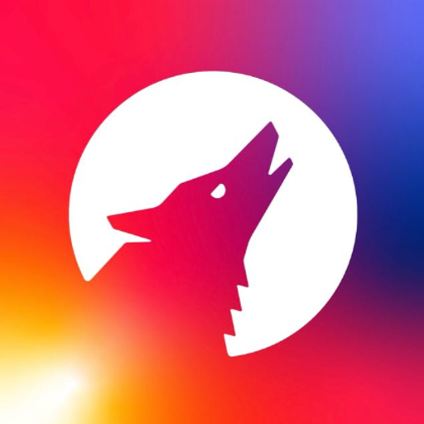
Finger on the Pulse tiles
Editable versions: ring, bell, mail + briefing, badge.
Friday · 07:00
2
🔔
99%
🎯 18 000 tickets reached
🎯 Goals
🔔 Alerts
✉️📰 Digests / Briefings
📱 Notifications
Set the target once. Every screen shows ahead, on track or behind.
A tap on the shoulder the moment a number matters.
Scheduled digests and the Owl’s written briefing, in the right inbox.
Pulse pings your phone even when the app is closed.

Slide 7
Marketing pipeline
Phase chips + audience sync pop.
Announce
Pre-sale
On-sale
Event week
Live
Wrap
Meta · 3 396 synced ✓
TikTok · 2 118 synced ✓

Slide 8



Owl channels
Dark chips with the real platform marks (icons are images; swap freely).
Pulse Web App
WhatsApp
ChatGPT
Claude
Also: TikTok / Meta / Google Cloud marks in the icon set (dark + white, SVG and PNG).

Slide 9
The honest comparison
A real table: edit cells directly.
If you’re using | The gap | What Pulse changes
Looker / Tableau | You see the problem, then export a CSV and switch tools. | See it and act on it in the same governed place.
Mailchimp / Klaviyo | Audiences go stale the moment you upload them. | Audiences built from live data, re-resolved at send time.
Email + WhatsApp threads | Approvals and settlements get lost. | One inbox with read/ack trails; settlements file themselves.
Gut feel on event night | You find out about problems when the queue does. | Live ops board, alerts, a mini report every 30 minutes.

Slide 10
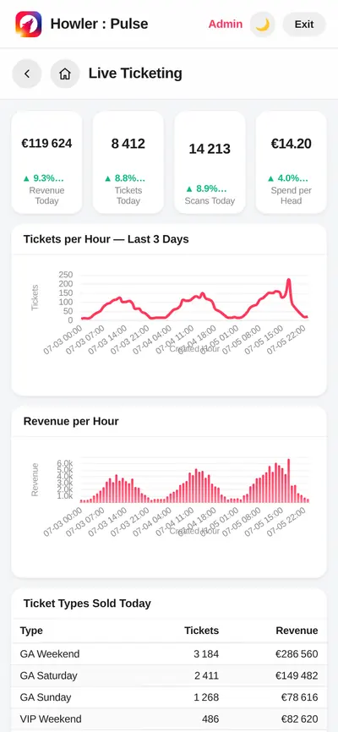
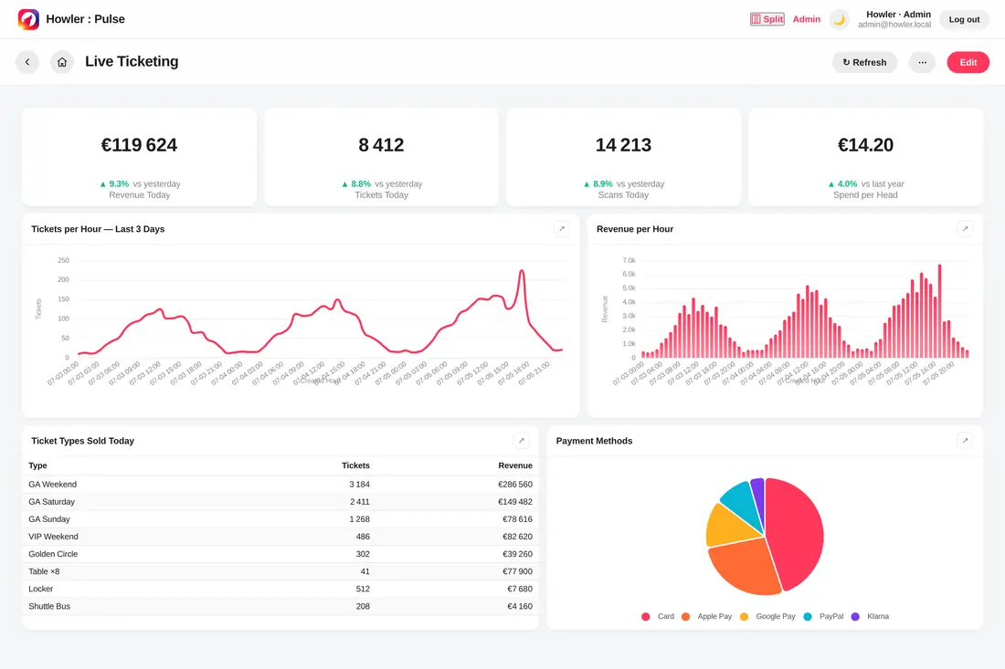
Device frames
Browser + phone shells are shapes; the screens inside are real app screenshots (swap the image, keep the shell).
pulse.howler.co.za/d/live
Swap screenshots via right-click → Replace image

Slide 11
Headline kit
The hero, as editable text.
Howler is the Experience OS for live events. Pulse is its flagship.
Your event's data, finally working for you.
The future of event intelligence is here. Your event intelligence, with you, on every platform.
See how it works
See it in flow

