Slide 1

HOWLER PRESENTS
Pulse.
Your event’s data, finally working for you.
Howler is the Experience Operating System for live events, and Pulse is our new flagship product: one white-label platform that turns your ticketing, cashless and web data into insight, action and results, in your brand, on your phone.
In brief · July 2026

Slide 2
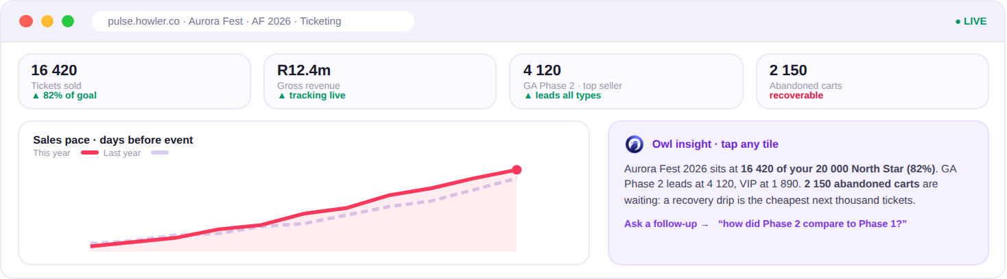
One living loop, not five disconnected tools
your data flows in, gets read for you, and turns into action and results
📡 Your data flows in live
→
🦉 The Owl reads it for you
→
⚡ You act in one tap
→
📈 Results come back measured
Live dashboards with the Owl one tap away. Screens and numbers are illustrative.
“See what’s happening, act on it, and prove the results. The longer you use Pulse, the better it gets.”
Pulse · flagship of the Howler Experience OS
howler-pulse-v2.onrender.com
2

Slide 3
Six things you’ll feel in the first month
what Pulse does for you, in plain terms
🌅 Wake up already knowing
🦉 Ask your data anything
⚡ Act in one tap
A personal morning briefing and scheduled digests tell you what changed overnight and what’s worth doing about it.
Your own AI analyst: in the app, on WhatsApp, even from ChatGPT or Claude. Grounded answers, only from your own data.
Reach exactly the right people with on-brand email and SMS, drafted for you, approved by you. Cohort to campaign in minutes.
📣 Make your ads work harder
🎯 Prove the results
🎪 Own event night
Send Pulse audiences to Meta and TikTok, keep them fresh automatically, and see what the spend actually returned.
Set the target that matters, like your ticket-sales North Star, and every screen shows how you’re tracking.
A live command centre for gates, bars and devices, with a report to the team’s phones through the night.
No exports. No stale lists. No tab-switching. One login.
Pulse · flagship of the Howler Experience OS
howler-pulse-v2.onrender.com
3

Slide 4
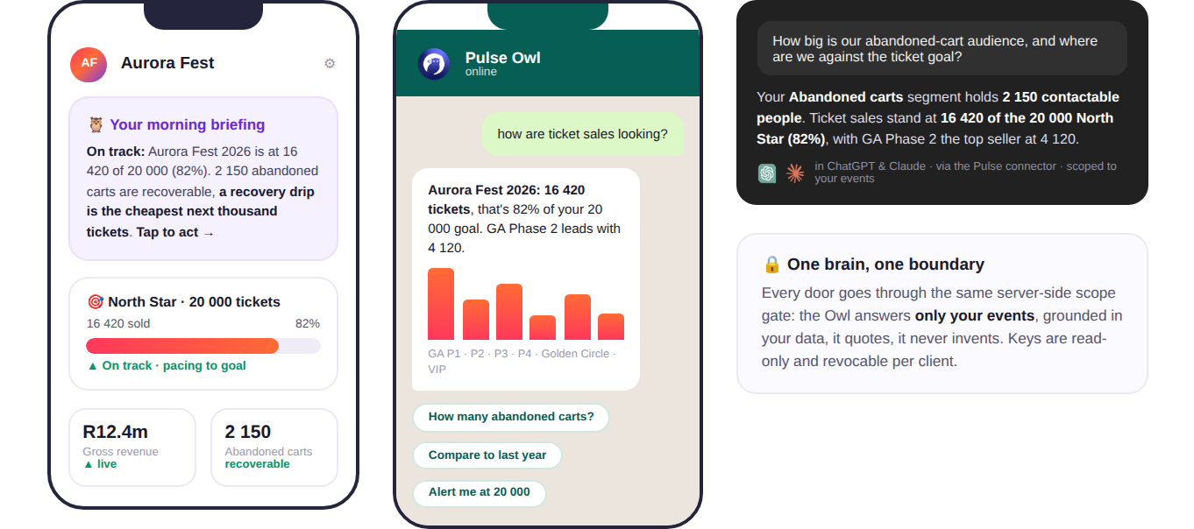
Meet the Owl: your analyst, everywhere
the same brain, whichever door your team walks through
Left to right: the morning briefing in the app, the Owl on WhatsApp, and the Pulse connector answering in ChatGPT and Claude.
Only ever your data, and it quotes, it never invents.
Pulse · flagship of the Howler Experience OS
howler-pulse-v2.onrender.com
4

Slide 5

The Howler One stack
one experience, one dataset, one partner, and Pulse is the brain of it
🎟 Ticketing
💳 Cashless Payments
📱 SuperApp
⭐ VIP Tables
Ticket sales, access control and scanning: every buyer and every entry, captured from minute one.
Tap-to-pay across bars and vendors: faster queues, higher spend, zero cash risk.
The fan’s companion: tickets, top-ups, line-ups and offers, an ownable channel to every attendee.
Premium done properly: bookings, minimum spends and hosted service, managed and measured.
↓
↓
↓
↓
Pulse: the brain of the stack. Every ticket, every tap at a bar, every SuperApp session and every VIP booking feeds one dataset, and Pulse turns that dataset into decisions.
ONE STACK · ONE DATASET · ONE BRAND EXPERIENCE · ONE PARTNER
Pulse · flagship of the Howler Experience OS
howler-pulse-v2.onrender.com
5

Slide 6
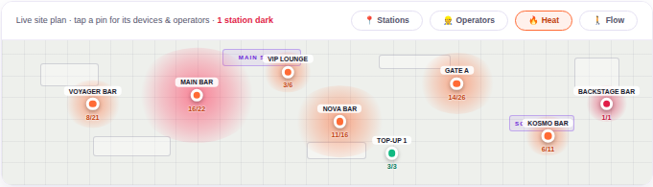
Own event night
your whole operation, live, on your own venue plan
Every station pinned, heat showing where the crowd is spending right now, and a dark station flagged the moment its data stops flowing.
“You’ll know a hotspot is forming, or a scanner has died, before anyone on the ground has to tell you. And through the night, a compact report lands on the team’s phones.”
Pulse · flagship of the Howler Experience OS
howler-pulse-v2.onrender.com
6

Slide 7
Where to from here
Your ticketing and cashless data is already flowing through the Howler stack. Pulse is the switch that turns it into insight, action and results.
Let’s show you, live on your own numbers.
Book a live walkthrough with your Howler team →
howler-pulse-v2.onrender.com

