Slide 1

HOWLER PRESENTS · PREPARED FOR MILK & COOKIES
Pulse.
Your event’s data, finally working for you.
Howler is the Experience Operating System for live events, and Pulse is our new flagship product: one white-label platform that turns your ticketing, cashless and web data into insight, action and results, in your brand, on your phone.
In brief · July 2026

Slide 2
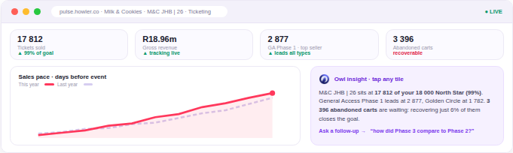
One living loop, not five disconnected tools
your data flows in, gets read for you, and turns into action and results
📡 Your data flows in live
→
🦉 The Owl reads it for you
→
⚡ You act in one tap
→
📈 Results come back measured
Live dashboards with the Owl one tap away. Screens are illustrative; the numbers are Milk & Cookies’ real Pulse data, pulled live on 9 July 2026.
“See what’s happening, act on it, and prove the results. The longer you use Pulse, the better it gets.”
Pulse · flagship of the Howler Experience OS
howler-pulse-v2.onrender.com
2

Slide 3
Six things you’ll feel in the first month
what Pulse does for you, in plain terms
🌅 Wake up already knowing
🦉 Ask your data anything
⚡ Act in one tap
A personal morning briefing and scheduled digests tell you what changed overnight and what’s worth doing about it.
Your own AI analyst: in the app, on WhatsApp, even from ChatGPT or Claude. Grounded answers, only from your own data.
Reach exactly the right people with on-brand email and SMS, drafted for you, approved by you. Cohort to campaign in minutes.
📣 Make your ads work harder
🎯 Prove the results
🎪 Own event night
Send Pulse audiences to Meta and TikTok, keep them fresh automatically, and see what the spend actually returned.
Set the target that matters, like your 18 000-ticket North Star, and every screen shows how you’re tracking.
A live command centre for gates, bars and devices, with a report to the team’s phones through the night.
No exports. No stale lists. No tab-switching. One login.
Pulse · flagship of the Howler Experience OS
howler-pulse-v2.onrender.com
3

Slide 4
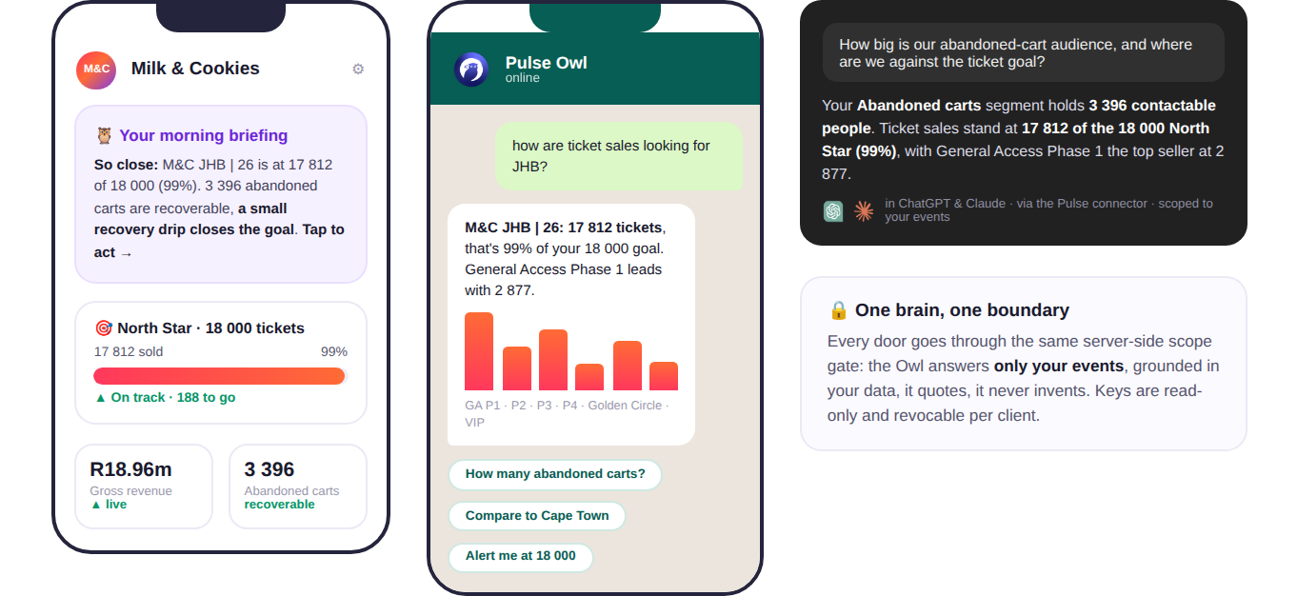
Meet the Owl: your analyst, everywhere
the same brain, whichever door your team walks through
Left to right: the morning briefing in the app, the Owl on WhatsApp, and the Pulse connector answering in ChatGPT and Claude, with Milk & Cookies’ real numbers.
Only ever your data, and it quotes, it never invents.
Pulse · flagship of the Howler Experience OS
howler-pulse-v2.onrender.com
4

Slide 5

The Howler One stack
one experience, one dataset, one partner, and Pulse is the brain of it
🎟 Ticketing
💳 Cashless Payments
📱 SuperApp
⭐ VIP Tables
Ticket sales, access control and scanning: every buyer and every entry, captured from minute one.
Tap-to-pay across bars and vendors: faster queues, higher spend, zero cash risk.
The fan’s companion: tickets, top-ups, line-ups and offers, an ownable channel to every attendee.
Premium done properly: bookings, minimum spends and hosted service, managed and measured.
↓
↓
↓
↓
Pulse: the brain of the stack. Every ticket, every tap at a bar, every SuperApp session and every VIP booking feeds one dataset, and Pulse turns that dataset into decisions.
ONE STACK · ONE DATASET · ONE BRAND EXPERIENCE · ONE PARTNER
Pulse · flagship of the Howler Experience OS
howler-pulse-v2.onrender.com
5

Slide 6
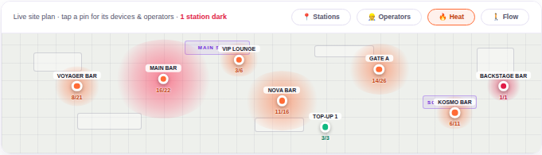
Own event night
your whole operation, live, on your own venue plan
Every station pinned, heat showing where the crowd is spending right now, and a dark station flagged the moment its data stops flowing.
“You’ll know a hotspot is forming, or a scanner has died, before anyone on the ground has to tell you. And through the night, a compact report lands on the team’s phones.”
Pulse · flagship of the Howler Experience OS
howler-pulse-v2.onrender.com
6

Slide 7
Where to from here
You’re 188 tickets from the 18 000 North Star, and there are 3 396 abandoned carts sitting in Pulse waiting to be asked nicely.
Let’s close the goal together, live on your data.
Book a live walkthrough with your Howler team →
howler-pulse-v2.onrender.com

