Slide 1



AI Master Class series – Day 13
Hand Gesture Recognition

Slide 2
Day-11 Agenda.
01.
02.
03.
Hand Gesture Recognition
Basic Syntax
Hand Gesture recognition
04.
05.
Task
Q & A
Hand Gesture recognition & its Applications
Basic Syntax of Keras
Training Hand Gesture recognition

Slide 3

Hand Gesture Recognition.
Human gestures include different components of visual actions such as motion of hands, facial expression, and torso, to convey meaning. So far, in the field of gesture recognition, most previous works have focused on the manual component of gestures.
A hand gesture recognition system provide a natural, innovative and modern way of non verbal communication. It has a wide area of application in human computer interaction and sign language

Slide 4
Block Diagram – Workflow of Hand Gesture recognition - CNN.
Dataset Creation
Train, Test, Val
CNN Design
Pre-Processing
Training - Model
Load Model - Test
Pre-process Input Image
Classification

Slide 5
Early Stopping.
EarlyStopping(monitor='val_loss',patience=10),
ModelCheckpoint(filepath="model.h5",monitor='val_loss',save_best_only=True,verbose=1)]
It is used to stop the model training in between. This function is very helpful when your models get overfitted.
It is used to stop the model as soon as it gets overfitted.
We defined what to monitor while saving the model checkpoints.
We also need to define the factor we want to monitor while using the early stopping function.
We will monitor validation loss for stopping the model training. Use the below code to use the early stopping function.

Slide 6

! PRACTICAL SESSION !

Slide 7
INTERN PARTICIPANTS Real time Hand Gesture recognition using Computer Vision – BONUS

Slide 8
Hand Gesture recognition using Deep Learning

Slide 9
from keras.preprocessing.image import ImageDataGenerator
from keras.layers import Conv2D
from keras.layers import MaxPooling2D
from keras.layers import Dropout
from keras.layers import Dense
from keras.layers import Flatten
from keras.callbacks import EarlyStopping, ModelCheckpoint
from keras.models import Sequential
model = Sequential()
model.add(Conv2D(32, (3, 3), input_shape = (256, 256, 1), activation = 'relu'))
model.add(MaxPooling2D(pool_size = (2, 2)))
model.add(Conv2D(64, (3, 3), activation = 'relu'))
model.add(Conv2D(64, (3, 3), activation = 'relu'))
model.add(MaxPooling2D(pool_size = (2, 2)))
model.add(Conv2D(128, (3, 3), activation = 'relu'))
model.add(MaxPooling2D(pool_size = (2, 2)))
model.add(Conv2D(256, (3, 3), activation = 'relu'))
model.add(MaxPooling2D(pool_size = (2, 2)))
model.add(Flatten())
model.add(Dense(units = 150, activation = 'relu'))
model.add(Dropout(0.25))
model.add(Dense(units = 6, activation = 'softmax'))

Slide 10
model.compile(optimizer = 'adam', loss = 'categorical_crossentropy', metrics = ['accuracy'])
train_datagen = ImageDataGenerator(rescale = 1./255,
rotation_range = 12.,
width_shift_range = 0.2,
height_shift_range = 0.2,
zoom_range=0.15,
horizontal_flip = True)
val_datagen = ImageDataGenerator(rescale = 1./255)
training_set = train_datagen.flow_from_directory('Dataset/train',
target_size = (256, 256),
color_mode = 'grayscale',
batch_size = 8,
classes = ['NONE','ONE','TWO','THREE','FOUR','FIVE'],
class_mode = 'categorical')
val_set = val_datagen.flow_from_directory('Dataset/val',
target_size = (256, 256),
color_mode='grayscale',
batch_size = 8,
classes=['NONE', 'ONE', 'TWO', 'THREE', 'FOUR', 'FIVE'],
class_mode='categorical')
callback_list = [
EarlyStopping(monitor='val_loss',patience=10),
ModelCheckpoint(filepath="model.h5",monitor='val_loss',save_best_only=True,verbose=1)]
model.fit_generator(training_set,
steps_per_epoch = 37,
epochs = 25,
validation_data = val_set,
validation_steps = 7,
callbacks=callback_list
)

Slide 11
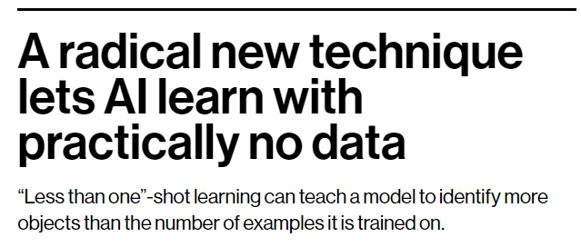
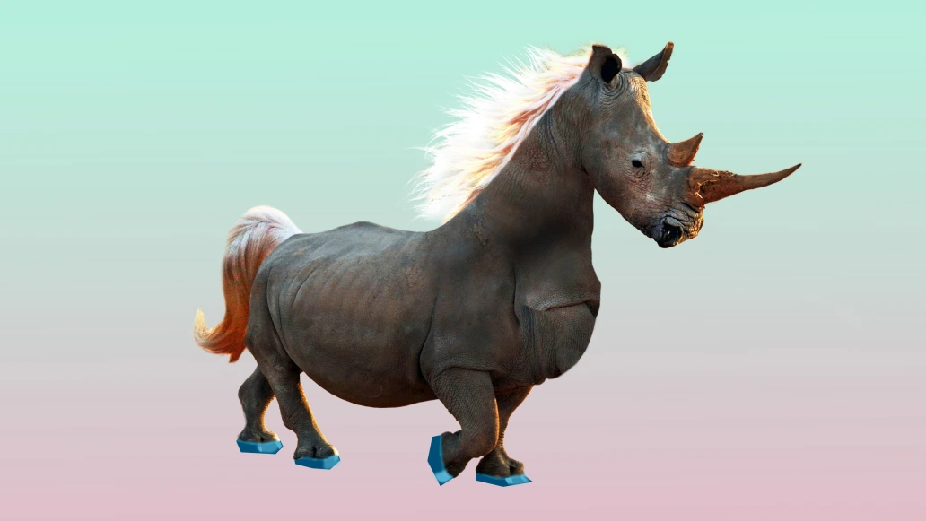
AI News – Day 13. OCT - 2020
Machine learning typically requires tons of examples. To get an AI model to recognize a horse, you need to show it thousands of images of horses. This is what makes the technology computationally expensive—and very different from human learning. A child often needs to see just a few examples of an object, or even only one, before being able to recognize it for life.
In fact, children sometimes don’t need any examples to identify something. Shown photos of a horse and a rhino, and told a unicorn is something in between, they can recognize the mythical creature in a picture book the first time they see it.

Slide 12
Thanks!
Tomorrow session
Do you have any questions?
sanjay@pantechmail.com
www.pantechsolutions.net
Hand Gesture Recognition

