Slide 1



RRR
View in Power BI
Last data refresh:
10/5/2021 11:07:09 AM UTC
Downloaded at:
10/5/2021 11:13:29 AM UTC

Slide 2
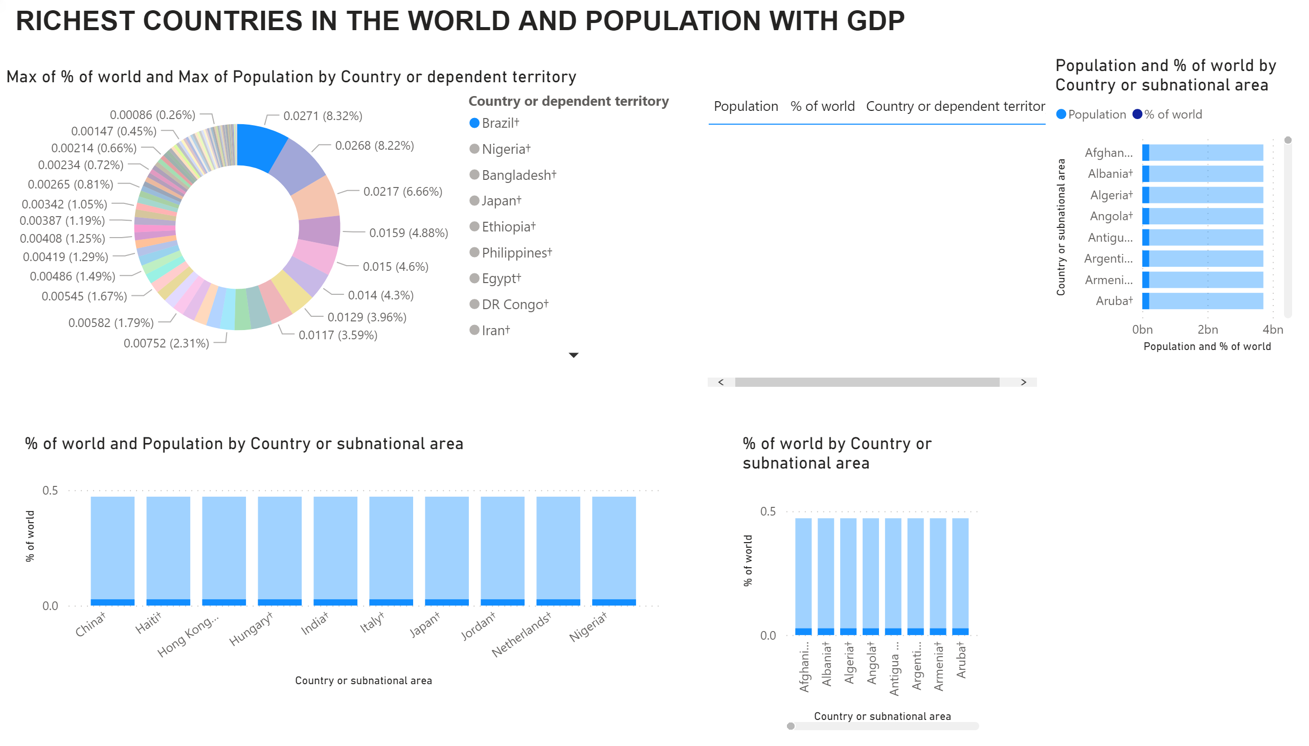
Page 1
Notes:
textbox
No alt text provided.
donutChart
No alt text provided.
columnChart
No alt text provided.
tableEx
No alt text provided.
barChart
No alt text provided.
columnChart
No alt text provided.

