Slide 1

Bow & Arrow
Graphics game in C++
Presentation

Slide 2
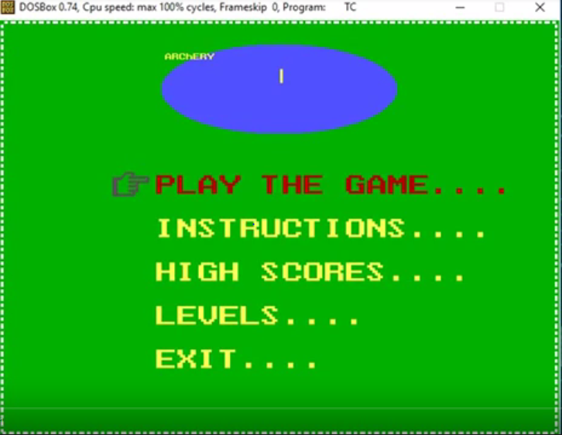

Slide 3
Computer graphics is a subfield of computer science which studies the manipulation of visual and geometric information using computational techniques. It focuses on the mathematical and computational foundations of image generation and processing rather than purely aesthetic issues. Fundamental graphics program like drawing of various geometrical shapes(rectangle, circle ellipse etc), use of mathematical function in drawing curves, coloring an object with different colors and patterns and simple animation programs are the utilities of graphics programming. Using C++ graphics we wrote the game program. C++ is a high level language which supports graphics in it. Bow & Arrow game tests players concentration power.

Slide 4
INTRODUCTION
This is entirely written in C++ language. At first we have an arrow and bow. The series of circles will roll from top to bottom. We have to hit the target. The arrow hitting at any point of the circle is the target. We get the score on the basis of hitting numbers. Players will have twenty chances to hit the target in each level.There are three levels of different difficulties
Based on players performance the score of all the twenty times will be added up. The score reaching 100 will lead to another level. Finally the score will be displayed at the end of the game. Player will have two options either to continue or to quit the game.

Slide 5
Modules
1.Welcome Screen
2.Game Screen
3.Ending Screen

Slide 6
WELCOME SCREEN:
In this module the functions we used, are::
hand()----In this function we use graphics commands like ellipse, line, setcolor for designing the hand gesture to indicate the points.
image(), conveximage(), image1()----These functions draws the decorative front screen
getkey()----This function gets the movement of hand from the user keyboard.
rules()---The next screen will have the rules for the game.
updatehighscore()----This funtion will update the highest score of the game.
level()------This function describes each levels to the players.
exit()-----This function exits the game

Slide 7
GAME SCREEN:
We use the following functions for designing this screen
arrow(int pos)---This will create the arrow .The arrow with the yellow colour used the graphical command line only.
shoot()-----This will get the spacebar pointer to shoot the arrows in each level.
ball(),balllevel2()----These functions forms balls in each levels.
eyelevel()----This function contrlos the bow to move up/down/right/left.
displaytopscore()-----This function displays the sore after the end of the game.
gethighscores()-----It gets the highest score and send it to front screen function to update the score.
game()-----This function calls the other functions in gamescreen mode to complete the whole game in a if else conditions where the players chooses how to play.

Slide 8
Ending Screen:
Here we use the following functions
main():---
This function combines all other function to actually run the program.At the end of game, the score of the game will be displayed with two options either to quit or continue.
Finally the names will be asked to display in the middle of the screen.

Slide 9
LITERATURE
Prototypes in <GRAPHICS.H>
1.INITGRAPH: Initializes the graphics system.
Syntax: Initgraph (int far *graph driver, int far *graph mode, char far *path drive);
2.RECTANGLE : Draws a rectangle
Syntax: Rectangle(intleft,inttop,intright,int bottom);
3.SETBACKCOLOR:Sets the back ground colour
Syntax: setbkcolor(clour)
4.ELLIPSE: Draws the ellipse
Syntax: ellipse (int x, int y, int stangle, int endangle, int xrasius,int yradius)
5.SETTEXTSTYLE: Sets the current text characteristics.
Syntax: Settextstyle(intfont,intdirection,intcharsize);

Slide 10
6.SETFILLSTYLE: Sets fill pattern and color.
Syntax: Setfillstyle(intpattern,int color);
7.SETCOLOR: Set color sets the current drawing color.
Syntax: Setcolor(int color);
8.CLOSEGRAPH: Shuts down the graphics system.
Syntax: Closegraph(void);
9.DELAY: Suspends execution for some time interval(milliseconds)
Syntax: Delay(unsigned milliseconds);
10.SLEEP: Suspends execution for interval
Syntax: Sleep(unsigned seconds);
11.nosound: Sound turns on the PC's speaker at a given frequency.
nosound turns the speaker off after it has been turned on by a call to sound.Frequency specifies the frequency of the sound in hertz (cycles per second)
Synatx:■ void sound(unsigned frequency);

Slide 11
12.OUTYEXTXY:Outtextxy displays a string at the specified location(graphics mode)
Syntax: Outtextxy(intx,inty,char far *textstring);
13.line:Purpose: Draws a line.
Syntax: void far line (int left, int top, int right, int bottom);
14.flag:Purpose: Resets the formatting flags as the default value
Syntax; long flag();
15.ARC(): Purpose : Draws an arc.
Syntax: void arc (int xcentre, int ycenter, int stangle, int endangle,int radius);
16.CIRCLE: Circle draws a circle.
Syntax: Circle(intx,inty,int radius)
17.RANDOM: Macro that returns an integer.
Syntax: Random(num);

Slide 12
18.getaccords() get coordinates of the last call to arc.
Syntax: void getaccords(struct accordstype *arccords);
19.FLOODFILL(); It fills an enclosed area.
Syntax: void floodfill(int x,int y,int border);
20.sound: Sound turns on the PC's speaker at a given frequency.
nosound turns the speaker off after it has been turned on by a call to sound.Frequency specifies the frequency of the sound in hertz (cycles per second)
Synatx:
■ void sound(unsigned frequency);

Slide 13
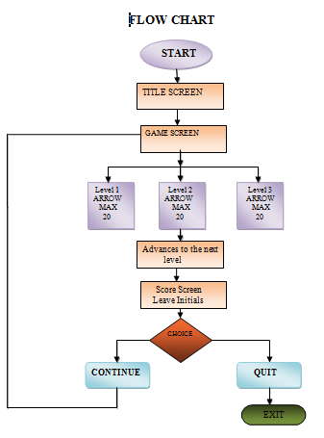
Algorithm
STEP1: Welcome screen will be displayed.
STEP2: Different choices would be displayed
STEP3: Game is chosen player would be redirected to game screen
.
STEP4: Game screen with bow and arrow will be there to hit the target.
STEP5: When the arrow is hitted the score will be displayed.
STEP6: Like that 20 arrows will be there to hit the target.
STEP7: If scores 100 then proceeds to level 2 and repeat the procedure.
STEP8: The final score will be displayed.
STEP9: Option ‘continue’ is there to continue the game.
STEP10: Another option to quit the game is also available.
STEP11: Final window will ask for player name to it on leaderboard. And then player would be redirected to the main screen.

Slide 14
CONCLUSION
The ‘Bow & Arrow’ game is basically a memory game.’C++’ provides modularity by dividing the program into number of function blocks. We have used several user defined functions for developing our game. Most of these user defined functions use graphic commands. The graphics commands that we used most frequently are settextstyle, setfillstyle, setcolor, rectangle, circle.
The advantage of this game over the other games is besides providing entertainment to the player it even helps them to improve to some extent their concentration.

Slide 15
REFERENCES
WEBSITES
v www.google.com
v www.Programmersheaven.com
v www.programmersworld.com
v www.wikipedia.com
v www.cprogramming.com
v www.tutorialspoint.com/computer_graphics/

Slide 16
Bow&Arrow.cpp

Slide 17


