Slide 1
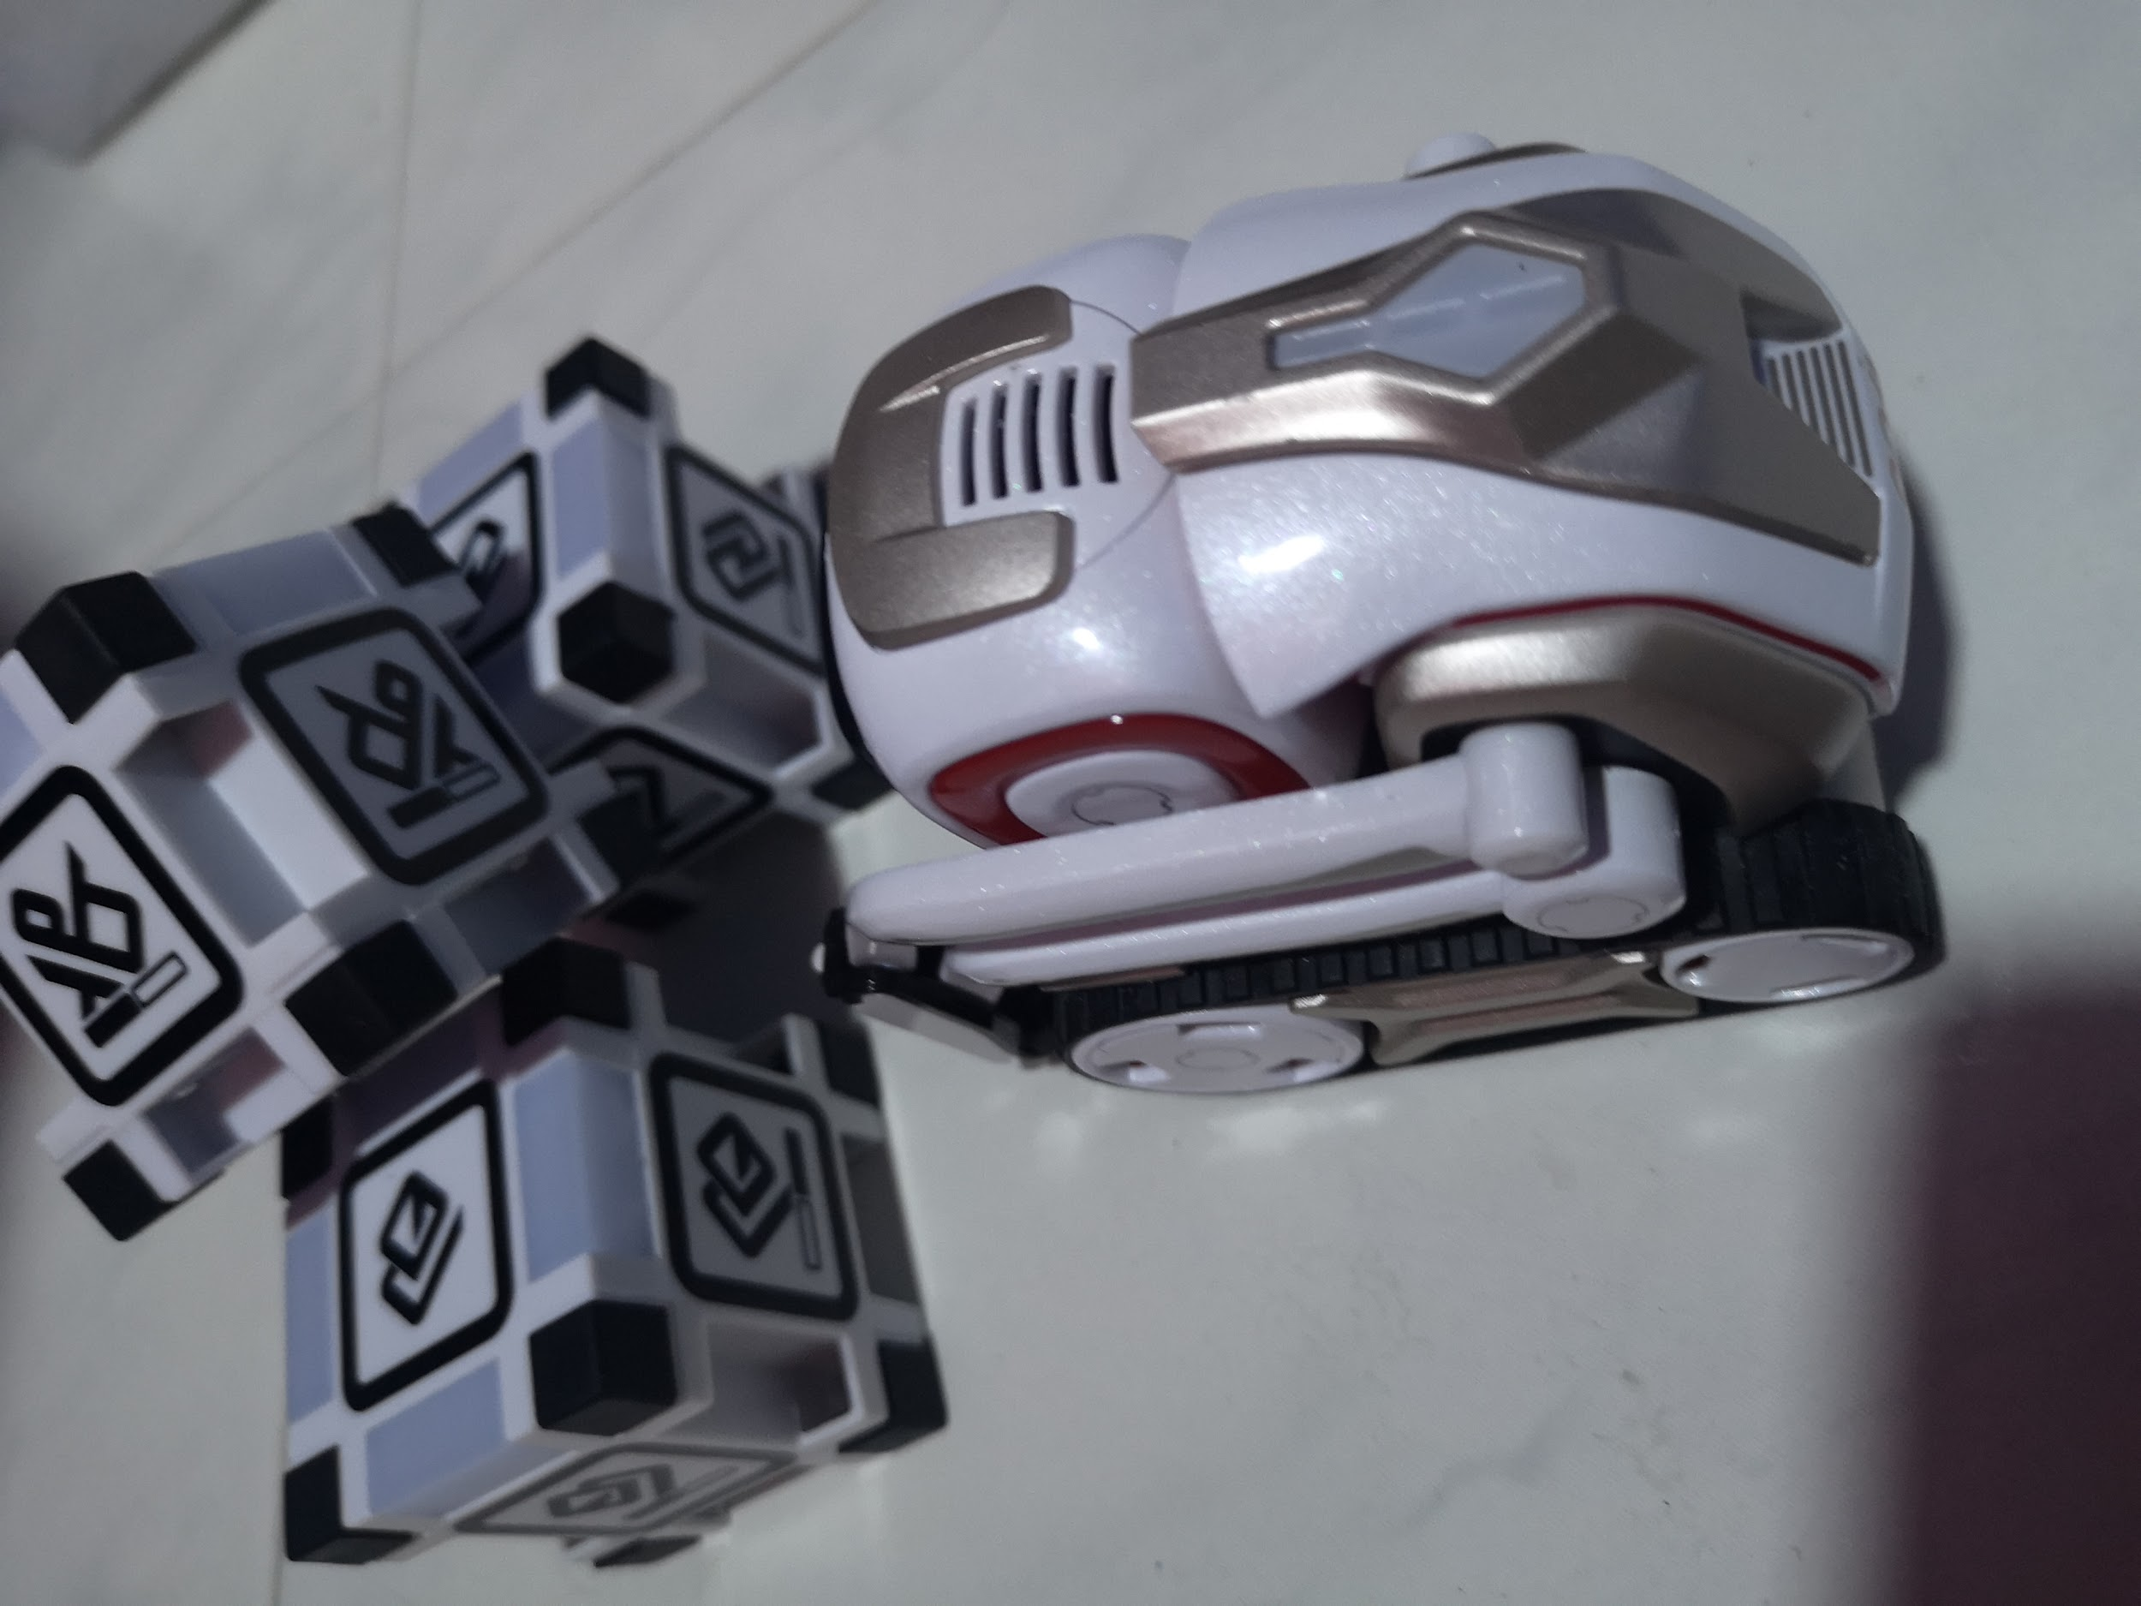
cozmo
By: Tricia, Shaidah, Si Hui, Hui Qi, Ruth

Slide 2
Task Allocation
1. See Human and say a greeting | Ruth
2. Move forward until detect a cube then make that cube light up and sing song | Tricia
3. Cube obstacle - turn to avoid cube. when ever detect cube, avoid | Si Hui
4. Stack a pyramid | Shaidah
5. Predefine a cube to pick up. After pick up, user will tap and then cozmo will stack on that cube. | Hui Qi

Slide 3
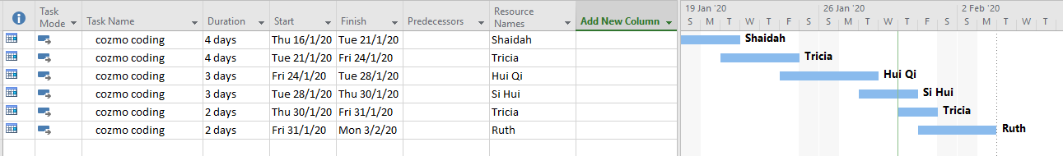
Planning

Slide 4
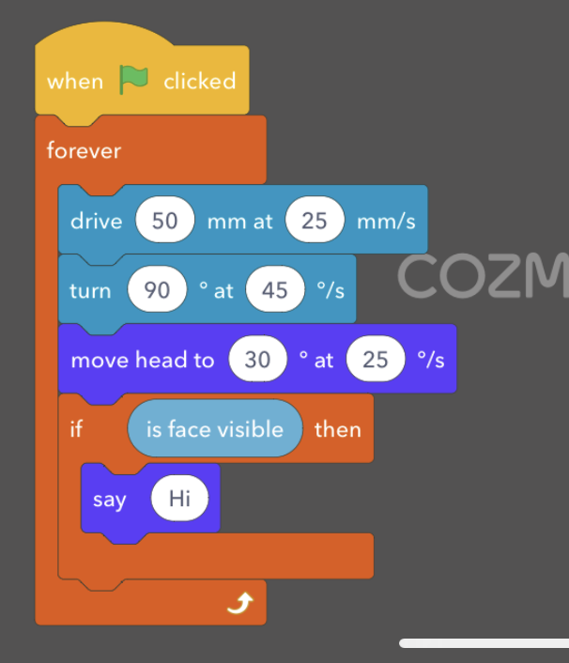
Process
Task : see a human and say a greeting “hello”
what i did : for cozmo to move around and look
around until it detects a human face and it will say
a greeting.

Slide 5
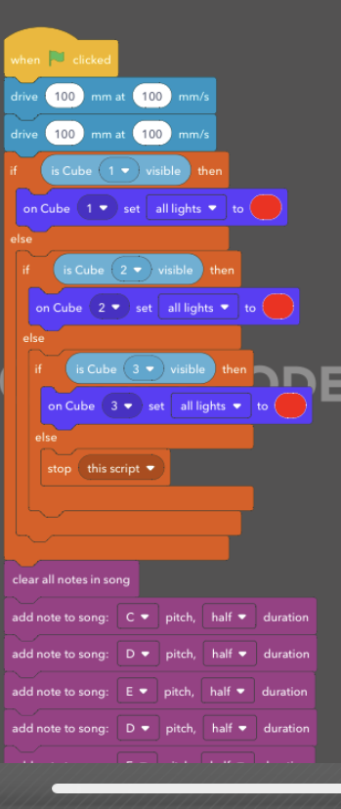
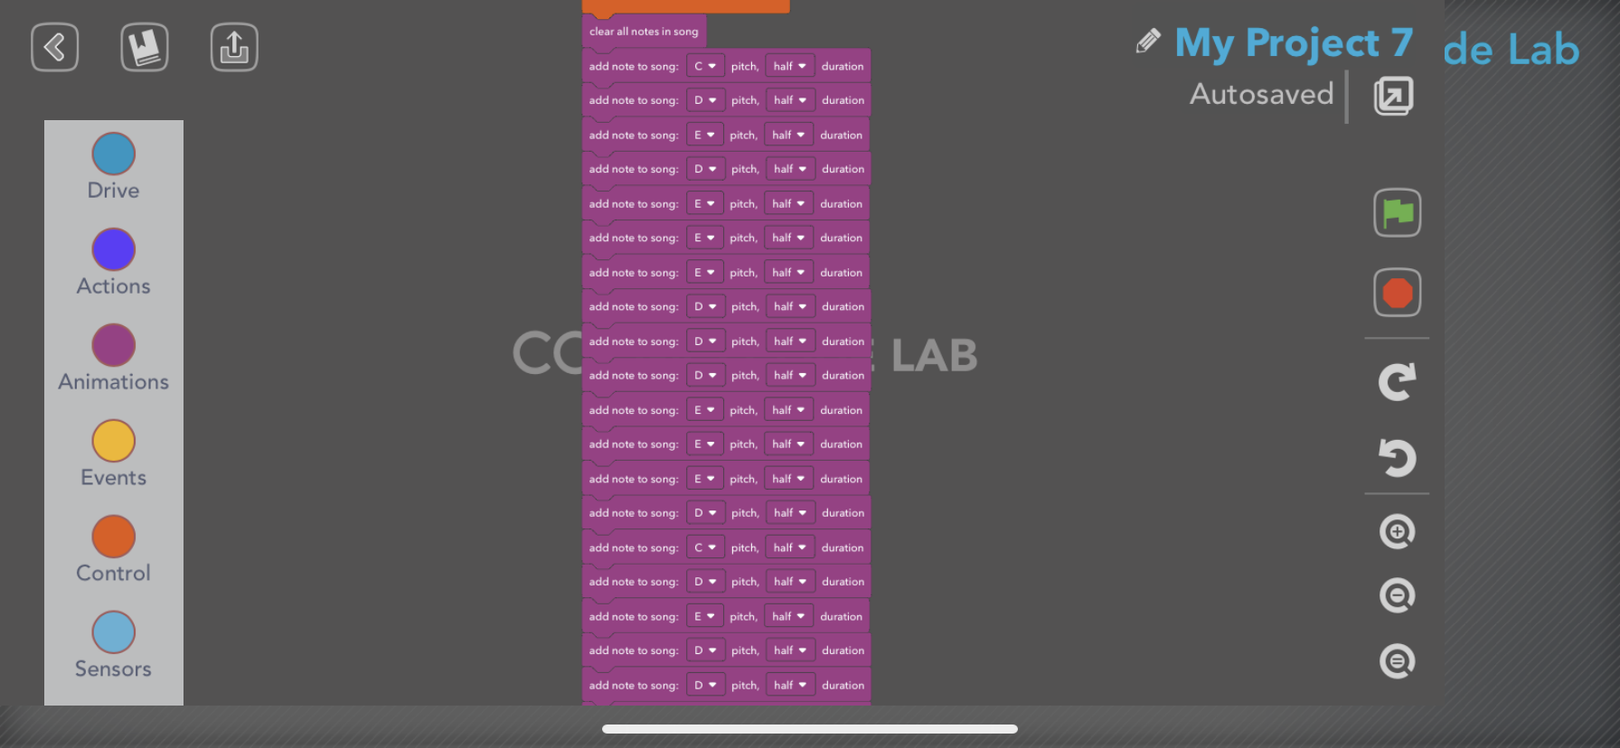
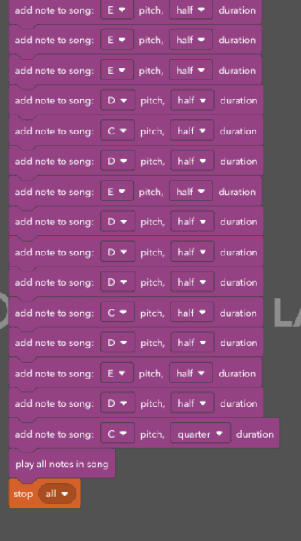
Process
2. Move forward until detect a cube then make that cube light up and sing song ( mary had a little lamb)

Slide 6
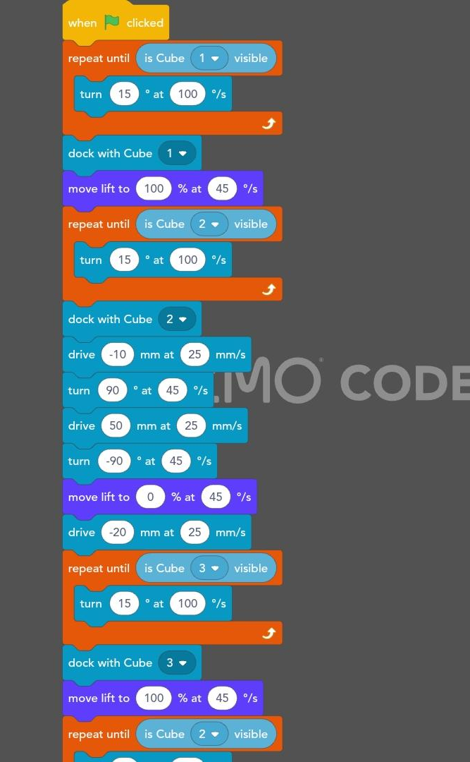
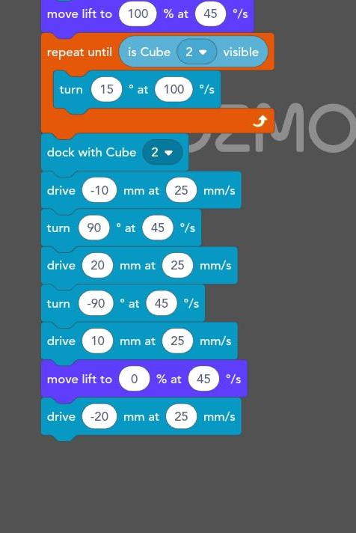
Process
Pyramid

Slide 7
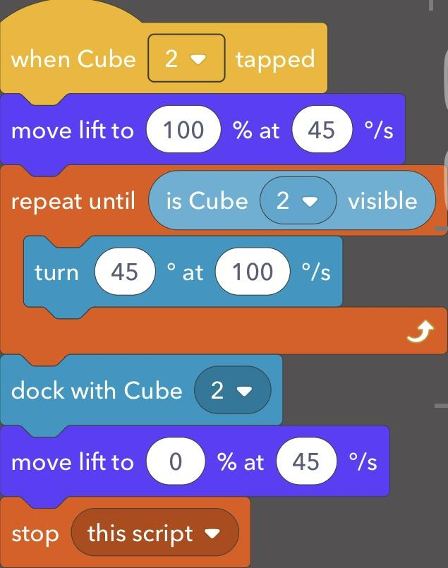
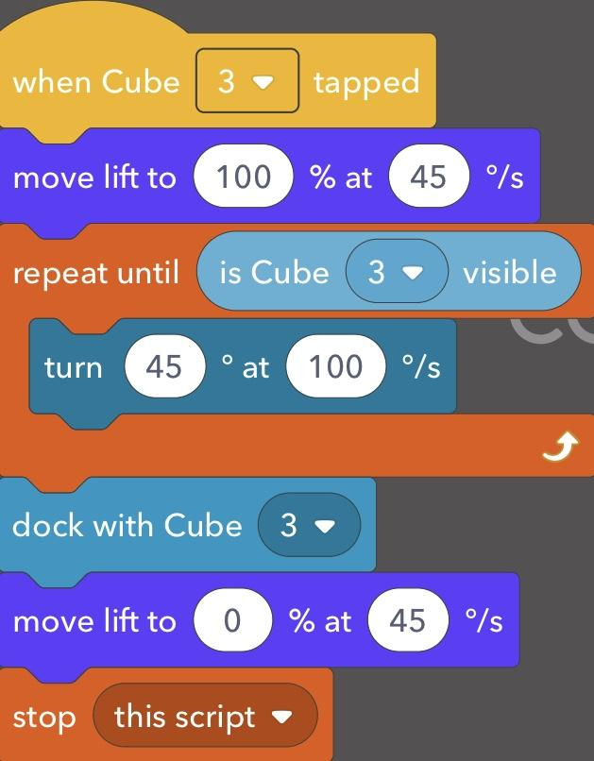
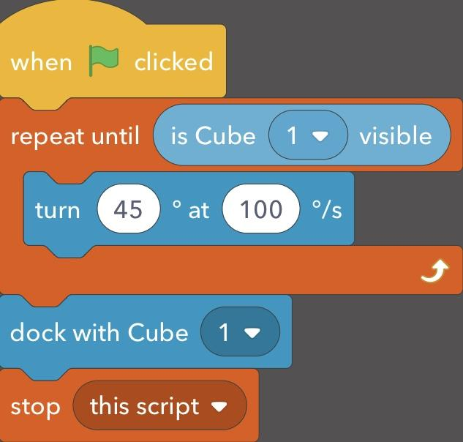
Process
Predefine a cube to pick up. After pick up, user will tap and then cozmo will stack on that cube.
Notes:
HuiQi

Slide 8
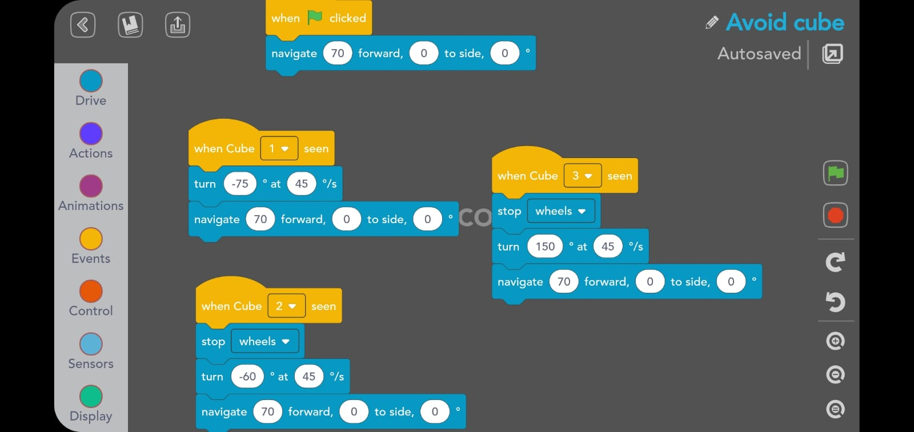
Process
Will move forward
Once it detect any cube, it will avoid the cube

Slide 9
Difficulties faced
It took awhile to understand the codes so we had to try out the codes to see what it does
Didn’t understand some of the codes which made it difficult
Sometimes it does not do what it wants you to do
Difficult to gauge the angle for the cube to turn
It was not easy to make a song

Slide 10
Thank you

