Slide 1
Artificial Intelligence in Fintech Exam (1)
Shaif Chowdhury

Slide 2
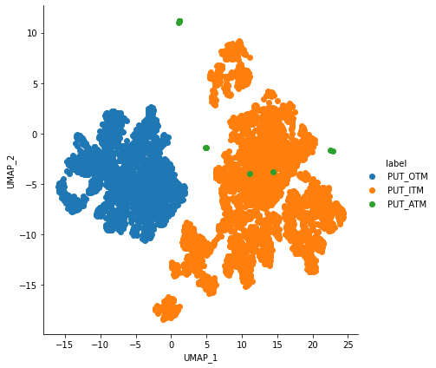
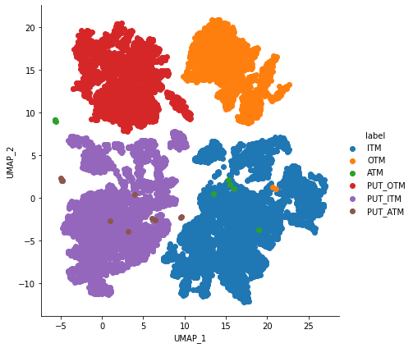
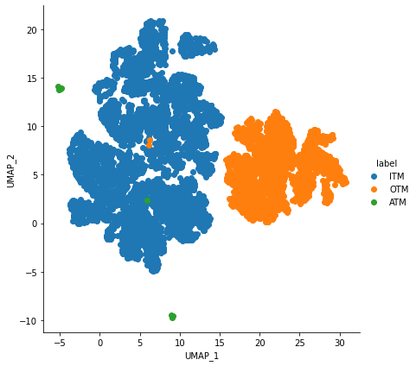
UMAP nei = 30, dist = 1
Full Dataset Call Option Put Option

Slide 3
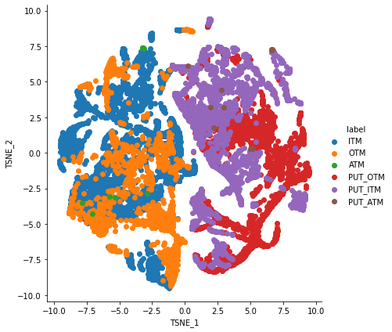
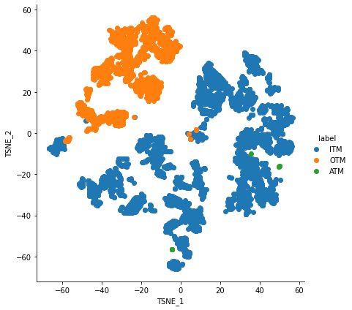
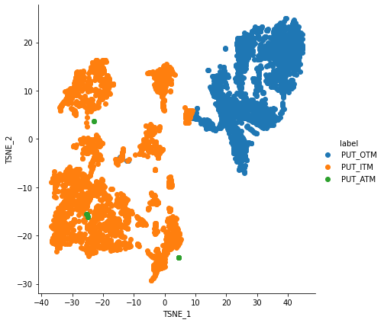
TSNE perplexity = 60
Full Dataset Call Option Put Option

Slide 4
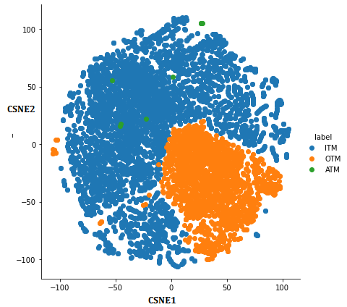
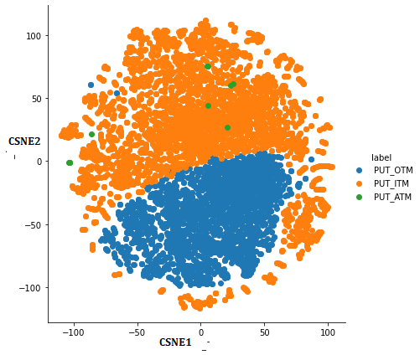
CSNE perplexity = 90 t=0, s= 0
Call Option Put Option

Slide 5
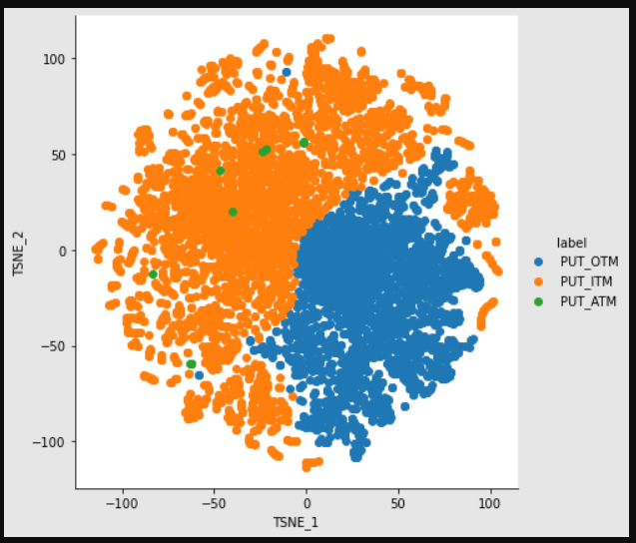
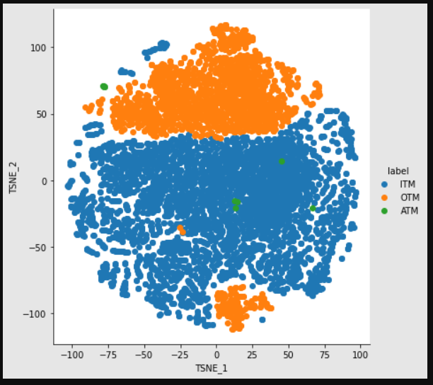
T =10 s =10 t =0 s = 10
Put Option Call Option

Slide 6
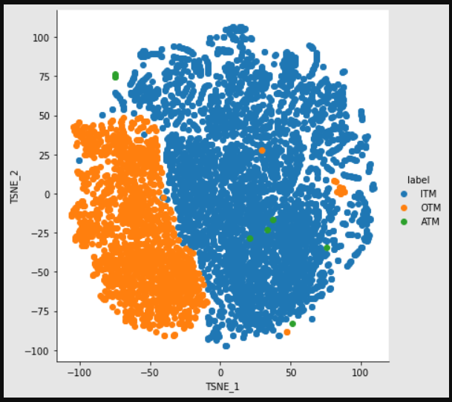
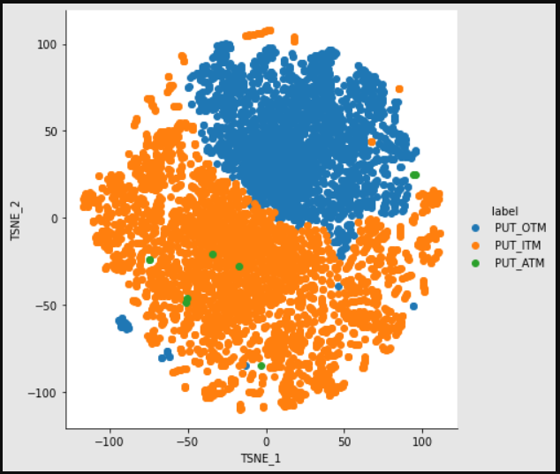
T =10 s =1000 t =1 s = 10
Call Option Put Option

Slide 7
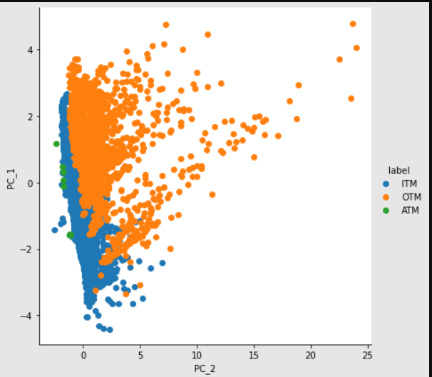
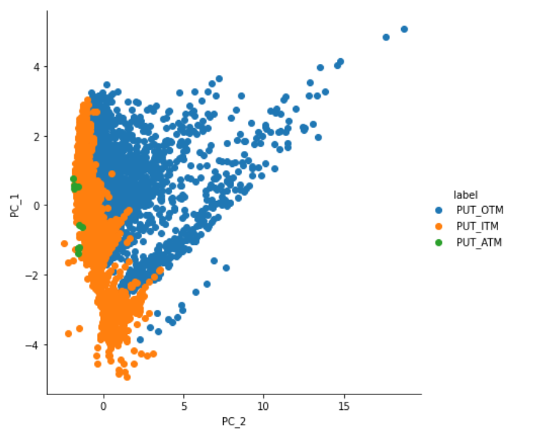
PCA
Call Option Put Option

Slide 8
What Can you find ?
I believe UMAP does a better job of separating the clusters than other methods.
T-SNE preserves local structure in the data.
UMAP would preserve both local and most of the global structure.

Slide 9
SVM
Total Dataset : 1. MSE: 0.016090432662343515 2. R2: 0.5398899609492142
ITM : 1. MSE: 0.01746852801976977 2. R2: 0.5666898019513156
OTM : 1. MSE: 0.014036382482041858 2. R2: 0.588525291623401

Slide 10
Nearest Neighbour
Total Dataset : 1. MSE: 0.011020712656361826 2. R2: 0.6848599017133208
OTM : 1. MSE: 1. MSE: 0.01007707724861122 2. R2: 0.704591804372263
ITM : 1. MSE: 0.01698161722847595 2. R2: 0.578767717799107

Slide 11
Random Forest
1. MSE 2. R2 7221.205880976808 -206491.22986189643

Slide 12
MLP
Total Dataset : 1. MSE: 0.01198626655572063 2. R2: 0.6572496409041553
OTM : 1. MSE: 0.008161537184342886 2. R2: 0.760745609694747
ITM : 1. MSE: 0.012747412083849937 2. R2: 0.6837979909692465

Slide 13
Gradient Boosting
Total Dataset : 1. MSE: 0.06762502265930194 2. R2: -0.9337548262080051
OTM : 1. MSE: 0.012747412083849937 2. R2: 0.6837979909692465
ITM : 1. MSE: 0.05815570622408339 2. R2: -0.704826887526427

Slide 14
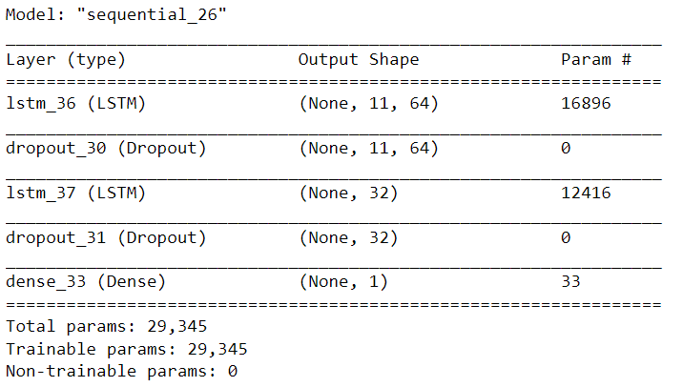
LSTM
1. MSE 2. R2 : 0.011144819115242238 0.6813110457664227

Slide 15
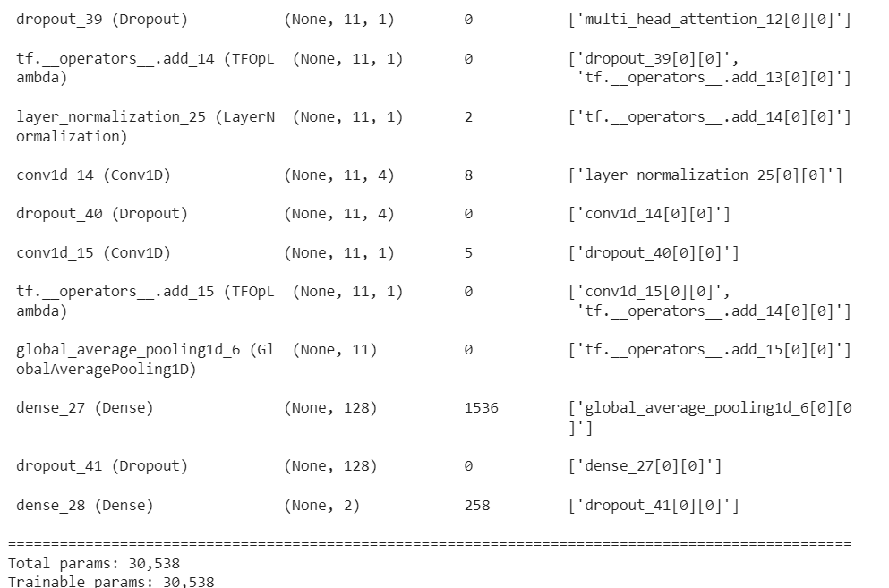
Transformer 1
head_size=256,
num_heads=4,
ff_dim=4,
num_transformer_blocks=4,
mlp_units=[256],
mlp_dropout=0.4,
dropout=0.25,
1. MSE 2. R2 : 0.014810904443471226 0.5764783977617123

Slide 16
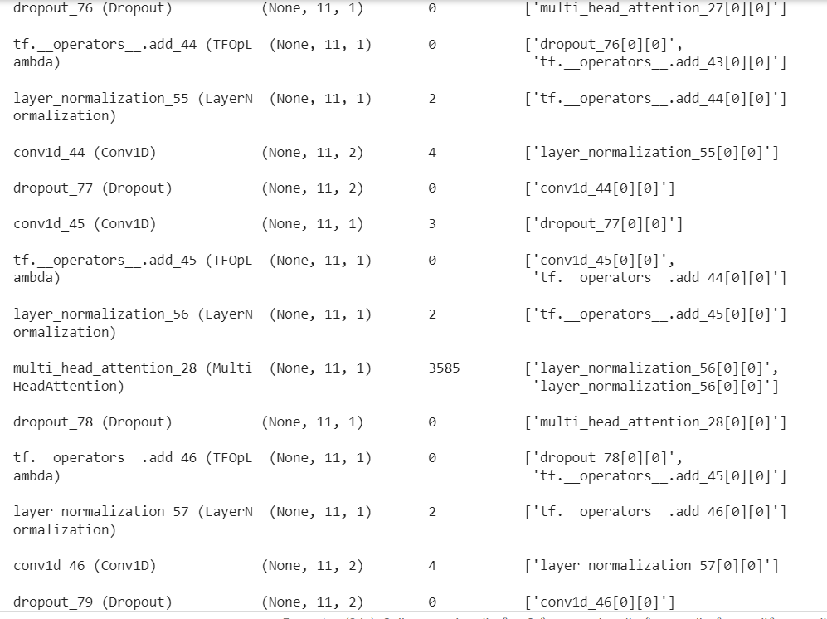
Transformer 2
head_size=128,
num_heads=4,
ff_dim=2,
num_transformer_blocks=8,
mlp_units=[128],
mlp_dropout=0.4,
dropout=0.25,
1. MSE 2. R2 : 0.014780902343461215 0.5754571977617191

Slide 17
RESNET
resnet = tf.keras.applications.resnet50.ResNet50(
include_top=False,
input_tensor=None,
input_shape=(None),
pooling=None
)
for layer in resnet.layers[:-4]:
layer.trainable = False
#model.summary()
model = Sequential()
model.add(Dense (500, input_shape=(11,)))
model.add(Dense (3072, activation='relu'))
model.add(Reshape((32,32,3)))
model.add(resnet)
model.add(Dense (32, activation='relu'))
#Final Dense Layer
model.add(Dropout(.2))
model.add(Dense(1, activation="linear"))
Results :
1. MSE 2. R2 : 0.035161400956146255 -0.005449257115035522

Slide 18
Feature Interpolation : On SVM
Call Option Intrinsic Value=USC−CS
where:
USC=Underlying Stock’s Current Price
CS=Call Strike Price
​
Time Value=Option Price−Intrinsic Value
1. MSE: 0.015800232532311316 2. R2: 0.5400179406493346
Slight Improvement

Slide 19
integrate machine learning methods to get better learning results
SVM + KNN + MLP + gradient Boosting
Average of predictions as final result :
Average of results :
1. MSE: 0.00951646417957406 2. R2: 0.7278742718002529

Slide 20

References
https://keras.io/examples/timeseries/timeseries_transformer_classification/
https://scikit-learn.org/stable/
https://towardsdatascience.com/lstm-framework-for-univariate-time-series-prediction-d9e7252699e
https://www.tensorflow.org/api_docs/python/tf/keras/applications/resnet50/ResNet50
https://www.investopedia.com/articles/optioninvestor/07/options_beat_market.asp

Slide 21
Thank You

