Slide 1
Artificial Intelligence in Fintech Exam (1)
Shaif Chowdhury

Slide 2
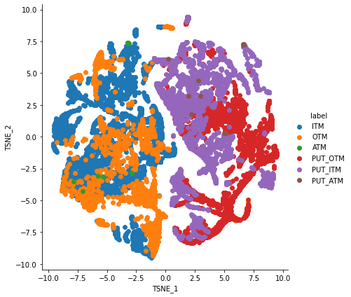
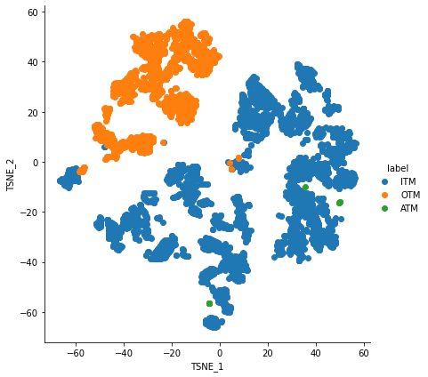
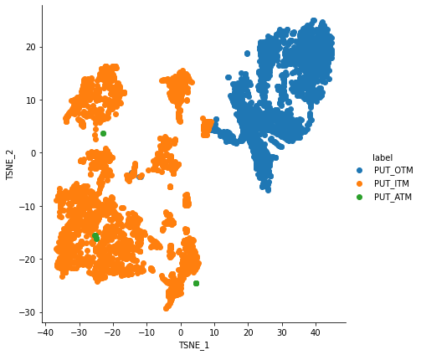
TSNE

Slide 3
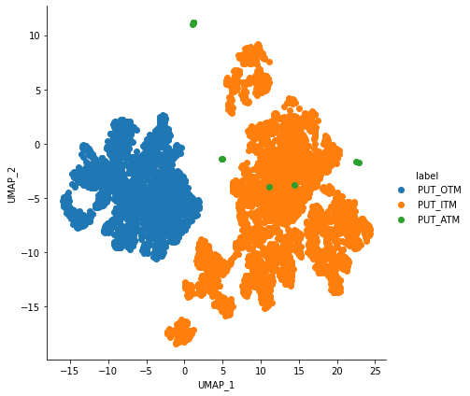
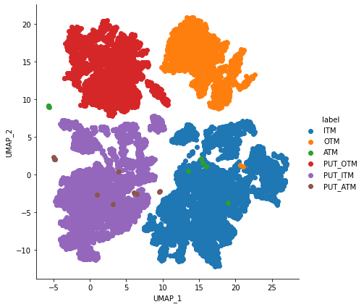
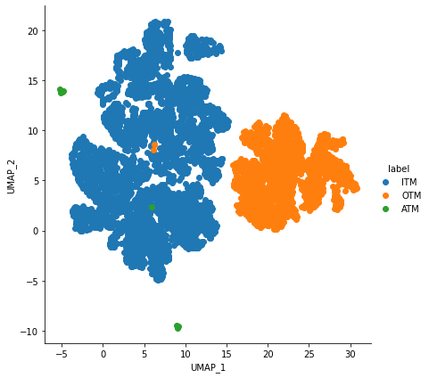
UMAP

Slide 4
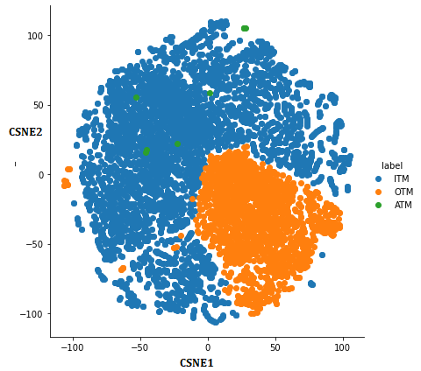
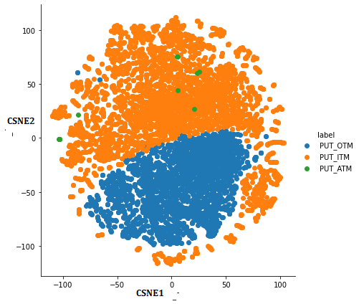
CSNE

Slide 5
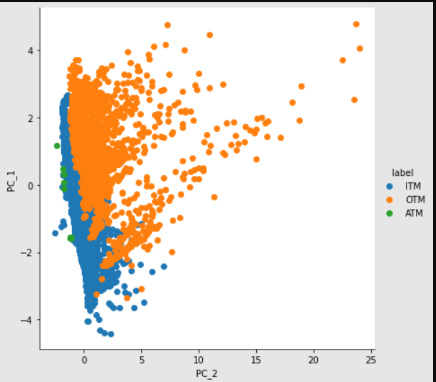
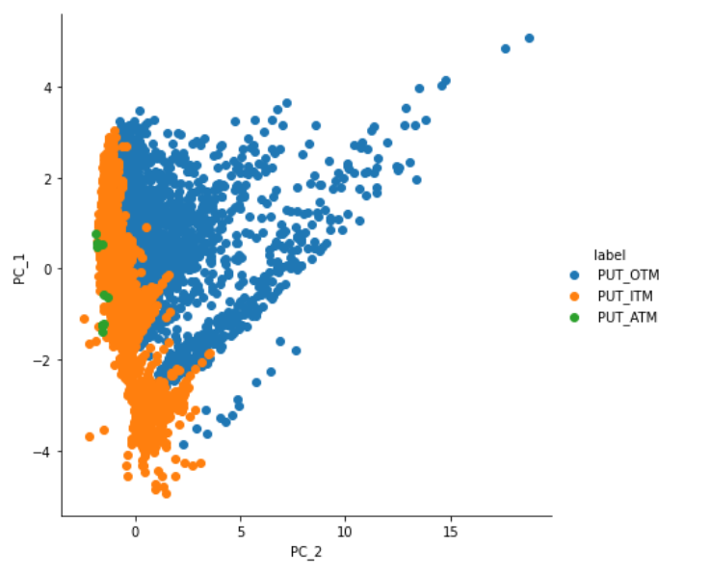
PCA

Slide 6
What Can you find ?
I believe UMAP does a better job of separating the clusters than other methods.
T-SNE preserves local structure in the data.
UMAP would preserve both local and most of the global structure.

Slide 7
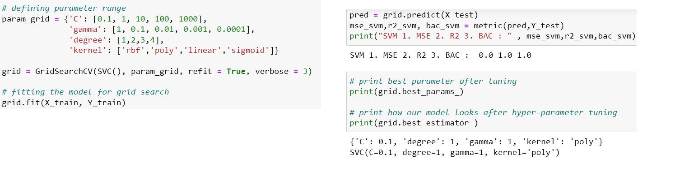
SVM
ITM/OTM
MSE : 0.0 R2 : 1.0 : BAC : 100.0 %
Implied Volatility
(C=1.0, epsilon=0.2)
SVM 1. MSE : 0.004053883908414975 , 2. R2 : 0.88040781523685578

Slide 8
Nearest Neighbour
MSE : 0.00578 R2 : .9955 BAC : 99.26
Implied Volatility
(n_neighbors=2)
1. MSE 0.0010034247690523016 , 2. R2 : 0.9713068119819012

Slide 9
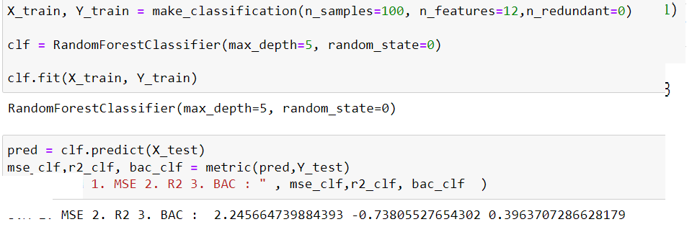
Random Forest
MSE : 2.245 R2 : -0.738 BAC : 39.637
Implied Volatility :
1. MSE : 6668.883513998514 , 2. R2 : -190697.43045501385

Slide 10
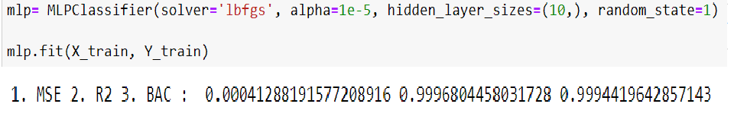
MLP
ITM/OTM :
MSE : 0.000412 R2 : .9996 BAC : 99.94
Implied Volatility
‘lbfgs’ : quasi-Newton methods.
1. MSE : 2.5064146686179925e-05 , 2. R2 : 0.9992832843123267

Slide 11
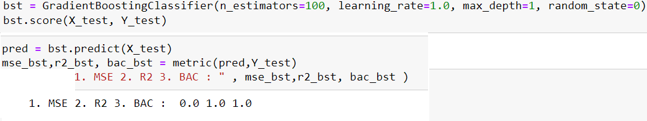
Gradient Boosting
Implied Volatility :
1. MSE : 0.00012098030211499927 , 2. R2 : 0.9965405373057009

Slide 12
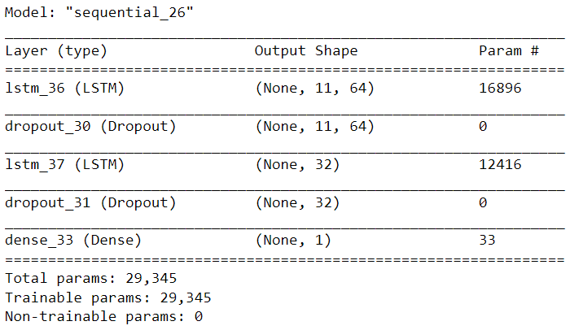
LSTM
After 500 epochs of training
Implied Volatility :
1. MSE : 3.445397482824486e-05
2. R2 : 0.999014779774022

Slide 13
RESNET
resnet = tf.keras.applications.resnet50.ResNet50(
include_top=False,
input_tensor=None,
input_shape=(None),
pooling=None
)
for layer in resnet.layers[:-4]:
layer.trainable = False
#model.summary()
model = Sequential()
model.add(resnet)
model.add(Dense (32, activation='relu'))
#Final Dense Layer
model.add(Dropout(.2))
model.add(Dense(1, activation="linear"))
Results :
1. MSE 2. R2 :
1. 0.38172601948303075
2. 0.0

Slide 14
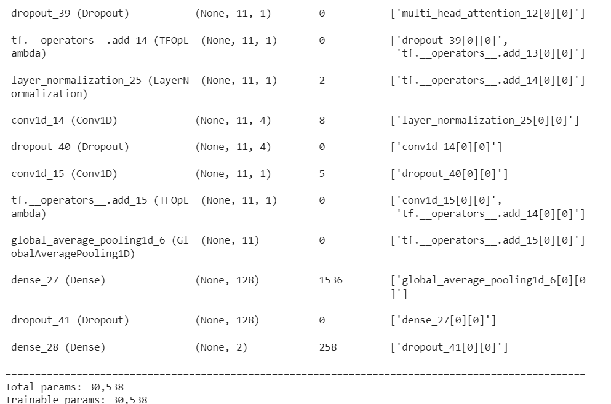
Transformer 1
head_size=256,
num_heads=4,
ff_dim=4,
num_transformer_blocks=4,
mlp_units=[256],
mlp_dropout=0.4,
dropout=0.25,
1. MSE 2. R2 :
0.00013612616657376553 0.9961074374361188

Slide 15
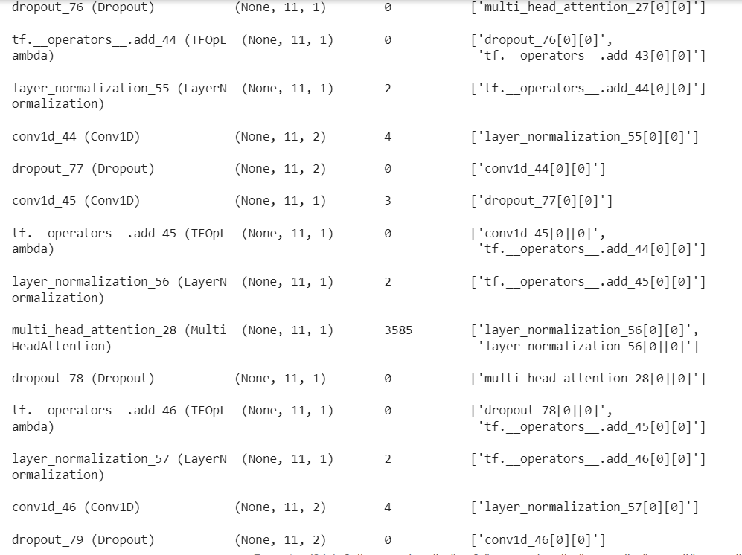
Transformer 2
head_size=128,
num_heads=4,
ff_dim=2,
num_transformer_blocks=8,
mlp_units=[128],
mlp_dropout=0.4,
dropout=0.25,
1. MSE 2. R2 :
0.001373049429059922 0.9607373002528444

Slide 16
Feature Interpolation : On SVM
Call Option Intrinsic Value=USC−CS
where:
USC=Underlying Stock’s Current Price
CS=Call Strike Price
​
Time Value=Option Price−Intrinsic Value
SVM 1. MSE 2. R2 : 0.0041673633935109065 0.8808331774561586
Slight Improvement

Slide 17
Feature Interpolation : On KNN
Implied Volatility
(n_neighbors=2)
1. MSE 0.001002313494123401 , 2. R2 : 0.98410857081213116

Slide 18
integrate machine learning methods to get better learning results
SVM + KNN + MLP + gradient Boosting
Shuffle Dataset (Train_Test Split ) before training.
Cross-Validation
Average of results :
1. MSE 2. R2 : 0.0004127063389560714 , 0.9881985566380707
Percentage improvement compared to SVM = 11%

Slide 19

References
https://keras.io/examples/timeseries/timeseries_transformer_classification/
https://scikit-learn.org/stable/
https://towardsdatascience.com/lstm-framework-for-univariate-time-series-prediction-d9e7252699e
https://www.tensorflow.org/api_docs/python/tf/keras/applications/resnet50/ResNet50
https://www.investopedia.com/articles/optioninvestor/07/options_beat_market.asp

Slide 20
Thank You

