Slide 1
Artificial Intelligence in Fintech Quiz (4)
Shaif Chowdhury

Slide 2
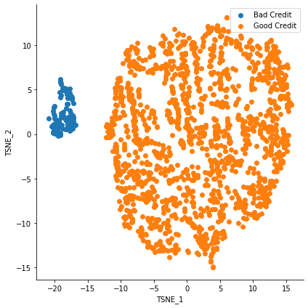
TSNE
Perplexity = 60

Slide 3
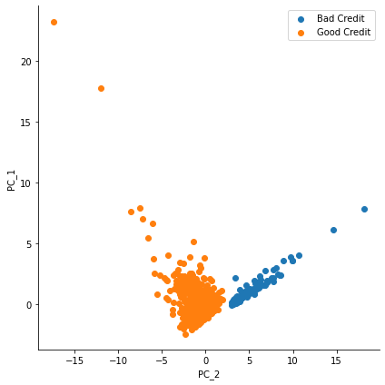
PCA

Slide 4
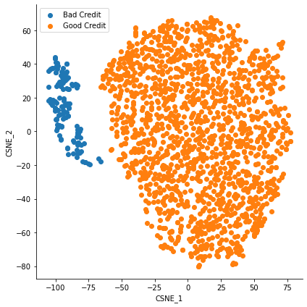
CSNE
( 10 , 1 )
Perplexity = 50

Slide 5
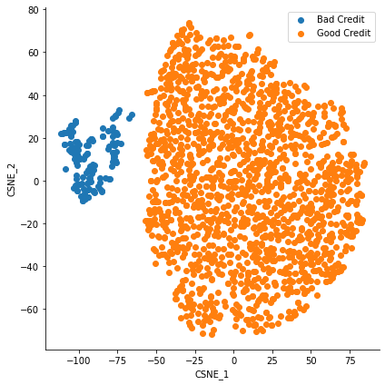
CSNE
( 1 , 0 )
Perplexity = 50

Slide 6
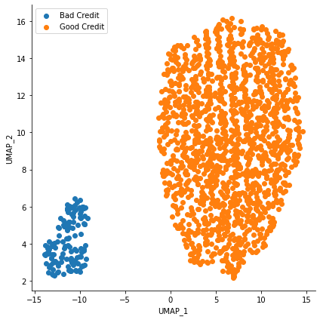
UMAP
n_neighbors=30, min_dist=1

Slide 7
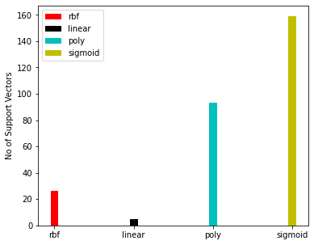
SVM
k_fold_ = 10
kernel = ['rbf','linear','poly','sigmoid']

Slide 8
SVM
kernel = [ 'rbf','linear','poly','sigmoid',cosine,custom,tanH ]
Custom kernel = linear * tanH = X.dot(Y)*np.tanh(X.dot(Y))
10-Fold Cross validation
Grid Search param = {'C': [10,1,.1,.001],}

Slide 9
SVM
RBF :
SVC(C=10)
Metrics ： Accuracy Sensitivity Specificity F1_Score D_Index ):
[1.0, 1.0, 1.0, 1.0, 2.0]

Slide 10
SVM
SVC(C=10, kernel='linear')
Linear :
Metrics ： Accuracy Sensitivity Specificity F1_Score D_Index ):
[1.0, 1.0, 1.0, 1.0, 2.0]

Slide 11
SVM
Poly :
SVC(C=10, kernel='poly')
Metrics ： Accuracy Sensitivity Specificity F1_Score D_Index ):
[0.9700598802395209, 0.9684542586750788, 1.0, 0.9839743589743589, 1.966816658001071]

Slide 12
SVM
SVC(C=1, kernel='sigmoid')
Sigmoid :
Metrics ： Accuracy Sensitivity Specificity F1_Score D_Index ):
[0.9401197604790419, 0.9388379204892966, 1.0, 0.9684542586750788, 1.933915763027107]

Slide 13
SVM
SVC(C=10, kernel=<function cosine at 0x00000295B2B1A9D0>)
Cosine :
Metrics ： Accuracy Sensitivity F1_Score ):
[0.9191616766467066, 0.9191616766467066, 0.9578783151326054]

Slide 14
SVM
SVC(C=10, kernel=<function tanH at 0x00000295B2B1AAF0>)
TanH :
Metrics ： Accuracy Sensitivity F1_Score ):
[0.9191616766467066, 0.9191616766467066, 0.9578783151326054]

Slide 15
SVM : Custom Kernel Gives 100 % Accuracy
Custom Kernel : Linear * TanH
SVC(C=10, kernel=<function custom at 0x00000295B2B1A5E0>)
Kernel = X.dot(Y)*np.tanh(X.dot(Y))
Custom Kernel :
Metrics ： Accuracy Sensitivity Specificity F1_Score D_Index ):
[1.0, 1.0, 1.0, 1.0, 2.0]

Slide 16
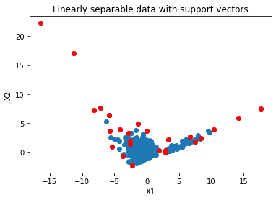
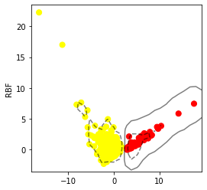
RBF : Support vectors Hyperplane

Slide 17
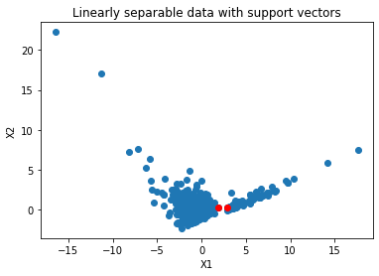
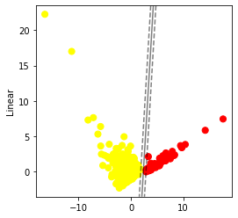
Linear : Support vectors Hyperplane

Slide 18
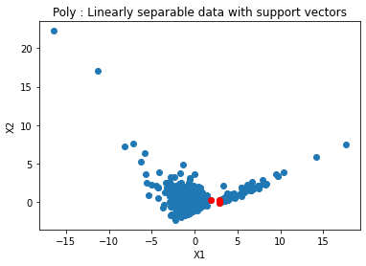

Poly : Support vectors Hyperplane

Slide 19
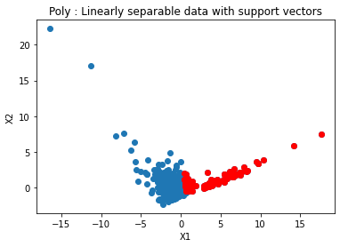
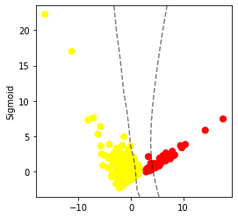
Sigmoid : Support vectors Hyperplane

Slide 20
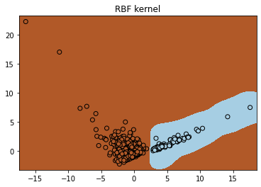
RBF

Slide 21
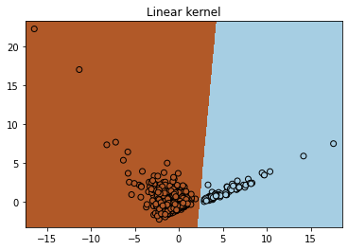
Linear

Slide 22

Polynomial

Slide 23
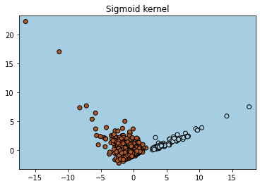
Sigmoid

Slide 24
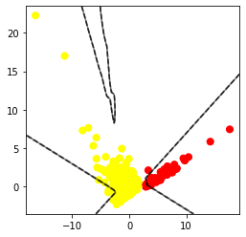
Custom : Hyperplane

Slide 25
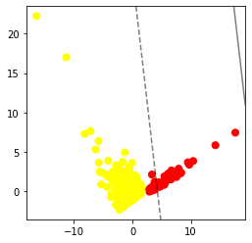
Cosine : Hyperplane

Slide 26
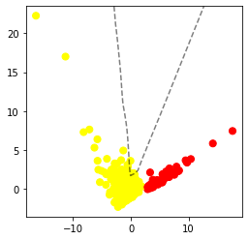
TanH : Support vectors Hyperplane

Slide 27
IRIS Data :
Label No of observation
2 50
1 20
0 50
Positive class = 1
Best param :
{'C': 0.1, 'kernel': 'linear'}
D_index = 1.93
Positive class = 0
Best param :
{'C': 10, 'kernel': 'poly'}
D_index = 2

Slide 28
D-index in k − class classification is [2log2( k+1 / k ), 2]
So, D-index = log2 (1 + a ) + log2 ( 1 + (s+p)/2 )
So, for the worst case of k classes a = 1/k
S = p = 1/k
So, D-index = log2 ( 1 + 1/k ) + log2 ( 1 + (1/k + 1/k)/2 )
= log2 (1 + 1/k) + log2 (1 + 1/k)
= 2 log2 ( k+1 / k )
For the best case a = 1 s=p = 1
D-index = log2 (2) + log ( 1 + 1 )
= 2

Slide 29
The d-index has the range: [log2( 3(γ+1) 2 ) − ε, 2]
So, D-index = log2 (1 + a ) + log2 ( 1 + (s+p)/2 )
So, if majority ratio γ >> 0 in a binary classification, then assume that in worst case the model completely overfits to the majority class.
Here, Accuracy a = γ , s = 0 , p = 1
So, D-index = log2 (1 + γ ) + log2 ( 1 + + 1/2 )
= log2(1 + γ ) + log2 (3/2) = log2 ( 3(γ+1) 2 )

Slide 30
Appendix :
from sklearn.model_selection import GridSearchCV
from sklearn.svm import SVC
from numpy.linalg import norm
from numpy import dot
def cosine(X, Y):
Y = Y.T
r = X.dot(Y)/(np.linalg.norm(X)*np.linalg.norm(Y))
return r
def tanH(X,Y):
Y= Y.T
return np.tanh(X.dot(Y))
def custom(X,Y):
Y= Y.T
return X.dot(Y)*np.tanh(X.dot(Y))
k_fold_ = 10
#
kernel = [ 'rbf','linear','poly','sigmoid',cosine,custom,tanH ]
param = {'C': [10,1,.1,.001],}
rs = []
for i in range(0,len(kernel)):
sv = SVC(kernel=kernel[i])
clf = GridSearchCV(sv,param,cv = k_fold_)
clf.fit(X_train, Y_train)
rs.append(clf)

Slide 31
def plot_svc_decision_function(model, ax=None, plot_support=True):
"""Plot the decision function for a 2D SVC"""
if ax is None:
ax = plt.gca()
xlim = ax.get_xlim()
ylim = ax.get_ylim()
# create grid to evaluate model
x = np.linspace(xlim[0], xlim[1], 30)
y = np.linspace(ylim[0], ylim[1], 30)
Y, X = np.meshgrid(y, x)
xy = np.vstack([X.ravel(), Y.ravel()]).T
P = model.decision_function(xy).reshape(X.shape)
# plot decision boundary and margins
ax.contour(X, Y, P, colors='k',
levels=[-1, 0, 1], alpha=0.5,
linestyles=['--', '-', '--'])
# plot support vectors
if plot_support:
ax.scatter(model.support_vectors_[:, 0],
model.support_vectors_[:, 1],
s=300, linewidth=1, facecolors='none');
ax.set_xlim(xlim)
ax.set_ylim(ylim)

Slide 32
from sklearn.metrics import confusion_matrix
from sklearn.metrics import accuracy_score
from sklearn.metrics import precision_recall_fscore_support
from sklearn.metrics import precision_recall_fscore_support
import math
def metric(pred,true):
acc = accuracy_score(true, pred)
y = precision_recall_fscore_support(true, pred)
sen = np.mean(y[2])
spc = np.mean(y[1])
cal = math.log2(1+acc) + math.log2(1 + ( (sen+spc) /2 ) )
D_index = cal * (-1)
return D_index
from sklearn.model_selection import GridSearchCV
from sklearn.svm import SVC
from sklearn.metrics import make_scorer
my_func = make_scorer(metric2, greater_is_better=False)
param = {
'C': [10,1,.1,.001],
'kernel' : ['rbf','linear','poly','sigmoid']
}
rs = []
import warnings
warnings.filterwarnings('ignore')
clf = GridSearchCV(SVC(),param,scoring = my_func)
clf.fit(data,label)

Slide 33
support_vectors =rs[0].best_estimator_.support_vectors_
# Visualize support vectors
plt.scatter(Xt[:,0], Xt[:,1])
plt.scatter(support_vectors[:,0], support_vectors[:,1], color='red')
plt.title('Linearly separable data with support vectors')
plt.xlabel('X1')
plt.ylabel('X2')
plt.show()

Slide 34
h = 0.02
X = Xt
Y = Y_train
x_min, x_max = X[:, 0].min() - 1, X[:, 0].max() + 1
y_min, y_max = X[:, 1].min() - 1, X[:, 1].max() + 1
xx, yy = np.meshgrid(np.arange(x_min, x_max, h), np.arange(y_min, y_max, h))
Z = rs[0].best_estimator_.predict(np.c_[xx.ravel(), yy.ravel()])
# Put the result into a color plot
Z = Z.reshape(xx.shape)
plt.pcolormesh(xx, yy, Z, cmap=plt.cm.Paired)
# Plot also the training points
plt.scatter(X[:, 0], X[:, 1], c=Y, cmap=plt.cm.Paired, edgecolors="k")
plt.title("Classification using Support Vector Machine with custom kernel")
plt.axis("tight")
plt.show()

Slide 35
References
https://www.geeksforgeeks.org/svm-hyperparameter-tuning-using-gridsearchcv-ml/
https://github.com/christianversloot/machine-learning-articles/blob/main/how-to-visualize-support-vectors-of-your-svm-classifier.md
https://jakevdp.github.io/PythonDataScienceHandbook/05.07-support-vector-machines.html
https://scikit-learn.org/stable/auto_examples/svm/plot_linearsvc_support_vectors.html
https://scikit-learn.org/stable/modules/generated/sklearn.svm.SVC.html

Slide 36

Thank You

