Slide 1
Artificial Intelligence in Fintech Quiz (5)
Shaif Chowdhury

Slide 2
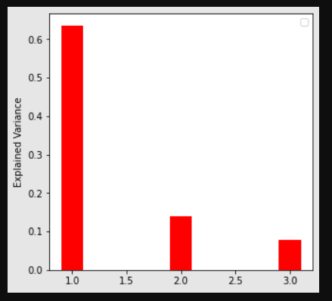
Option Data : Variance
OptionData12110

Slide 3
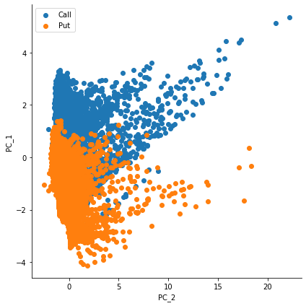
Option Data PCA

Slide 4
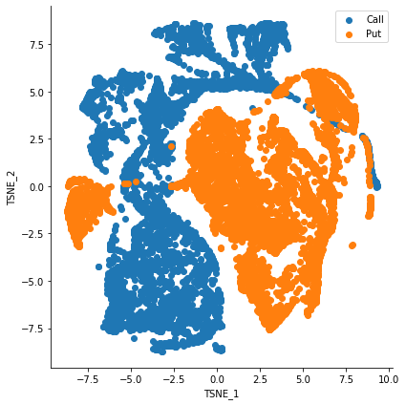
Option data TSNE
Perplexity = 90

Slide 5
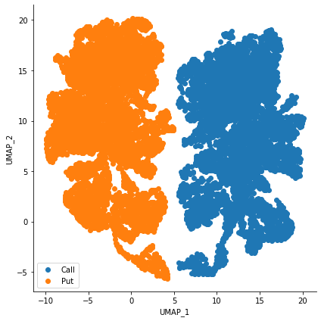
Option data UMAP
30,1

Slide 6
Hierarchical Learning with Option Data
HL :
Points with top errors are bad guys.
N = 50 (No of bad guys).
For each bad guy I find nearest points with 1 KNN (KD tree based) .
Remove bad guys and their neighbours.
Train again.
Adaptive Learning :
Created a custom training set for each bad point with train_test + 1KNN
BTC dataset here is really small with only 354 observations. And I have used 25 % split twice. So, I felt it’s better to go with 1 KNN

Slide 7
Code for HL and Adaptive learning
def get_res(i,sv):
neib = []
for i in range(0,len(bad)):
distance,index = spatial.KDTree(X_train).query(bad[i])
neib.append(index)
nei = np.array( X_train[index]).reshape(1,10)
nei_y = np.array( Y_train[index]).reshape(1,)
xt = np.concatenate((X_train_ts,nei), axis=0)
yt = np.concatenate((Y_train_ts,nei_y), axis=0)
regr = sv()
regr.fit(xt, yt)
p = regr.predict(X_test_bad[i].reshape(1,10))
return p
def adapt(sv):
pred_bad = np.array([])
for i in range(0,len(X_test_bad)):
k = get_res(i,sv)
pred_bad = np.concatenate((pred_bad,k),axis = 0)
p2 = regr.predict(X_test_bad)
mse1 = mean_squared_error(Y_test_bad, pred_bad)
mse2 = mean_squared_error(Y_test_bad, p2)
bar4 = plt.bar("Classifier Result",mse2 , color= 'r', width = .28)
bar5 = plt.bar('Adaptive Learning', mse1, color= 'b',width = .28)
plt.legend( (bar4,bar5), ( mse2,mse1) )
plt.ylabel("MSE Error")
plt.show()
def hl(regr,sv,n,X_train_tr, X_train_ts, Y_train_tr, Y_train_ts,X_train, X_test, Y_train, Y_test):
test_res = regr.predict(X_train_ts)
errors = []
for i in range(0,len(X_train_ts)):
err = abs ( test_res[i] - Y_train_ts[i] )
errors.append(err)
errors = np.array(errors)
idx = (-errors).argsort()[:n]
bad = np.array( X_train_ts)[idx]
neib = []
for i in range(0,len(bad)):
distance,index = spatial.KDTree(X_test).query(bad[i])
neib.append(index)
X_test_bad = np.array( X_test)[neib]
Y_test_bad = np.array( Y_test)[neib]
X_test = np.delete( X_test,neib, axis=0)
Y_test = np.delete( Y_test,neib, axis=0)
xt = np.concatenate((X_train_tr,X_train_ts), axis=0)
yt = np.concatenate((Y_train_tr,Y_train_ts), axis=0)
regr = sv()
regr.fit(xt, yt)
pred= regr.predict(X_test)
mse = mean_squared_error(Y_test, pred)
r = r2_score(Y_test, pred)
return mse,r,X_test_bad,Y_test_bad,bad

Slide 8
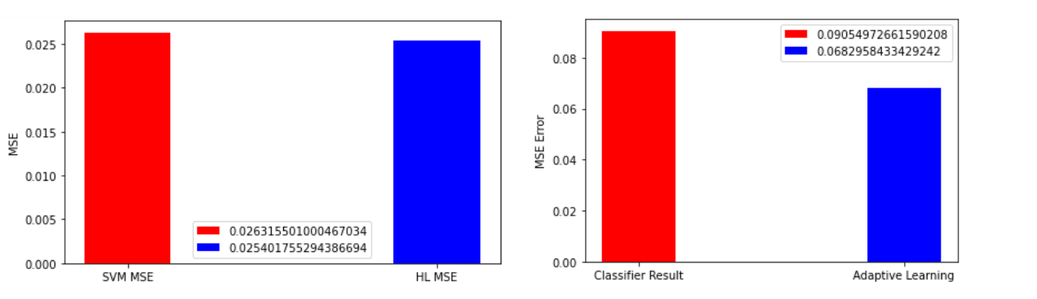
OptionData12110 HL SVM SVM C=5,kernel='linear'
datagen()
m1,r1,reg = svm()
m2,r2,X_test_bad,Y_test_bad,bad = hl(reg,svr,n,X_train_tr, X_train_ts, Y_train_tr, Y_train_ts,X_train, X_test, Y_train, Y_test)
plot1("SVM",m1,m2)
#plot2("SVM",r1,r2)
adapt(svr)

Slide 9
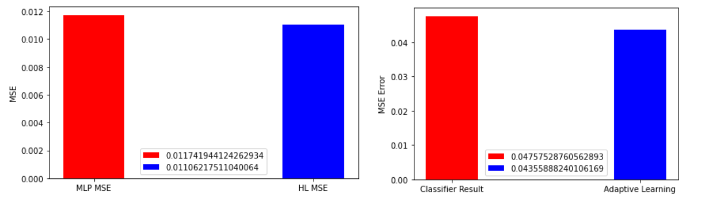
OptionData12110 HL MLP
datagen()
m1,r1,reg = mlp()
m2,r2,X_test_bad,Y_test_bad,bad = hl(reg,mlp_p,n,X_train_tr, X_train_ts, Y_train_tr, Y_train_ts,X_train, X_test, Y_train, Y_test)
plot1("MLP",m1,m2)
#plot2("SVM",r1,r2)
adapt(mlp_p)

Slide 10
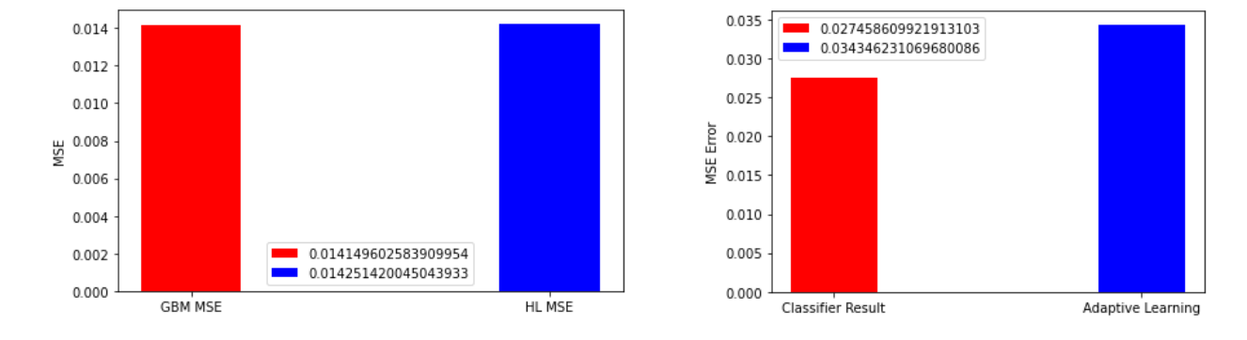
OptionData12110 HL GBM
datagen()
m1,r1,reg = gdr()
m2,r2,X_test_bad,Y_test_bad,bad = hl(reg,gdr_p,n,X_train_tr, X_train_ts, Y_train_tr, Y_train_ts,X_train, X_test, Y_train, Y_test)
plot1("GBM",m1,m2)
#plot2("SVM",r1,r2)
adapt(gdr_p)

Slide 11
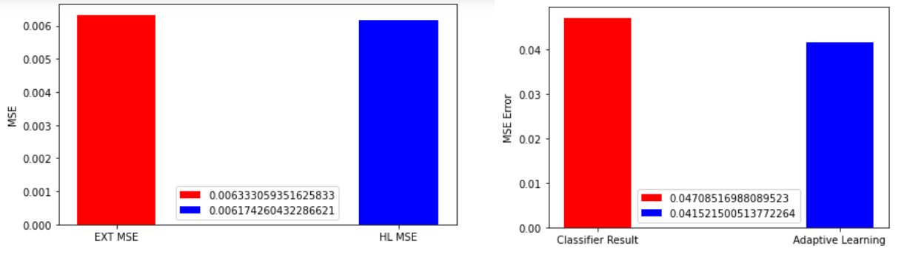
OptionData12110 HL Extra Tree
datagen()
m1,r1,reg = ext()
m2,r2,X_test_bad,Y_test_bad,bad = hl(reg,ext_p,n,X_train_tr, X_train_ts, Y_train_tr, Y_train_ts,X_train, X_test, Y_train, Y_test)
plot1("EXT",m1,m2)
#plot2("SVM",r1,r2)
adapt(ext_p)

Slide 12
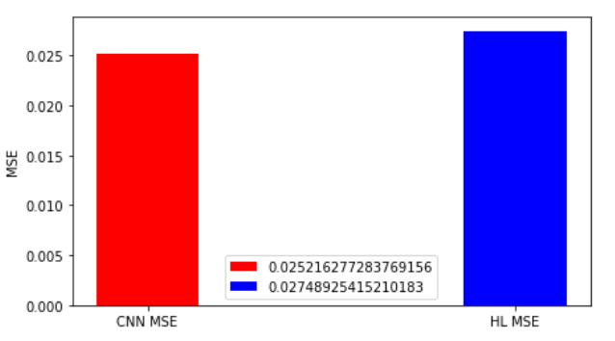
OptionData12110 HL CNN
def cnn():
model = Sequential()
model.add(Conv1D(16, kernel_size=3, activation='relu', input_shape=(10,1)))
model.add(Flatten())
model.add(Dense(1, activation='linear'))
model.compile(optimizer='adam', loss='mse', metrics=['accuracy'])
model.fit( X_train, Y_train, epochs=1)
regr= model
pred= regr.predict(X_test)
mse = mean_squared_error(Y_test, pred)
print(mse)
r = r2_score(Y_test, pred)
return mse,r,regr

Slide 13
Feature Interpolation OptionData12110
Skewness
Curtosis
Intrinsic value =Stock Price - Strike Price
def datagen2():
OOP_df = pd.read_csv('OptionData12110.csv')
OOP_df = OOP_df.dropna()
OP_df = OOP_df
OP_df = OP_df.drop(['Implied_volatility'], axis = 1)
data = OP_df
data["kurt"] = data.kurtosis(axis = 1, skipna = True)
data = data.dropna()
data["skew"] = data.skew(axis = 1, skipna = True)
data = data.dropna()
data["in"] = data["Stock_price"] - data["Strike_price"]
from sklearn.model_selection import train_test_split
X = StandardScaler().fit_transform ( data )
Y = np.array(OOP_df['Implied_volatility'])
X_train, X_test, Y_train, Y_test = train_test_split( X, Y, test_size=0.25, random_state=42)
X_train_tr, X_train_ts, Y_train_tr, Y_train_ts = train_test_split( X_train, Y_train, test_size=0.25, random_state=40)
return X_train_tr, X_train_ts, Y_train_tr, Y_train_ts,X_train, X_test, Y_train, Y_test

Slide 14
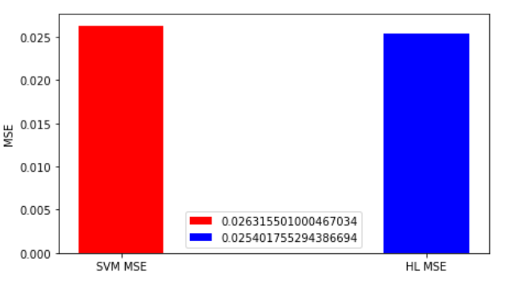
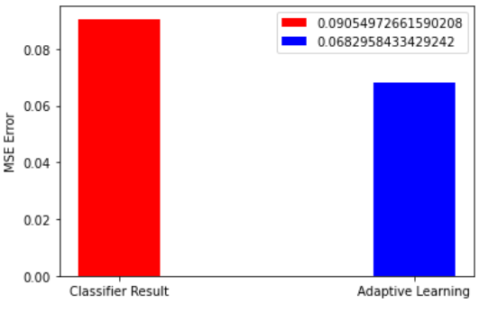
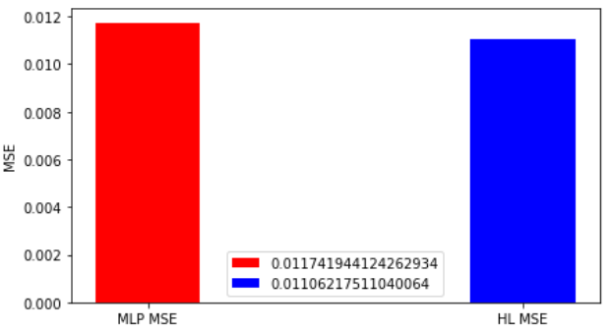
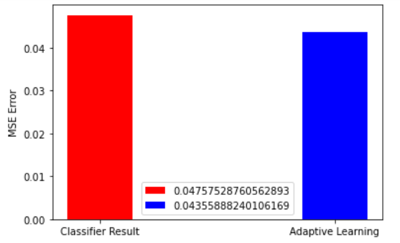
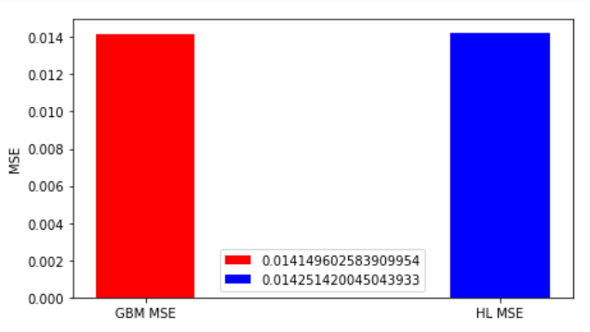
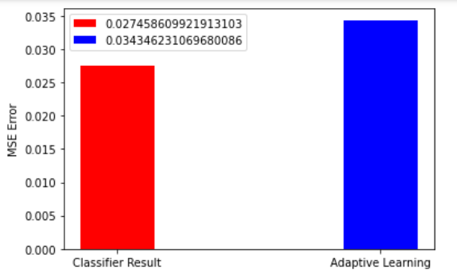
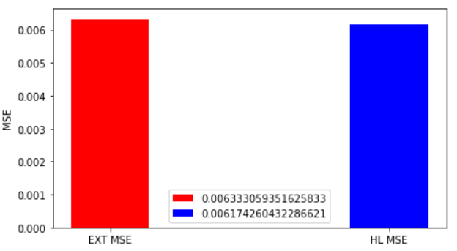
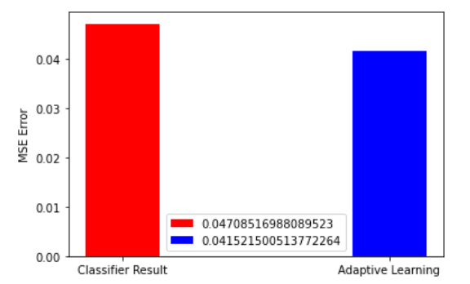
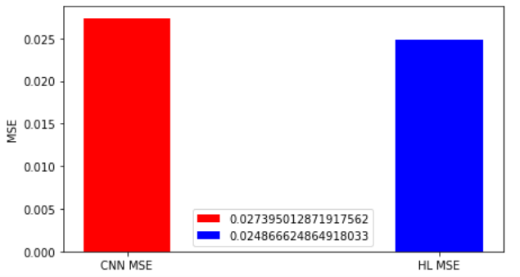
SVM 2. MLP 3. GBM 4. EXT Feature Interpolation: HL followed by Adaptive Learning.
CNN :

Slide 15
Distance Function : 1. Gaussian 2. Kernel : Linear*TanH
def distance(p1,p2):
mse = np.linalg.norm( np.array(p1) - np.array(p2) )
return mse
def cosine(X, Y):
Y= Y.T
return X.dot(Y)*np.tanh(X.dot(Y))
def getNearest(x, p,ne) :
err = distance(x,p[0])
z = 0
res = 0
n = np.array(ne)
for i in range(1,len(p)):
if((i in n)):
z = i
else:
e = distance(x,p[i])
if(e < err ):
res = i
return res
def distance(p1,p2):
x = np.array(p1)
y = np.array(p2)
return cosine(x,y)

Slide 16
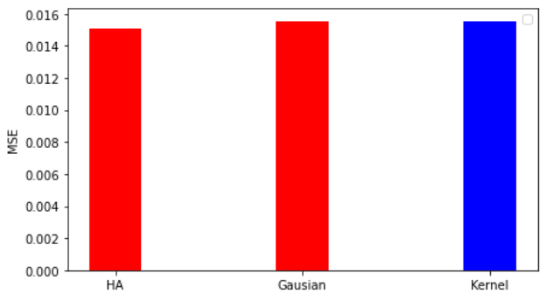
Distance Function, N =50 , OptionData

Slide 17
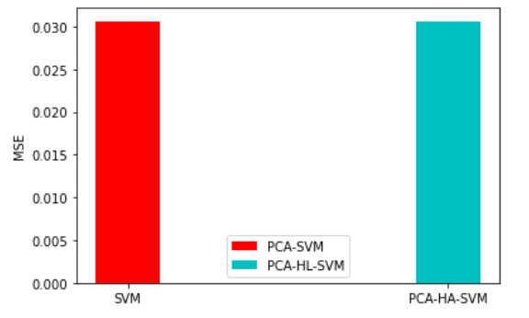
PCA, Dimensions = 2, N =20, OptionData
n = 20
OOP_df = pd.read_csv('OptionData12110.csv')
OOP_df = OOP_df.dropna()
OP_df = OOP_df
OOP_df = OOP_df.drop(['Implied_volatility'], axis = 1)
data = OOP_df
norm = StandardScaler().fit_transform(data)
pca = PCA(n_components = 2)
nn = pca.fit_transform(norm)
from sklearn.model_selection import train_test_split
X = nn
Y = np.array(OP_df['Implied_volatility'])
X_train, X_test, Y_train, Y_test = train_test_split( X, Y, test_size=0.25, random_state=42)
X_train_tr, X_train_ts, Y_train_tr, Y_train_ts = train_test_split( X_train, Y_train, test_size=0.25, random_state=40)

Slide 18
BTC Option Data
mark_iv

Slide 19
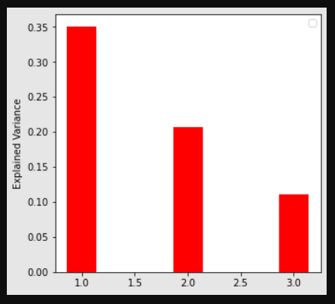
BTC Option Data : Variance

Slide 20
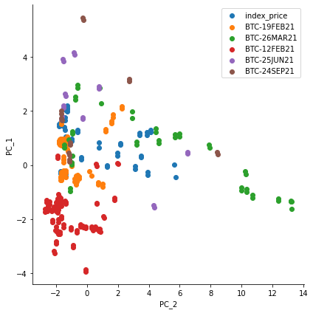
BTC Option Data : PCA
Date-Time

Slide 21
Hierarchical Learning with BTC Data
N = 10
C=1,kernel='linear'
def datagen():
OP_df = pd.read_csv('btc_option_data.csv')
OP_df = OP_df.dropna()
data = OP_df
data = data.drop(['underlying_index'], axis = 1)
data = data.drop(['settlement_period'], axis = 1)
data = data.drop(['instrument_name'], axis = 1)
data = data.drop(['bids'], axis = 1)
data = data.drop(['asks'], axis = 1)
OOP_df = data
OOP_df = OOP_df.drop(['mark_iv'], axis = 1)
X = StandardScaler().fit_transform ( OOP_df )
Y = StandardScaler().fit_transform ( np.array ( data['mark_iv'] ).reshape(-1, 1).reshape(-1, 1) ).ravel()
X_train, X_test, Y_train, Y_test = train_test_split( X, Y, test_size=0.25, random_state=47)
X_train_tr, X_train_ts, Y_train_tr, Y_train_ts = train_test_split( X_train, Y_train, test_size=0.25, random_state=41)
return X_train_tr, X_train_ts, Y_train_tr, Y_train_ts,X_train, X_test, Y_train, Y_test

Slide 22
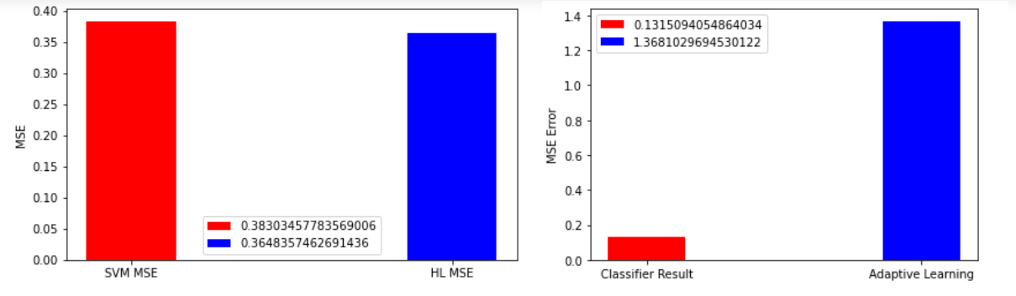
SVM N = 10 C=1,kernel='linear' BTC Data

Slide 23
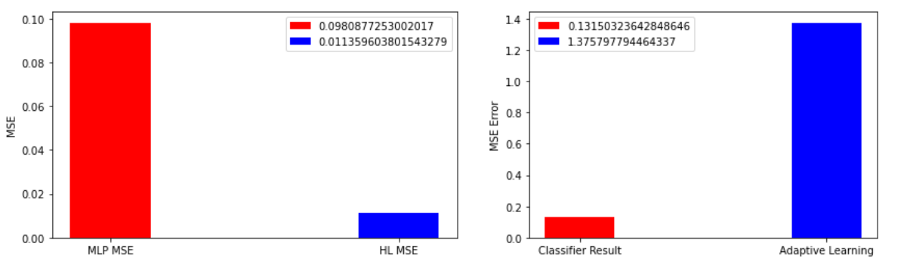
MLP BTC Data

Slide 24
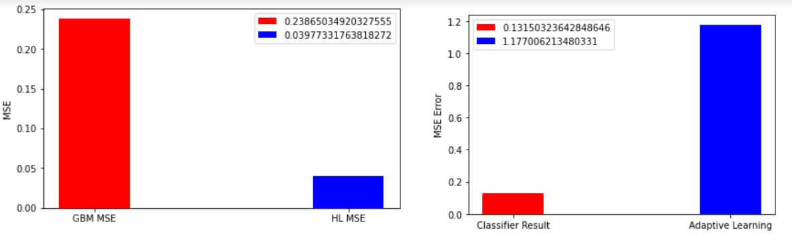
GBM BTC Data

Slide 25
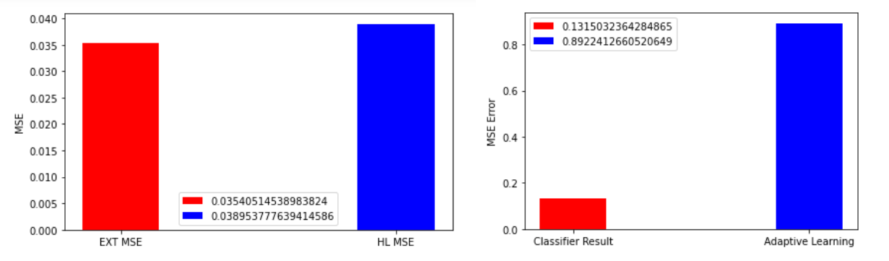
EXT BTC Data

Slide 26
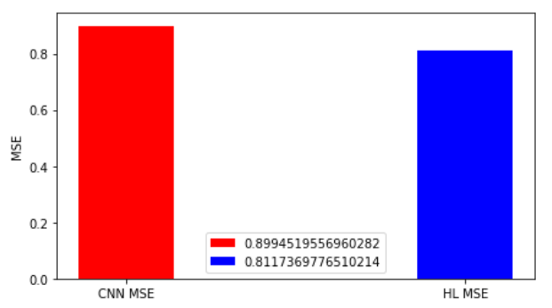
CNN BTC Data
def cnn():
model = Sequential()
model.add(Conv1D(16, kernel_size=3, activation='relu', input_shape=(26,1)))
model.add(Flatten())
model.add(Dense(1, activation='linear'))
model.compile(optimizer='adam', loss='mse', metrics=['accuracy'])
model.fit( X_train, Y_train, epochs=1)
regr= model
pred= regr.predict(X_test)
mse = mean_squared_error(Y_test, pred)
print(mse)
r = r2_score(Y_test, pred)
return mse,r,regr

Slide 27
Feature Interpolation BTC:
Skewness
Curtosis
Intrinsic value =underlying_price - last_price
data["kurt"] = data.kurtosis(axis = 1, skipna = True)
data = data.dropna()
data["skew"] = data.skew(axis = 1, skipna = True)
data = data.dropna()
data["in"] = data["underlying_price"] - data["last_price"]

Slide 28
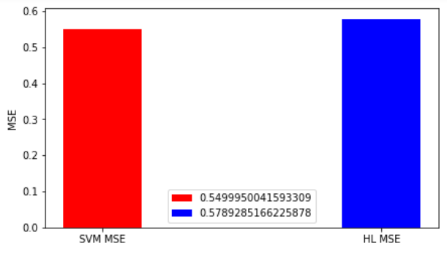
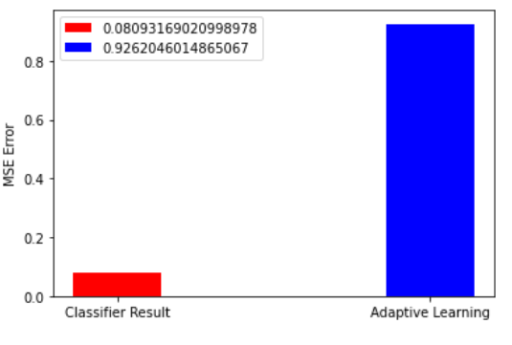
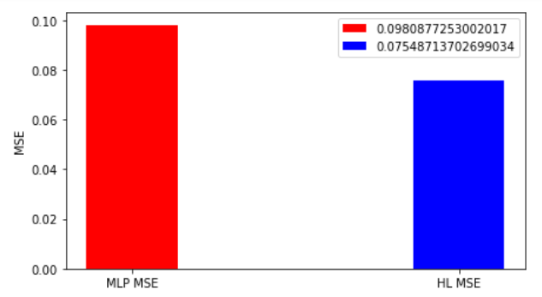
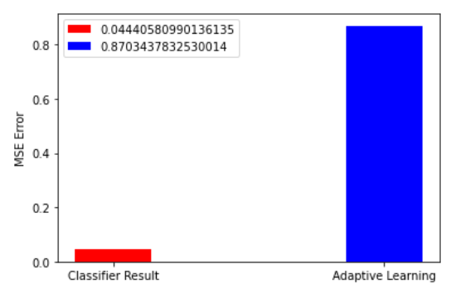
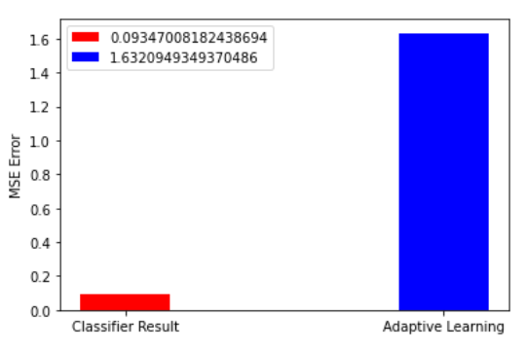
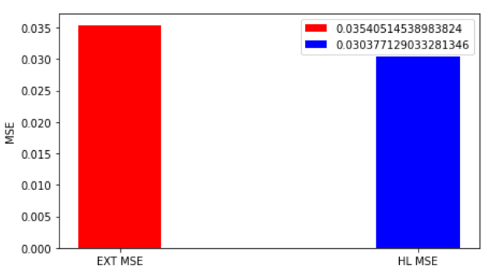
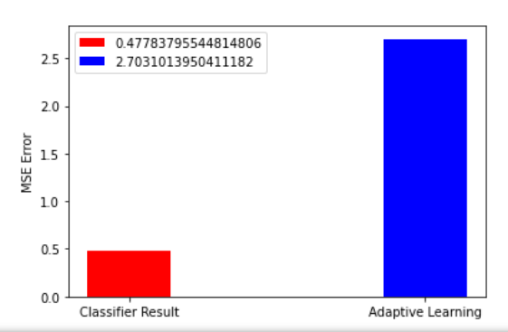
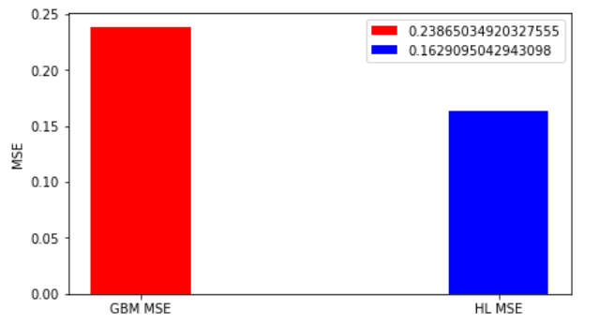
SVM 2. MLP 3. GBM 4. EXT Feature Interpolation BTC: HL followed by Adaptive Learning.

Slide 29
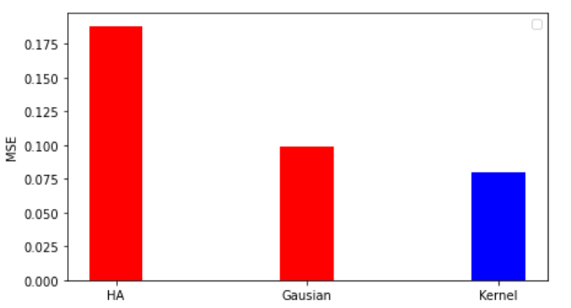
Distance Function : 1. Gaussian 2. Kernel : Linear*TanH , N = 10 BTC

Slide 30
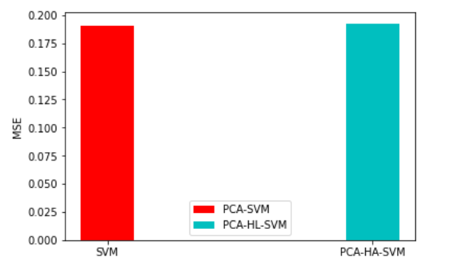
PCA, Dimensions = 2, N =50, BTC Data

Slide 31
European Option

Slide 32
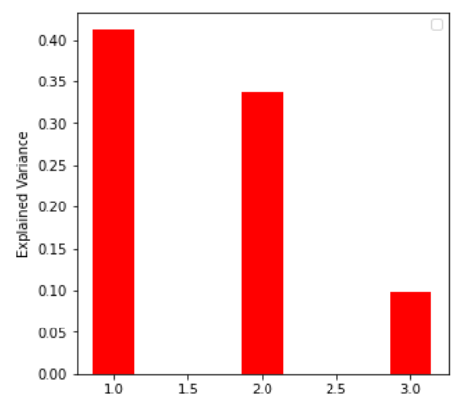
European Option : Variance

Slide 33
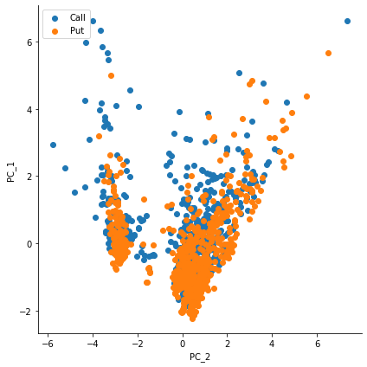
PCA

Slide 34
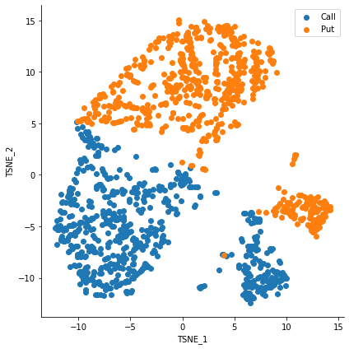
TSNE

Slide 35
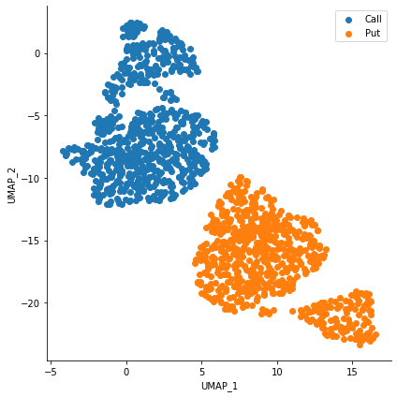
UMAP

Slide 36
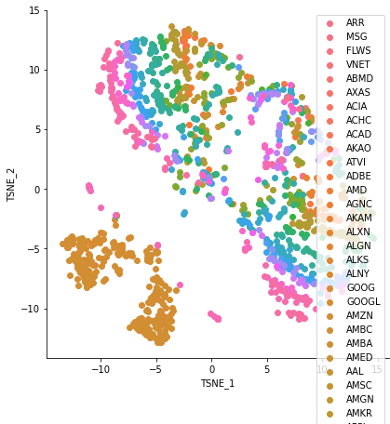
TSNE Ticker

Slide 37
Hierarchical Learning with EU Option
N = 20
C=1,kernel='linear'
def datagen():
OP_df = pd.read_csv('EuropeanOptionCleanData.csv')
OP_df = OP_df.dropna()
OP_df['Option_type'] = np.where(OP_df['Type'] == "Call", 1, 0)
OP_df['Implied_volatility'] = OP_df['ImpliedVolatility (caluclated)']
OP_df = OP_df.drop('ImpliedVolatility (caluclated)', 1)
OP_df = OP_df.drop('Ticker', 1)
OP_df = OP_df.drop('Type', 1)
OP_df = OP_df.drop('currentDate', 1)
OP_df = OP_df.drop('ExpDate', 1)
OP_df.head(1)
data = OP_df
OOP_df = OP_df
OP_df = OOP_df
OP_df = OP_df.drop(['Implied_volatility'], axis = 1)
from sklearn.model_selection import train_test_split
X = StandardScaler().fit_transform ( OP_df )
Y = np.array(OOP_df['Implied_volatility'])
X_train, X_test, Y_train, Y_test = train_test_split( X, Y, test_size=0.25, random_state=42)
X_train_tr, X_train_ts, Y_train_tr, Y_train_ts = train_test_split( X_train, Y_train, test_size=0.25, random_state=40)
return X_train_tr, X_train_ts, Y_train_tr, Y_train_ts,X_train, X_test, Y_train, Y_test

Slide 38
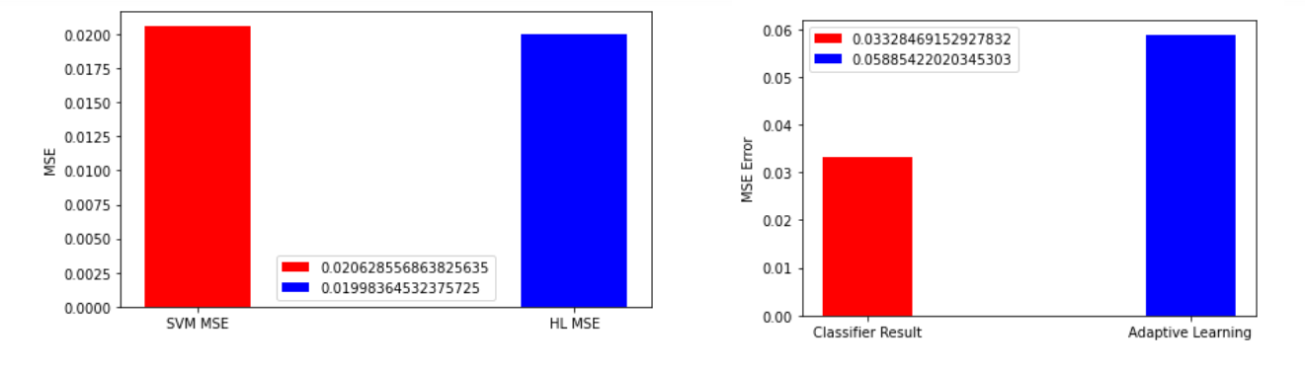
SVM N = 20 C=1,kernel='linear' BTC Data

Slide 39
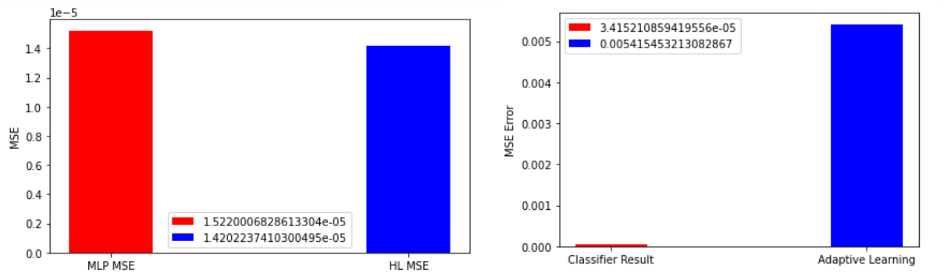
MLP EU Option

Slide 40
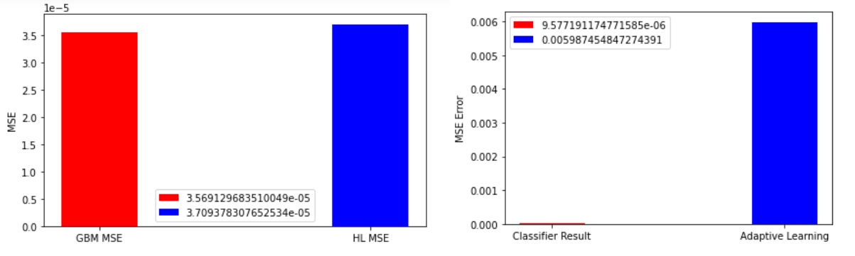
GBM EU Option

Slide 41
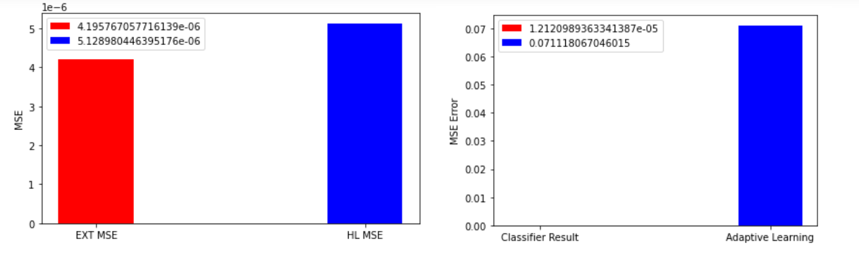
EXT EU Option

Slide 42
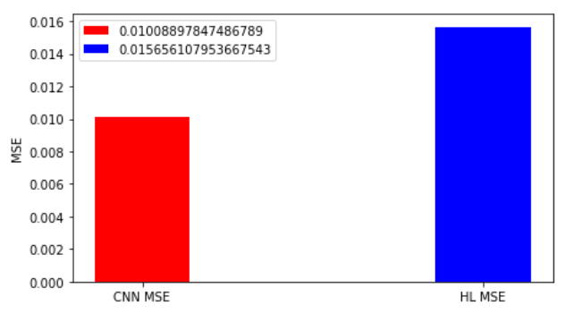
CNN EU Option
def cnn():
model = Sequential()
model.add(Conv1D(16, kernel_size=3, activation='relu', input_shape=(9,1)))
model.add(Flatten())
model.add(Dense(1, activation='linear'))
model.compile(optimizer='adam', loss='mse', metrics=['accuracy'])
model.fit( X_train, Y_train, epochs=1)
regr= model
pred= regr.predict(X_test)
mse = mean_squared_error(Y_test, pred)
print(mse)
r = r2_score(Y_test, pred)
return mse,r,regr

Slide 43
Feature Interpolation EU Option:
Skewness
Curtosis
Intrinsic value =Stock Price - Strike Price
data = OP_df
data["kurt"] = data.kurtosis(axis = 1, skipna = True)
data = data.dropna()
data["skew"] = data.skew(axis = 1, skipna = True)
data = data.dropna()
data["in"] = data["StockPrice"] - data["StrikePrice"]

Slide 44
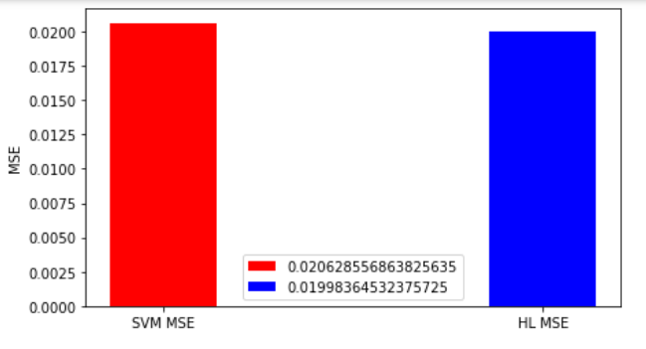
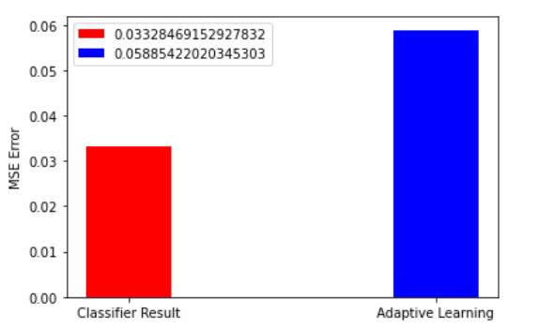
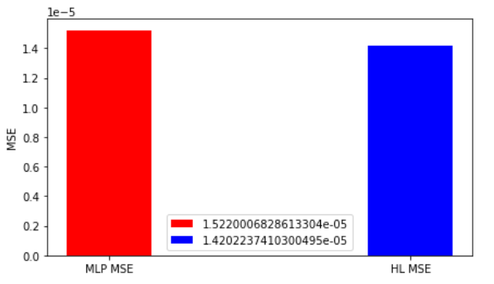





SVM 2. MLP 3. GBM 4. EXT Feature Interpolation: HL followed by Adaptive Learning. EU option

Slide 45

Distance Function : 1. Gaussian 2. Kernel : Linear*TanH , N = 100 EU Option

Slide 46

PCA, Dimensions = 2, N =50, EU Option Data

Slide 47
BTC Option Data
ask_iv

Slide 48

SVM N = 5 C=1,kernel='linear' BTC Data ask iv

Slide 49

MLP ask_iv

Slide 50

GBM ask_iv

Slide 51

EXT ask_iv

Slide 52








Feature Interpolation; N =5 1.SVM 2. MLP 3. GBM 4. EXT ask_iv

Slide 53

Distance Function : 1. Gaussian 2. Kernel : Linear*TanH , N = 5 BTC ask_iv

Slide 54

PCA, Dimensions = 2, N =50, BTC Data ask_iv

Slide 55
Conclusion
Can we do dimension reduction processing for option data before HL? Why? Show at least one example.
Dimensionality reduction doesn’t improve accuracy with HL. Example is with PCA.
Draw your conclusion :
The improvement with Hierarchical Learning depends on the number of points chosen as bad guys.
Adaptive learning improves the result significantly for the bad guy neighbours. But the training can be time consuming depending on the size of observations.

Slide 56
References
https://scikit-learn.org/stable/supervised_learning.html#supervised-learning
https://numpy.org/doc/stable/user/whatisnumpy.html
https://scikit-learn.org/stable/modules/generated/sklearn.svm.SVC.html

Slide 57

Thank You

