Slide 1
Artificial Intelligence in Fintech Project 2
Shaif Chowdhury

Slide 2
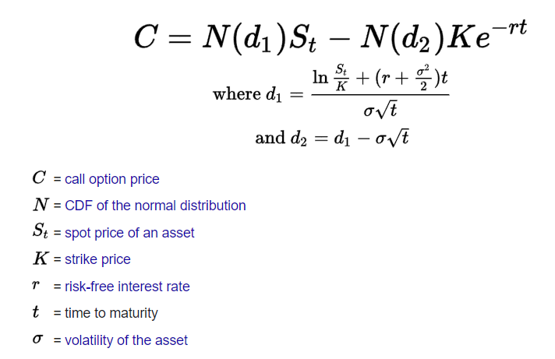
Black Scholes Option2017_2
S : Underlying asset price
K : Strike price
R : Interest rate : .03
T-t : Expiration time: T
OptionMarketPrice: last
imp : implied volatility

Slide 3
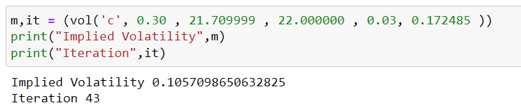
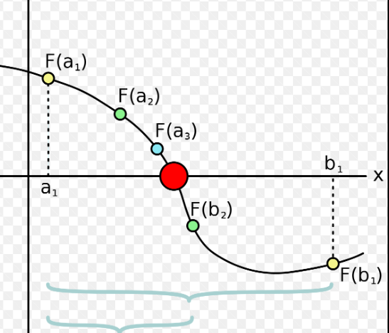
Bisection
Precision = 0.000000000001
B = 5
A = .0001
def vol(type, last, S, K, r, T):
while (True):
iter +=1
mid = (b + a)/2.0
if type == 'c':
price = call(S,K,T,r,mid)
lower = call(S,K,T,r,a)
if (lower - last ) * (price - last ) > 0:
a = mid
else:
b = mid
if abs(price - last ) < p: break
if mid > max - 2 :
mid = 0.31;break
return mid,iter

Slide 4
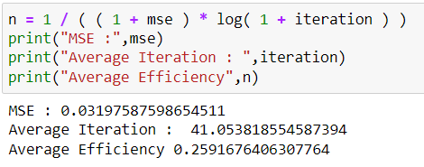
Bisection

Slide 5
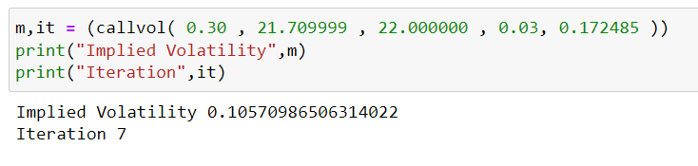
Brent
tol=0.000000000001
max_iter=1000
def callvol(price,S,K,r,T):
def brentt(sigma):
d11 = d1(S,K,T,r,sigma)
d22 = d2(S,K,T,r,sigma)
Brent = call(S,K,T,r,sigma)
fx = Brent - price
return fx
x = optimize.brentq(brentt,
0.0001,10,maxiter=1000,
full_output=True)
return x[0] , x[1].iterations

Slide 6
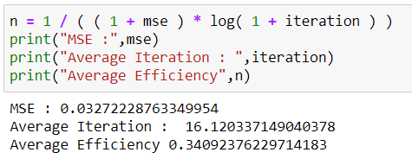
Brent

Slide 7
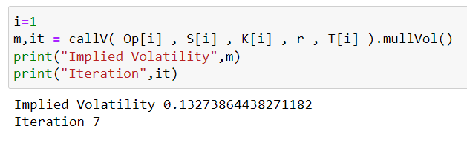
Muller Bisection
def Muller(self, x, y, z):
f1 = self.func(x)
f2 = self.func(y)
f3 = self.func(z)
h0 = x - z
h1 = y - z
e0 = f1 - f3
e1 = f2 - f3
det = h0 * h1 * (h0 - h1)
a = (e0 * h1 - h0 * e1) / det
b = ( ((h0**2) * e1) - ((h1**2) * e0) ) / det
c = f3
if b < 0:
w = z - 2 * c / (b - math.sqrt( (b**2) - (4*a*c) ))
else:
w = z - 2 * c / (b + math.sqrt( (b**2) - (4*a*c) ))
return w

Slide 8
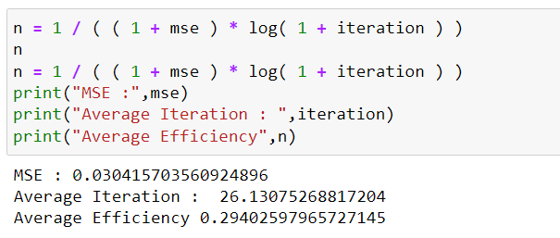
Muller Bisection

Slide 9
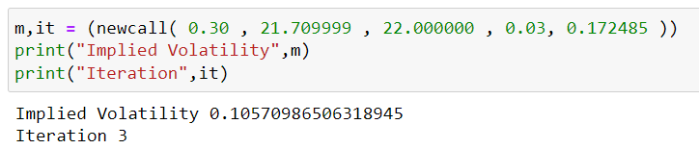
Newton Raphson
tol=0.000000000001
max_iter=1000
sigma = avg implied volatility
def vega(S, K, T, r, sigma):
vega = S * np.sqrt(T) * norm.pdf(d11)
return vega
def newcall(C, S, K,r, T ):
tol=0.000000000001
max_iter=1000
sigma = avg
for i in range(max_iter):
diff = call(S, K, T, r, sigma) - C
if abs(diff) < tol:
break
sigma = sigma - diff / vega(S, K, T, r, sigma)
return sigma,i

Slide 10
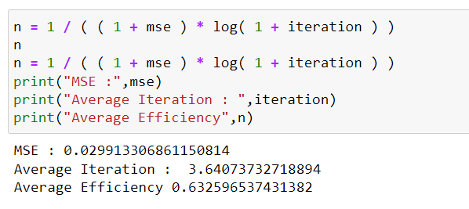
Newton Raphson

Slide 11
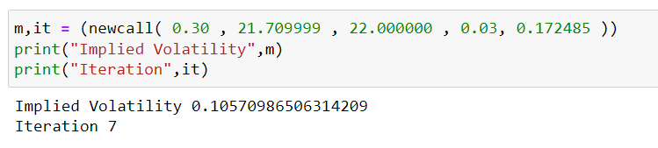
New Newton
tol=0.000000000001
max_iter=1000
sigma = BrentQ
def newcall(C, S, K,r, T ):
def brentt(sigma):
d11 = d1(S,K,T,r,sigma)
d22 = d2(S,K,T,r,sigma)
Brent = call(S,K,T,r,sigma)
fx = Brent - C
return fx
tol=0.000000000001
max_iter=100
rr = optimize.brentq(brentt,0.001,
10,maxiter=1000,full_output=True)
sigma = rr[0]
for i in range(max_iter):
diff = call(S, K, T, r, sigma) - C
if abs(diff) < tol:
break
sigma = sigma - diff / vega(S, K, T, r, sigma)
return sigma, ( i + rr[1].iterations )

Slide 12
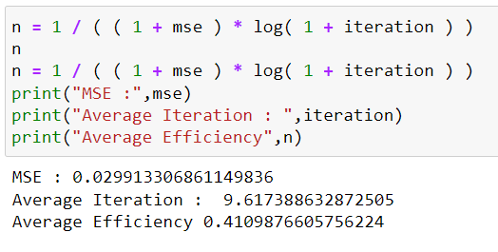
New Newton

Slide 13
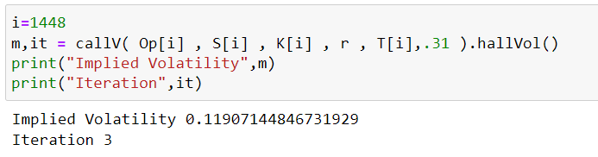
New Halley
def Vomma(self):
d1 = self.d11(self.sigma)
d2 = self.d22(self.sigma)
return (self.Vega()*d1*d2) / self.sigma
def hallVol(self):
i = 0
#print(i)
while self.func() > self.tol:
i = i + 1
self.sigma = self.sigma +(-self.Vega()+sqrt(self.Vega()**2 - 2*self.func()*self.Vomma()))/self.Vomma()
if(i>1000):
break
return self.sigma,i

Slide 14
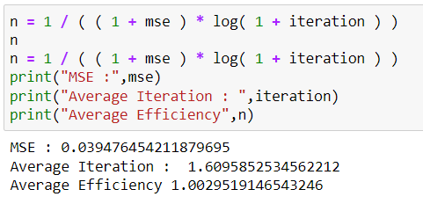
New Halley

Slide 15
Halley Irrational Formula
tol=0.000000000001
max_iter=1000
sigma = avg implied volatility
def Vomma(self):
d1 = self.d11(self.sigma)
d2 = self.d22(self.sigma)
return (self.Vega()*d1*d2) / self.sigma
def hallVol(self):
i = 0
#print(i)
while self.func() > self.tol:
i = i + 1
self.sigma = self.sigma
+(-self.Vega()+sqrt(self.Vega()**2 - 2*self.func()*self.Vomma()))/self.Vomma()
if(i>1000):
break
return self.sigma,i

Slide 16
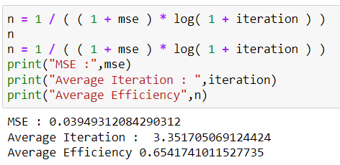
Halley Irrational Formula

Slide 17
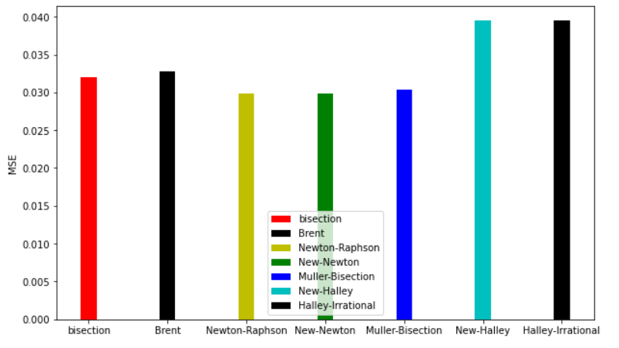
MSE

Slide 18
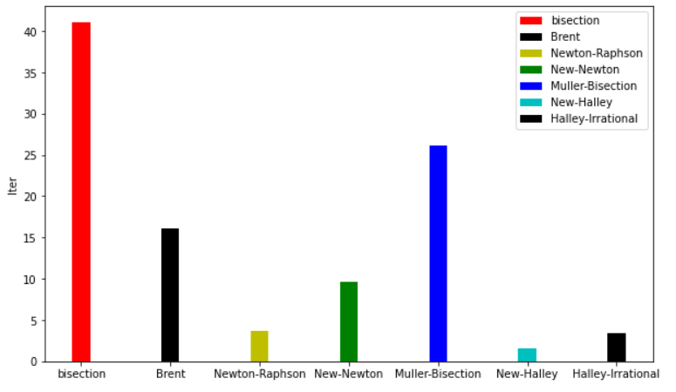
No of Iteration

Slide 19
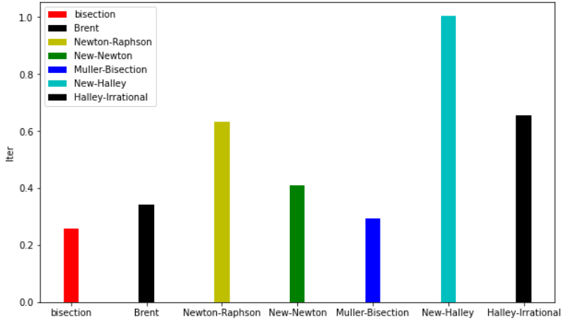
Efficiency

Slide 20
Conclusion
In terms of MSE these methods have pretty similar results.
Bisection has largest amount of time/iteration. But this depends on the limits of bisection.
New Halley is best in terms of efficiency.
Newton Raphson also had a good efficiency. But it depends on the starting point.

Slide 21
Trading System

Slide 22
Trading System
P = 1 %
The system would buy or sell stock at every 1 % change.
So, the the end we report the number of shares, transaction price.
The transaction price is calculated based on the average price . (marketAverage)
Transaction price = ( buy - sell ) / total / 10
The return is calculated based on the transaction price - market Average
def cal(data,k,p,t):
df = data
df['temp'] = 0
df['tempsum'] = 0
df['sum'] = 0
df['action'] = 'hold'
for i in range(1, k + 1):
df['temp'] = (df['marketAverage'].shift(-i) - df['marketClose']) / df['marketClose']
df['tempsum'].loc[(abs (df['temp']) > p)] = abs(df['temp'])
df['sum'] = df.tempsum.rolling(window=k).sum()
df['action'].loc[(df['temp'] >= t)] = 'buy'
df['action'].loc[(df['temp'] <= -t)] = 'sell'
return df
buy = calc.loc[calc.action == 'buy', 'marketAverage'].sum() * 10
sell = calc.loc[calc.action == 'sell', 'marketAverage'].sum() * 10
total = calc.loc[calc.action == 'buy'].count().mean() - calc.loc[calc.action == 'sell'].count().mean()
price = (buy-sell)/total / 10
profit = (calc[ 'marketAverage'].sum() - (price* total ) )

Slide 23
Machine Learning System
Models :
DNN
LSTM
CNN
Extra Tree
Transformer
CNN with Class Weights
Datasets :
AAPL
FB
AMZN
GOOG
MSFT
Report :
Confusion Matrix
Accuracy
F1 Score
D Index
Profit based on the predicted buy/sell action

Slide 24
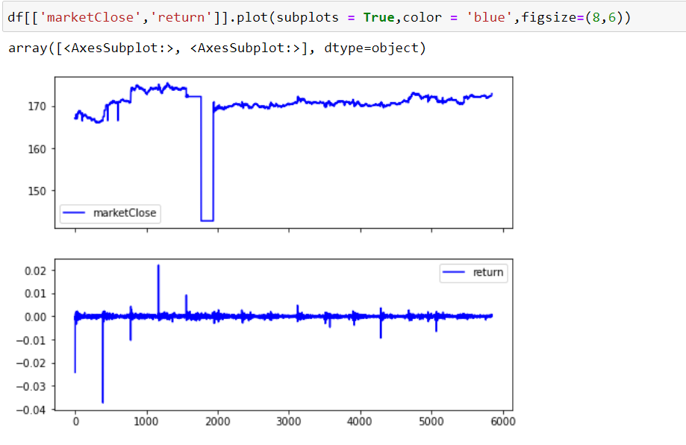
HFT Trading : AAPL

Slide 25
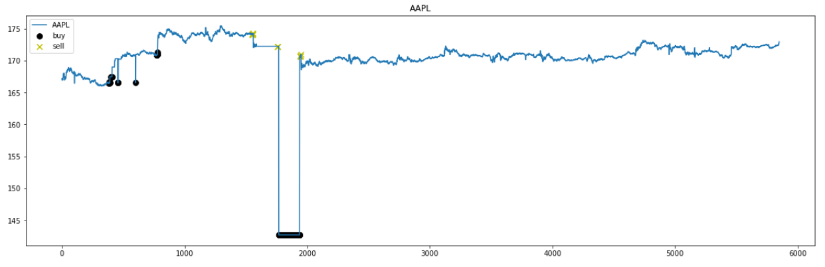
AAPL Trading Markers

Slide 26
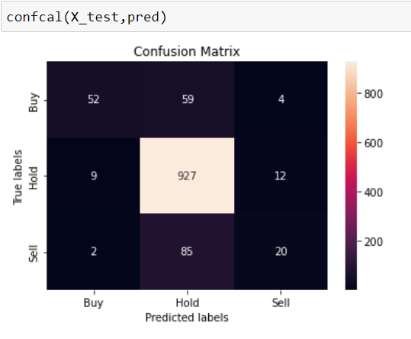
DNN Prediction : AAPL
clf= MLPClassifier(solver='lbfgs', alpha=1e-7, hidden_layer_sizes=(10,2), random_state=1, max_iter =1e7)
clf.fit( x_train, Y_train)
Accuracy : 0.8538461538461538
D Index : 1.6316310604541866
F1 Score : 0.880643517830946
Prediction on Test Data :
No of shares 1035.0
Average transaction price 171.01027922705316

Slide 27
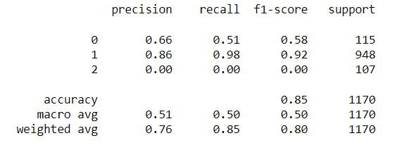
DNN Classification Report

Slide 28
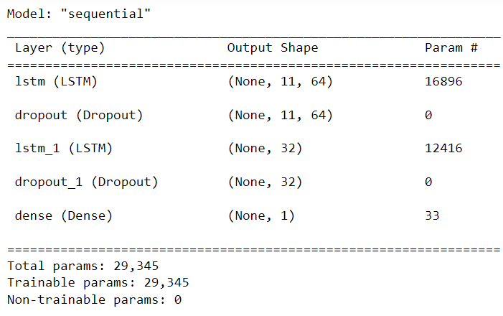
LSTM Prediction : AAPL
model = Sequential()
model.add(LSTM (64,
return_sequences = True,
input_shape = [11,1]))
model.add(Dropout(0.2))
model.add(LSTM (32))
model.add(Dropout(0.2))
model.add(Dense(1,
activation="sigmoid"))
model.compile(optimizer=
'Adam',loss='mse',
metrics=('accuracy') )
model.summary()

Slide 29
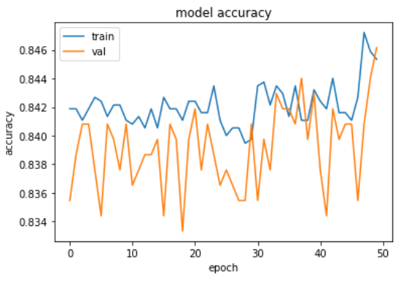
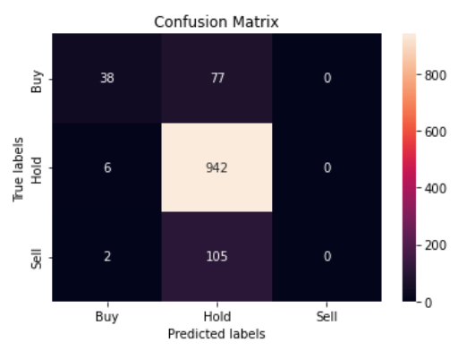
LSTM Prediction : AAPL

Slide 30
LSTM Prediction Metrics : AAPL
Accuracy : 0.8376068376068376
D Index : 1.4700629058756074
F1 Score : 0.8920766920766922
Prediction on Test Data :
No of shares 1124.0
Average transaction price 171.1275569395018

Slide 31
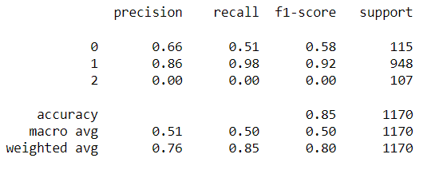
LSTM Report

Slide 32
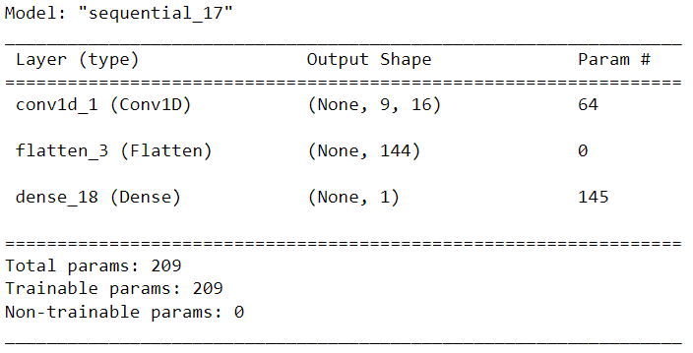
CNN : AAPL
model = Sequential()
model.add(Conv1D(16,
kernel_size=3, activation='relu', input_shape=(11,1)))
model.add(Flatten())
model.add(Dense(1,
activation='sigmoid'))
model.compile(optimizer=
'Adam', loss='mse',
metrics=['accuracy'])
model.summary()

Slide 33
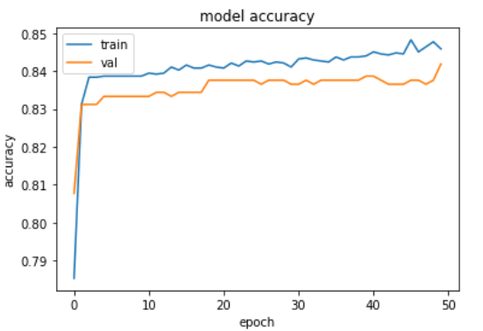
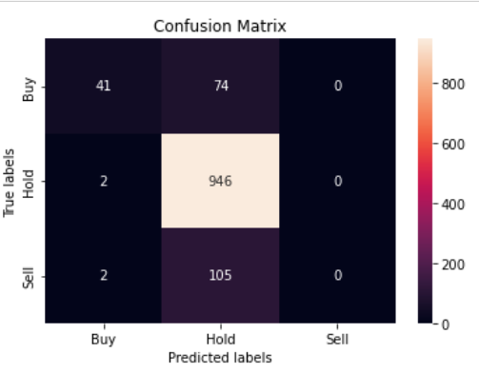
CNN : AAPL

Slide 34
CNN Prediction : AAPL
Prediction on Test Data :
No of shares 1125.0
Average transaction price 171.1107191111111
Accuracy : 0.8435897435897436
D Index : 1.4956071396747592
F1 Score : 0.8972951222679878

Slide 35
CNN Report

Slide 36
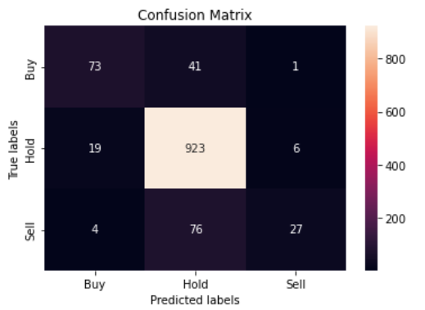
Extra Tree : AAPL
Accuracy : 0.8743589743589744
D Index : 1.7062482397686556
F1 Score : 0.8933009423883681
Prediction on Test Data :
No of shares 1006.0
Average transaction price 171.11321471172965
Profit $28,038.04

Slide 37
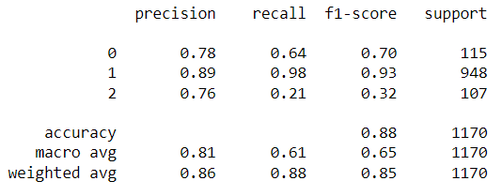
Extraa Tree Report

Slide 38
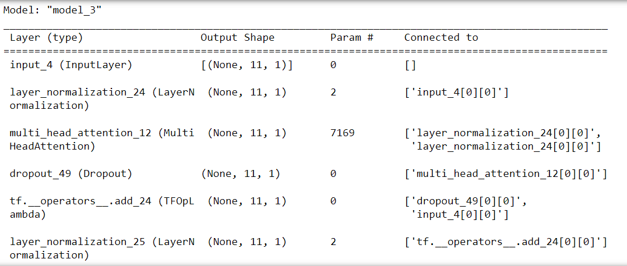
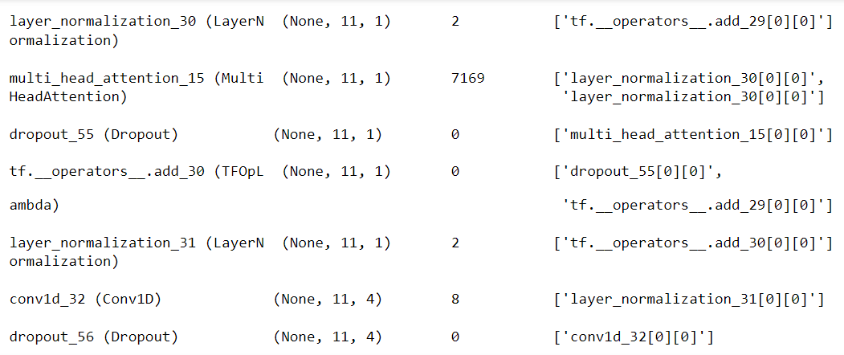
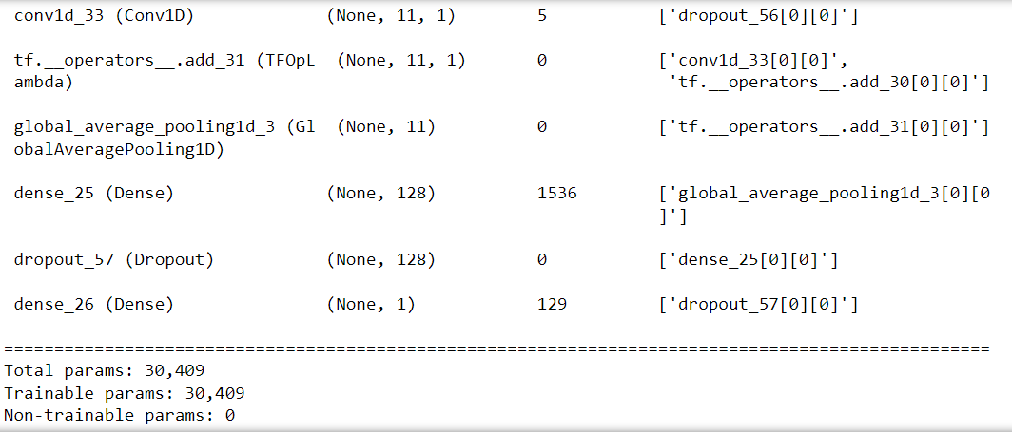
Transformer
def transformer_encoder(inputs, head_size, num_heads, ff_dim, dropout=0):
# Normalization and Attention
x = layers.LayerNormalization(epsilon=1e-6)(inputs)
x = layers.MultiHeadAttention(
key_dim=head_size, num_heads=num_heads, dropout=dropout
)(x, x)
x = layers.Dropout(dropout)(x)
res = x + inputs
# Feed Forward Part
x = layers.LayerNormalization(epsilon=1e-6)(res)
x = layers.Conv1D(filters=ff_dim, kernel_size=1, activation="relu")(x)
x = layers.Dropout(dropout)(x)
x = layers.Conv1D(filters=inputs.shape[-1], kernel_size=1)(x)
return x + res

Slide 39
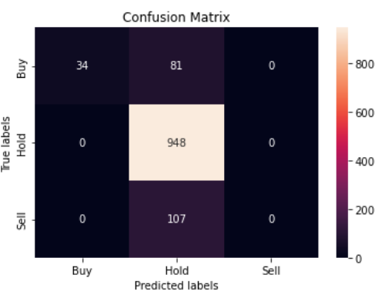
Transformer prediction AAPL
Accuracy : 0.8393162393162393
D Index : 1.4959462447517007
F1 Score : 0.8966127624567125

Slide 40
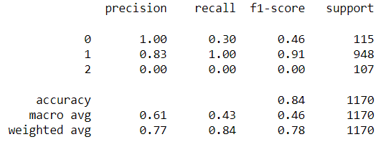
Transformer Report

Slide 41
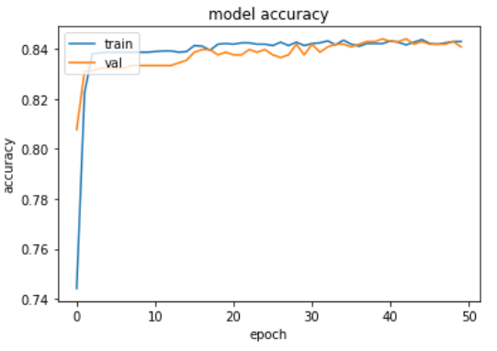
CNN with Class Weight : AAPL
class_weight = {0: 2.81,
1: 0.41,
2: 4.54}
hist = model.fit(x_train, Y_train, batch_size=32,epochs=50,validation_split = 0.2, verbose = 1,class_weight=class_weight)

Slide 42
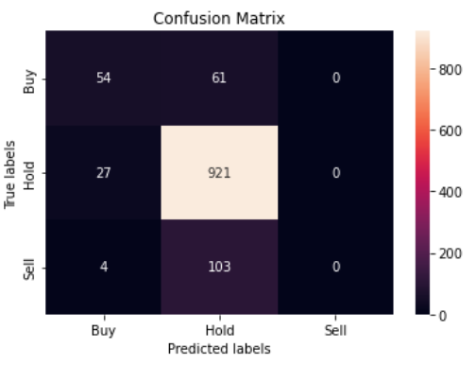
CNN with Class Weight : AAPL
Accuracy : 0.8333333333333334
D Index : 1.4481978458664395
F1 Score : 0.8794567835836897
Prediction on Test Data :
No of shares 1085.0
Average transaction price 171.18853179723504
Profit $14,438.38

Slide 43
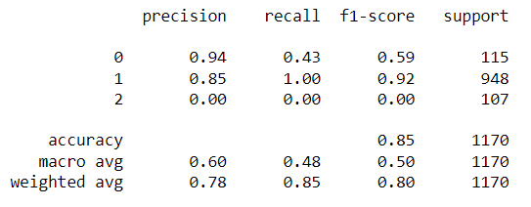
CNN Class weight prediction

Slide 44
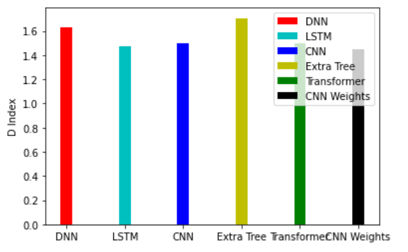
Comparison AAPL

Slide 45
AMAZON HFT

Slide 46
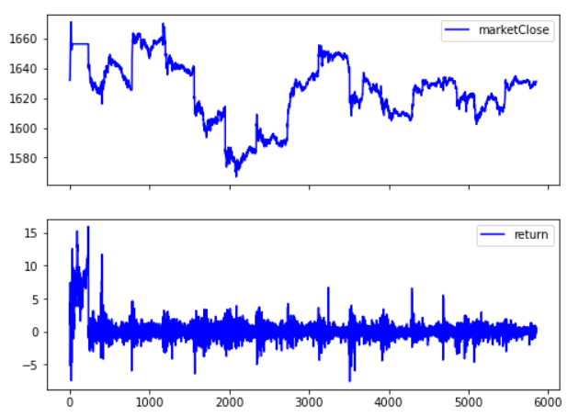
HFT Trading AMZN

Slide 47
AMZN total Trading Profit
No of shares -217.60000000000002
Average transaction price 1657.9816819852942
Prediction on 80/20 split.

Slide 48
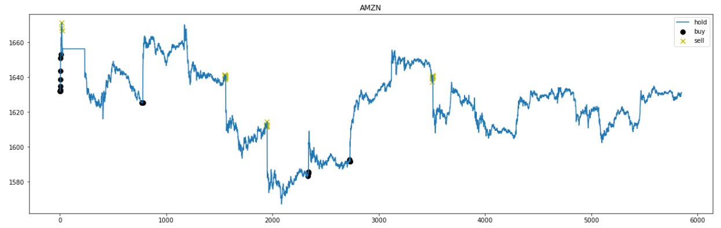
AMZN markers

Slide 49
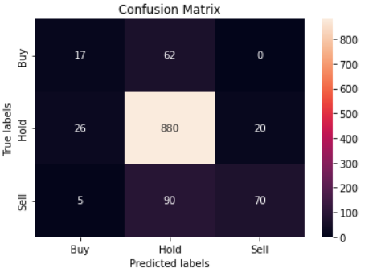
DNN
Accuracy : 0.8264957264957264
D Index : 1.5621408070590344
F1 Score : 0.8460706049956171
Prediction on Test Data :
No of shares 942.0
Average transaction price 1622.3032101910826
Profit $373,128.40

Slide 50
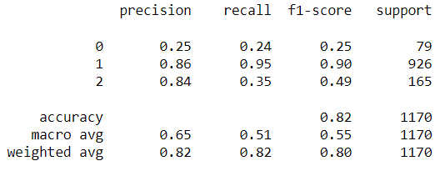
DNN Report

Slide 51
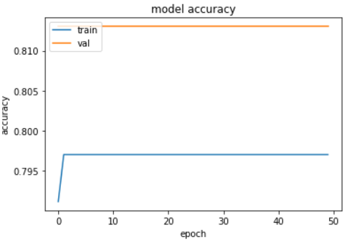
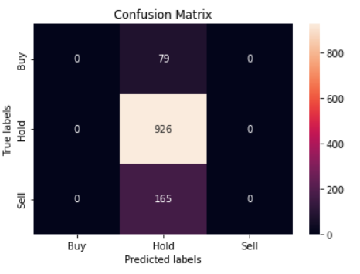
LSTM

Slide 52
LSTM Result
Accuracy : 0.7914529914529914
D Index : 1.1963421019289784
F1 Score : 0.8835877862595419
Prediction on Test Data :
No of shares 1170.0
Average transaction price 1625.0752316239318
Profit $-0.00

Slide 53
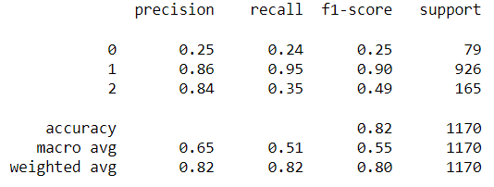
LSTM report

Slide 54
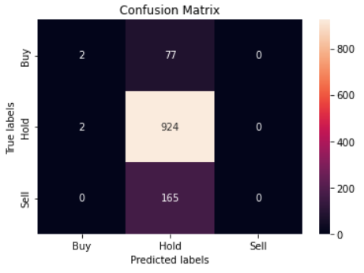
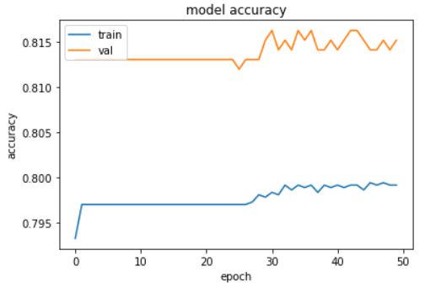
CNN

Slide 55
CNN Result
Accuracy : 0.7914529914529914
D Index : 1.296009845823352
F1 Score : 0.8805099104069364
Prediction on Test Data :
No of shares 1166.0
Average transaction price 1625.103144939966
Profit $6,467.75

Slide 56
CNN Report

Slide 57
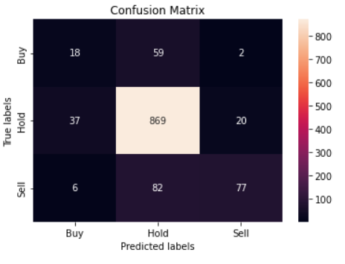
Extra Tree Result
Accuracy : 0.8239316239316239
D Index : 1.5558227282748545
F1 Score : 0.8377267177267177
Prediction on Test Data :
No of shares 911.0
Average transaction price 1622.0602360043908
Profit $423,641.15

Slide 58

Extra tree Report

Slide 59


Transformer

Slide 60
Transformer results
Accuracy : 0.7914529914529914
D Index : 1.1963421019289784
F1 Score : 0.8835877862595419
Prediction on Test Data :
No of shares 1170.0
Average transaction price 1625.0752316239318
Profit $-0.00

Slide 61

Transformer

Slide 62


CNN Class Weights

Slide 63
CNN Class Weights result
Prediction on Test Data :
No of shares 1150.0
Average transaction price 1625.1183773913044
Profit $32,451.89
Accuracy : 0.7803418803418803
D Index : 1.2251304297121435
F1 Score : 0.8627358511751575

Slide 64

CNN Class Weights Report

Slide 65

AMZN Classification Result

Slide 66
FACEBOOK HFT

Slide 67

FB HFT

Slide 68

FB markers

Slide 69
Trading System
No of shares 40.39999999999998
Average transaction price 170.97616336633817
Profit $1,101,615.58
Trading 10 stocks at every Buy/Sell mark.
Prediction on 80/20 split.

Slide 70

DNN Prediction
Accuracy : 0.7145299145299145
D Index : 1.3296700998583684
F1 Score : 0.7921884614433445
Prediction on Test Data :
No of shares 1084.0
Average transaction price 189.60765867158673
Profit $16,095.34

Slide 71

DNN Report

Slide 72


LSTM

Slide 73
LSTM Prediction
Prediction on Test Data :
No of shares 1141.0
Average transaction price 189.5662541630149
Profit $5,334.95
Accuracy : 0.7205128205128205
D Index : 1.247788234748619
F1 Score : 0.8192564641163821

Slide 74

LSTM Report

Slide 75


CNN

Slide 76
CNN Prediction
Accuracy : 0.7153846153846154
D Index : 1.1869530980077896
F1 Score : 0.8268478341043329
Prediction on Test Data :
No of shares 1159.0
Average transaction price 189.4805772217429
Profit $2,022.06

Slide 77

CNN Report

Slide 78

Extra Tree
Accuracy : 0.7196581196581197
D Index : 1.3858397576863264
F1 Score : 0.7588916954770614
Prediction on Test Data :
No of shares 936.0
Average transaction price 189.88705341880342
Profit $43,895.76

Slide 79

Extra Tree Report

Slide 80


Transformer

Slide 81
Transformer Prediction
Accuracy : 0.7162393162393162
D Index : 1.1109369780082305
F1 Score : 0.8346613545816732
Prediction on Test Data :
No of shares 1170.0
Average transaction price 189.42739059829057
Profit $0.00

Slide 82

Transformer Report

Slide 83


CNN Class Weights

Slide 84
CNN Class Weights Prediction
Accuracy : 0.7136752136752137
D Index : 1.180662584227746
F1 Score : 0.8211365393683788
Prediction on Test Data :
No of shares 1151.0
Average transaction price 189.54331885317112
Profit $3,465.69

Slide 85

CNN Class Weight Report

Slide 86

FB D Index Comparison

Slide 87
GOOGLE HFT

Slide 88

GOOG HFT

Slide 89

Google Markers

Slide 90
HFT Trading : GOOG
No of shares 50
Average transaction price 1084.9438612143717
Profit $6,459,058.17

Slide 91

DNN
Accuracy : 0.805982905982906
D Index : 1.4849453852863892
F1 Score : 0.8451024286947173
Prediction on Test Data :
No of shares 1036.0
Average transaction price 1113.3687664092665
Profit $149,404.03

Slide 92

DNN Report

Slide 93


LSTM

Slide 94
LSTM Prediction
Accuracy : 0.805982905982906
D Index : 1.4146632960419467
F1 Score : 0.8853017614480555
Prediction on Test Data :
No of shares 1160.0
Average transaction price 1113.7173258620692
Profit $10,941.97

Slide 95

LSTM Report

Slide 96


CNN

Slide 97
CNN Predictions
Prediction on Test Data :
No of shares 1148.0
Average transaction price 1113.5639155052263
Profit $24,482.70
Accuracy : 0.7991452991452992
D Index : 1.3869143420385677
F1 Score : 0.8866892430351538

Slide 98

CNN Report

Slide 99

Extra Tree
Accuracy : 0.811965811965812
D Index : 1.5176476717953213
F1 Score : 0.8366878692289383
Prediction on Test Data :
No of shares 976.0
Average transaction price 1113.2234866803278
Profit $216,347.95

Slide 100

Extra Tree Report

Slide 101


Transformer

Slide 102
Transformer Prediction
Accuracy : 0.7974358974358975
D Index : 1.2029742220616966
F1 Score : 0.8873038516405137
Prediction on Test Data :
No of shares 1170.0
Average transaction price 1113.5504880341882
Profit $-0.00

Slide 103

Transformer Report

Slide 104


CNN Class Weights

Slide 105
CNN Class Weights
Prediction on Test Data :
No of shares 1151.0
Average transaction price 189.54331885317112
Profit $3,465.69
Accuracy : 0.8025641025641026
D Index : 1.358815688016436
F1 Score : 0.8761508092683715

Slide 106

Class Weight Report

Slide 107

D Index Comparison

Slide 108
MSFT HFT

Slide 109

MSFT HFT

Slide 110
MSFT Trading
No of shares -56.8125
Average transaction price 96.85394939493975

Slide 111

MSFT Markers

Slide 112

DNN
Accuracy : 0.8606837606837607
D Index : 1.6492772048928197
F1 Score : 0.8767219366436063
Prediction on Test Data :
No of shares 1036.0
Average transaction price 1113.3687664092665

Slide 113

DNN Reports

Slide 114


LSTM

Slide 115
LSTM Prediction
Prediction on Test Data :
No of shares 1138.0
Average transaction price 106.71637609841828
Accuracy : 0.8376068376068376
D Index : 1.436009904571523
F1 Score : 0.8948003247749762

Slide 116

LSTM Report

Slide 117


CNN

Slide 118
CNN Prediction
Prediction on Test Data :
No of shares 1137.0
Average transaction price 106.68659278803871
Accuracy : 0.8350427350427351
D Index : 1.4219927115469544
F1 Score : 0.8923815583076256

Slide 119

CNN Report

Slide 120

Extra Tree
Accuracy : 0.8760683760683761
D Index : 1.6971322938160072
F1 Score : 0.8908842024786034
Prediction on Test Data :
No of shares 989.0
Average transaction price 107.06158442871586

Slide 121

Extra Tree Report

Slide 122


Transformer

Slide 123
Transformer Prediction
Prediction on Test Data :
No of shares 1170.0
Average transaction price 106.66094102564102
Accuracy : 0.8256410256410256
D Index : 1.233934302347389
F1 Score : 0.9044943820224719

Slide 124

Transformer Prediction

Slide 125


Class Weights

Slide 126
Class Weights prediction
Prediction on Test Data :
No of shares 1121.0
Average transaction price 106.69318198037467
Accuracy : 0.8358974358974359
D Index : 1.426726161172717
F1 Score : 0.8880057467872143

Slide 127

Class Weights Report

Slide 128

Comparison D Index

Slide 129
Conclusion
Extra Tree had the best results among all the methods.
Deep learning models overfit to the majority choice . ie : hold.
CNN with class weight has slight improvement.

Slide 130
References
https://sites.google.com/view/vinegarhill-financelabs/black-scholes-merton/implied-volatility
https://github.com/
https://github.com/Shaif95
https://pythoninoffice.com/calculate-option-implied-volatility-in-python/
https://stackoverflow.com/questions/66644981/calculating-implied-volatility-using-scipy-optimize-brentq-error
https://www.geeksforgeeks.org/program-muller-method/
https://towardsdatascience.com/nonlinear-optimization-using-halleys-method-2f2e7da4024

Slide 131

Thank You

