Slide 1
SLAM (Simultaneous Localization and Mapping)
Name: Shaif Chowdhury
Adviser: Guoyu Lu

Slide 2
Sections
Introduction
Objectives
Methods
Timeline
Closure

Slide 3

What is SLAM ?
In navigation, robotic mapping and odometry for virtual reality or augmented reality, simultaneous localization and mapping (SLAM) is the computational problem of constructing or updating a map of an unknown environment while simultaneously keeping track of an agent's location within it.
SLAM algorithms are tailored to the available resources, hence not aimed at perfection, but at operational compliance. Published approaches are employed in self-driving cars, unmanned aerial vehicles, autonomous underwater vehicles, planetary rovers, newer domestic robots and even inside the human body.

Slide 4
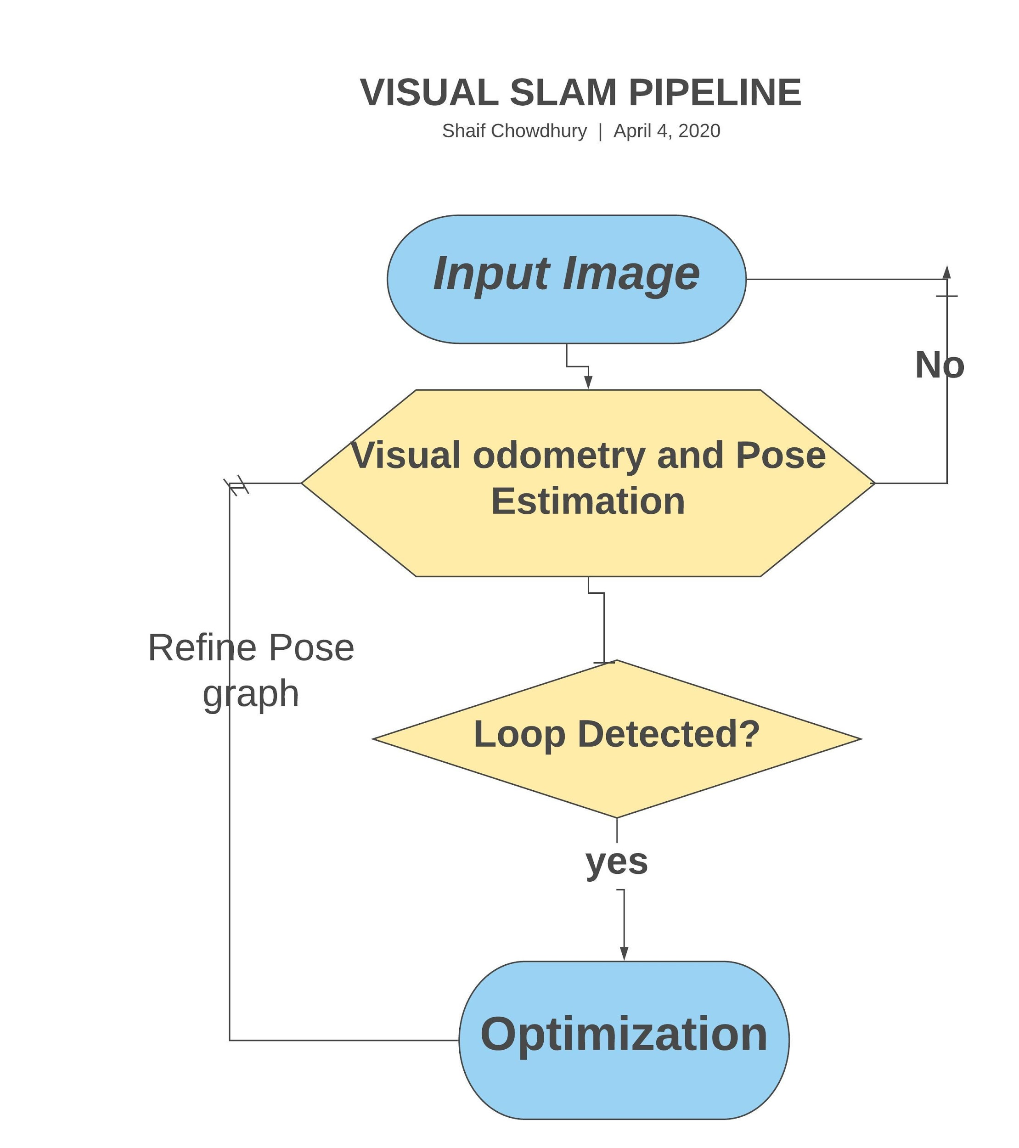
Objectives
Pose Estimation : To just compute the current pose of the camera relative to the previous frame.
This is essentially performing visual odometry, and results in drift as error accumulation occurs.
Loop closure Detection : Loop closure is the problem of recognizing a previously-visited location. This is usually done by storing features from every image and searching through them.
Optimization : To continuously optimize the whole 3D model as well as all the camera poses. There are different algorithms that can do this task: Kalman filtering, Particle filtering, and Bundle Adjustment. We would concentrate on bundle Adjustment using deep learning.

Slide 5
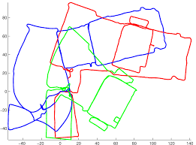
Methods : Loop Closure Detection
Since it is robotics problem, it needs to be Real Time and needs low false positive rate.
Loop Closure detection is solved by using Image Searching. .
The number of features increase incrementally, it results in heavy storage need and high searching time.
The problem is how to store and search in large Dataset with minimal resource.

Slide 6
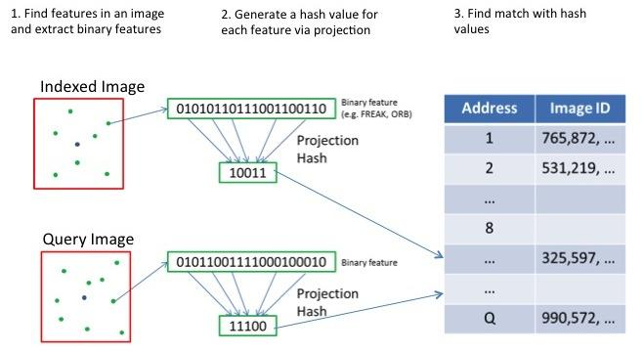
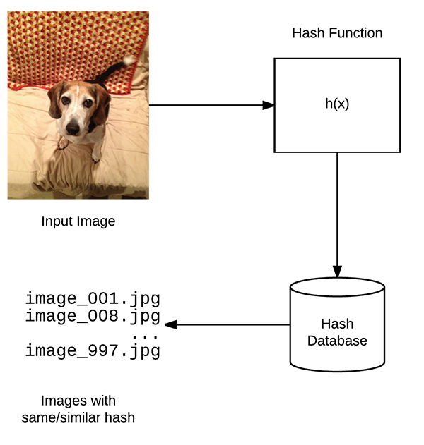
Loop Closure Detection
Most SLAM systems use SIFT features to find similarity. But SIFT features take up a lot of space and have high searching time.
This problem can be solved using Hashing.
HASHING
Hashing is a way to map image features to binary numbers while preserving similarity.
Most Hashing techniques suffer from low recall and rely on supervised information. We can solve it using deep learning based unsupervised Hashing.

Slide 7
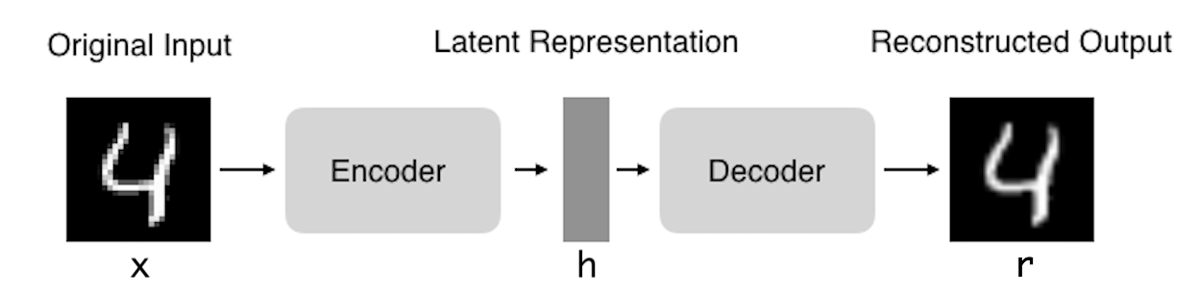
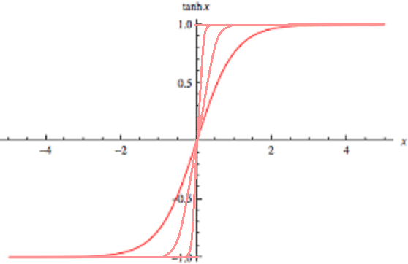
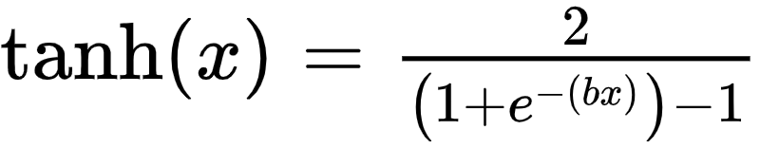
Unsupervised Hashing
So, an autoencoder type architecture would be needed to generate hash codes from images.
Autoencoders are neural networks that can compress the input into a latent-space representation, and then reconstruct the output from this representation.
latent representation to binary from. For this the above mentioned tanh(x) function can be used over one or multiple layers to force the latent representation to binary. The function is differentiable and can be used with standard back-propagation.
Once a network is trained it can be used to extract binary features from images and use them for searching.

Slide 8
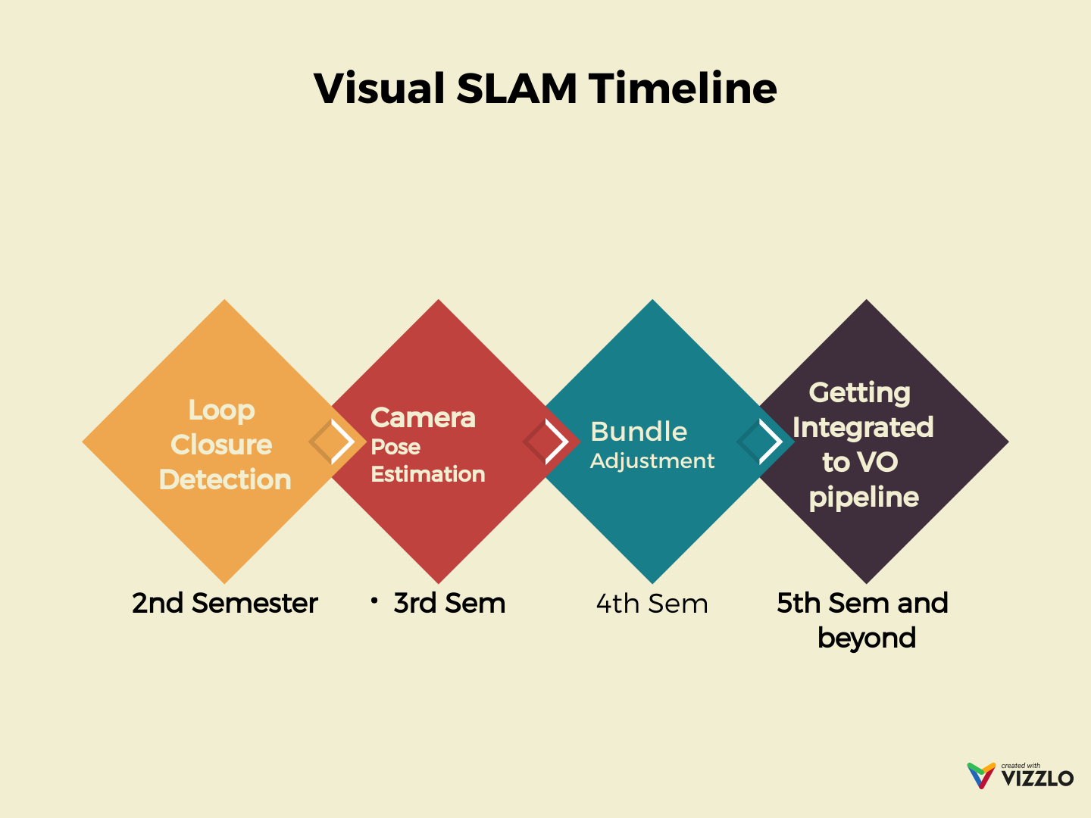

Slide 9
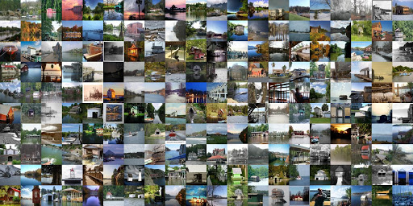
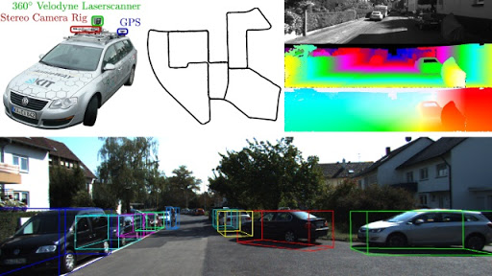
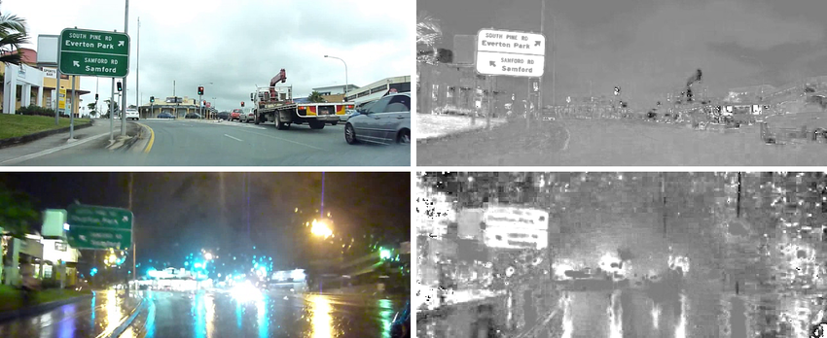
Dataset
Datasets :MIT Places Dataset : Places is a 10 million image database for scene recognition. Because of the volume, it can be used for training the Hashing Network.
KITTY : Autonomous vehicles driving through a mid-size city with images captured by cameras and laser scanners.
The Alderley Dataset :The dataset contains images in two different conditions for the same route: one on a sunny day and one during a rainy night, making it challenging dataset for testing loop Closure.

Slide 10
References
https://github.com/OpenSLAM/awesome-SLAM-list
Beyond SIFT Using Binary features in Loop Closure Detection. IROS 2017 , Lei Han ; Guyue Zhou ; Lan Xu ; Lu Fang
Multi-Index Hashing for Loop closure Detection. International Conference on Multimedia Expo, 2017. Best Student Paper Awards, Lei Han, Lu Fang
BA-Net: Dense Bundle Adjustment Network, Chengzhou Tang, Ping Tan
Unsupervised semantic deep hashing, Sheng Jin
Unsupervised Deep Generative Adversarial Hashing Network, Kamran Ghasedi Dizaji , Feng Zheng , Najmeh Sadoughi Nourabadi , Yanhua Yang, Cheng Deng , Heng Huang

Slide 11
Thank You

