Slide 1

From Zero to Hero #2
Git and Maven
Notes:
*Note* Image is replaceable. To add your image, delete the placeholder, then click the ‘picture icon’ and browse to your preferred image. Use the ‘Picture crop’ tool to adjust your image within the placeholder as required.

Slide 2
Agenda
01 | Git
02 | Branches and workflow
03 | Other commands
04 | Github
05 | Maven
06 | Step by step
07 | Archetype
08 | Future and questions

Slide 3
Git
Remote
Push
Fetch
Local
Local
Commit
Checkout
Staging
Staging
Add
Workspace
Workspace

Slide 4
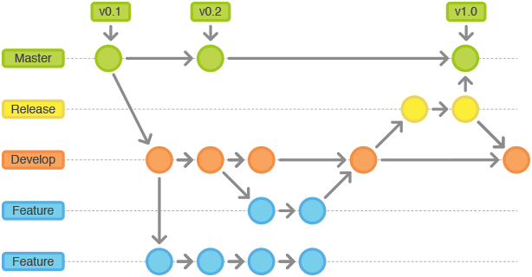
Branches and workflow

Slide 5
Other commands
GIT PULL
GIT MERGE
GIT BRANCH
GIT STASH (POP)

Slide 6
Github
github.com
SSH Key
https://help.github.com/articles/connecting-to-github-with-ssh/

Slide 7

Maven
https://maven.apache.org/
Project management:
Build
Reporting
Documentation
Dependencies
Testing

Slide 8
Step by step
Live example

Slide 9
Archetype
Project
Archetype
mvn archetype:generate
Project
Project
Project
mvn archetype:generate -DarchetypeGroupId=org.apache.maven.archetypes -DarchetypeArtifactId=maven-archetype-quickstart

Slide 10
Links
http://learngitbranching.js.org/?NODEMO
https://git-scm.com
https://maven.apache.org/

Slide 11
Future and questions
APACHE OAK
Questions?

