Slide 1

Balaji institute of technology and science Laknepally (V), Narsampet (M), Warangal District – 506 331, Telangana State, India Accredited by NBA (UG-CE, ME, ECE &CSE) & NAAC A+ Grade (Affiliated to JNT University, Hyderabad and Approved by AICTE, New Delhi)
DEPARTMENT OF COMPUTER SCIENCE AND ENGINEERING
SIGNATURE VERIFICATION
PRESENTED BY:
ODELA SAIRAM-20C31A0548
SHAIK AAKHIL-20C31A0558
MACHIKA SUSMITHA-20C31A0529
PAMU JAHNAVI-20C31A0550
GUIDED BY:
Dr.B.KRISHNA
Associate Professor

Slide 2
ABSTRACT
Signature is the most commonly used tool for identification of individuals extracted by previous signatures.
Main thing is that signature is very important part in the bank because withdrawal of money depends on it.
For personal identification, signature verification is one of the biometric techniques which is used commonly.
In many commercial scenarios, like check payment, the signature verification process is predicted on human examination of one known sample.

Slide 3
REQUIREMENTS
SOFTWARE REQUIREMENTS And TECHNOLOGIES
Operating system : Windows/linux/Mac OS
Anaconda Navigator:
Jupyter Notebook : Python 3

Slide 4
MODULES
There are three modules :
Preprocessing
Feature extraction
Classification

Slide 5
PREPROCESSING
Pre-processing is nothing but a process in which input is an image the input image is converted into .bmp format which is a bitmap format And sent for further execution the purpose of converting it into bitmap format is that in second module we are going extract the boundaries of the signature if it is in bitmap format it would easy for the boundary extraction.

Slide 6
FEATURE EXTRACTION
In feature extraction the boundaries of the signature image is extracted for further modification purpose of extraction of the signatures boundaries.
It would be easy for the classifier to identify and verify the signature because in the in the Feature extraction the size of the image is reduced.

Slide 7
CLASSIFICATION
In classification process the input is an image file the classifier verifies and identifies the signature this is the last module of this project which uses trained classifier which gives an accuracy.

Slide 8
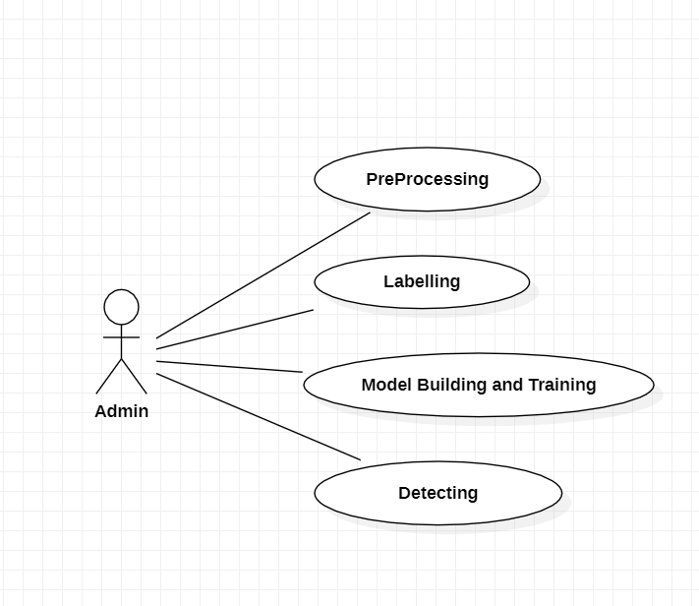
DESIGN:
Usecase diagram

Slide 9
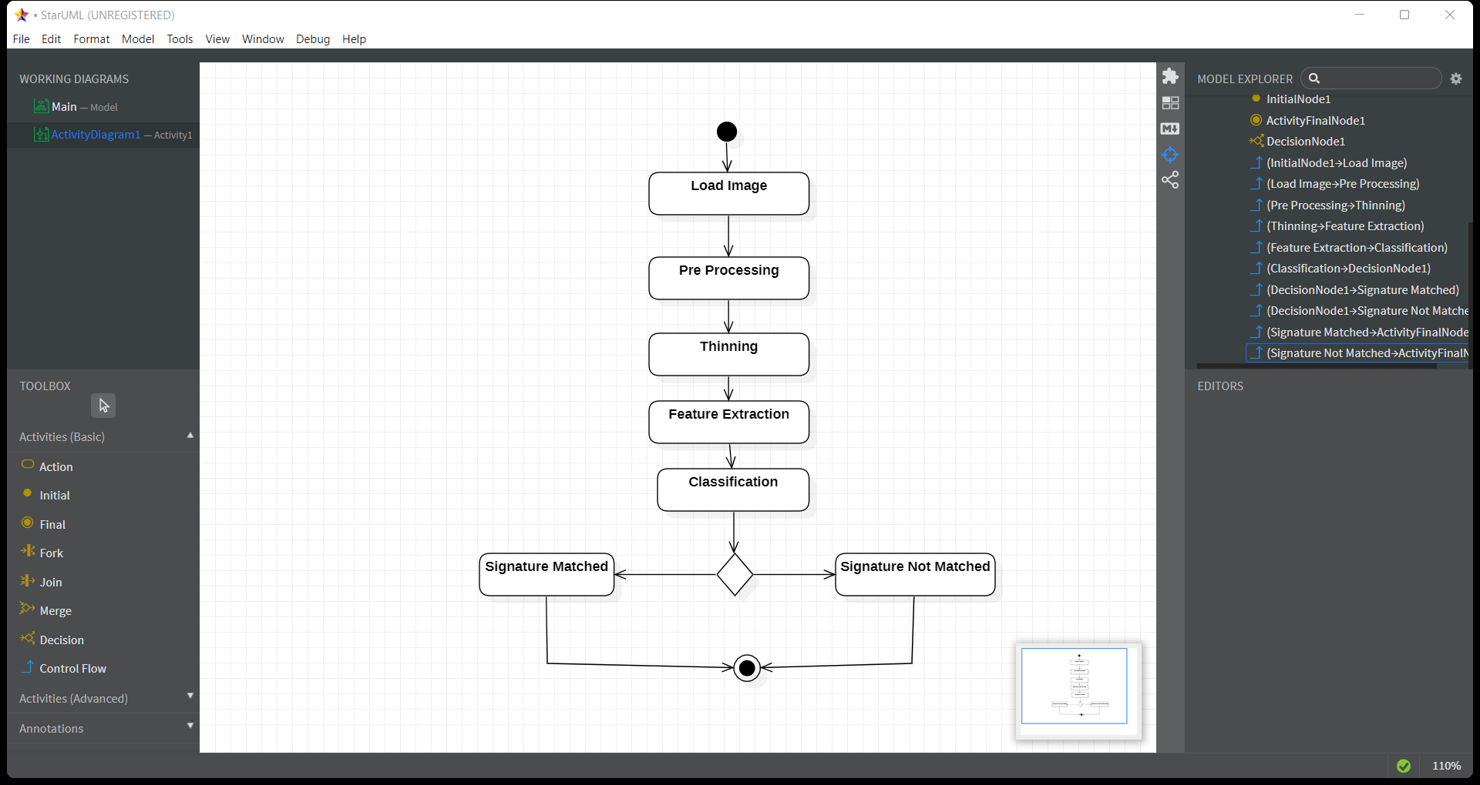
Activity diagram for signature verification

Slide 10
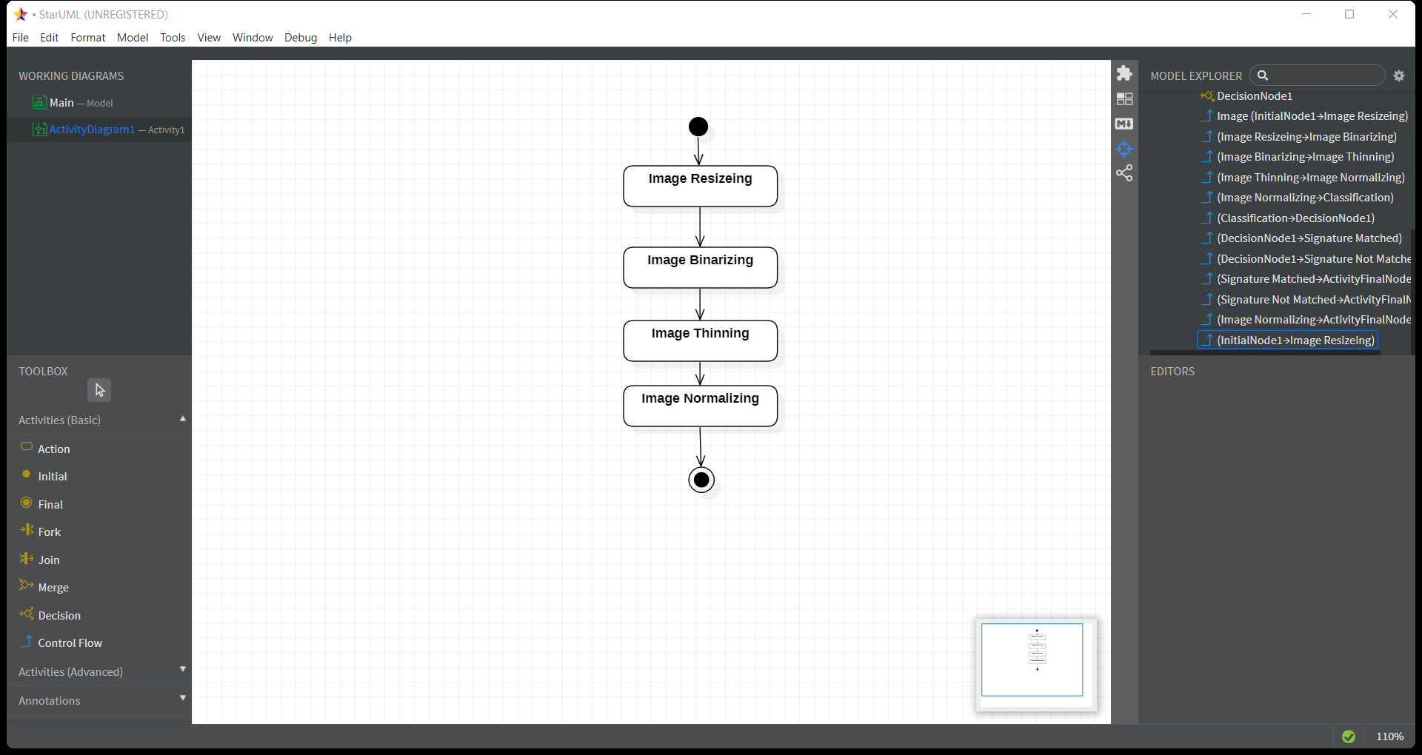
Activity diagram for pre processing

Slide 11
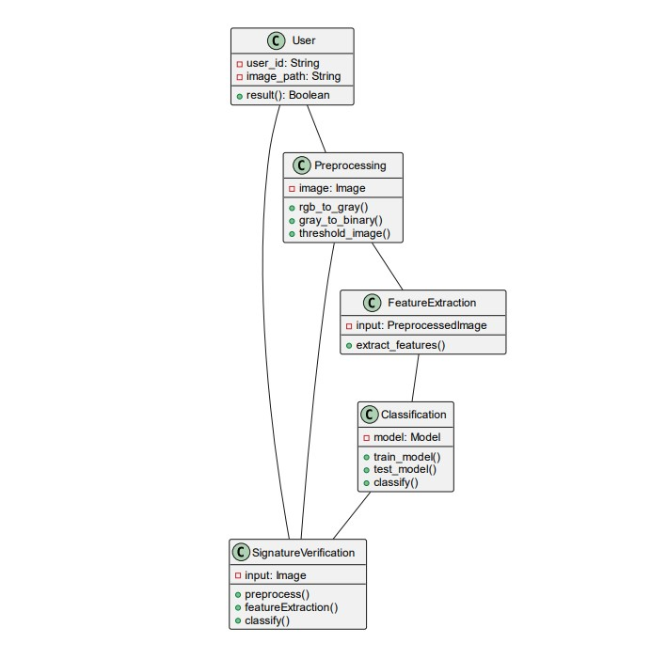
Class Diagram:

Slide 12
CONCLUSION
The final outcomes of the project is very optimistic and it genuinely encourages us for further research and development in this field.
Overall, the successful outcomes of this project provide a strong foundation for continued exploration and utilization of machine learning in the field of signature verification. It opens doors to new possibilities in security, efficiency, and fraud prevention.

Slide 13
THANK YOU !

