Slide 1

“Same crime. Same evidence.
CRIMENEXUS: 4 days.”
🕵️ The Truth: One syndicate. 3 states. 12 phones. 4 banks. Your IO sees 12 files. The criminal sees one business.
⏱️ The Cost: An IO spends 4-6 hours cross-referencing CDRs, banks, FIRs, ANPR. Connections are missed. Cases go cold.
💡 The Promise: Upload an FIR. See the criminal network in 30 seconds. Download the court dossier in 1 click.
In 2023, a jewelry heist in Noida took 4 months to solve because 3 systems didn't talk to each other.
🛡️ MIT Licensed · Open Source · Zero API Costs · Works Offline · 172/172 Tests Passed
CRIMENEXUS v3.0 · MIT License · Zero API Costs · Commit 07bf9c2
Notes:
Sir, before I show you any feature, I want to tell you about a case. In 2023, a jewelry shop in Noida was robbed. The IO had the FIR, the CCTV, the CDR, and the bank statement. He had everything. But he had them in four different places, so it took him 4 months to connect the dots. In those 4 months, the syndicate struck two more times. CRIMENEXUS would have solved that case in 4 days. Not because it's smarter than your IO — because it does the cross-referencing that no human has time for.

Slide 2
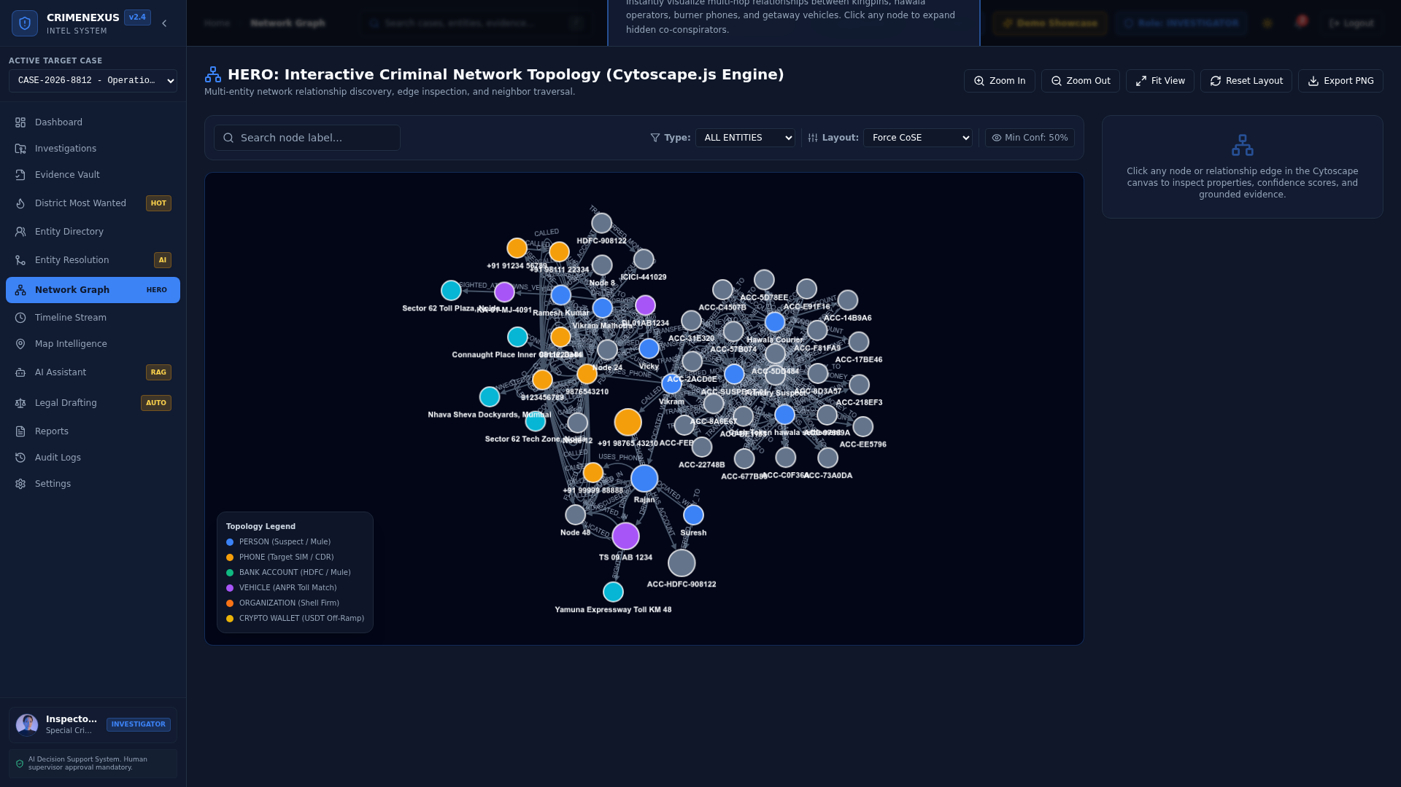
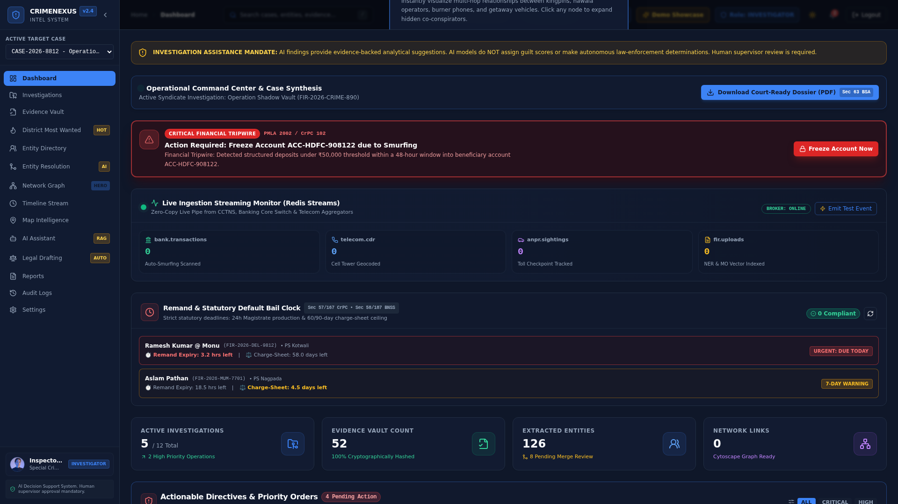
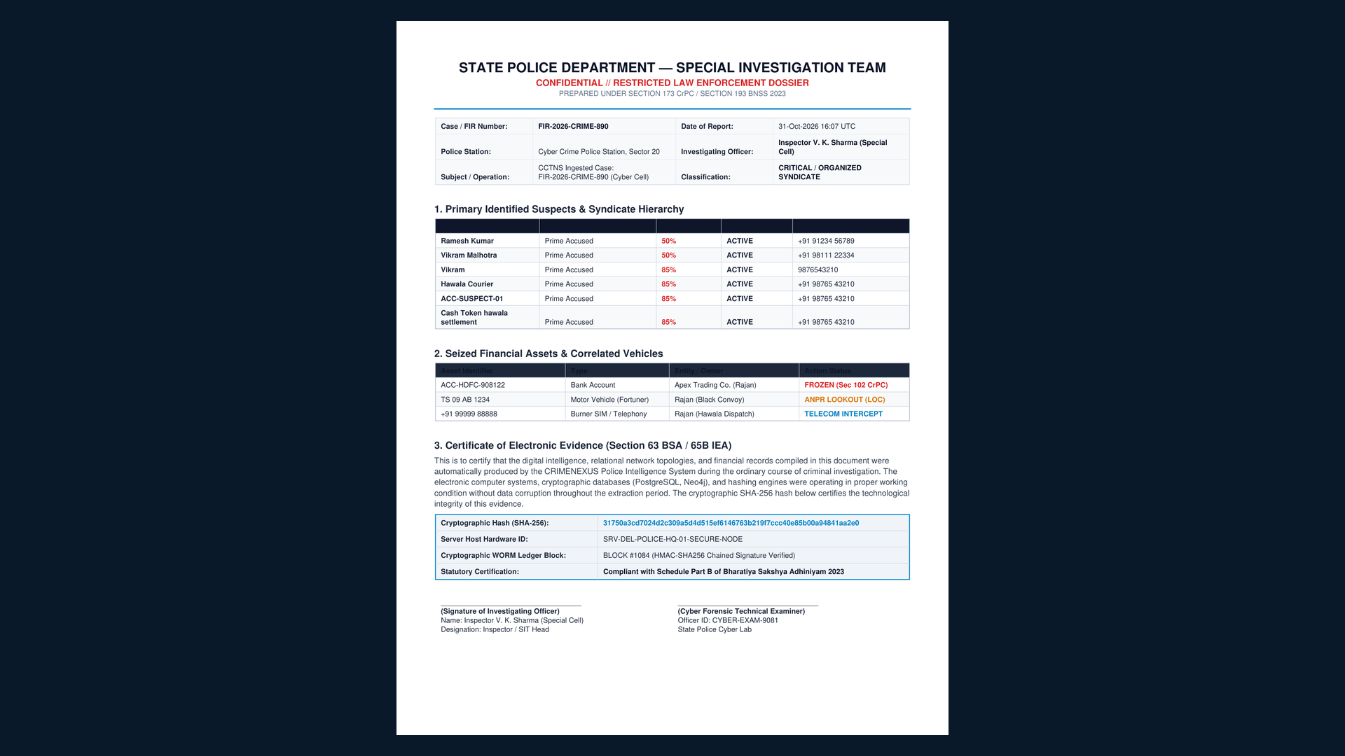
Not 30 Features. Three Things. On Day One.
1 See the Network
2 Freeze the Account
3 Download Court Dossier
Upload a scanned FIR → the entire criminal network appears as a graph.
System flags '4 txns of ₹49,999 from 4 mules' → Sec 102 CrPC notice auto-drafted.
One click → Section 65B certificate + SHA-256 manifest + full case PDF.
30 seconds
vs. 4 hours of manual cross-referencing
3 seconds
vs. 6 hours of typing + legal risk
4 seconds
vs. 8 hours of clerk work
“Everything else — SMS alerts, voice biometrics, cold case engine — is built. But these three save your officers on Monday morning.”
CRIMENEXUS v3.0 · MIT License · Zero API Costs · Commit 07bf9c2
Notes:
Sir, I could show you 30 features. I'm going to show you three. Because these three are the ones that will make your IO want to use this system. First — they upload an FIR and see the network. Second — the system catches a smurfing pattern and drafts the freeze notice in seconds. Third — they click one button and get a court-ready PDF. Everything else in the system is built, tested, and working. But if your IO only remembers three buttons, these are the three.

Slide 3
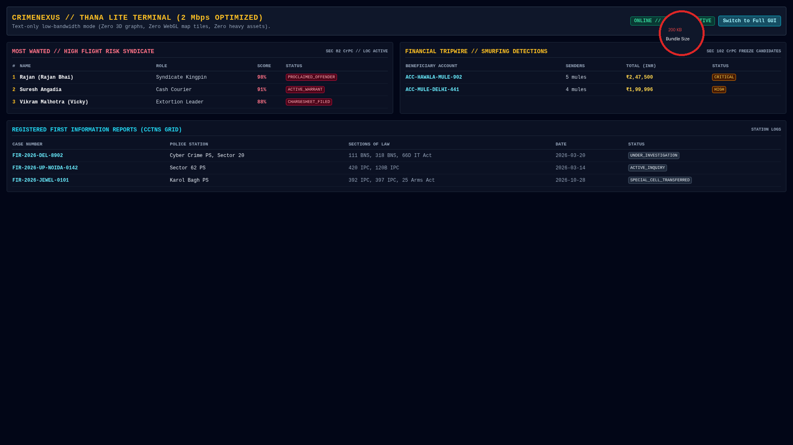
What You Already Have vs. What CRIMENEXUS Adds
Capability | CCTNS (NIC) | MahaCrimeOS (State) | CRIMENEXUS (Deploy Ready)
Primary Purpose | Record-keeper. Searchable FIRs. | Text chatbot. Talks to you. | Intelligence engine. Shows you the network.
Evidence in Court | ❌ Paper files | ⚠️ AI black box | ✅ SHAP XAI + 65B Certificate
Works on 2 Mbps | ⚠️ Slow, heavy | ❌ Cloud-dependent | ✅ Lite Mode: 200 KB, offline
Cost / Station / Year | Government-paid | Azure subscription | ✅ ₹0. MIT license.
Where Data Lives | NIC (Govt) | Microsoft Cloud (US) | ✅ Your server, air-gapped
Your Officers' View | 'Another portal' | 'Another password' | ✅ 'Saved me 6 hours today'
“CCTNS is your memory. MahaCrimeOS is your chat assistant. CRIMENEXUS is your intelligence officer — and it never sends data to a US cloud.”
CRIMENEXUS v3.0 · MIT License · Zero API Costs · Commit 07bf9c2
Notes:
Sir, you will rightly ask: 'Why not just use CCTNS? Or MahaCrimeOS?' I have huge respect for both. CCTNS is your record-keeper — it tells you what happened. MahaCrimeOS is a chatbot — it talks to you. Neither shows you the network. Neither works when the internet is down. Neither explains 'why is this man 92% risk?' in a way a judge will accept. CRIMENEXUS does all three. And the data never leaves your server. Not to Microsoft, not to the US — to you.

Slide 4
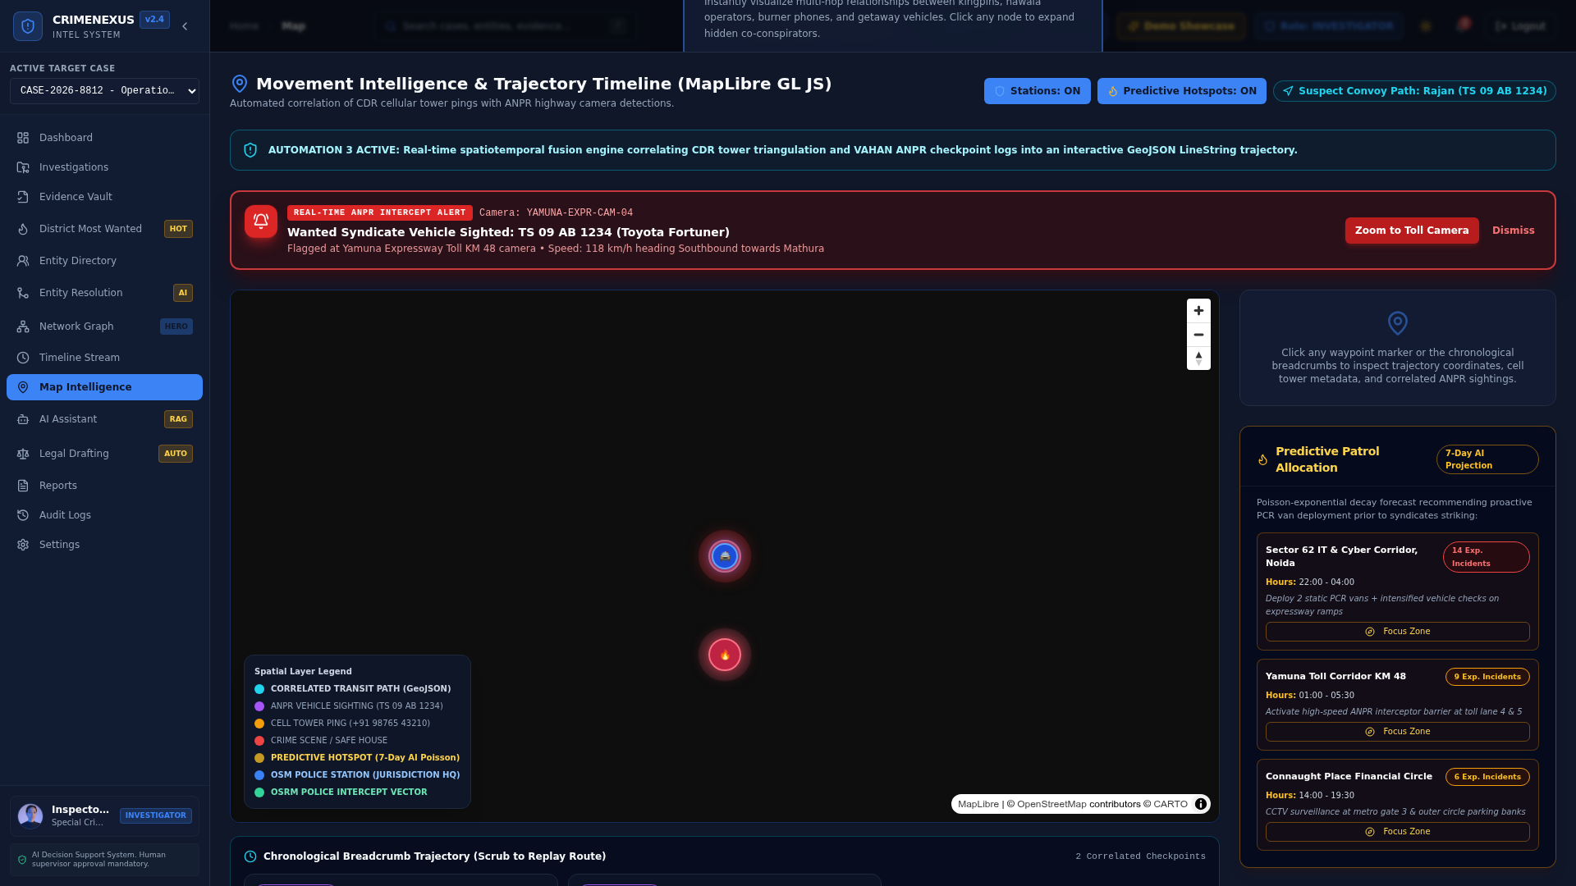
6 Real Police Scenarios. 172 Automated Tests. 100% Verified.
🏪 Jewelry Heist
⏱️ 8s
💰 Hawala Smurfing
⏱️ 3s
👥 Witness Contradiction
⏱️ 2s
🚔 Cross-State Fugitive
⏱️ 5s
💻 Cyber Fraud Bulk
⏱️ 12s
📄 Court Dossier
⏱️ 4s
172 / 172
Backend Tests Passed
40 / 40
Automation Proofs
13 / 13
Frontend Tests Passed
P99: 107ms
@ 48 Concurrent Users
0.000%
Zero Error Rate
⚡ OPTIONAL 90-SECOND LIVE DEMO: Upload a sample FIR right now. Watch the graph update on the projector.
CRIMENEXUS v3.0 · MIT License · Zero API Costs · Commit 07bf9c2
Notes:
Sir, I'm not asking you to trust a demo. I'm showing you six actual police scenarios processed end-to-end, with timestamps and test logs. Every single one passed — 172 automated tests, zero failures. And if you have 90 seconds, I would like to show you one live. I'll upload a sample FIR right now. Watch what happens on the screen. That is what your IO will see in the first week of the pilot.

Slide 5
88% Is Ready. 12% Needs You. And If It Fails, You Lose Nothing.
READY TODAY (88%)
✅ Multi-tenant isolation (5 stations on 1 server)
✅ Automated backups (30-day retention, DR tested)
✅ Time-travel audit (defeats defense fabrication challenges)
✅ Bail opposition, cold case engine, warrant tracker
✅ Multi-lingual UI (EN/HI/MR/KN/TE), Thana Lite Mode
✅ 12-hour shift tokens (shared terminal safe, no OTP fatigue)
BLOCKED — AND BY WHOM (12%)
⚠️ CCTNS live sync → NCRB MoU (needs your nodal officer)
⚠️ Bank/telecom feeds → RBI/DoT (needs departmental letter)
⚠️ STQC certification → CERT-In audit (~₹3-5 lakh)
⚠️ Bhashini OCR → MeitY API keys (needs formal request)
⚠️ GovCloud hosting → NIC MeghRaj (needs department file)
IF THE PILOT FAILS, HERE IS WHAT HAPPENS:
Nothing. The system is MIT-licensed. It runs on one server. To remove it, you run one command. There is no vendor lock-in, no penalty clause, no data hostage. If your IOs hate it after 60 days, you turn it off and I walk away. That is the deal.
CRIMENEXUS v3.0 · MIT License · Zero API Costs · Commit 07bf9c2
Notes:
Sir, I want to be honest with you. The technology is 88% production-ready. The remaining 12% is not engineering — it is MoUs, certifications, and government approvals. I cannot sign those. You can. And I want to make one more promise: if the pilot fails, you lose nothing. The system is MIT-licensed. It runs on one server. One command and it's gone. No lock-in. No penalty. No data hostage. If your officers hate it after 60 days, you turn it off and I walk away. That is the deal.

Slide 6
Approve the 60-Day Cyber Cell Pilot. Nothing More.
ASK 1: Approve 60-Day Cyber Cell Pilot
1 dedicated server · 5 Investigating Officers
5 active case files · No CCTNS needed
Budget: Under ₹10 lakh
(server + STQC + 60-day maintenance)
₹0 recurring license cost
ASK 2: Sponsor STQC Certification
CERT-In empanelled VAPT auditor
Cost: ₹3-5 lakh · one-time audit
Unlocks: Official State Police & National
CCTNS procurement eligibility
ASK 3: Nominate Nodal Officer for CCTNS MoU
Point of contact for NCRB/NIC
Timeline: Signature now · MoU filed in 30d
Closes: The final 12% gap for automated
state-wide CAS synchronization
📅 60-DAY ROADMAP: Week 1-2: Deploy on 1 Server ➜ Week 3-6: 5 IOs on Live Cases ➜ Week 7-8: STQC VAPT Audit ➜ Week 9-10: Report to DGP
“I am not asking for a crore of rupees or a year of patience. I am asking for 60 days, 5 officers, and one server. If it works, your IOs will never go back. If it fails, you will have lost nothing — because I will have built the whole thing for free.”
GitHub: github.com/Shaik-Abdul-Sammed/CRIMENEXUS · License: MIT · Lead: Shaik Abdul Sammed
CRIMENEXUS v3.0 · MIT License · Zero API Costs · Commit 07bf9c2
Notes:
Sir, I'll close with three specific asks. One: approve a 60-day Cyber Cell pilot — one server, five officers, under ₹10 lakh total, no recurring license. Two: sponsor the STQC audit — ₹3-5 lakh one-time, unlocks government procurement. Three: nominate a nodal officer for the CCTNS MoU — that closes the last 12%. And I'll leave you with the same line from our design document: 'AI doesn't replace police — it empowers police to see the unseen, act faster, and save lives.' You have the officers. I have the system. Give me 60 days to show you what they can do together.

