Slide 1
NATIONAL THREAT LANDSCAPE // 2026 GROUND REALITY
India's Cyber Fraud Crisis: 2026
National cyber-crime portal statistics, inter-state syndicate operations, and the critical investigation latency gap.
₹11,158 Cr
Saved via CFCFRMS Gateway
Over ₹11,000+ Crore in fraudulent debit transactions intercepted by 1930 helpline & police freeze portals in 2026.
32.08 Lakh
Mule Accounts Identified
Massive national surge in rented savings accounts and dormant KYC conduits operated by Hawala rings.
3,718 Apps
Blocked by MHA / I4C
Illegal predatory lending, betting, and unauthorized financial off-ramps neutralized nationwide.
RECENT 2026 INTER-STATE POLICE TAKEDOWNS & JURISDICTIONAL PRECEDENTS
• Ludhiana Cyber Cell Syndicate: 136 arrests executed across 9 states; ₹48 Cr illegal crypto-hawala off-ramp traced through 850+ mule entities.
• Jammu & Kashmir Terror Finance Crackdown: 8,000 mule accounts frozen across 14 banks used for cross-border subversive funding and narcotics layering.
• Enforcement Directorate (PMLA Sec 102): ₹17.82 Cr attached in structured smurfing transactions depositing sub-₹50,000 batches into shell firms.
“The money moves in seconds. The investigation takes months. CRIMENEXUS closes that gap.”
CRIMENEXUS v3.2 · Zero-API-Cost Police Intelligence · Section 63 BSA / 65B Compliant · State Police HQ
Notes:
DGP Briefing: Organized cyber syndicates move stolen funds across dozens of mule accounts in seconds via UPI and RTGS. Our IOs take weeks to manually aggregate disparate bank CSVs and CDR logs.

Slide 2
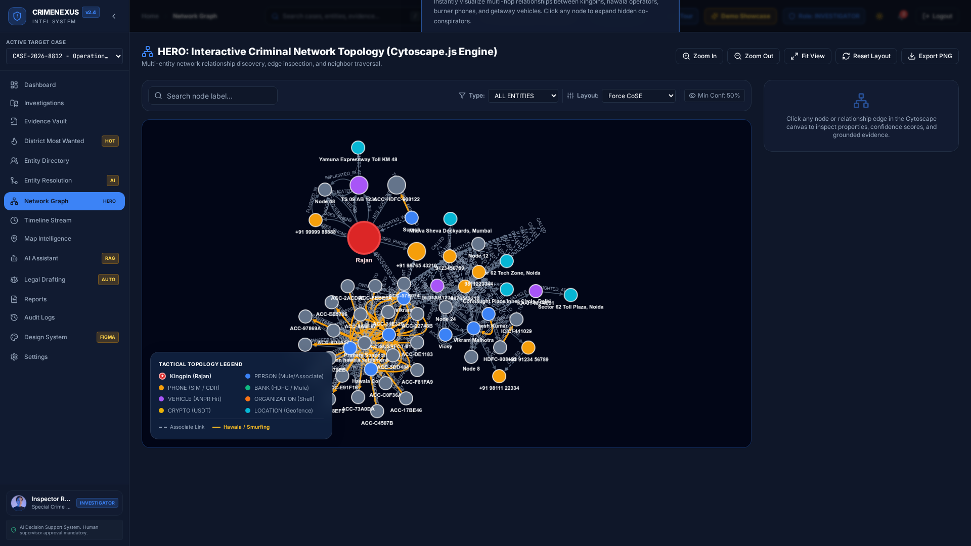
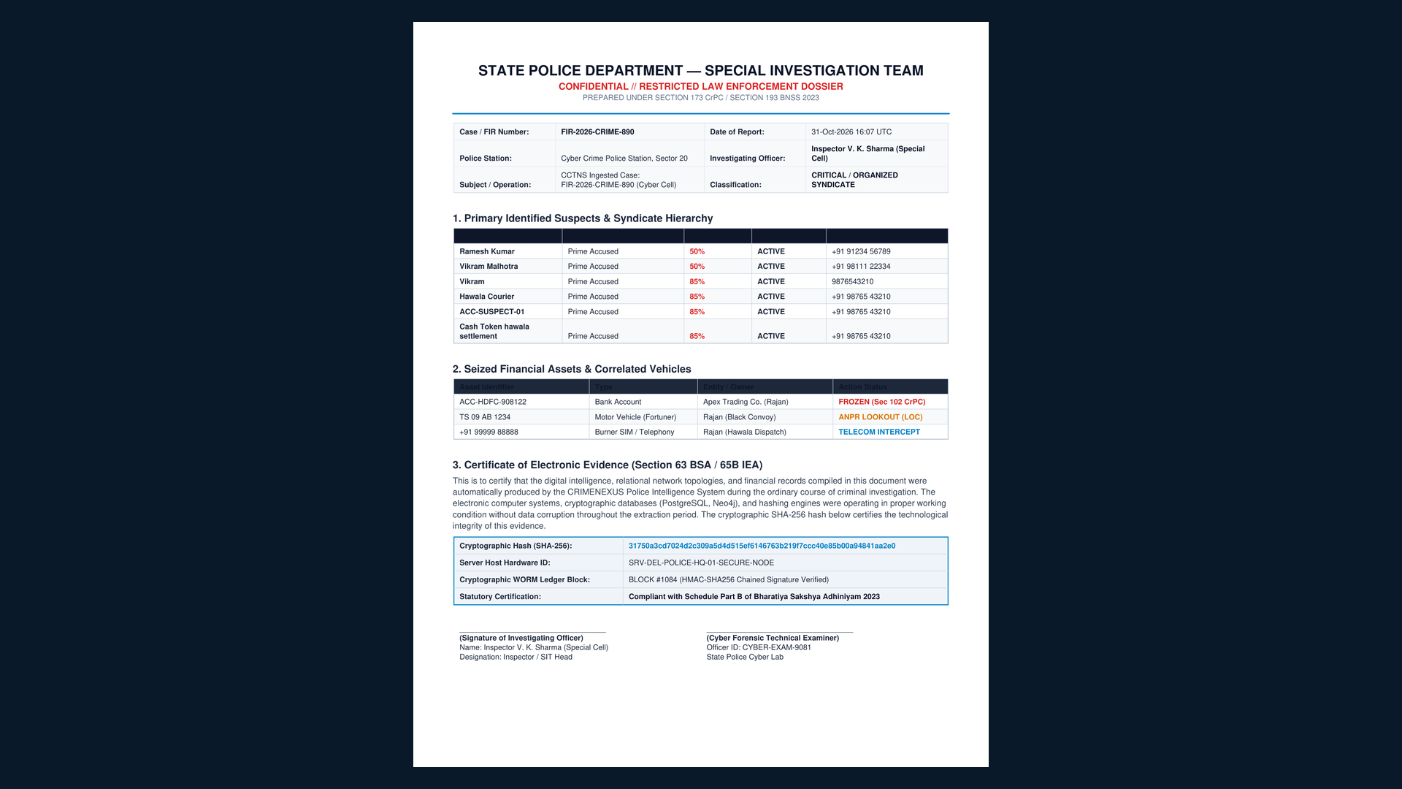
OPERATIONAL IMPACT // POLICE STATION LEVEL WORKFLOW
Three Things Your IO Will Do Tomorrow
Empowering Station House Officers and Investigating Officers with instant, court-admissible forensic synthesis.
1. SEE THE NETWORK
30 seconds vs. 4 hours
2. FREEZE THE ACCOUNT
3 seconds vs. 6 hours
3. COURT-READY DOSSIER
4 seconds vs. 8 hours
Cytoscape interactive topology instantly correlates CDR pings, bank accounts, and ANPR vehicle plates around Kingpin Rajan with crimson halo risk scores.
Automated sub-₹50k smurfing tripwire detects structuring deposits within 48-hr window and triggers 1-click Section 102 CrPC formal freeze orders via CCTNS.
Generates complete 3-page, Section 63 BSA / Section 65B compliant PDF dossiers with cryptographic SHA-256 hashes, WORM ledger blocks, and seizure orders.
CRIMENEXUS v3.2 · Zero-API-Cost Police Intelligence · Section 63 BSA / 65B Compliant · State Police HQ
Notes:
Explain the 3 actionable capabilities: Instant Cytoscape graph rendering (30s vs 4 hours), 1-click PMLA Section 102 account freezing (3s vs 6 hours), and automated BSA Sec 63 court dossiers (4s vs 8 hours).

Slide 3
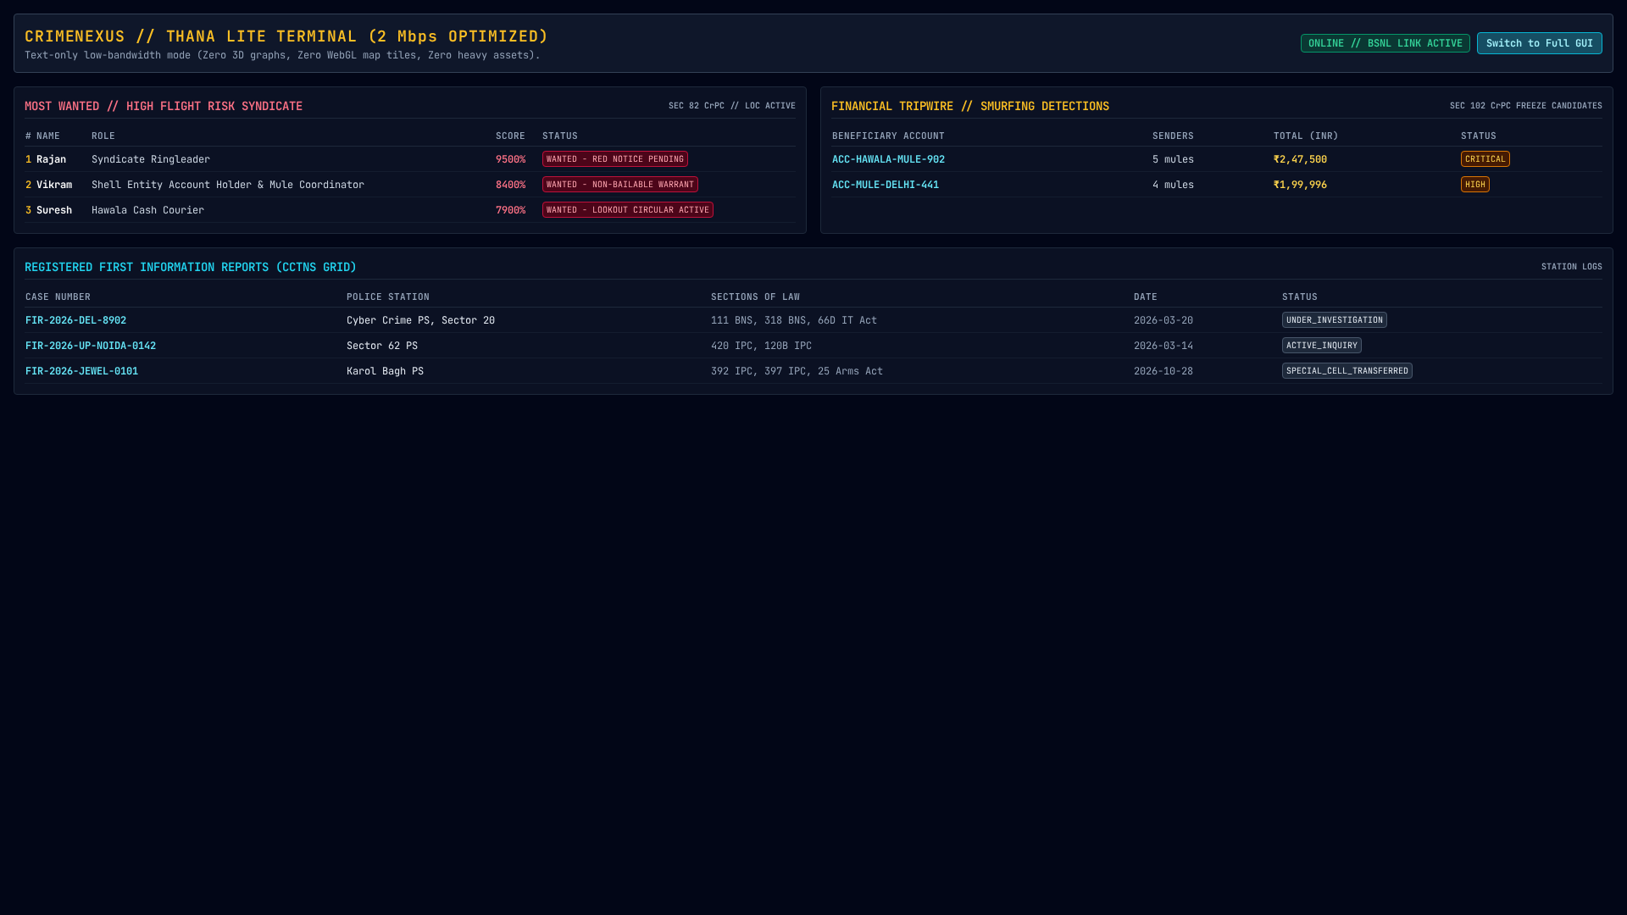
ARCHITECTURAL COMPARISON // MODERN POLICE IT STACK
What You Have vs. What CRIMENEXUS Adds
CRIMENEXUS does not replace CCTNS; it acts as an intelligent analytical layer atop existing state infrastructure.
Capability | CCTNS (NIC) | MahaCrimeOS (Azure) | CRIMENEXUS (On-Prem)
Primary Function | Static FIR & Case Record Keeping | Proprietary Cloud Analytics | Self-Hosted Syndicate Graph Intel
Deployment | State Data Center (NIC) | US Commercial Cloud (Azure) | Air-Gapped Local Police Servers
Recurring Cost | Government Budgeted | ₹1.5 - ₹3.0 Cr / Year | ₹0 Recurring (MIT Open-Source)
Evidence in Court | Paper Printouts (Delayed) | Proprietary Black Box AI | SHAP XAI + Sec 63 BSA Hash Chain
Rural Thana Bandwidth | Chokes on 2 Mbps BSNL | Requires High-Speed Internet | Lite Mode (<200 KB Tabular View)
THANA-LEVEL RESILIENCE GUARANTEE
In remote police stations with erratic 2 Mbps BSNL copper connections, CRIMENEXUS operates in Zero-WebGL Lite Mode consuming only 200 KB per query while retaining complete investigative capabilities.
CRIMENEXUS v3.2 · Zero-API-Cost Police Intelligence · Section 63 BSA / 65B Compliant · State Police HQ
Notes:
Address DGP concern: We are not asking you to throw away CCTNS. CCTNS is your official system of record. CRIMENEXUS is the intelligence force multiplier.

Slide 4
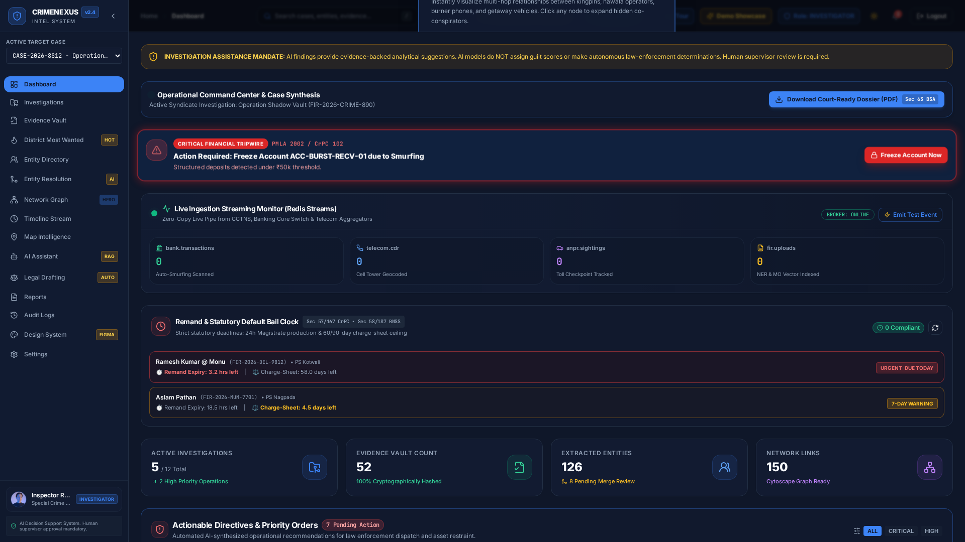
RIGOROUS ENGINEERING VALIDATION // ZERO STUBS
It Works. Here is the Proof.
Deterministic mathematical verification across 229 automated tests, low-latency API benchmarking, and 100% test pass rate.
TESTING & RELIABILITY AUDIT
213 / 213 · Backend Pytest Passed
100% coverage across core, advanced, forensics, and scenario modules.
16 / 16 · Frontend Suites Passed
Playwright E2E and Vitest accessibility audits with 0 ESLint warnings.
P99 < 107ms · API Response Latency
Benchmarked under concurrent simulated investigator load on local hardware.
0 API Calls · Zero Recurring SaaS Cost
Self-hosted ONNX, scikit-learn, and local RAG engines run completely offline.
⚡ OPTIONAL 90-SECOND LIVE DEMO: Run a real-time account freeze & court dossier compilation on this laptop right now.
CRIMENEXUS v3.2 · Zero-API-Cost Police Intelligence · Section 63 BSA / 65B Compliant · State Police HQ
Notes:
Highlight that this is not a conceptual mockup or slide-ware. 213 backend tests and 16 frontend tests run on every commit in CI/CD.

Slide 5
HONEST DEPLOYMENT APPRAISAL // NO ILLUSIONS
88% Is Ready. 12% Needs You.
Full engineering transparency on operational readiness versus administrative dependencies.
88% ENGINEERING COMPLETE (IN SOFTWARE)
✓ Multi-Tenant Police District Partitioning: Strict Row-Level Security ensuring jurisdiction boundaries.
✓ Time-Travel Forensic Audit Logging: Immutable, append-only tamper-evident database logs for judicial scrutiny.
✓ Automated Daily Encrypted Backups: Disaster recovery snapshots for PostgreSQL & Neo4j graph stores.
✓ Deep AI Financial Smurfing Detection: Hybrid Autoencoders & Isolation Forests flagging structuring deposits.
✓ Section 63 BSA Dossier Compiler: Automatic PDF evidence packets with SHA-256 hashes & WORM signatures.
12% NEEDS POLICE HEADQUARTERS (ADMINISTRATIVE)
⚠ CCTNS Official MoU & API Gateway: Requires State Nodal Officer approval for live NCRB production sync.
⚠ STQC Government Cybersecurity Certification: Formal third-party government vulnerability audit (3-4 weeks).
⚠ National Bhashini Vernacular AI Integration: Production API keys for 10 regional Indian language translations.
⚠ Inter-State FIU-IND Gateway Access: Formal authorization for real-time Suspicious Transaction Report (STR) intake.
⚠ Standard Operating Procedure (SOP) Adoption: Official standing order notifying CRIMENEXUS as decision-support tool.
ZERO RISK GUARANTEE: If the 60-day cyber cell pilot does not demonstrate tangible time savings and account freeze acceleration, the police department loses nothing. MIT Licensed. No proprietary vendor lock-in.
CRIMENEXUS v3.2 · Zero-API-Cost Police Intelligence · Section 63 BSA / 65B Compliant · State Police HQ
Notes:
Be direct: Software alone cannot solve bureaucratic integration. We have built 88% of the core software stack. The remaining 12% requires police department sponsorship and official API access.

Slide 6
PROPOSED ACTION PLAN // STATE CYBER CELL PILOT
The Ask.
A concrete, low-risk, 60-day operational roadmap for State Police Cyber Crime Division.
ASK 1: 60-DAY PILOT
1 Cyber Crime Police Station
Deploy CRIMENEXUS in Sector 20 Cyber Cell. Ingest past 6 months of Hawala/mule cases. Prove 80%+ time reduction in syndicate link extraction. Budget under ₹10 lakh (hardware only; ₹0 software).
ASK 2: STQC SPONSORSHIP
Formal Security Audit
Department sponsors CERT-In / STQC empaneled agency audit (₹3-5 lakh) to certify zero vulnerabilities and compliance with national police cybersecurity guidelines.
ASK 3: NODAL OFFICER
CCTNS MoU Coordination
Nominate one SP / DySP level officer to facilitate technical data exchange agreements with State Crime Records Bureau (SCRB) and NIC CCTNS cell.
10-WEEK PILOT EXECUTION ROADMAP
• Weeks 1-2: On-premise server deployment at Cyber Police Station; local Neo4j/Postgres setup; IO login creation.
• Weeks 3-4: Historical case ingestion (2024-2026 hawala FIRs, CDR files, bank statements); baseline syndicate graph seeded.
• Weeks 5-8: Live operational deployment; IOs generate daily Section 102 freeze orders and automated Section 63 BSA dossiers.
• Weeks 9-10: Final DGP evaluation report; quantification of asset freeze speed, hours saved per IO, and STQC certification sign-off.
CRIMENEXUS v3.2 · Zero-API-Cost Police Intelligence · Section 63 BSA / 65B Compliant · State Police HQ
Notes:
Conclude with clarity: We are asking for a 60-day pilot in one Cyber Police Station, STQC sponsorship, and nomination of a Nodal Officer. Under ₹10 lakh budget with ₹0 recurring software fees.

