Slide 1
WATER MANAGEMENT SYSTEM AUTOMATION
(Scripting Languages – CPSC 6210 Spring 2024)---------(Professor :- Soon-Ok Park)
Presented by:-
Abdullah Shaik
Mohammed Shabuddin
Swetha Patibandla

Slide 2
INTRODUCTION
Urban areas mainly rely on Local Corporations for Water Supply provided according to pre-determined schedules.
Changes in schedule leads to confusion and inconvenience for residents.
Our project addresses this challenge by automating the water supply scheduling process.
This project aims to develop a Water Supply Management System using Python for backend operations and Tkinter for the Frontend User Interface.
By providing real-time information on water supply schedules, our system enables residents to prepare accordingly, minimizing water wastage.
Local Officers update future schedules in a Centralized Database that can be accessible for residents to know schedules , water bill information etc.

Slide 3
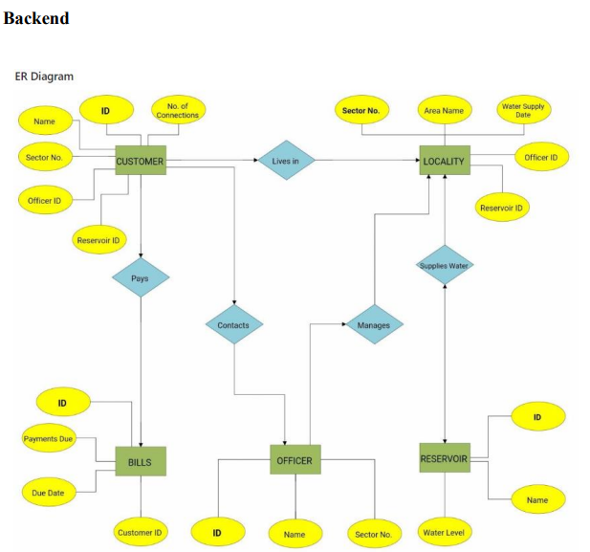
PROJECT STRUCTURE
Backend Logic:-
The backend logic involves the creation, manipulation, and deletion of data within the database. Key functionalities include:
• Defining database schema and table structures. • Adding, viewing, and deleting records.
• Updating water supply dates dynamically based on user-defined parameters.

Slide 4
Code Snippets
Backend Operations:-
•Creating Officer Table: Defines the schema and structure for the 'Officer' relation in the database.
•Adding, Viewing, and Deleting Records: Functions to perform CRUD operations on the database.
•Updating Water Supply Dates: Automates the process of updating supply dates based on predefined rules.

Slide 5
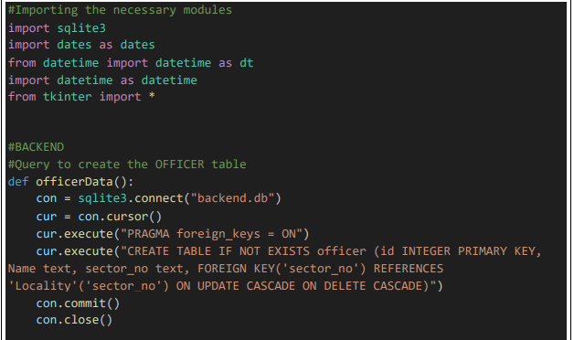
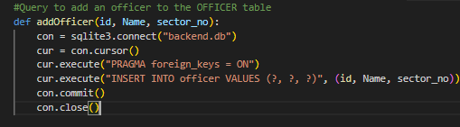
In the backend.py file, several functions handle database operations:
officerData: Creates the OFFICER table.
addOfficer: Adds an officer to the OFFICER table.
viewOfficer: Views all the officers from the OFFICER table.
delOfficer: Deletes an officer from the OFFICER table.
officerView: Views customers associated with a specific officer.
reservoirData:Creates the RESERVOIR table.
addReservoir : Adds a reservoir to the RESERVOIR table.
delReservoir: Deletes a reservoir from the RESERVOIR table.
viewReservoir: Views all the reservoirs from the RESERVOIR table.
billData: Creates the BILLS table.
addBill: Adds a bill to the BILLS table.
delBill: Deletes a bill from the BILLS table.
viewBill: Views all the bills.
Query to create Officer Table:
Query to add an Officer to Officer Table:

Slide 6
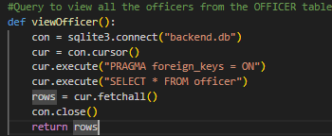
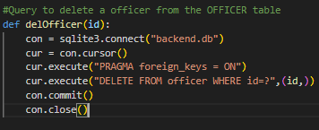
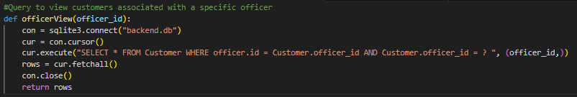
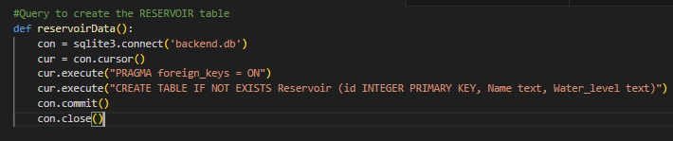
Query to view Officers from Officer Table:
Query to delete an Officer from Officer Table:
Query to view customers associated with specific officer:
Query to create the RESERVOIR table :

Slide 7
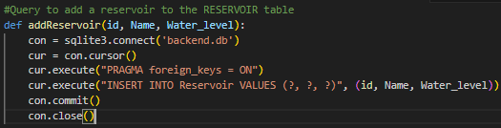
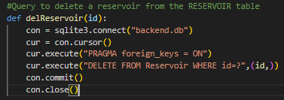
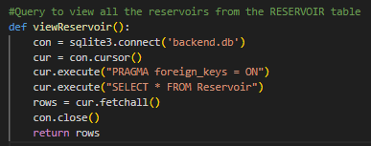
Query to add reservoir to RESERVOIR Table:
Query to delete Reservoir from RESERVOIR Table:
Query to view all the reservoirs from RESERVOIR Table:
Query to create the BILLS Table:

Slide 8
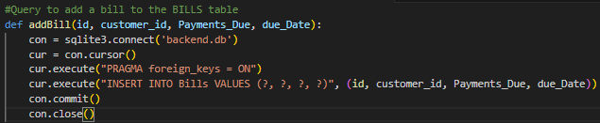
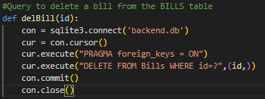
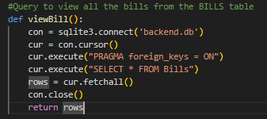
Query to add bill to BILLS Table:
Query to delete a bill from the BILLS Table:
Query to view all the bills from the BILLS Table:

Slide 9
PROJECT STRUCTURE
Frontend Interface:-
• GUI Construction: Design and layout of GUI elements using Tkinter.
• Button Actions: Implementation of button functionalities such as adding new records and resetting data.
• TreeView Display: Representation of database records in a TreeView format for easy viewing and management.
Frontend Logic:-
The frontend interface is designed using Tkinter, offering a user-friendly environment for interaction. Features include:
• Creation of GUI elements such as buttons, text boxes, and TreeView for database representation.
• Integration with backend functionalities for seamless data manipulation.
• Enhanced user experience through intuitive design and layout.

Slide 10
The presentation layer includes the main function and several classes:
Check Class: Sets up the main window of the application, including the title, dimensions, background color, and a frame within the window. It also includes buttons for admin login, customer login, and officer login, along with functions to redirect to the respective login screens.
Window1 Class: Creates the admin login screen with user input fields for username and password, along with buttons for login, reset, and exit. It also includes functions to handle the login system, reset input fields, and exit the application. After a successful login, it redirects to different screens based on the user's role (customer, officer, admin).
Customer Class: Manages customer-related functionality, including adding, displaying, deleting, and updating customer records. It also includes a function to handle the selection of a customer record and contains frames and widgets for the customer interface.
Officer Class: Manages officer-related functionality, including adding, displaying, deleting, and updating officer records. It also includes frames and widgets for the officer interface.
Bills Class: Manages billing information, including adding, displaying, deleting, and updating billing records. It also includes frames and widgets to display billing records using a Treeview widget.
Locality Class: Manages locality-related information, including adding, displaying, deleting, and updating locality records. It also includes frames and widgets for the locality interface.
Reservoir Class: Manages reservoir-related information, including adding, displaying, deleting, and updating reservoir records. It also includes frames and widgets for the reservoir interface.
Window2 Class: Creates the customer login screen with functions to fetch and display customer details based on the provided ID.
Window3 Class: Creates the officer login screen with functions to add, display, and reset officer records

Slide 11
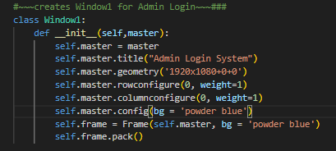
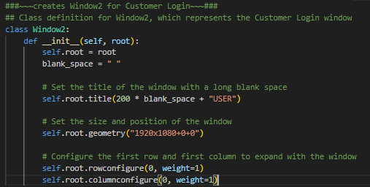
Code Snippets
Some example code snippets of main functions involved in Front End:-
Creation of Window1 for Admin Login:-
Creation of Window2 for Customer Login:-

Slide 12
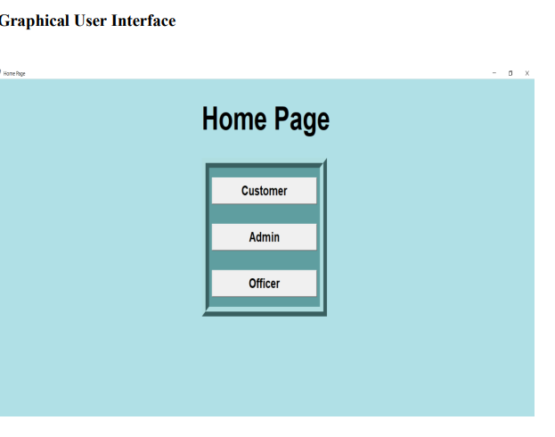
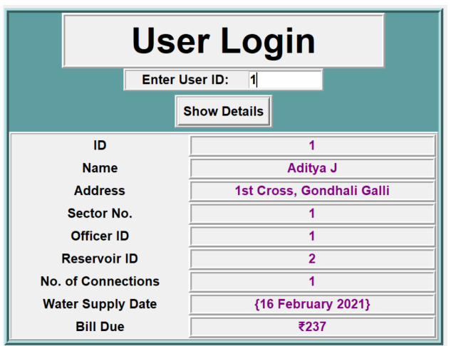
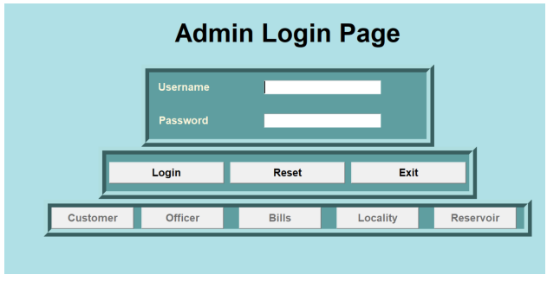
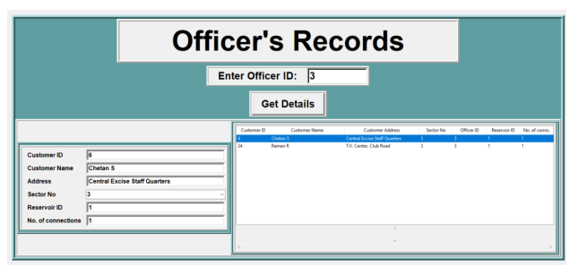
GUI of Home Page:-
GUI of User LoginPage:-
GUI of Admin Login Page:-
GUI of Officer’ Record’sPage:-

Slide 13
The Water Supply Management System addresses the growing challenges of water resource management by streamlining supply schedules and improving communication with residents. By leveraging technology, the system aims to optimize resource utilization and ensure equitable distribution of water.
Conclusion:-

Slide 14
--THANK YOU!!!

