Slide 1
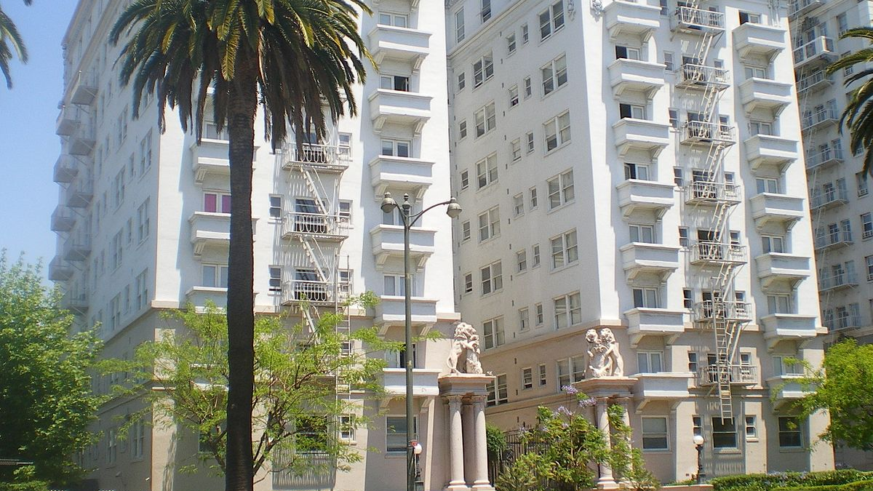
Conprect
A Construction Predictor and Manpower provider
V. Kalyan: 1602-19-737-135
Shaik Amaan: 1602-19-737-166

Slide 2

Actors wise Use Cases
User Administrator
Services > Login
Structure Cost 1.Verify details
Time Required 2.Error if details are wrong
EMI > Updation
Total Cost Required
Interior
Semi Furnished
Fully Furnished
Manpower
Plumber
Carpenter
Electrician

Slide 3
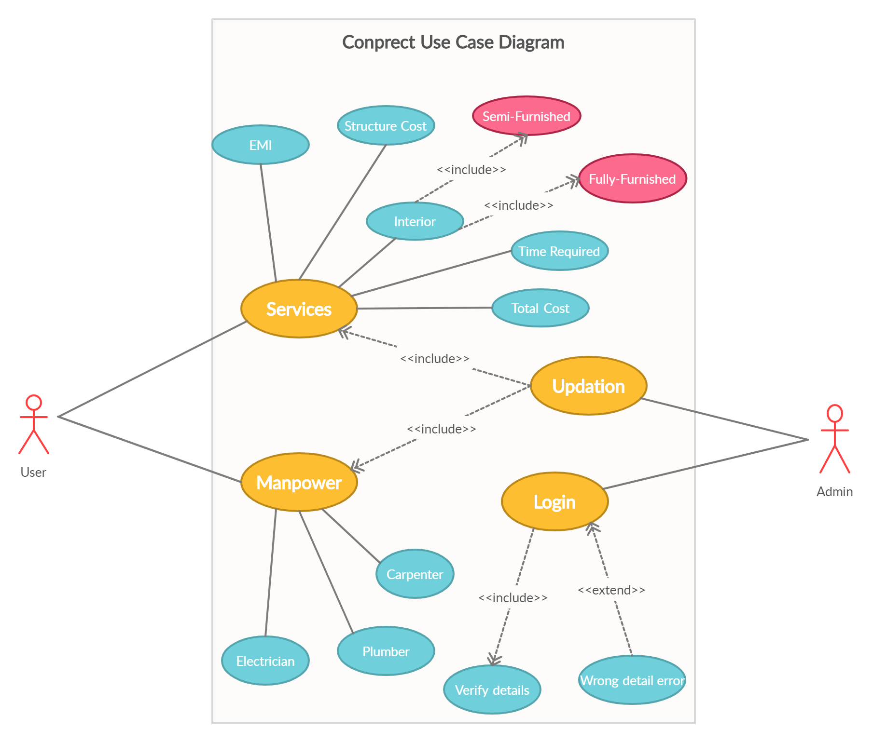

Slide 4
USE CASE DESCRIPTION
Use Case ID: UC101
Name: EMI
Actors: User
Description: Allows user to know the amount to be paid per month to builder
Pre-conditions: User should enter his choice of flat
Post-conditions: System should display the requested details
Main Flow:
User | System
1. Chooses the EMI option
 | 2. Prompts data required for system to calculate EMI per month
3. Enters the data prompted by the system
 | 4. Validate user's data then display the concerned data.

Slide 5
Use Case ID: UC102
Name: Total time
Actors: User
Description: Allows user to know the total time required to complete the project by inserting the required data prompted by the system
Pre-conditions: None
Post-conditions: Result displays the time required
Main Flow:
User | System
1. Chooses the Time option
 | 2. Prompts data required for system to calculate time required.
3. Enters the data prompted by the system
 | 4. Validate user's data then display the time required in months.

Slide 6
Use Case ID: UC103
Name: structure
Actors: User
Description: Allows user to know the total amount required to complete structure of the project
Pre-conditions: None
Post-conditions: Result displays the amount required in rupees
Main Flow:
User | System
1. Chooses the Structure option
 | 2. Prompts data required for system to calculate time required.
3. Enters the data prompted by the system
 | 4. Validate user's data then display the amount required in rupees.

Slide 7
Use Case ID: UC104
Name: semi furnished interior
Actors: User
Description: Allows user to know the total amount required to complete semi furnished type interior of the project
Pre-conditions: User should select semi furnished option
Post-conditions: Result displays the amount required in rupees
Main Flow:
User | System
1. Chooses the Structure option
 | 2. Prompts data required for system to calculate time required.
3. Enters the data prompted by the system
 | 4. Validate user's data then display the amount required in rupees.

Slide 8
Use Case ID: UC105
Name: Fully furnished interior
Actors: User
Description: Allows user to know the total amount required to complete fully furnished type interior of the project
Pre-conditions: User should select fully furnished option
Post-conditions: Result displays the amount required in rupees
Main Flow:
User | System
1. Chooses the Structure option
 | 2. Prompts data required for system to calculate time required.
3. Enters the data prompted by the system
 | 4. Validate user's data then display the amount required in rupees.

Slide 9
Use Case ID: UC106
Name: Plumber
Actors: User
Description: Allows user to know details of the plumbers from the data base of the admin
Pre-conditions: Should choose Manpower option before choosing plumber option
Post-conditions: Result displays the plumbers details
Main Flow:
User | System
1. Chooses the plumber option
 | 2. Validate user’s option then display the required information. 2.1 if the information is not present display no information board

Slide 10
Use Case ID: UC107
Name: Carpenter
Actors: User
Description: Allows user to know details of the carpenter from the data base of the admin
Pre-conditions: Should choose Manpower option before choosing carpenter option
Post-conditions: Result displays the carpenter details
Main Flow:
User | System
1. Chooses the carpenter option
 | 2. Validate user’s option then display the required information. 2.1 if the information is not present display no information board

Slide 11
Use Case ID: UC108
Name: Electrician
Actors: User
Description: Allows user to know details of the electrician from the data base of the admin
Pre-conditions: Should choose Manpower option before choosing electrician option
Post-conditions: Result displays the electrician details
Main Flow:
User | System
1. Chooses the Electrician option
 | 2. Validate user’s option then display the required information. 2.1 if the information is not present display no information board

Slide 12
Use Case ID: UC109
Name: Login
Actors: Admin
Description: Allows admin to Login
Pre-conditions: None
Post-conditions: Admin logs in and all the updating options are shown
Main Flow:
User | System
1. Enters username and password
 | 2. Validate username and password. 2.1 If the username is valid, then login and display updating options. 2.2 If the password is invalid, display error message and prompt for valid username. 2.3 If the password is invalid, display error message and prompt for valid password.

Slide 13
Use Case ID: UC110
Name: Updating
Actors: User
Description: Allows admin to change the rates, update manpower details
Pre-conditions: None
Post-conditions: Shows options for updating which information the admin need to change
Main Flow:
Admin | System
1. Chooses the Updation option
 | 2. Display the required options of updating
3. Choose the required option which admin need to update
 | 4. Update the required information

