Slide 1
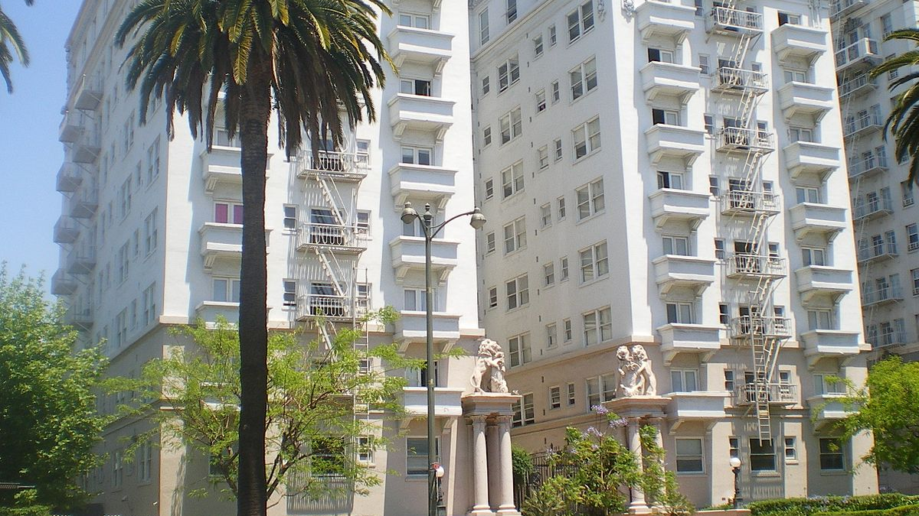
Conprect
A Construction Predictor and Manpower provider

Slide 2



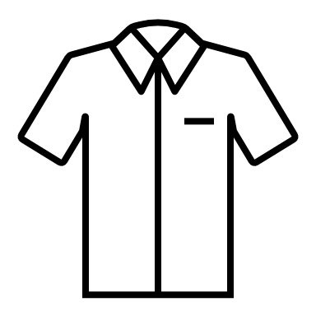
Objectives
Days needed to built
Finance Required
EMI payment for buyer
Needed Get it
Admin Login
Objectives

