Slide 1
Receipt and Invoice Digitizer Milestone 3 – Admin Dashboard & System Enhancements

Slide 2
Team Project Presentation
Developed By:
Frontend: srushti
Database: Leelakrishna kondapaturi
Backend and Ai: Shaik Ayisha
Technologies: React, Flask, OCR, Gemini API
Milestone Focus: Admin Panel & User Management

Slide 3
Project Overview
The Receipt and Invoice Digitizer is a system designed to convert physical receipts and invoices into structured digital data
Key Objective
Automatically extract important information from receipts and invoices.
Core Features
→OCR-based text extraction
→Secure user login
→AI chatbot assistance
→Admin dashboard for monitoring uploads

Slide 4
Milestone 3 Objectives
In Milestone 3, we focused on implementing the Admin Dashboard and System Management Features.
Goals:
→Build an Admin Control Panel
→Display uploaded invoices and receipts
→Visualize system activity through graphs
→Enable navigation between different admin sections
→Improve authentication and user interaction

Slide 5
Admin Dashboard
The Admin Dashboard provides an overview of the system activity.
Features:
→Graph visualization of uploaded invoices/receipts
→Summary of system data
→Easy navigation to different modules
Admin Navigation Includes
→Dashboard Page
→Users Page
→Invoices Page
→This helps administrators monitor platform usage and manage data efficiently.

Slide 6
Invoice Management (Admin Table)
The admin panel includes a table displaying uploaded documents.
Information Displayed
→Vendor Name
→Price / Amount
→Invoice or Receipt Status
Benefits
→Easy tracking of uploaded documents
→Quick verification of invoice details
→Better financial record management

Slide 7
UI & Navigation Enhancements
• Implemented a functional sidebar navigation for easy movement across dashboard sections.
• Added auto-scroll from “Documents” in the sidebar to the Recent Documents section.
• Introduced a Home dropdown menu with options like Admin profile and Logout
.User Experience Enhancement
• Designed a consistent global dashboard layout for better usability.
• Enabled smooth navigation between sections to improve overall user interaction.

Slide 8
UI/UX Design Improvements
Enhanced Dashboard Theme
• Updated the overall dashboard layout with a blue–purple gradient background.
• The color palette was chosen to:
• Improve visual appeal
• Provide a modern professional interface
• Enhance user focus on key data sections
Structured Content Layout
• Organized dashboard sections into a clear hierarchy:
• Upload Section
• Recent Documents
• Analysis Section
• How-It-Works Guide
This structured layout improves information clarity and navigation efficiency.

Slide 9
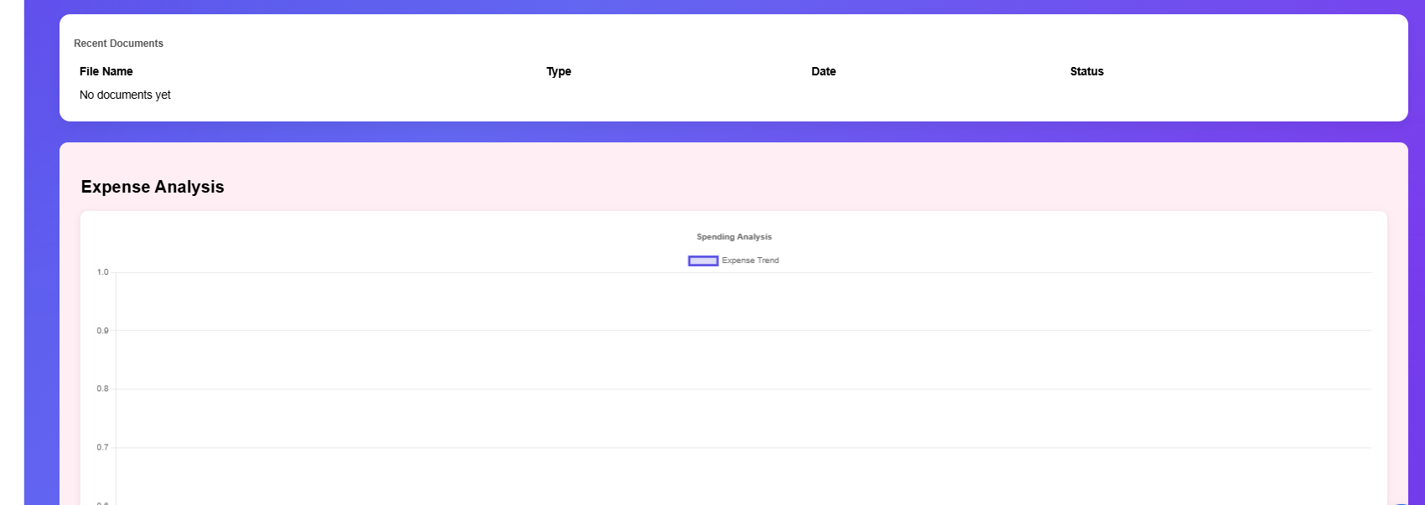
Data Visualization & Insights
Expense Analysis Chart
•Added an Expense Analysis Chart to visualize extracted invoice data.
•Positioned directly below the Recent Documents section to maintain logical data flow.
Design Decisions
•Chart displayed inside a pinkish-white card container to visually highlight the analytics area.
•Provides users with quick financial insights from uploaded invoices.
User Benefit
•Enables visual tracking of expenses
•Improves data understanding and decision making

Slide 10
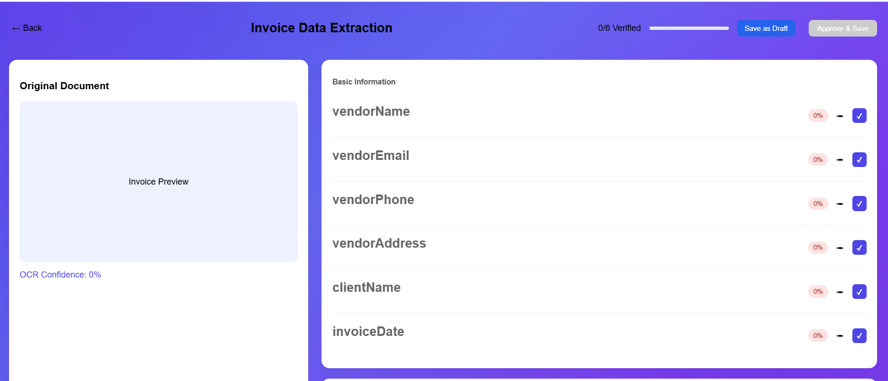
Invoice Data Verification & Editing
Invoice Data Extraction Preview
• Implemented a data verification interface for extracted invoice information.
• Displays extracted fields such as:
• Vendor details
• Invoice number
• Dates
• Line items
• Financial totals

Slide 11
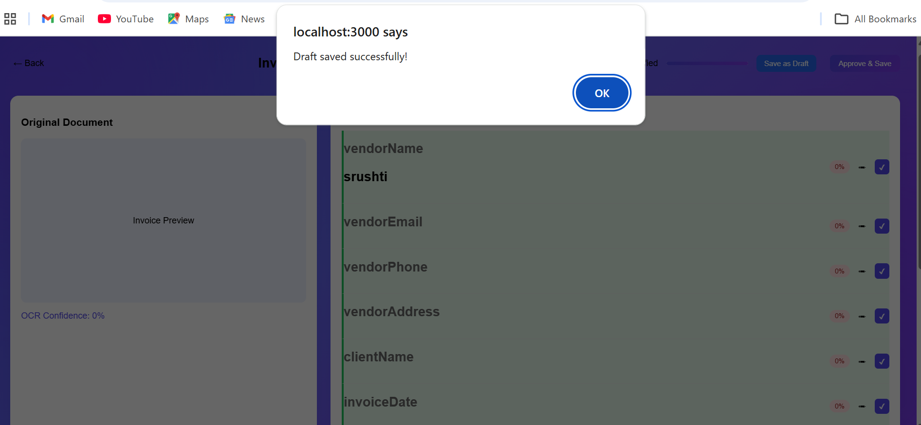
Invoice Data Verification & Editing
Editable Verification Panel
• Users can review and edit extracted data before final submission.
• Supports:
• Adding missing information
• Editing incorrect values
• Removing unwanted entries
Save Functionality
• After verification, users can save the corrected data, ensuring higher accuracy in stored records

Slide 12
Backend Features Implemented
Backend enhancements in this milestone include:
Google Authentication
→Secure login using Google OAuth
→Simplifies user access
→Ensures authentication security
AI Chatbot Integration
→Implemented using Gemini API
→Helps users interact with the system
→Can assist with invoice-related queries

Slide 13
Conclusion & Future Work
Achievements in Milestone 3:
→Admin dashboard implemented
→Invoice data monitoring through tables
→Graph visualization added
→Google login integrated
→AI chatbot functionality implemented
Future Enhancements:
→Advanced expense analytics
→Automated invoice categorization
→Multi-language OCR support
→Cloud database integration

