Slide 1
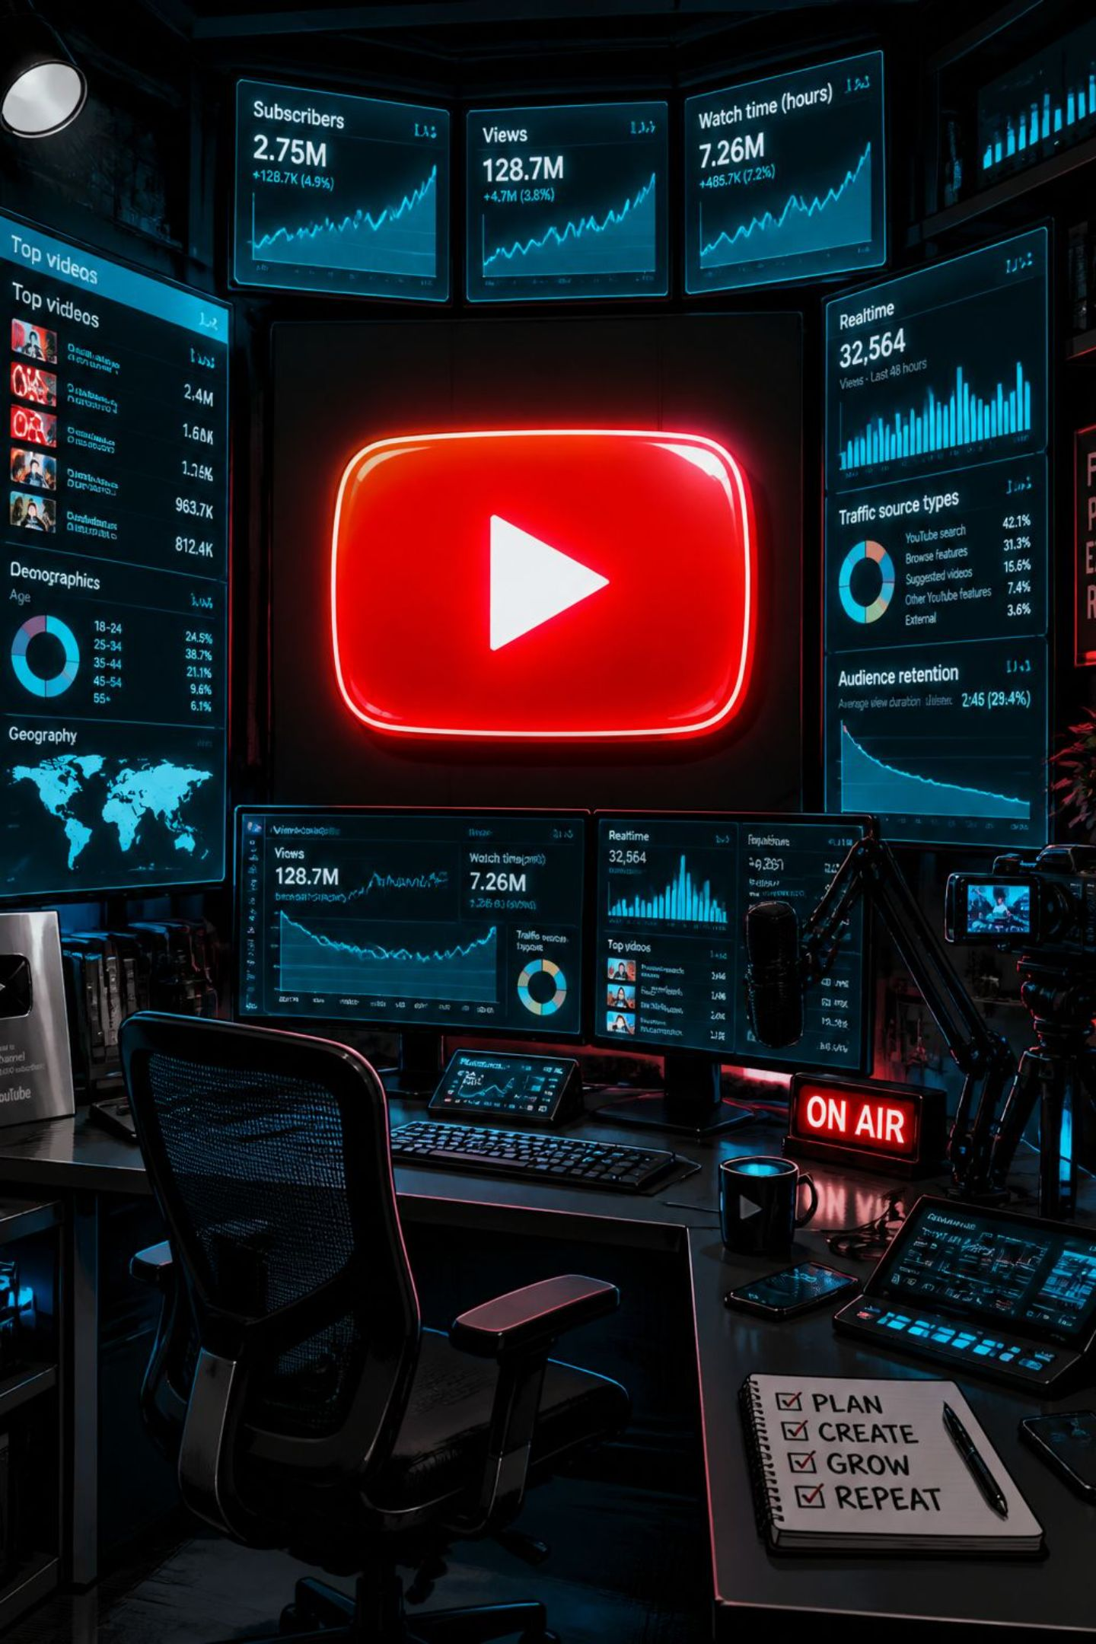
YouTube Trending Analytics
An end-to-end data analysis project — from raw data to actionable business intelligence — built with Python, Pandas, and advanced statistical methods.
DATA SCIENCE PORTFOLIO
BUSINESS INTELLIGENCE
STATISTICAL ANALYSIS

Slide 2






Technology Stack
Each tool was selected for a specific analytical role — together forming a complete, production-grade data workflow.
Python
Pandas & NumPy
Core language for data processing, analysis, and automation.
Data wrangling, aggregation, and numerical computation at scale.
Matplotlib & Seaborn
Plotly
Static visualisations for EDA and publication-quality charts.
Interactive dashboards, treemaps, and sunburst charts for stakeholder presentations.
SciPy
Jupyter Notebook
Hypothesis testing, correlation analysis, and statistical validation.
Reproducible, narrative-driven analysis combining code, output, and documentation.

Slide 3
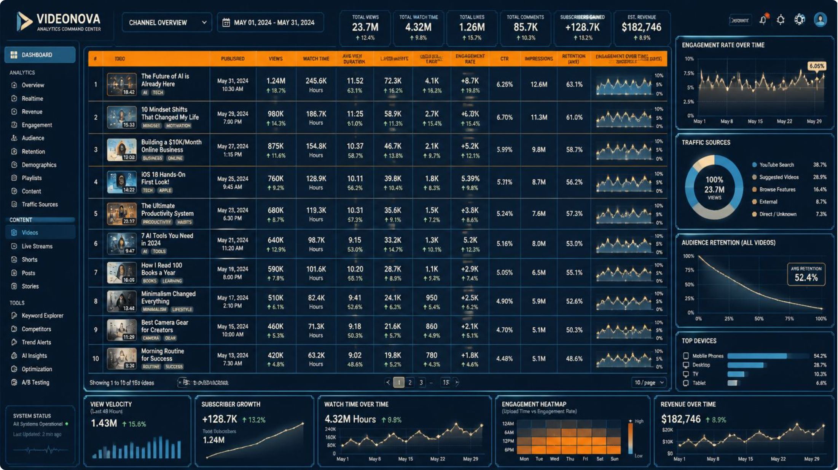
Dataset Overview
The dataset captures trending YouTube videos across multiple countries, enriched with engagement metrics, temporal features, and content attributes — forming the foundation for a complete analytical pipeline.
Core Identity
Engagement Metrics
Temporal Features
Engineered Features
video_id, title, description, channel_id, channel_title, tags
view_count, like_count, comment_count, favourite_count
publish_date, publish_hour, is_weekend, publish_quarter
engagement_score, like_rate, duration_category, view_bucket

Slide 4






Data Cleaning Pipeline
Six sequential steps transformed raw, inconsistent data into a trustworthy analytical foundation. Each step addresses a distinct quality risk that could otherwise skew results or produce misleading business insights.
Missing Values
Imputed or removed incomplete records to prevent null propagation.
Duplicates
Eliminated repeated video entries that would inflate aggregate metrics.
Type Conversion
Cast dates, integers, and floats to correct dtypes for accurate computation.
Invalid Records
Filtered outliers and logically impossible values (e.g., negative durations).
Feature Creation
Derived engagement rates, duration categories, and temporal flags.
Validation
Final integrity checks confirmed a clean, analysis-ready dataset.

Slide 5

Feature Engineering
Raw columns were transformed into business-ready features that directly support strategic decision-making.
Engagement Score
Composite metric combining likes, comments, and views — enabling fair cross-category comparison.
Like & Comment Rate
Normalised ratios revealing content quality independent of audience size.
Duration Category
Binned videos into Short, Medium, and Long segments to identify optimal length per category.
Upload Session & Weekend Flag
Temporal flags uncovering peak publishing windows and weekend performance patterns.

Slide 6
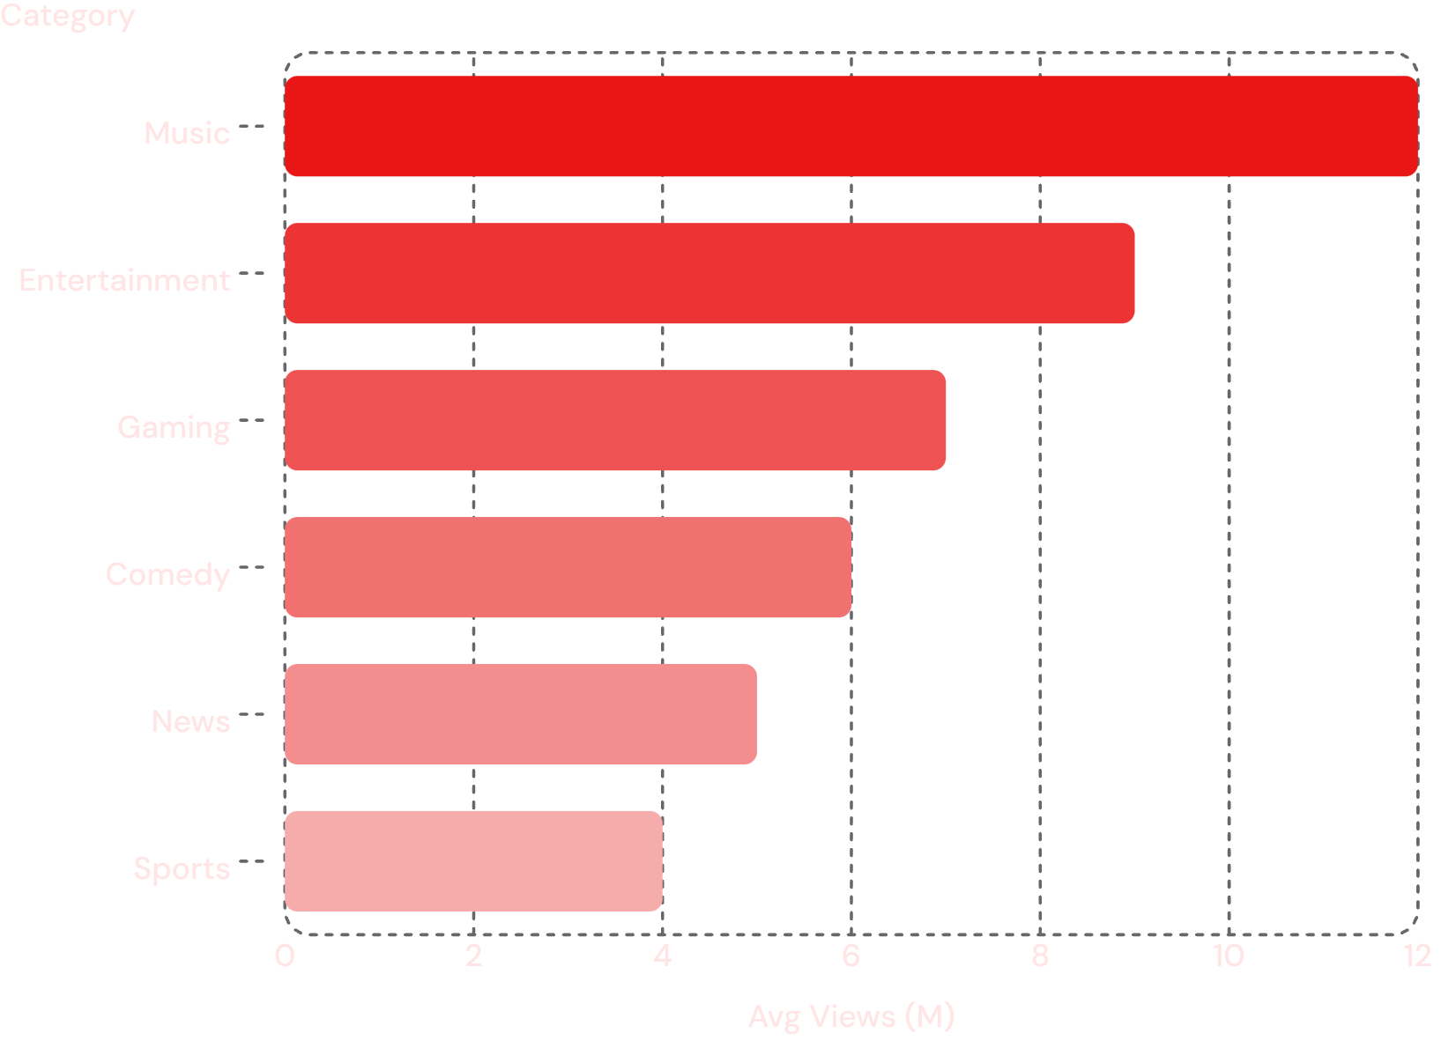
Exploratory Data Analysis
Key EDA Findings
Music dominates trending with the highest average views — a clear content opportunity.
View distribution is right-skewed; a small fraction of videos drive the majority of traffic.
Short-form content (under 5 min) shows the highest engagement rates across most categories.
Peak upload hours cluster between 2 PM and 8 PM, aligning with audience activity windows.

Slide 7
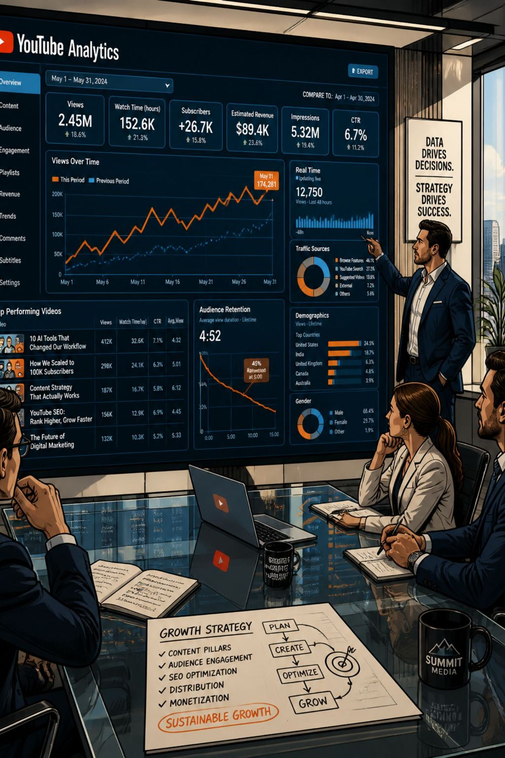


Business Questions — Key Insights
Twenty analytical questions were answered across four strategic themes, each driving a specific business recommendation.
Content Performance
Category, channel, and video-level analysis identifying top performers and content gaps.
Engagement Patterns
Like rates, comment rates, and engagement scores benchmarked by category and duration.
Upload Timing
Hour, session, day, month, and weekend analysis revealing optimal publishing windows.
Creative Optimisation
Title length, tag count, and duration category tested against view and engagement performance.

Slide 8
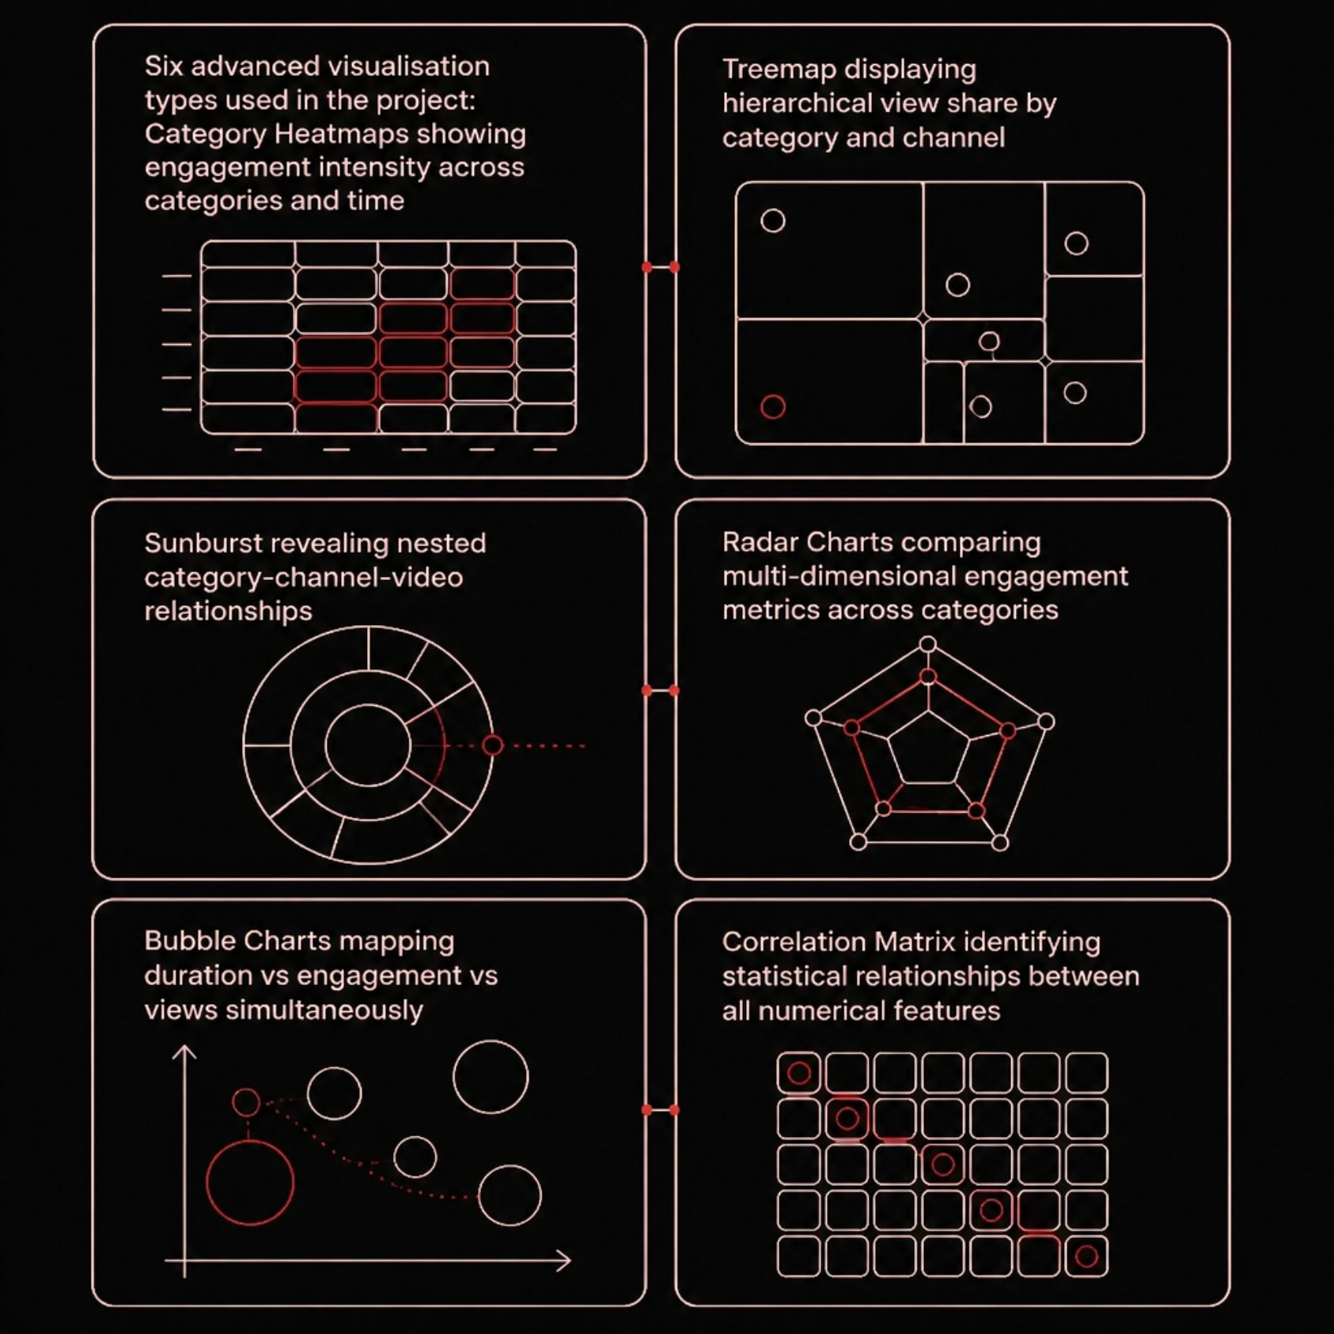

Advanced EDA & Time Series
What the Advanced Analyses Revealed
Heatmaps exposed strong category × time interaction effects on engagement.
Treemaps and Sunbursts made hierarchical view-share intuitive for stakeholders.
Radar charts enabled multi-metric category comparison in a single view.
Time series uncovered clear seasonal upload patterns and weekly trending cycles.
The Executive KPI Dashboard consolidated Total Videos, Views, Likes, Comments, Average Engagement, Categories, and Channels into a single stakeholder-ready summary.

Slide 9






Statistical Analysis
Rigorous hypothesis testing validated every insight — separating genuine patterns from random noise.
t-Test & Mann-Whitney U
Compared engagement between two groups (e.g., HD vs. non-HD videos).
ANOVA & Kruskal-Wallis
Tested for significant differences across multiple categories simultaneously.
Pearson & Spearman
Measured linear and monotonic relationships between duration, title length, and engagement.
Shapiro-Wilk & Levene
Confirmed normality and equal variance — prerequisites for parametric tests.
Chi-Square Test
Tested independence between categorical variables such as category and upload session.
Tukey HSD
Post-hoc pairwise comparisons following ANOVA to pinpoint exactly which categories differed.

Slide 10


Business Recommendations & Conclusion
Content Strategy
Prioritise Music and Entertainment; target 3–8 minute videos for peak engagement.
Upload Timing
Publish between 2 PM–8 PM on weekdays; avoid early-morning weekend uploads.
Optimisation
Enable HD and captions; craft titles of 50–70 characters with 8–12 targeted tags.
Future Scope
Extend to predictive modelling, real-time pipelines, and NLP-based sentiment analysis.
Project Impact: This end-to-end analysis demonstrates production-ready skills in Python, Pandas, statistical testing, and business intelligence — portfolio-ready for Data Analyst, BI, and Data Scientist roles.

