Slide 1
Customer Churn Analysis & Prediction
End-to-End Data Analytics · SQL · EDA · Machine Learning · Power BI · Streamlit
Customer Intelligence | Churn Analytics | Revenue Risk | Predictive Analytics
S MOHAMMED KAIF

Slide 2








Project at a Glance
A complete, production-grade analytics system for a Telecom and Subscription-Based business. This project combines Python data processing, SQL business analysis, machine learning prediction, and interactive dashboards into a unified customer intelligence platform.
Project Type
Domain
Customer Churn Analytics & Prediction
Telecom / Subscription Business
Approach
Output
Data Analytics + SQL + Machine Learning + BI
Business Intelligence + Predictive Customer Risk
Technology Stack
Data Processing
Visualization
Python · Pandas · NumPy
Matplotlib · Seaborn
Database
Machine Learning
SQLite · SQL
Scikit-Learn
Business Intelligence
Web App
Power BI
Streamlit
Geospatial
Notebook
GeoJSON
Jupyter

Slide 3



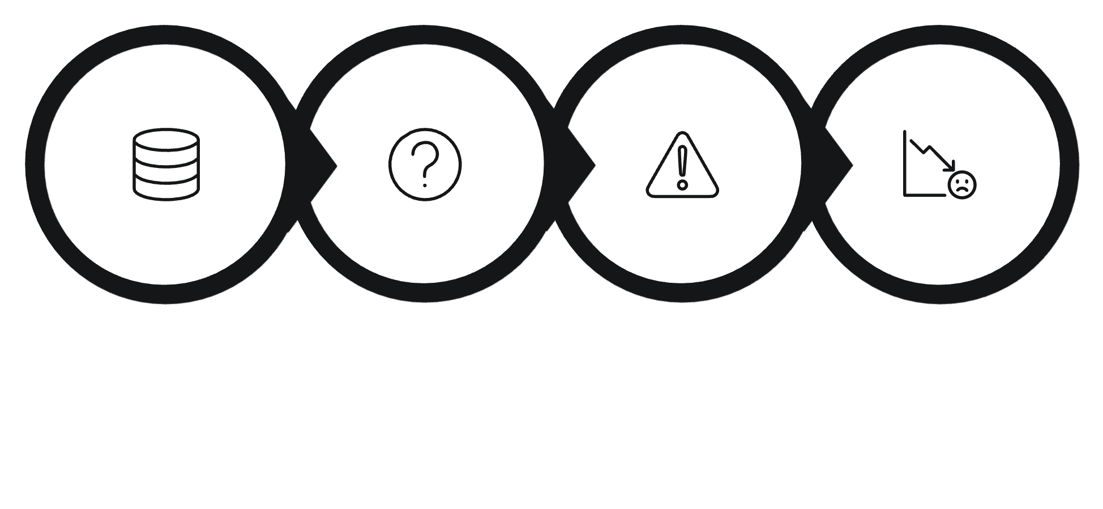
Business Context & The Core Problem
Customers subscribe to a range of services — Phone, Internet, Streaming, Online Security, Online Backup, Device Protection, and Technical Support. Understanding why they leave is critical to protecting revenue and customer lifetime value.
Potential Churn Drivers
High monthly charges
Short tenure
Contract type
Payment issues
Service problems
Poor customer experience
Support issues
Customer dissatisfaction
The Central Question
Why are customers leaving? This project addresses three critical business questions:
Why are customers leaving?
Which customers are most at risk?
How much revenue is potentially at risk?
Customer Data
Unknown Behavior
Churn Risk
Revenue Loss
Without structured analytics, churn remains an invisible threat. This project transforms raw customer data into actionable retention intelligence.

Slide 4

Project Objectives & Key Business Questions
This project is structured around a clear set of analytical objectives and business questions that drive every stage of the workflow — from data processing through to machine learning and dashboard delivery.
Project Objectives
Key Business Questions
Analyze customer demographics and subscription behavior
What is the overall churn rate?
Which customer groups churn most?
Study customer tenure and service usage patterns
Does tenure influence churn?
Which contracts have higher churn?
Identify high-risk customer segments
Which payment methods correlate with churn?
Which states show higher churn?
Analyze contract-level and payment-method churn
How do monthly charges relate to churn?
Which customers are predicted to churn?
Perform SQL business analysis
Build churn prediction models
Create Power BI dashboard and Streamlit web app
Generate actionable business recommendations

Slide 5
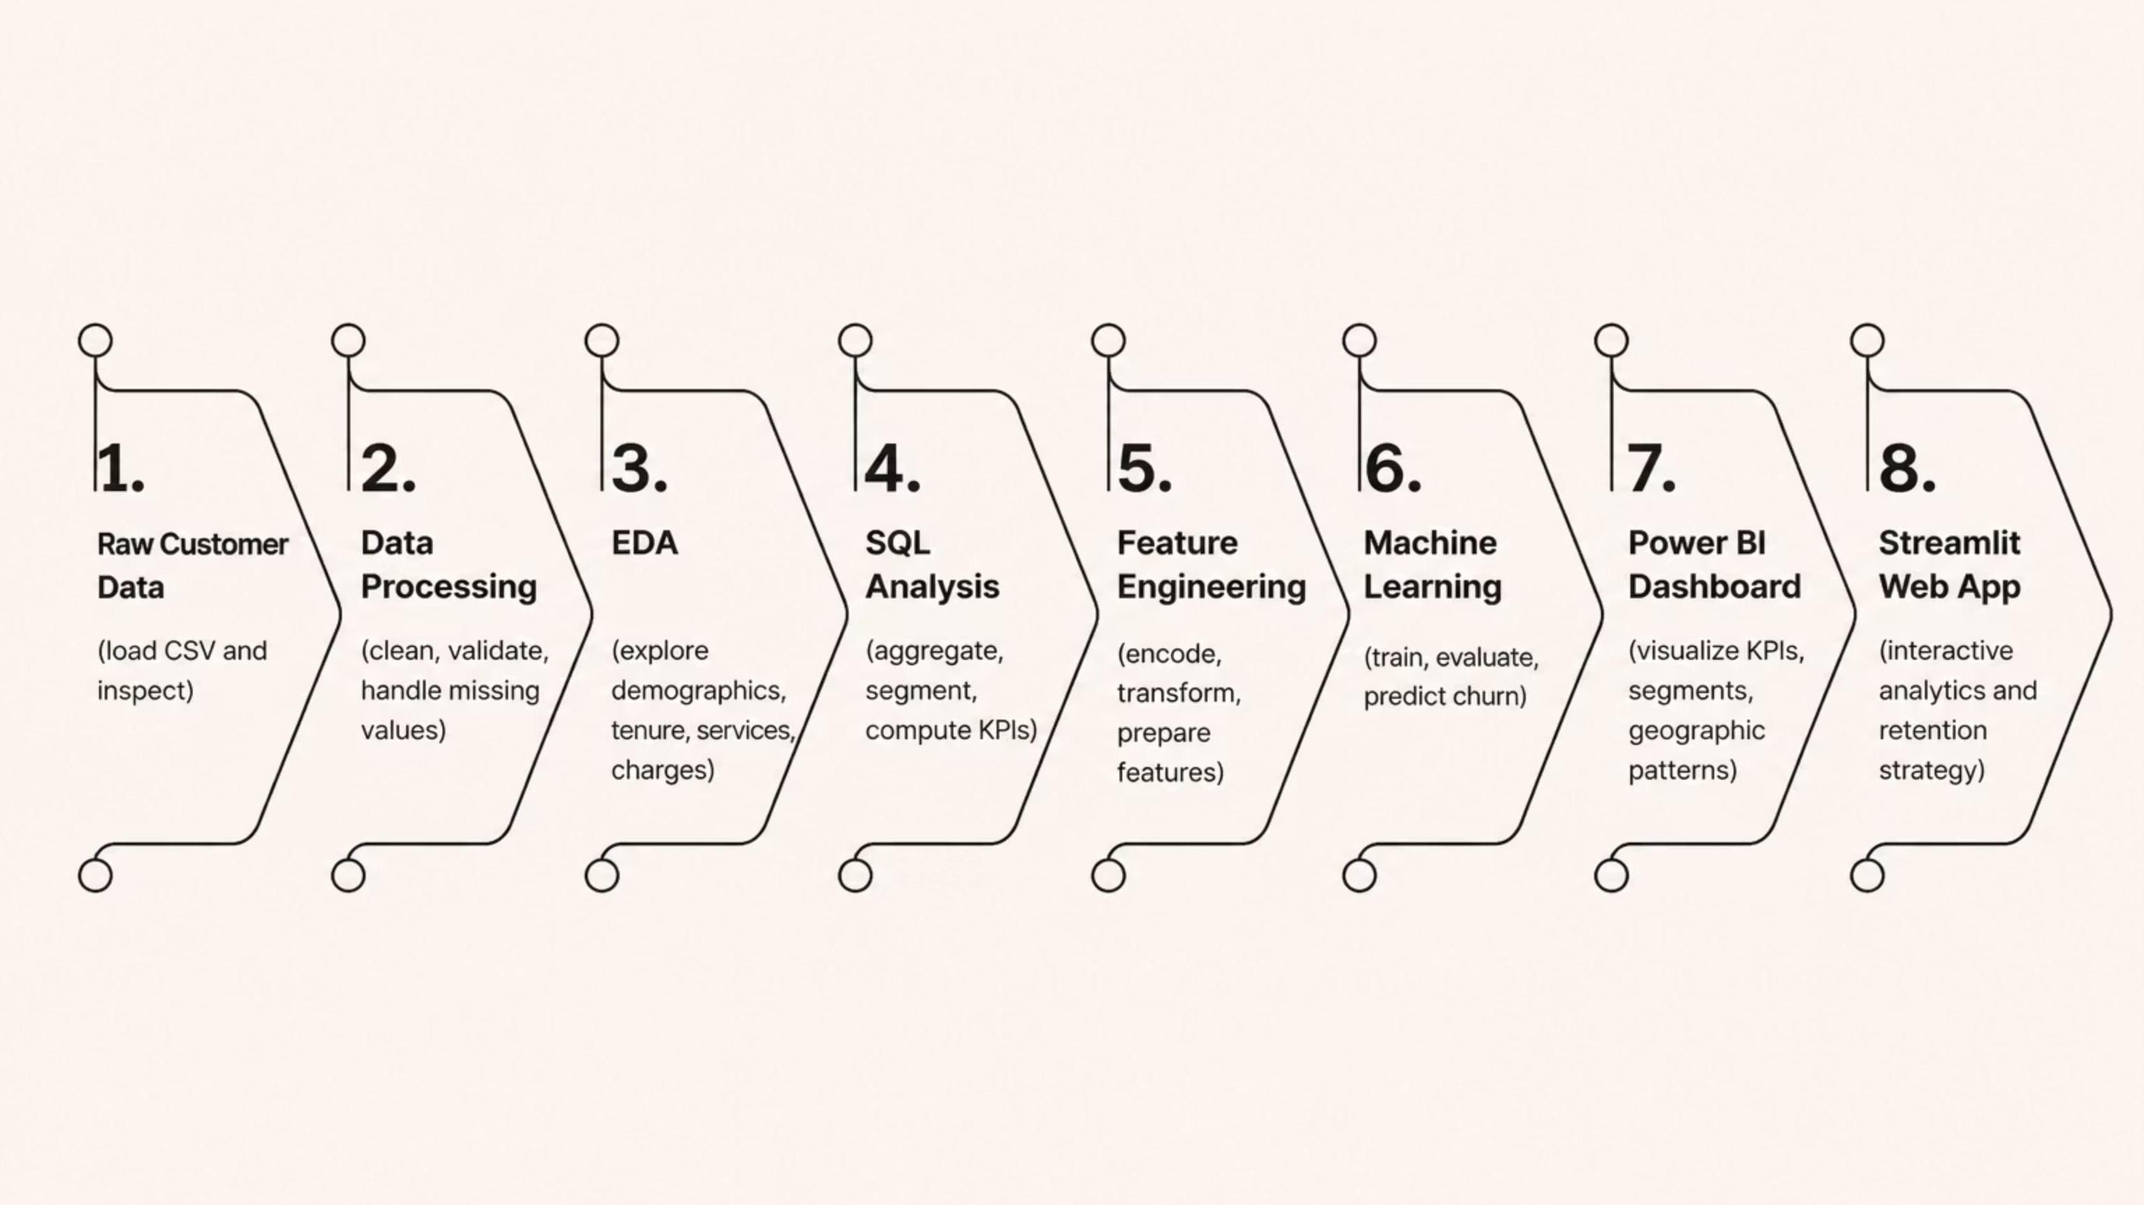
End-to-End Project Workflow
The project follows a structured, production-grade pipeline — from raw data ingestion through to executive dashboards and a live web application. Each stage is designed to ensure data quality, analytical rigor, and business relevance.
Data Assets
Data Processing Steps
CSV: Churn_Customer_Data.csv, Clean_customer_data.csv, Customer_Data.csv, Customer_Churn_Predictions.csv, Predicted_Churned_Customers.csv
Database: customer_churn.db, customer_data.db
Geographic: india_state.geojson
Data loading and inspection
Missing-value analysis
Duplicate detection and removal
Data type validation
Numerical and categorical analysis
Data consistency checks
Preparation for analytics

Slide 6

Customer Data Dimensions & EDA
The dataset covers four analytical dimensions spanning customer demographics, service subscriptions, billing information, and lifecycle attributes. Exploratory Data Analysis investigates patterns across each dimension to surface churn signals.
Demographics
Services
Gender
Age
Marital Status
State
Phone Service
Internet Service
Streaming Services
Online Security
Online Backup
Device Protection
Premium Support
Billing
Lifecycle
Monthly Charges
Total Charges
Refunds
Extra Data Charges
Long Distance Charges
Total Revenue
Tenure
Contract Type
Payment Method
Paperless Billing
Customer Status
EDA Focus Areas
Demographics: Gender, age, marital status, and state-level distribution
Tenure: Relationship between customer tenure and churn probability
Services: Internet type, phone service, streaming, and support package uptake
Contracts: Month-to-month vs. long-term contract churn rates
Payment: Payment method correlation with churn behavior
Charges: Monthly and total charge distribution for churned vs. retained customers
Where actual EDA results are unavailable, placeholders such as [INSERT ACTUAL EDA RESULT] are used throughout visualizations and analysis outputs.

Slide 7
Churn Pattern Analysis & SQL Business Intelligence
Churn is analyzed across multiple customer dimensions to identify which segments carry the highest attrition risk. SQL queries on SQLite databases (customer_churn.db, customer_data.db) enable structured business analysis at scale.
Dimension
Churn Rate
Customer Count
Business Interpretation
Contract Type
[ADD ACTUAL CHURN RATE]
[ADD TOTAL CUSTOMERS]
Month-to-month contracts typically show higher churn
Payment Method
[ADD ACTUAL CHURN RATE]
[ADD TOTAL CUSTOMERS]
Electronic check payments often correlate with higher churn
Internet Service
[ADD ACTUAL CHURN RATE]
[ADD TOTAL CUSTOMERS]
Fiber optic users may show elevated churn due to pricing
Tenure Band
[ADD ACTUAL CHURN RATE]
[ADD TOTAL CUSTOMERS]
Newer customers typically carry higher churn risk
Monthly Charges
[ADD ACTUAL CHURN RATE]
[ADD TOTAL CUSTOMERS]
Higher charges may increase churn probability
State
[ADD ACTUAL CHURN RATE]
[ADD TOTAL CUSTOMERS]
Regional patterns reveal geographic churn hotspots
SQL Analytical Categories
SQL Pipeline
Customer counts and churn counts
Churn rate computation by segment
Revenue aggregation and comparison
Average monthly charges by group
Customer segmentation queries
State-level and contract analysis
Payment-method breakdown
Customer status analysis
01
Raw data loaded into SQLite
02
Filter / Group By / Aggregation
03
Business KPI computation
04
Insight extraction

Slide 8
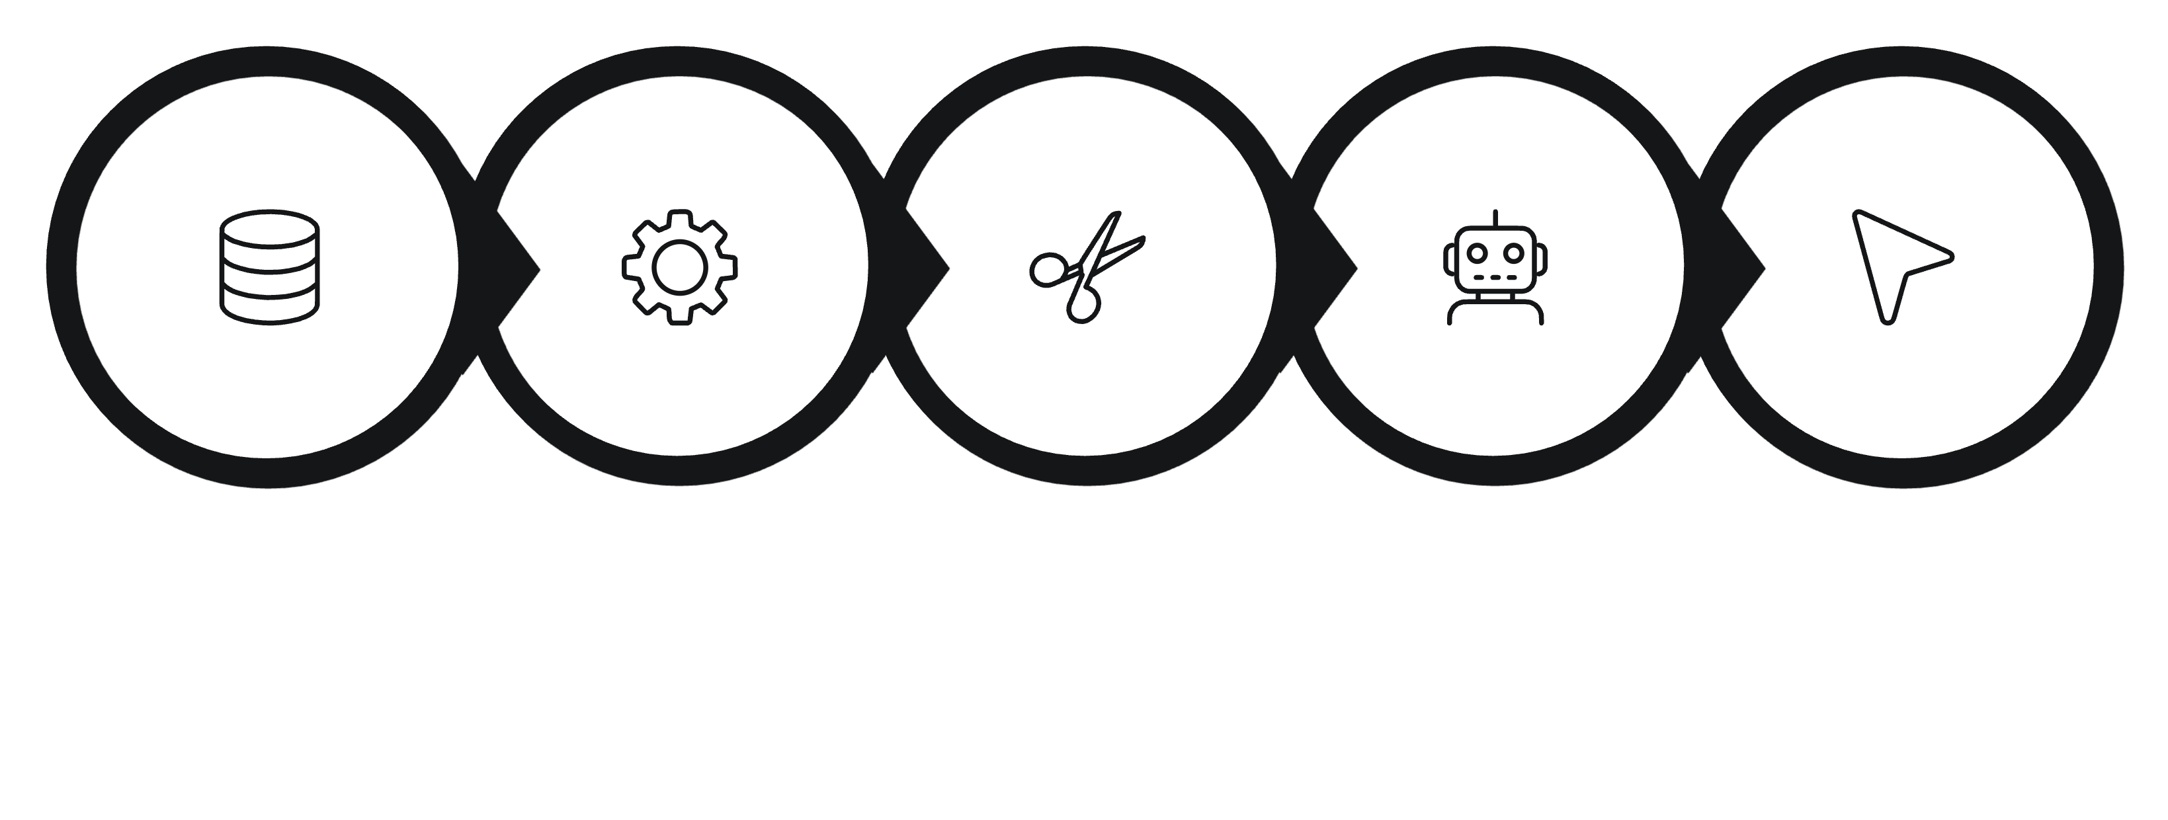

Machine Learning & Churn Prediction
A supervised machine learning model is trained to classify customers as Churn or No Churn. The pipeline transforms raw customer features into a trained, evaluated prediction model capable of scoring individual churn risk.
Customer Data
Feature Prep
Train/Test Split
Model Training
Prediction
The model target is binary: CHURN vs. NO CHURN. Features are encoded, scaled, and split for training and testing. Model performance is evaluated using standard classification metrics.
Prediction Output Files
Conceptual Risk Framework
Customer_Churn_Predictions.csv
Predicted_Churned_Customers.csv
Low Risk
Medium Risk
Each customer record is assigned a predicted risk category and a recommended retention action priority.
Monitor periodically
Targeted engagement
High Risk
Immediate retention action
Model algorithm, accuracy, ROC-AUC, and feature importance values should be populated with actual project results: [INSERT ACTUAL MODEL USED], [INSERT ACTUAL PERFORMANCE].

Slide 9
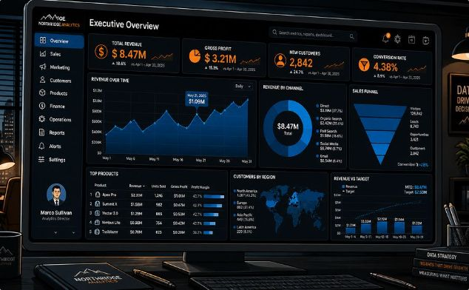
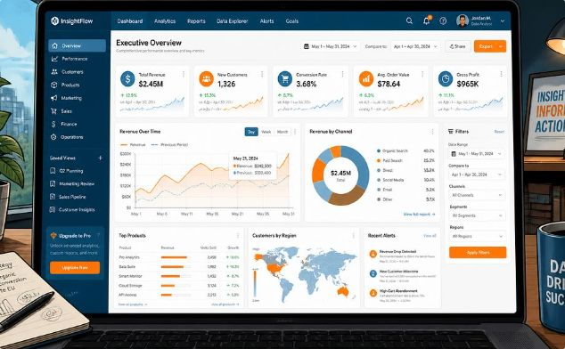
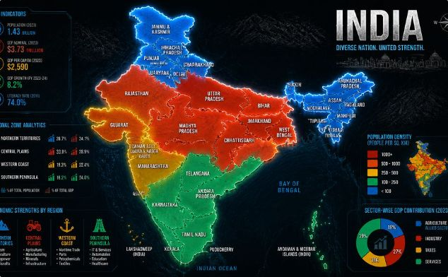
Power BI Dashboard, Streamlit App & Geographic Analysis
The analytical outputs are delivered through two interactive layers: an executive Power BI dashboard and a Streamlit web application, enabling stakeholders to explore churn insights without technical dependencies.
Power BI Dashboard
Streamlit Web Application
Geographic Churn Analysis
Churn_Analysis_BI_Dashbord.pbix
Stream_app.py · master_churn_dashboard.py
india_state.geojson
Customer KPIs and churn rate
Customer status and revenue
Services, contracts, and payment methods
Geographic churn distribution
Customer segment breakdowns
Customer distribution by state
Churn concentration mapping
Revenue by geographic region
High-risk geographic segments
Regional pattern identification
KPI cards and customer analytics
Churn and revenue analysis
Interactive filters and charts
Customer segmentation views
Prediction analysis interface

Slide 10




Business Impact, Deliverables & Portfolio
This project transforms raw customer data into a complete business intelligence system — from exploratory analysis and SQL queries to machine learning predictions, interactive dashboards, and actionable retention strategies.
27%
73%
Customer Churn Rate
Retention Rate
6418
1732
Total Customers
Churned Customers
17.34 mths
3411960.58
Average Tenure
Revenue at Risk
Business Recommendations
Project Deliverables
1
Prioritize high-risk customers for immediate retention outreach
01-Churn-Analysis-proj-for-EDA-Data-Processing.ipynb
02-Churn-SQL-Dashbord-Analysis.ipynb
03-Churn-Prediction-Analysis.ipynb
CSV datasets and SQLite databases
Power BI dashboard (.pbix)
Streamlit web application
Geospatial analysis (.geojson)
2
Encourage longer-term contracts to reduce month-to-month churn
3
Improve onboarding and customer support experience
4
Build proactive retention campaigns using predictive analytics
Explore the Project
5
Monitor churn KPIs continuously via Power BI and Streamlit
"Turning Customer Data into Business Intelligence" — S Mohammed Kaif
Thank you for reviewing this project. This end-to-end analytics system demonstrates proficiency in data processing, SQL, machine learning, business intelligence, and full-stack data application development.
S MOHAMMED KAIF
DATA SCIENCE
DATA ANALYTICS
MACHINE LEARNING
BUSINESS INTELLIGENCE

