Slide 1

DATA SCIENCE · BUSINESS INTELLIGENCE · MACHINE LEARNING
SuperStore AI Intelligence Platform
An end-to-end analytics and machine-learning platform transforming SuperStore transaction data into business insights, interactive dashboards, SQL analysis, and predictive Return_Flag classification — built across five structured Jupyter notebooks and deployed via Streamlit.
S Mohammed Kaif · Data Science · Machine Learning · AI · Data Analytics

Slide 2
EXECUTIVE SUMMARY
From Raw Transactions to Predictive Intelligence
This project transforms SuperStore transaction data into an integrated analytics and predictive intelligence platform. It combines Data Science, Business Intelligence, SQL, Machine Learning, Interactive Visualization, and Streamlit Deployment — supporting both historical business understanding and forward-looking decision support.
Platform Capabilities
Technology Foundation
Descriptive analytics & KPI intelligence
Interactive Plotly dashboards
Structured SQL business analysis
Statistical & GroupBy analysis
Binary Return_Flag classification
Model comparison, evaluation & explainability
Three deployed Streamlit applications
Python — Core language for all data processing, analysis, and ML
Pandas & NumPy — Data manipulation and numerical computation
Matplotlib & Seaborn — Static exploratory visualizations
Plotly — Interactive business intelligence charts
SQLite — Structured SQL business analysis
Scikit-learn & Joblib — ML modeling and model persistence
Streamlit — Interactive web application deployment
Jupyter Notebook — Iterative notebook-based development
ReportLab — PDF report generation

Slide 3
DATASET OVERVIEW
SuperStore Transaction Data
The platform is built on two primary dataset files and one SQLite database. The final machine-learning dataset contains 5,901 rows with 53 engineered features, with Return_Flag as the binary classification target. The dataset was split into 4,720 training rows and 1,181 testing rows.
5,901
53
Total Rows
Features
Final ML dataset
After engineering
4,720
1,181
Training Rows
Test Rows
Model development
Model evaluation
Source Files
Target Variable
SuperStore_Sales_Dataset.csv — Raw transaction data
SuperStore_Feature_Engineered.csv — Processed dataset
superstore_analysis.db — SQLite database for SQL analysis
Return_Flag — Binary Classification
Predicts whether a transaction will result in a product return, enabling proactive return-risk management and operational planning.

Slide 4
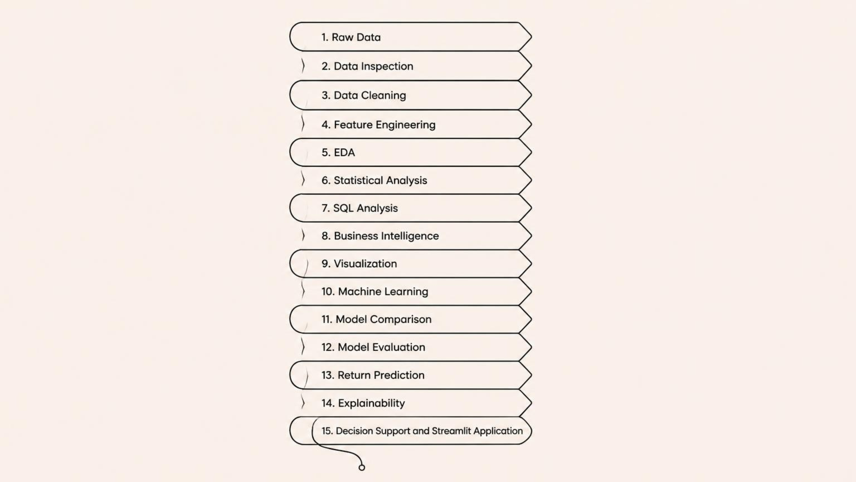
PLATFORM ARCHITECTURE
End-to-End Analytical Workflow
The project follows a structured, reproducible pipeline — from raw data ingestion through to deployed business intelligence and machine-learning prediction. Each stage builds upon the previous, ensuring data quality, analytical rigor, and decision-ready outputs.
The workflow was developed across five Jupyter notebooks, each addressing a distinct analytical layer — from data preparation and EDA through to SQL analysis, interactive visualization, and complete machine-learning modeling with model comparison and evaluation.

Slide 5
NOTEBOOK WORKFLOW
Five-Notebook Development Process
The project was developed iteratively using Jupyter notebooks, each addressing a distinct analytical layer. This modular approach ensures reproducibility, clear separation of concerns, and a logical progression from data preparation through to predictive modeling.
01
02
03
01 — Data Inspection, Cleaning, Feature Engineering & EDA
02 — GroupBy & Statistical Business Analysis
03 — SQL for Data Analysis
SQLite queries using SELECT, WHERE, GROUP BY, ORDER BY, HAVING, CASE, aggregate functions, subqueries, and business KPI extraction from superstore_analysis.db.
Data loading, inspection, shape analysis, column analysis, data types, missing values, duplicates, cleaning, feature engineering, univariate, bivariate, and exploratory data analysis.
Pandas GroupBy, aggregation, sales analysis, profit analysis, category, regional, segment, and product analysis, statistical analysis, and business performance evaluation.
04
05
04 — Plotly Business Insights
05 — ML Return Prediction & Modeling
Interactive visualizations covering sales trends, profit trends, category performance, regional performance, segment analysis, product performance, and profitability comparisons.
Complete ML workflow: data preparation, target definition, feature preparation, train/test split, preprocessing, model training, comparison, evaluation, selection, prediction, and model export.

Slide 6
BUSINESS KPI DASHBOARD
SuperStore Key Performance Indicators
The platform generates a comprehensive set of business KPIs from SuperStore transaction data. These metrics form the foundation of all downstream business intelligence, trend analysis, and strategic decision support.
$1.57M
$175K
Total Sales
Total Profit
$1,565,804.32 across all orders and categories
$175,262.11 net profit generated
11.19%
3,003
Profit Margin
Total Orders
Net profit as a percentage of total sales
Across 773 unique customers
22,317
$521.41
Quantity Sold
Avg Order Value
Total units sold across all product categories
With $58.36 profit generated per order
These KPIs are computed through Pandas aggregation, GroupBy analysis, and SQL queries — and are surfaced interactively across all three Streamlit applications for real-time stakeholder access.

Slide 7




BUSINESS INTELLIGENCE
Four Dimensions of Business Intelligence
The platform analyzes SuperStore data across four intelligence dimensions — sales, profitability, customer behavior, and time trends — each explored through interactive Plotly visualizations, SQL queries, and statistical analysis.
Sales Intelligence
Profitability Intelligence
Sales performance across categories, regions, segments, and products. Time-based trend analysis reveals yearly and monthly sales patterns. SQL queries identify top-performing categories and regional sales contribution.
Profit performance, margin analysis, and profitability breakdowns by category, region, and product. Identifies high-margin opportunities and areas requiring strategic attention.
Customer Intelligence
Time Intelligence
Analysis of 773 customers, their contribution to revenue, Average Order Value ($521.41), and Profit Per Order ($58.36). Segment-level analysis reveals behavioral patterns across customer groups.
Yearly and monthly trends for sales, profit, and margin. Time-series visualizations support seasonal pattern identification and forward-looking performance planning.

Slide 8

MACHINE LEARNING
Return_Flag Prediction Model
The platform applies binary classification to predict Return_Flag. Multiple algorithms were trained and compared, with F1 Score as the primary selection metric — balancing Precision and Recall for reliable positive-case identification.
Models Evaluated
Model Performance — Test Set (1,181 rows)
Logistic Regression
Random Forest
Extra Trees
Gradient Boosting
Hist Gradient Boosting
KNN
SVM (when available)
XGBoost (when available)
Accuracy: 1.0000
Precision: 1.0000
Recall: 1.0000
F1 Score: 1.0000
ROC-AUC: 1.0000
Selected Model: Logistic Regression
Model Validation Notice: Perfect test-set performance should be thoroughly investigated before production deployment. Recommended validation areas include: target leakage, target-derived features, duplicate or highly related observations, dataset construction characteristics, and validation using genuinely unseen future data. This is a validation consideration — not a confirmed issue.

Slide 9


MODEL EVALUATION
Understanding Evaluation Metrics
Five complementary metrics assess classifier performance. F1 Score is the primary selection criterion because Return_Flag prediction requires balancing reliable positive identification with minimizing missed returns.
Accuracy
Precision
Recall
Overall classification correctness — proportion of correct predictions across both classes.
Reliability of positive predictions — of transactions flagged as returns, how many actually were.
Ability to identify positive cases — of actual returns, how many were correctly flagged.
F1 Score
ROC-AUC
Harmonic mean of Precision and Recall. Primary metric for model selection, balancing false positives and false negatives.
Ability to distinguish between return and non-return transactions across all classification thresholds.

Slide 10
SQL ANALYTICS
Structured Business Analysis with SQLite
SQLite was used to perform structured, query-driven business analysis via superstore_analysis.db. SQL enables reproducible, auditable KPI extraction and segment-level investigation — complementing Pandas and GroupBy workflows.
SQL Techniques Applied
Analytical Questions Addressed
SELECT & WHERE — Targeted data retrieval and filtering
GROUP BY & HAVING — Aggregation by category, region, and segment
ORDER BY — Ranked performance comparisons
CASE — Conditional logic for custom business metrics
Aggregate Functions — SUM, COUNT, AVG for KPI computation
Subqueries — Nested analytical queries
Which categories generate the most sales?
Which regions generate the highest profit?
Which segments contribute the most revenue?
Which products have strong or weak profitability?
What are the major business KPIs?

