Slide 1
A Comparative Analysis of Machine Learning Models for Classification Tasks
By:-
Mohammed Zubaidi Shaik - 16353803

Slide 2
Introduction
Introduction to the study
Importance of selecting the right classification model
Overview of the models analyzed

Slide 3
Evaluation Metrics & Methodology
Dataset used and evaluation criteria
Models implemented using Scikit-learn & TensorFlow
Key metrics: Accuracy, Precision, Recall, F1 Score, AUC

Slide 4
Model Performance Results
Comparison of model performances (summary of table)
Neural Networks achieved the highest accuracy (99.71%)
XGBoost and Random Forest performed well
Logistic Regression performed poorly

Slide 5
Model | Accuracy | Precision | Recall | F1 Score | AUC
Decision Trees | 0.9816 | 0.9786 | 0.9765 | 0.9775 | 0.9808
KNN | 0.9886 | 0.9848 | 0.9875 | 0.9861 | 0.9994
SVM | 0.9944 | 0.9957 | 0.9905 | 0.9931 | N/A
Random Forest | 0.9901 | 0.9872 | 0.9887 | 0.9879 | 0.9997
XGBoost | 0.9931 | 0.9900 | 0.9933 | 0.9916 | 0.9998
Logistic Regression | 0.6085 | 0.0 | 0.0 | 0.0 | 0.4983
Neural Networks | 0.9971 | 0.9933 | 0.9994 | 0.9963 | 0.9975

Slide 6
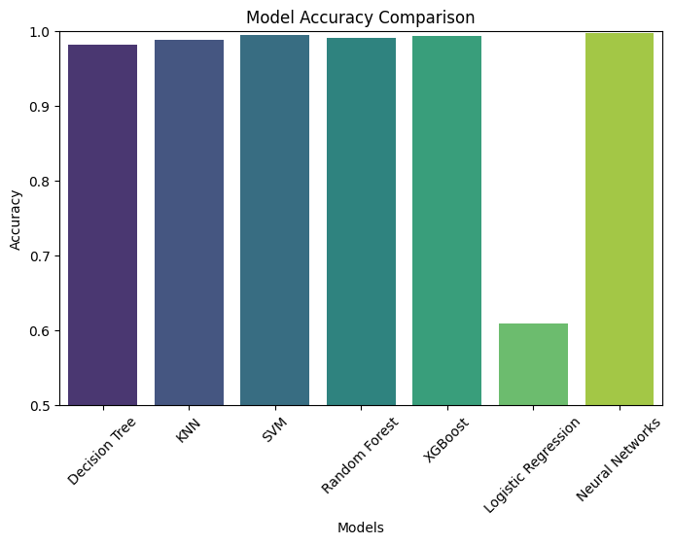

Slide 7
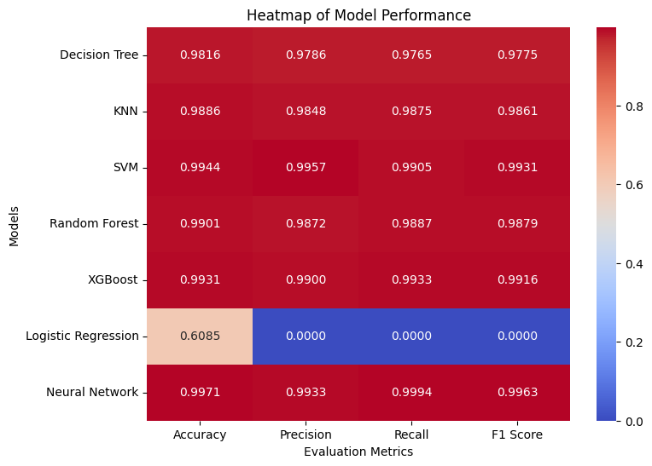

Slide 8
Discussion & Key Findings
Neural Networks outperformed other models
Ensemble models (XGBoost, Random Forest) were highly effective
SVM and KNN performed well with proper tuning
Logistic Regression failed due to dataset complexity

Slide 9
Conclusion & Future Work
Neural Networks and ensemble methods are best for complex tasks
Simpler models may not be suitable for high-dimensional data
Future work: Hyperparameter tuning, additional feature engineering
Testing on other datasets

