Slide 1

EMPOWERING EDUCATION:
DEVELOPING AN AI DRIVEN TUTOR FOR PERSONALIZED LEARNING AND CULTURAL RELEVANCE
TEAM:TECH COEUS
Shaik Muhammed Kaamil
Mohammed Muzammil Patel
Mohammad Rehan Ahamed

Slide 2
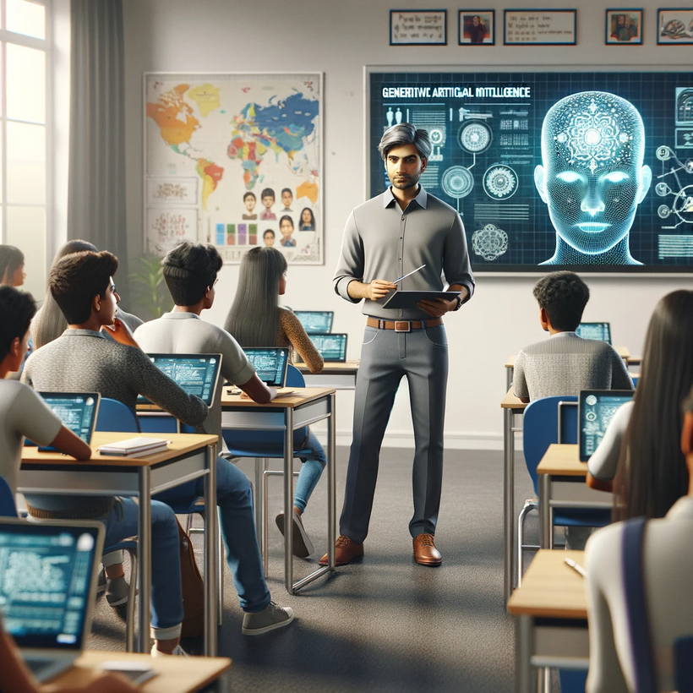
1
Introduction to AI in Education
2
3
In this presentation, we explore AI-driven tutoring
systems that enhance personalized learning
experiences. By focusing on cultural relevance,
we aim to address diverse learning needs and
improve educational outcomes for students
4
5
6
7
8
9

Slide 3
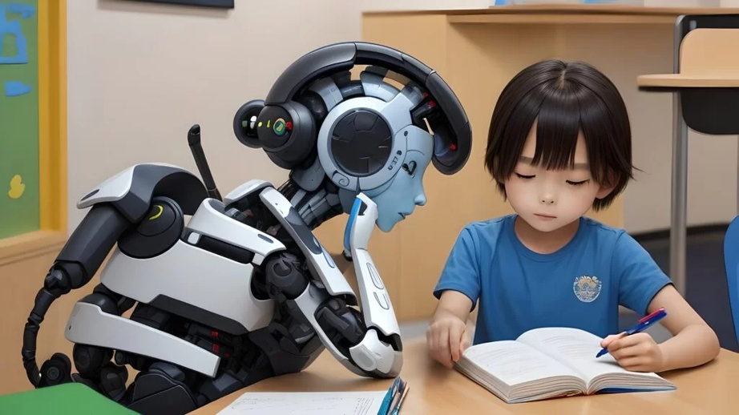
1
THE NEED FOR PERSONALIZATION
2
3
Every student learns dierently. Personalized learning allows for tailored educational experiences that cater to individual strengths and weaknesses. This approach not only boosts engagement but also fosters a deeper understanding of the material.
4
5
6
7
8
9

Slide 4




CULTURAL RELEVANCE IN EDUCATION
1
2
3
Cultural relevance is crucial in education. An AI-driven tutor can adapt content to react students' cultural backgrounds, making learning more relatable and effective.
This ensures that students feel valued and understood in their educational journey
4
5
6
7
8
9

Slide 5
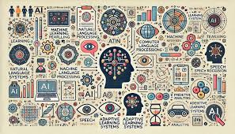
TECHNOLOGY BEHIND AI TUTORS
1
2
3
AI tutors utilize machine learning algorithms
to assess student performance and customize
learning paths. By analyzing data,
these systems can provide real-time
feedback and suggest resources that align
with students' unique learning styles.
4
5
6
7
8
9

Slide 6
ALGORITHM
1
1. Receive User Input:
Action: The AI receives a user query (text or voice).
Example: A student asks, "What is Newton’s Second Law?"
2. Process and Understand Input:
Action: The AI uses Natural Language Processing (NLP)
to clean and analyze the input, extracting the intent and key entities.
Example: Identifies the topic "Newton’s Second Law"
and the intent of the query (request for explanation).
3. Search Knowledge Base & Personalize Response:
Action: The AI queries its knowledge base or
external sources for relevant information and personalizes the answer based on user history and preferences.
Example: Finds the formula for Newton’s Second Law and adjusts the complexity of the explanation based on the student’s level.
4. Generate and Provide Response:
Action: The AI generates and presents a clear, accurate response to the student’s query.
Example: The AI explains, "Newton’s Second Law states that force equals mass times acceleration (F = ma)."
5. Collect Feedback and Adapt:
Action: The AI asks for feedback (e.g., "Was this explanation helpful?") and uses this to improve future responses
or adjust the learning experience.
Example: If feedback is negative, the AI may provide further clarification or ask if the student needs more detailed information.
2
3
4
5
6
7
8
9

Slide 7
FLOW CHART:
+---------------------+
| 1. Receive User |
| Input (Query) |
+---------------------+
|
v
+--------------------------+
| 2. Process & Understand |
| Input (NLP Analysis) |
+--------------------------+
|
v
+-----------------------------+
| 3. Search Knowledge Base |
| & Personalize Response |
+-----------------------------+
|
v
+-----------------------------+
| 4. Generate & Provide |
| Response to User |
+-----------------------------+
|
v
+-----------------------------+
| 5. Collect Feedback |
| & Adapt Future Interactions |
+-----------------------------+
|
v
+---------------------+
| End or Continue |
| Interaction (Loop) |
+---------------------+
1
2
3
4
5
6
7
8
9

Slide 8
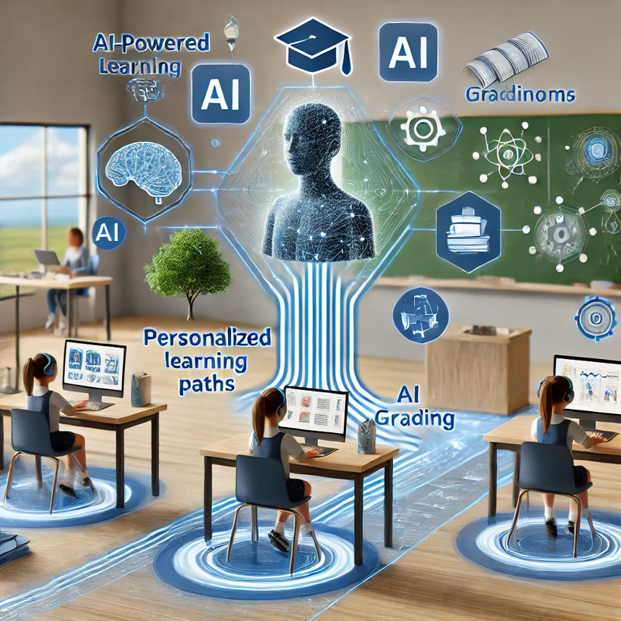
BENEFITS OF AI-DRIVEN TUTORING
1
2
Implementing AI in education offers numerous benefits, including scalability, 24/7 access, and the ability to track progress over time. These tools empower educators to focus on higher-order thinking and provide targeted support where needed
3
4
5
6
7
8
9

Slide 9
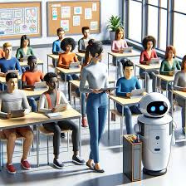
1
CONCLUSION: THE FUTURE OF LEARNING
2
3
AI-driven tutors represent a signicant step toward a
more inclusive and eective educational landscape.
By embracing personalization and cultural relevance,
we can create a learning environment that truly
empowers every student to succeed
4
5
6
7
8
9

Slide 10
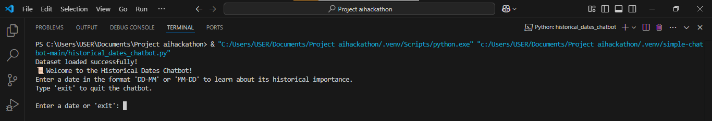
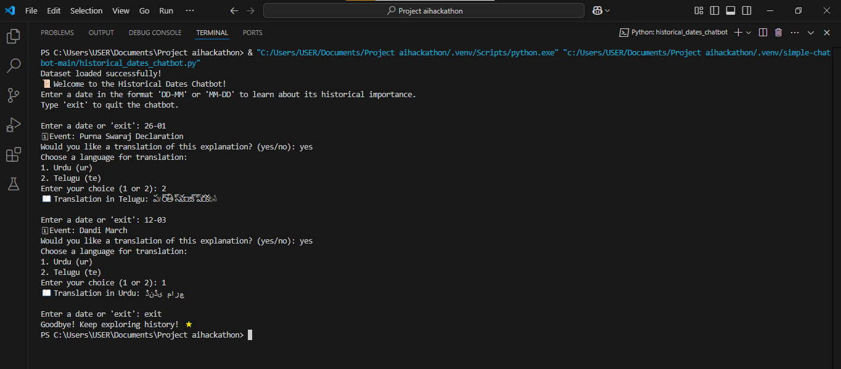
INPUT:
OUTPUT:

Slide 11
1
2
3
THANK YOU!
4
5
6
7
8
9

