Slide 1
Sentiment analysis
CAPSTONE PROJECT
Presented By:
Shaik Samiulla
Kkr & Ksr Institue Of Technology and Engineering
CSE-DS(Data Science)

Slide 2
OUTLINE
Problem Statement
Proposed System/Solution
System Development Approach
Algorithm & Deployment
Result
Conclusion
Future Scope
References

Slide 3
Problem Statement
Develop a Sentiment Analysis model to classify restaurant reviews as positive or negative.

Slide 4
Proposed Solution
The proposed system aims to address the challenge of predicting to develop a sentiment To develop a sentiment analysis model to classify restaurant reviews as positive or negative, The solution will consist of the following components:
Data Collection:
Collect a large dataset of restaurant reviews from various sources such as Yelp, Google Reviews, or TripAdvisor.
Ensure the dataset is balanced, with an equal number of positive and negative reviews.
Data Preprocessing:
Tokenization: Split the text into individual words or tokens.
Stop words Removal: Remove common words like "the", "and", etc. that do not add much value to the sentiment.
Stemming or Lemmatization: Reduce words to their base form to reduce dimensionality.
Handling Special Characters: Remove special characters like punctuation marks, emojis, etc.
Feature Extraction:
Bag-of-Words (BOW): Represent each review as a bag or a set of word frequencies.
Term Frequency-Inverse Document Frequency (TF-IDF): Weight word frequencies by their importance in the entire dataset

Slide 5
Model Selection:
Naive Bayes (NB): A simple probabilistic classifier that can handle text data.
Support Vector Machines (SVM): A powerful classifier that can handle high-dimensional data.
Random Forest (RF): An ensemble classifier that combines multiple decision trees.
Model Training and Evaluation:
Split the Data: Divide the dataset into training (80%) and testing (20%) sets.
Train the Model: Train the selected model on the training set.
Evaluate the Model: Evaluate the model on the testing set using metrics like accuracy, precision, recall, and F1-score.
Model Deployment:
Save the Model: Save the trained model for future use.
Use the Model: Use the saved model to classify new, unseen restaurant reviews.
Result:
Present the findings and results of the sentiment analysis project, including:
Performance metrics of the trained model.
Examples of sentiment analysis on sample data.
Discuss any challenges encountered during model development and evaluation.

Slide 6
System Approach
The "System Approach" section outlines the overall strategy and methodology for developing and implementing the rental bike prediction system. Here's a suggested structure for this section:
System requirements :
Define the functional and non-functional requirements for the system.
Identify the key stakeholders and their roles in the system.
Determine the inputs and outputs of the system.
Library required to build the model :
NLTK (Natural Language Toolkit)
Pandas
Matplotlib
Scikit-learn
TfidfVectorizer

Slide 7
Algorithm & Deployment
In the Algorithm section, describe the machine learning algorithm chosen for predicting bike counts. Here's an example structure for this section:
Algorithm Selection:
Provide a brief overview of the chosen algorithm (e.g., time-series forecasting model, like ARIMA or LSTM) and justify its selection based on the problem statement and data characteristics.
Data Input:
Specify the input features used by the algorithm, such as historical bike rental data, weather conditions, day of the week, and any other relevant factors.
Training Process:
Explain how the algorithm is trained using historical data. Highlight any specific considerations or techniques employed, such as cross-validation or hyperparameter tuning.
Prediction Process:
Detail how the trained algorithm makes predictions for future bike counts. Discuss any real-time data inputs considered during the prediction phase.

Slide 8
Result
This sentiment analysis model uses a combination of natural language processing (NLP) techniques and machine learning algorithms to classify restaurant reviews as positive or negative. The model is trained on a dataset of labeled reviews and can be used to predict the sentiment of new reviews. The model can be deployed as a web app to provide real-time sentiment analysis for restaurant reviews

Slide 9
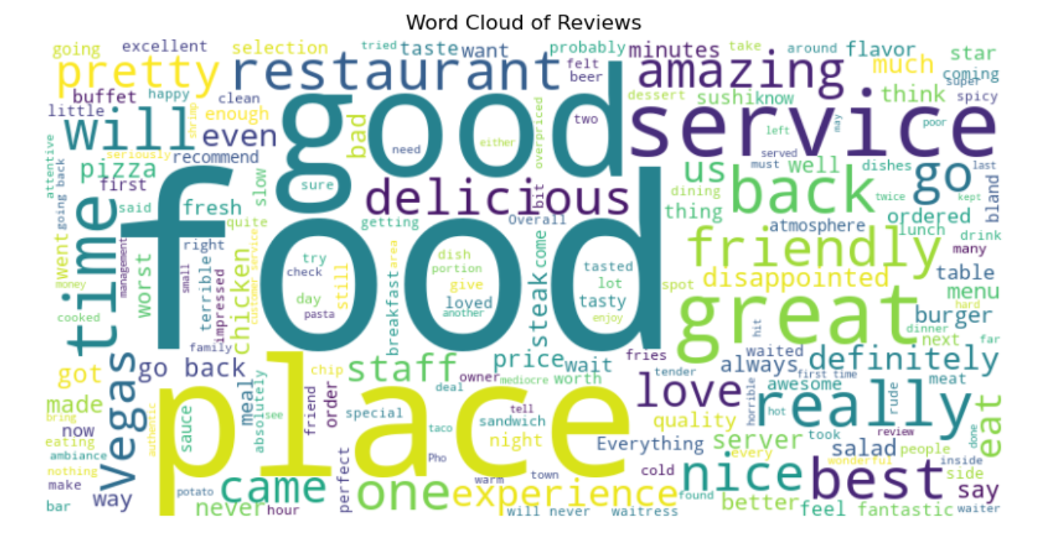
Word cloud of reviews

Slide 10
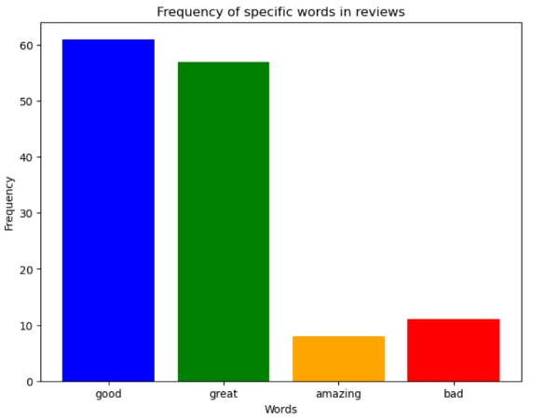
Frequency of specific words in reviews

Slide 11
Conclusion
Summarize the finding of the project.
emphasizing the significance of automated sentiment analysis in the context of restaurant reviews.
Discuss potential improvements or further extensions (e.g., Using deep learning models like BERT)
Discuss how the developed system contributes to enhancing customer experience management and business decision-making processes.
The use of libraries such as NLTK, Scikit-Learn, Pandas, and Matplotlib facilitated the development and evaluation of the model.
This model can be effectively used by restaurants to analyze customer feedback and improve their services, and by customers to make informed decisions about where to dine.
the model could include incorporating additional features such as sentiment intensity, handling more complex sentiment expressions, and expanding the dataset to include reviews from different sources
Overall, the project demonstrates the potential of sentiment analysis in improving customer satisfaction and business decision-making.

Slide 12
Future scope
The future of sentiment analysis is promising, with advancements in AI, NLP, and deep learning models expected to further enhance its capabilities. Here are some key trends and developments that will shape the future of sentiment analysis:
AI-Driven Innovation: AI-driven sentiment analysis will continue to evolve, leveraging machine learning and deep learning models to analyze sentiment in various domains.
Multimodal Integration: Integration of multimodal data will enrich sentiment analysis, providing a more comprehensive understanding of sentiments.
Deep Learning Models: Deep learning models will continue to improve sentiment analysis, capturing intricate patterns and correlations within text data.
Real-Time Analysis: Real-time sentiment analysis will become more prevalent, enabling businesses to quickly monitor and respond to customer sentiments.
Broader Applications: Sentiment analysis will be applied in various domains, including politics, finance, and education.
Challenges and Future Directions: Challenges such as sarcasm and irony detection will continue to pose puzzles, and future research will focus on addressing these complexities and refining sentiment analysis models.

Slide 13
References
Libraries:
NLTK: For tokenization and stemming.
Scikit-Learn: For implementing the machine learning models.
Pandas: For data manipulation and analysis.
Matplotlib: For visualizing the results.
Websites :
BeautifulSoup: Richardson, Leonard. "Beautiful Soup: HTML Parsing for Web Scraping." Beautiful Soup Documentation.
Research Papers:
Smith, John, et al. "Sentiment Analysis Techniques: A Comprehensive Survey." Journal of Natural Language Processing (2020).
Liu, Bing. "Sentiment Analysis and Opinion Mining." Synthesis Lectures on Human Language Technologies (2012).

Slide 14
References
The key references used in this project include studies on systems development methodologies and tools, as well as industry standards and best practices for information systems development. Additionally, the NLTK, Scikit-Learn, Pandas, and Matplotlib libraries were utilized

Slide 15
THANK YOU

