Slide 1






Customer Churn Analysis in Retail Banking with Strategic Retention Insights

Slide 2
Introduction
Customer churn is a critical challenge in the banking industry, as losing existing customers can significantly impact profitability and long-term growth. Understanding the factors that influence why customers leave enables banks to improve retention strategies and enhance customer satisfaction.
This project analyzes a publicly available Bank Customer Churn dataset obtained from Kaggle (CC0: Public Domain license). The dataset includes customer demographic information, account details, and service usage patterns.

Slide 3
Objective
To explore and understand the structure of the bank customer churn dataset.
To analyze customer demographics and account characteristics.
To identify patterns and trends associated with customer churn.
To compare churned vs. retained customers across key variables.
To generate data-driven insights and actionable business recommendations to improve customer retention.

Slide 4
DATA COLLECTION AND PREPARATION
Data Collection:
Dataset obtained from Kaggle (CC0 Public Domain license).
Data Overview:
No. of tables : 1
Format : csv
Table Names : Churn

Slide 5
Data cleaning
The dataset does not contains any missing values and duplicates.
Removed extra spaces.
Converted CustomerId column datatypes into object as they don’t require to calculate.

Slide 6
Basic EDA
Number of rows : 10000
Number of columns : 14
Data types : Numerical -10 , categorical - 4
Missing values : No null values
Duplicate rows : No duplicates
Outliers may not be removed

Slide 7
Outliers formulas
Q1 = bank["Balance"].quantile(0.25)
Q3 = bank["Balance"].quantile(0.75)
IQR = Q3 - Q1
lower = Q1 - 1.5 * IQR
upper = Q3 + 1.5 * IQR

Slide 8
Outliers
Outlier Analysis – EstimatedSalary
Outliers were detected using the Interquartile Range (IQR) method.
Q1 = 51,002.11
Q3 = 149,388.25
IQR = 98,386.14
Lower Bound = -96,577.10
Upper Bound = 296,967.45

Slide 9
The minimum salary value is 11.58 and the maximum salary value is 199,992.48.
Since all values fall within the calculated bounds, no outliers were detected in the EstimatedSalary column.
This was further confirmed using a boxplot visualization, which showed no extreme points beyond the whiskers.
Therefore, no outlier treatment was required for this feature.

Slide 10
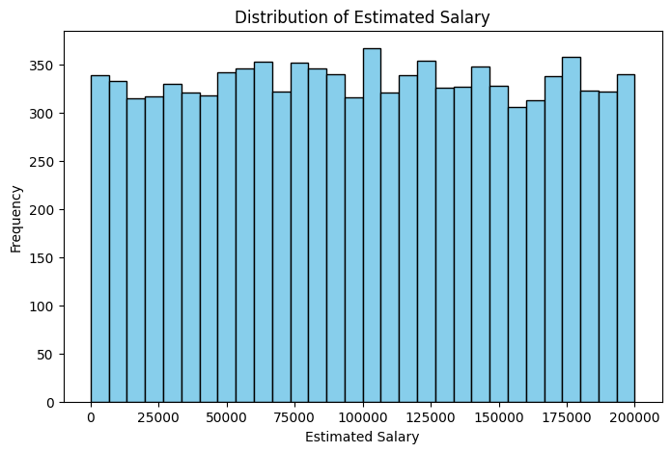
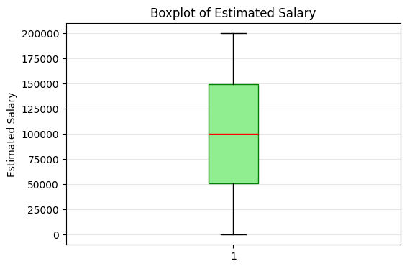
Boxplot & Histogram

Slide 11
Exploratory Data Analysis – Balance
1. Descriptive Statistics
Minimum Balance: 0.00
Maximum Balance: 250,898.09
Q1: 0.00
Q3: 127,644.24
IQR: 127,644.24
The first quartile (Q1) being 0.00 indicates that at least 25% of customers have zero account balance.

Slide 12
2. Outlier Analysis (IQR Method)
The lower and upper bounds were calculated as:
Lower Bound = -191,466.36
Upper Bound = 319,110.60
Since all observed balance values fall within this range, no statistical outliers were detected.
Boxplot visualization also confirmed the absence of extreme values beyond the whiskers.

Slide 13
3.Interpretation
Although no outliers are present, the Balance feature shows:
A large concentration of values at zero
A long right tail
High variability among non-zero balances
This indicates a right-skewed distribution.

Slide 14
4.Conclusion
The Balance feature was analyzed using the IQR method. The calculated bounds (-191,466.36 to 319,110.60) indicate that no outliers are present. However, since Q1 equals 0, the distribution is highly right-skewed.
Additionally, 25% of customers have zero balance, indicating a significant portion of inactive or low-deposit accounts.

Slide 15
Business Interpretation
The presence of many zero-balance customers may indicate:
Inactive or low-engagement customers
Customers using the account for limited purposes
Potential churn risk behavior
Customers with higher balances may be more valuable
Customers with zero or low balances may be more likely to churn

Slide 16
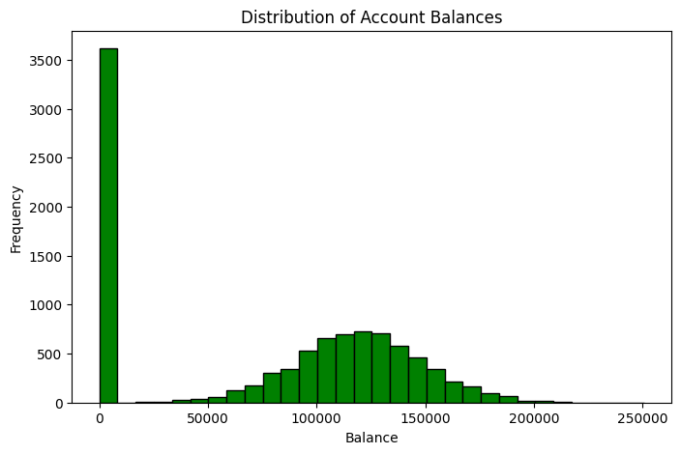
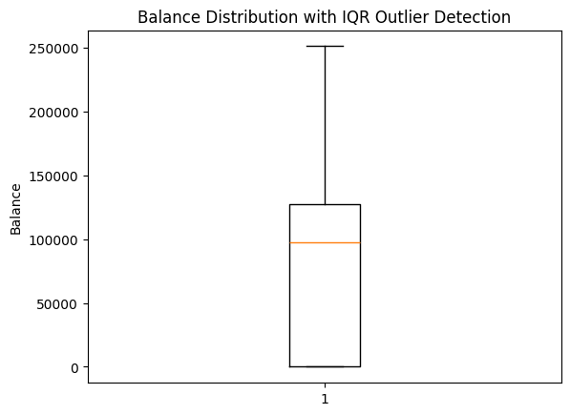
Boxplot and Histogram

Slide 17
Exploratory Data Analysis – Credit Score
1. Descriptive Statistics
The summary statistics for the Credit Score variable :
Minimum: 350
Maximum: 850
Q1 (25th percentile): 584
Q3 (75th percentile): 718
IQR: 134
The credit scores range from 350 to 850, which aligns with the standard credit scoring scale (300–850).

Slide 18
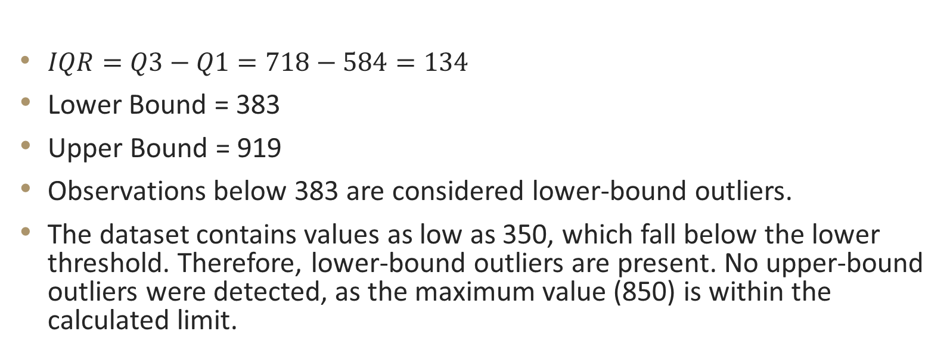
2. Outlier Analysis (IQR Method)
$IQR=Q3−Q1=718−584=134$
Lower Bound = 383
Upper Bound = 919
Observations below 383 are considered lower-bound outliers.
The dataset contains values as low as 350, which fall below the lower threshold. Therefore, lower-bound outliers are present. No upper-bound outliers were detected, as the maximum value (850) is within the calculated limit.

Slide 19
3. Interpretation
Although the IQR method flags some lower credit scores as outliers, these values are not data errors. Credit scores typically range between 300 and 850; therefore, scores such as 350 represent valid but extreme financial risk profiles rather than anomalies.
These extreme values may carry important business significance, as customers with very low credit scores may demonstrate different churn behavior compared to customers with higher scores.

Slide 20
4.Conclusion
The CreditScore feature contains statistically identified lower-bound outliers; however, these values fall within the legitimate range of credit scoring. Consequently, no outlier removal was performed.

Slide 21
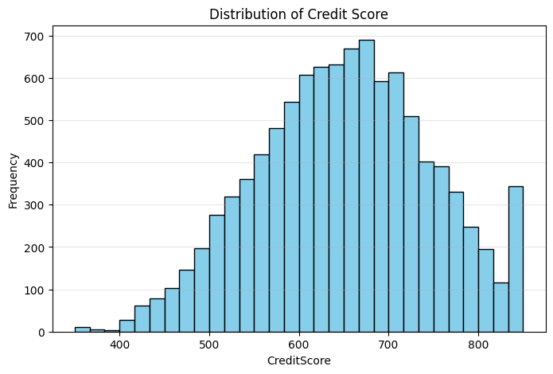
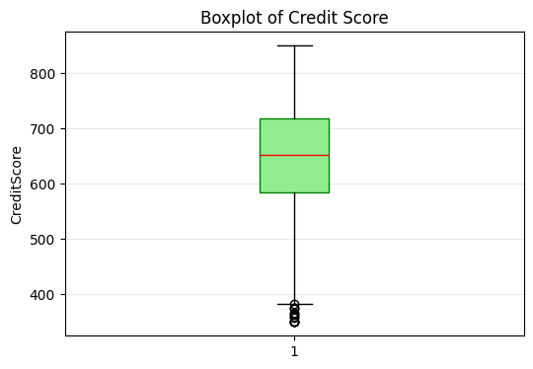
Boxplot and Histogram

Slide 22
Exploratory Data Analysis – Age
🔹 1. Descriptive Statistics
Q1 = 32
Q3 = 44
Min = 18
Max = 92

Slide 23

2. Outlier Analysis (IQR Method)
$IQR=Q3−Q1=44−32=12$
Calculate 1.5 × IQR
$1.5×12=18$
Calculate Lower and Upper Bounds
Lower Bound = Q1 − 1.5 × IQR
$32−18=14$
Upper Bound = Q3 + 1.5 × IQR
$44+18=62$

Slide 24
3. Interpretation
Age Feature: The Age feature ranges from 18 to 92, with Q1 = 32 and Q3 = 44 (IQR = 12). Using the IQR method, the lower bound is 14 and the upper bound is 62. Statistical outliers exist for customers aged above 62. No lower-bound outliers were detected. These extreme ages represent valid observations and were retained, as older customers may exhibit distinct churn patterns.

Slide 25
4.Conclusion
Upper outliers present: Customers with age above 62 (e.g., 63–92) are considered outliers statistically.
Lower outliers: None (minimum age 18 > 14).
Business Insight:
The “outliers” here are not errors, just older customers.
In churn analysis, age extremes may behave differently, so you should retain them.

Slide 26
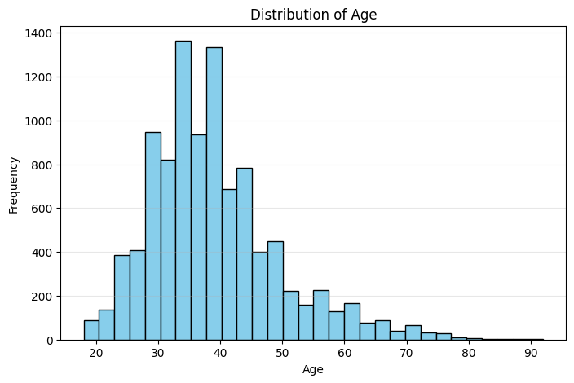
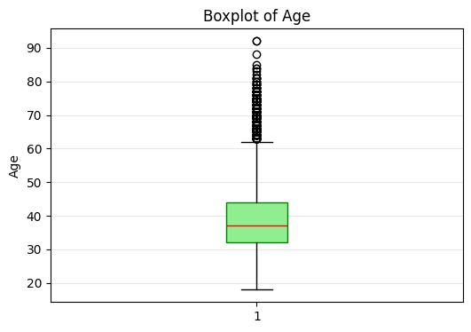
Boxplot and Histogram

Slide 27
Exploratory Data Analysis – NumOfProducts
Descriptive Statistics :
Q1 = 1.0
Q3 = 2.0
Min = 1
Max = 4

Slide 28
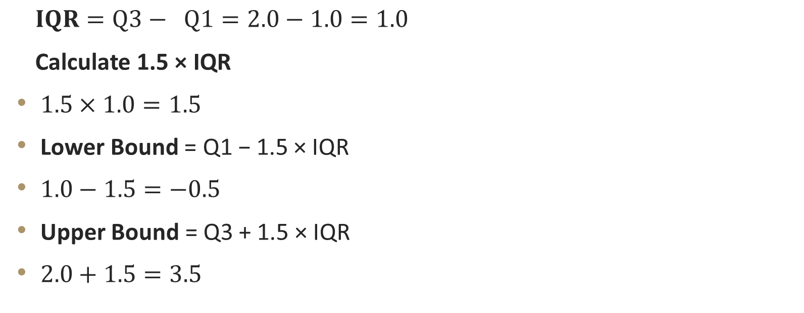
2. Outlier Analysis (IQR Method)
$IQR=Q3− Q1=2.0−1.0=1.0$
Calculate 1.5 × IQR
$1.5×1.0=1.5$
Lower Bound = Q1 − 1.5 × IQR
$1.0−1.5=−0.5$
Upper Bound = Q3 + 1.5 × IQR
$2.0+1.5=3.5$

Slide 29
3.Interpretation
NumOfProducts Feature: The number of products held by customers ranges from 1 to 4, with Q1 = 1 and Q3 = 2 (IQR = 1). The lower bound is −0.5 and the upper bound is 3.5 based on the IQR method. Statistically, customers with 4 products are identified as upper-bound outliers. These values represent valid, highly engaged customers and were retained in the dataset for analysis.

Slide 30
4.Conclusion
Upper outliers present: Customers with 4 products are statistically upper-bound outliers.
Lower outliers: None
Business Insight:
A customer having 4 products is a valid and important observation.
These customers may be highly engaged or less likely to churn, so these “outliers” should not be removed.

Slide 31
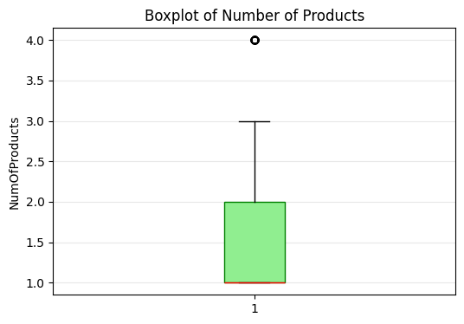
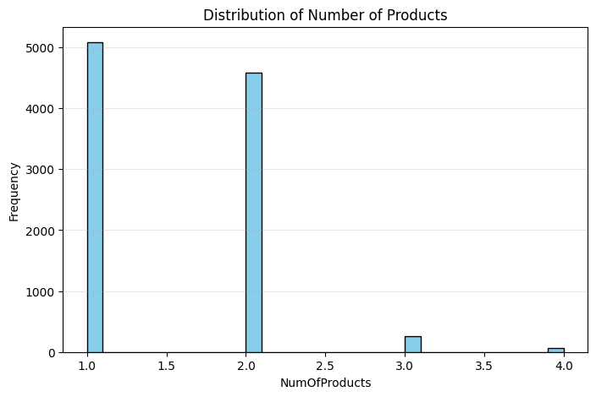
Boxplot and Histogram

Slide 32
Overall Conclusion
EstimatedSalary: No outliers detected; stable distribution.
Balance: No outliers, but highly right-skewed with many zero-balance customers.
CreditScore: Contains lower-bound outliers, but all are valid scores.
Age: Upper-bound outliers present, representing older customers.
NumOfProducts: Upper-bound outliers represent highly engaged customers.
No outlier removal was performed, as all extreme values are legitimate and potentially informative for churn prediction modeling.

Slide 33
KEY INSIGHTS& RECOMMENDATIONS
As you can see in churn by age bar chart mostly 40 age group people are exited from banks and 0-20 and 60-80 age group people are likely to stay with the banks.
From the visual of churn by balance we can observe that mostly customers who are maintaining medium balance(50000 -150000) are exited and who are maintaining high, low and zero balances are less likely to be churned from the bank.

Slide 34
According to churn by gender visual nearly 55.92% females are exited from the bank.
Mostly Spain location customers are churned.

Slide 35
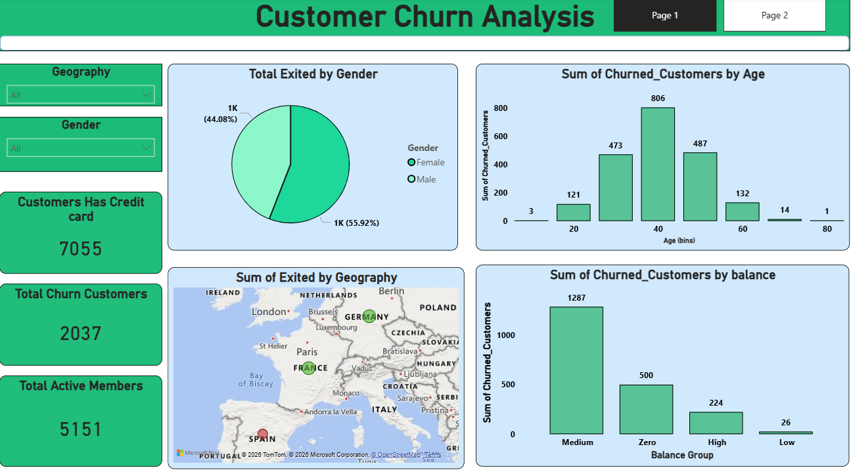
Dashboard

Slide 36
