Slide 1

AWS Lambda
Serverless Compute Service

Slide 2
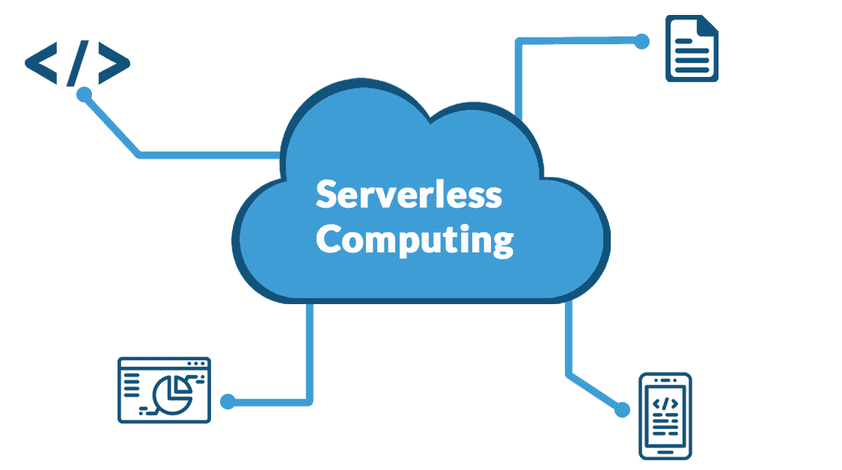
Introduction to AWS Lambda
• AWS Lambda is a serverless compute service.
• Run code without provisioning or managing servers.
• Pay only for the compute time you consume.
• Supports multiple programming languages.
Like: Java, Python, NodeJS …

Slide 3
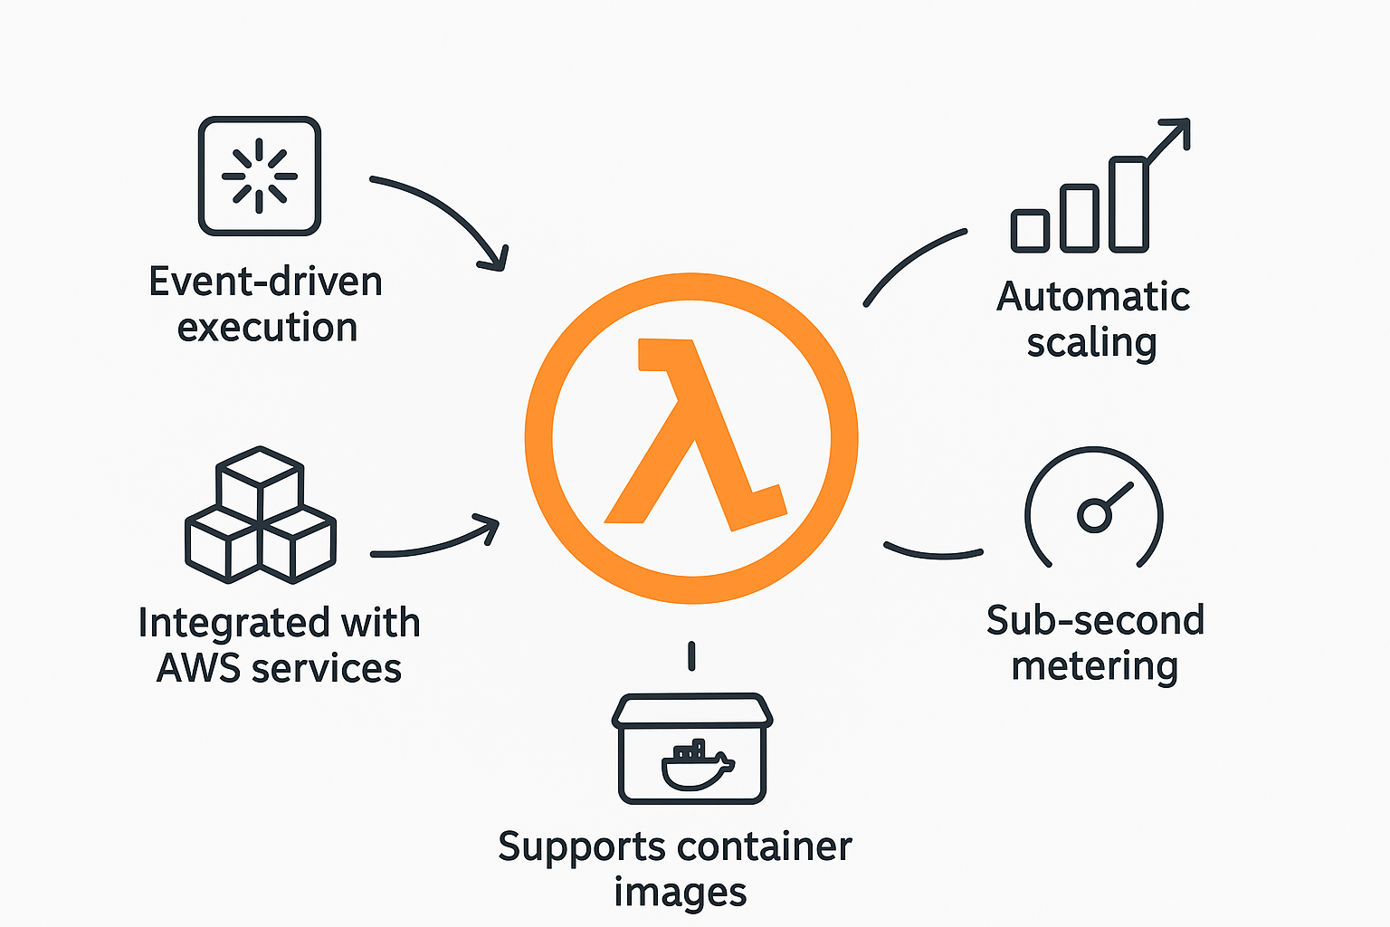
Key Features
• Event-driven execution.
• Automatic scaling.
• Integrated with AWS services.
• Sub-second metering.
• Supports container images.

Slide 4
Common Use Cases
• Real-time file processing.
• Data transformation and ETL.
• Backend services for web & mobile apps.
• IoT device data processing.
• Chatbots and automation.

Slide 5
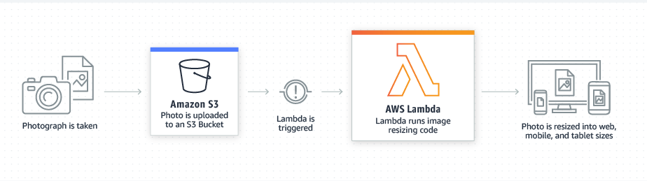
AWS Lambda Architecture
• Triggered by events (API Gateway, S3, DynamoDB, etc.).
• Executes Lambda function code.
• Returns response or triggers other services.
• Fully managed and highly available.

Slide 6
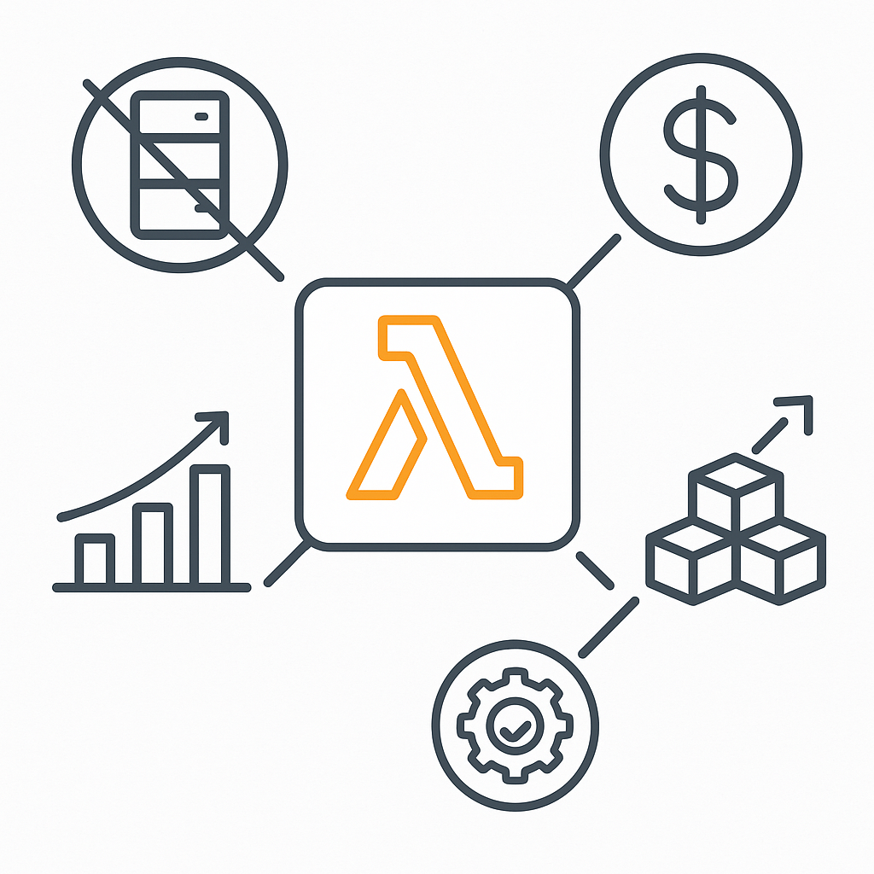
Benefits of AWS Lambda
• No server management.
• Cost-efficient (pay-per-use).
• Highly scalable and reliable.
• Easy integration with AWS ecosystem.
• Faster development cycles.

