Slide 1
MAJOR PROJECT CAPSTONE PRESENTATION
OmniClass: Next-Generation LMS
A Full-Stack AI-Powered Platform for Digital Learning & Institutional Governance
DOMAIN & ARCHITECTURE
✔ Full Stack Web Development
✔ MERN Stack + Google Gemini AI
✔ Vercel Edge + Render Cloud
CAPABILITIES & RIGOR
✔ 10 Functional Enterprise Modules
✔ 30-MCQ Proctored Assessment Engine
✔ Verifiable A4 Landscape Certificates
SECURITY & VERIFICATION
✔ Role-Based Access (Student/Faculty/Admin)
✔ JWT Cookie Session + Bcrypt Hashing
✔ GraphQL LeetCode Profile Verification
Candidate: Shaik Mahaboob Basha | GitHub: Shaik673/OmniClass | Quillance Infotech Pvt. Ltd.

Slide 2
OMNICLASS LMS | FULL STACK MAJOR PROJECT CAPSTONE
Executive Summary: The OmniClass Paradigm
Bridging the gap between isolated asynchronous learning and intelligent real-time instruction.
THE PROBLEM
THE INNOVATION
Challenges in Traditional LMS Platforms
• Asynchronous Isolation: Learners struggle without instant, personalized feedback when stuck on complex code or math.
• Static Content Delivery: Rigid text/video without active recall, dynamic summaries, or contextual knowledge grounding.
• Unverified Assessments: Surface-level non-proctored quizzes vulnerable to manipulation without rigorous academic standards.
• Insecure Credentials: Static PDF certificates with zero cryptographic verification, forgeable metadata, and manual validation.
• Fragmented Tooling: Students juggle disjointed tools (chatbots, note summarizers, code platforms, flashcards) outside the LMS.
The OmniClass Solution Architecture
• Interactive AI Omni Tutor: Multimodal streaming assistant with typewriter response and emotion-aware natural speech synthesis.
• YouLearn-Style 3-Mode Summarizer: Instant key takeaways from file drops (.pdf/.docx/.ppt), YouTube educational URLs, or raw text.
• 3-Part Dynamic Active Recall: 15 targeted MCQs categorized into Conceptual, Applied Analysis, and Problem Solving with flip flashcards.
• 30-MCQ Proctored Assessment Engine: Automated anti-cheat validation requiring a strict >= 70% passing threshold.
• Cryptographically Validated Certificates: High-resolution A4 landscape modal with digital signatures, live QR codes, and LinkedIn sharing.
OmniClass: Next-Generation Learning Management System | Quillance Infotech Student Project Brief | Slide 2 of 18

Slide 3
OMNICLASS LMS | FULL STACK MAJOR PROJECT CAPSTONE
User Personas & Role-Based Access Control (RBAC)
Strict multi-tenant security boundaries enforcing granular capability matrices across three core user tiers.
STUDENT TIER
FACULTY TIER
GOVERNANCE TIER
Student Persona
• Self-registration & OAuth identity integration
• Interactive course consumption across 5 modules
• Omni Tutor Q&A, voice speech & 3-mode summarizer
• Formative assignment submissions (code repos & URLs)
• 30-MCQ proctored exams & certificate claiming
• Custom hero cover banner & LeetCode verification
Instructor Persona
• Course Builder Studio with rich markdown lessons
• Curriculum structuring with 5 sequential modules
• Pro tier pricing configuration (INR Razorpay)
• Assignment authoring with deadline & rubric controls
• Centralized submission review & formative grading
• Student mastery velocity & intervention tracking
Administrator Persona
• Institutional health overview & system analytics
• Course approval queue (review & catalog publication)
• User directory management (search, promote, suspend)
• Institutional branding & accreditation configuration
• Digital certificate authority & signatory definitions
• System security logs & rate-limiting policies
OmniClass: Next-Generation Learning Management System | Quillance Infotech Student Project Brief | Slide 3 of 18

Slide 4
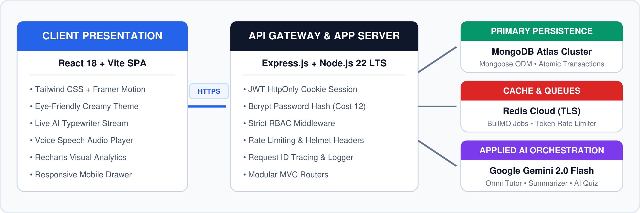
OMNICLASS LMS | FULL STACK MAJOR PROJECT CAPSTONE
Core Full-Stack Architecture & Data Flow
Decoupled SPA architecture communicating via authenticated HTTPS REST endpoints with stateful session governance.
TIER 1
TIER 2
TIER 3
Client Presentation
• React 18 + Vite SPA
• Tailwind CSS & Framer Motion
• Creamy-slate glare-free theme
App Server & Gateway
• Express.js + Node.js 22 LTS
• JWT HttpOnly cookies & bcrypt 12
• Strict RBAC & Helmet headers
Managed Data & AI
• MongoDB Atlas M0 Cluster
• Redis Cloud TLS (BullMQ jobs)
• Google Gemini 2.0 Flash API
OmniClass: Next-Generation Learning Management System | Quillance Infotech Student Project Brief | Slide 4 of 18

Slide 5
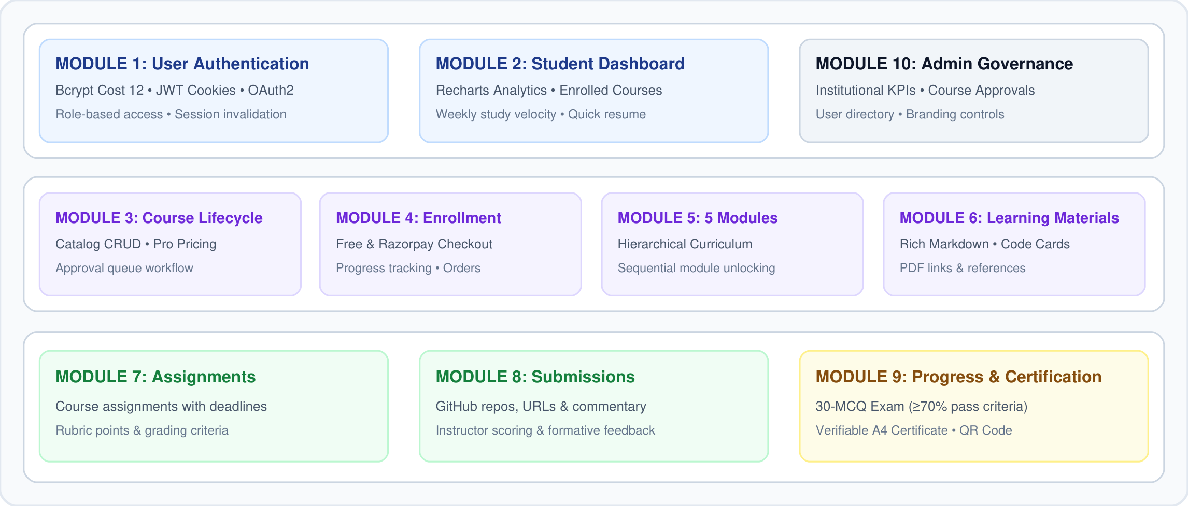
OMNICLASS LMS | FULL STACK MAJOR PROJECT CAPSTONE
OmniClass Platform: 10 Core Functional Modules
Comprehensive architectural module coverage from identity provisioning to automated cryptographic certification.
OmniClass: Next-Generation Learning Management System | Quillance Infotech Student Project Brief | Slide 5 of 18

Slide 6
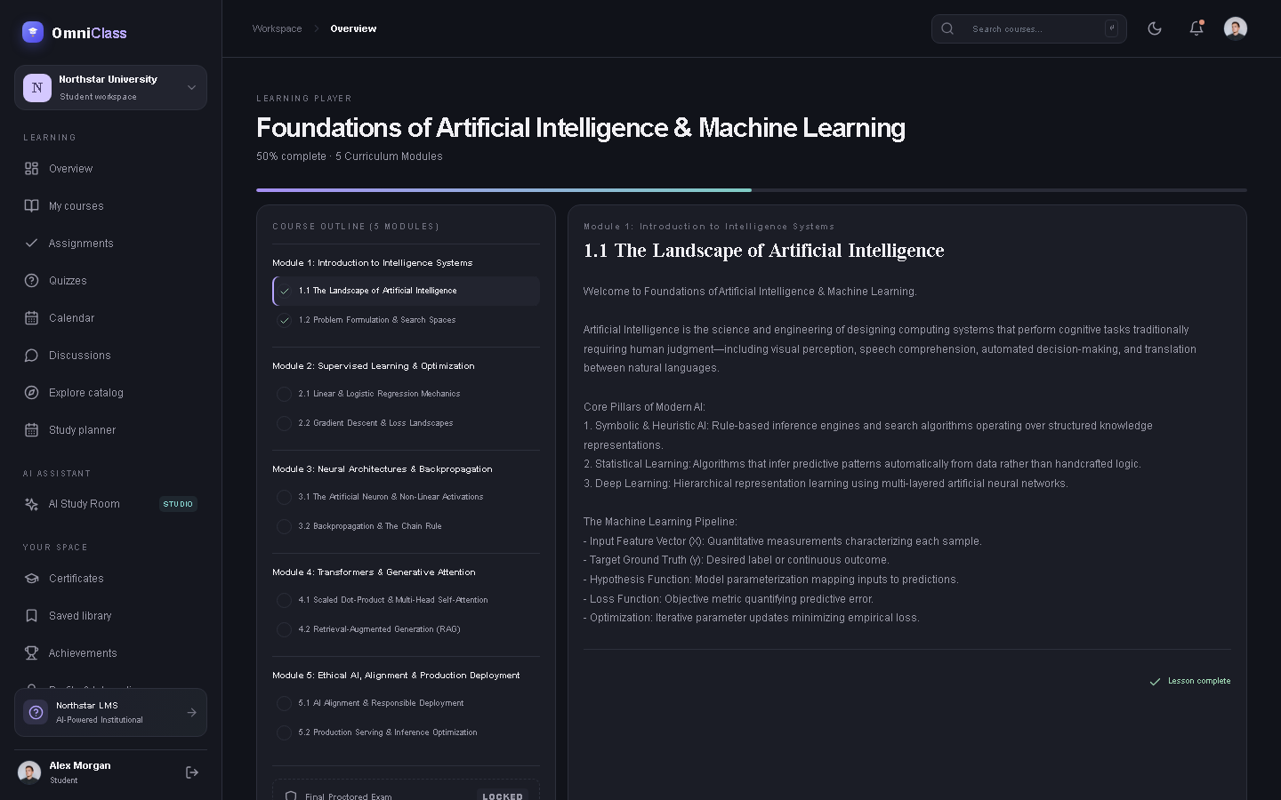
OMNICLASS LMS | FULL STACK MAJOR PROJECT CAPSTONE
Student Learning Hub & Interactive Course Player
5-module hierarchical curricula with syntax-highlighted code cards, markdown notes, and progress tracking.
CURRICULUM PLAYER
Key Course Player Capabilities
• Structured 5-Module Navigation: Sequential lesson progression prevents skipping ahead without reading materials.
• Rich Markdown Engine: Syntax-highlighted code cards, language pills, copy snippets, tables, and blockquotes.
• Visual Mastery Analytics: Real-time calculation of completed modules and overall percentage progress bar.
• Supplementary Materials: Embedded PDF references, recommended readings, and external repository links.
• Assignment Submission Portal: Accepts GitHub links, live demos, and rich text commentary for faculty grading.
OmniClass: Next-Generation Learning Management System | Quillance Infotech Student Project Brief | Slide 6 of 18

Slide 7
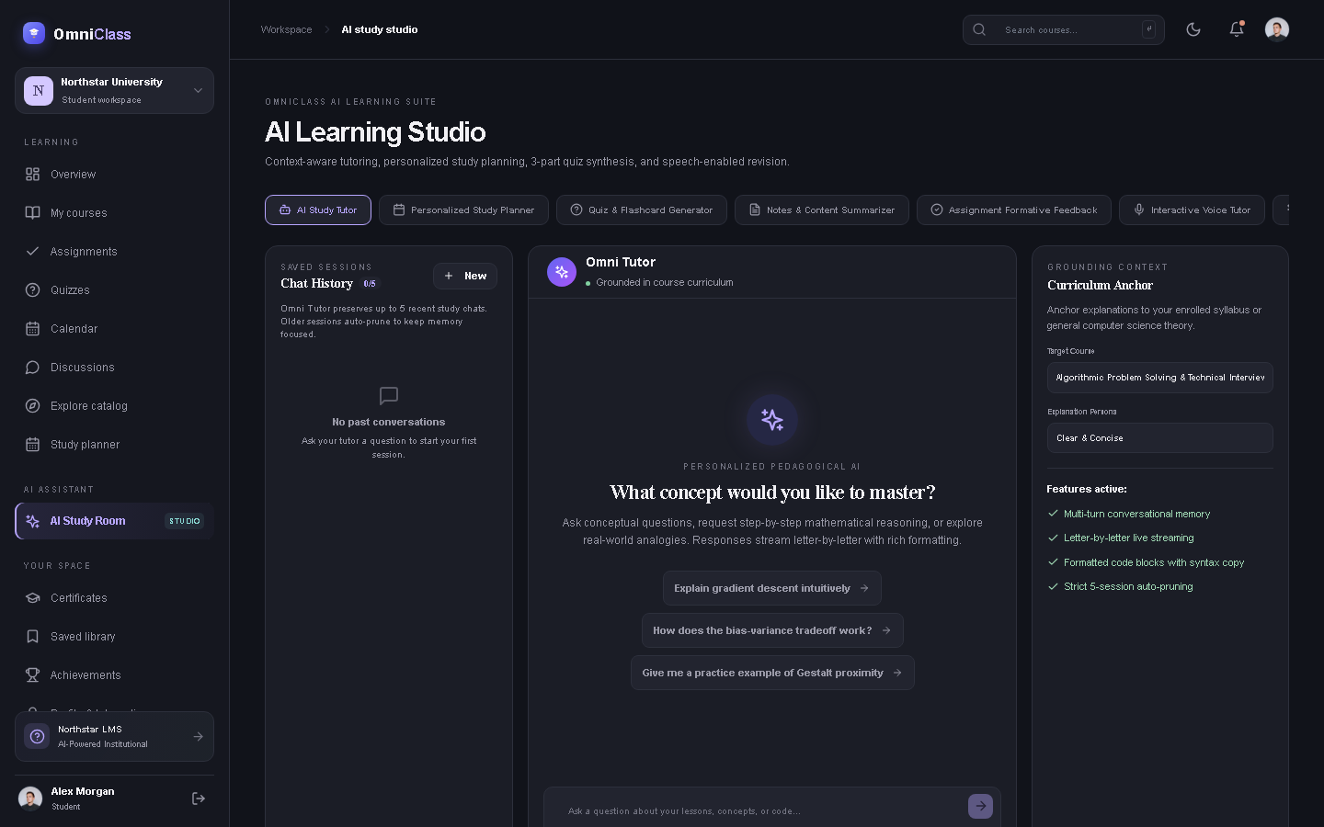
OMNICLASS LMS | FULL STACK MAJOR PROJECT CAPSTONE
AI Study Room: Omni Tutor & Natural Voice Synthesis
Curriculum-grounded conversational assistant powered by Google Gemini 2.0 Flash with live streaming.
OMNI TUTOR
Intelligent Tutoring Engine
• Gemini 2.0 Flash Orchestration: Low-latency streaming prompts grounded in current course syllabus context.
• Dynamic Typewriter Effect: Letter-by-letter live text rendering with automated scroll-to-bottom behavior.
• Regex-Sanitized Voice Audio: Strips asterisks, code symbols, and dashes to speak natural, expressive sentences.
• Multi-Turn Conversation Memory: Context-preserving chat history with session auto-pruning to prevent bloat.
• Zero-Hallucination Fallback: Multi-model failover ensures uninterrupted tutoring availability.
OmniClass: Next-Generation Learning Management System | Quillance Infotech Student Project Brief | Slide 7 of 18

Slide 8
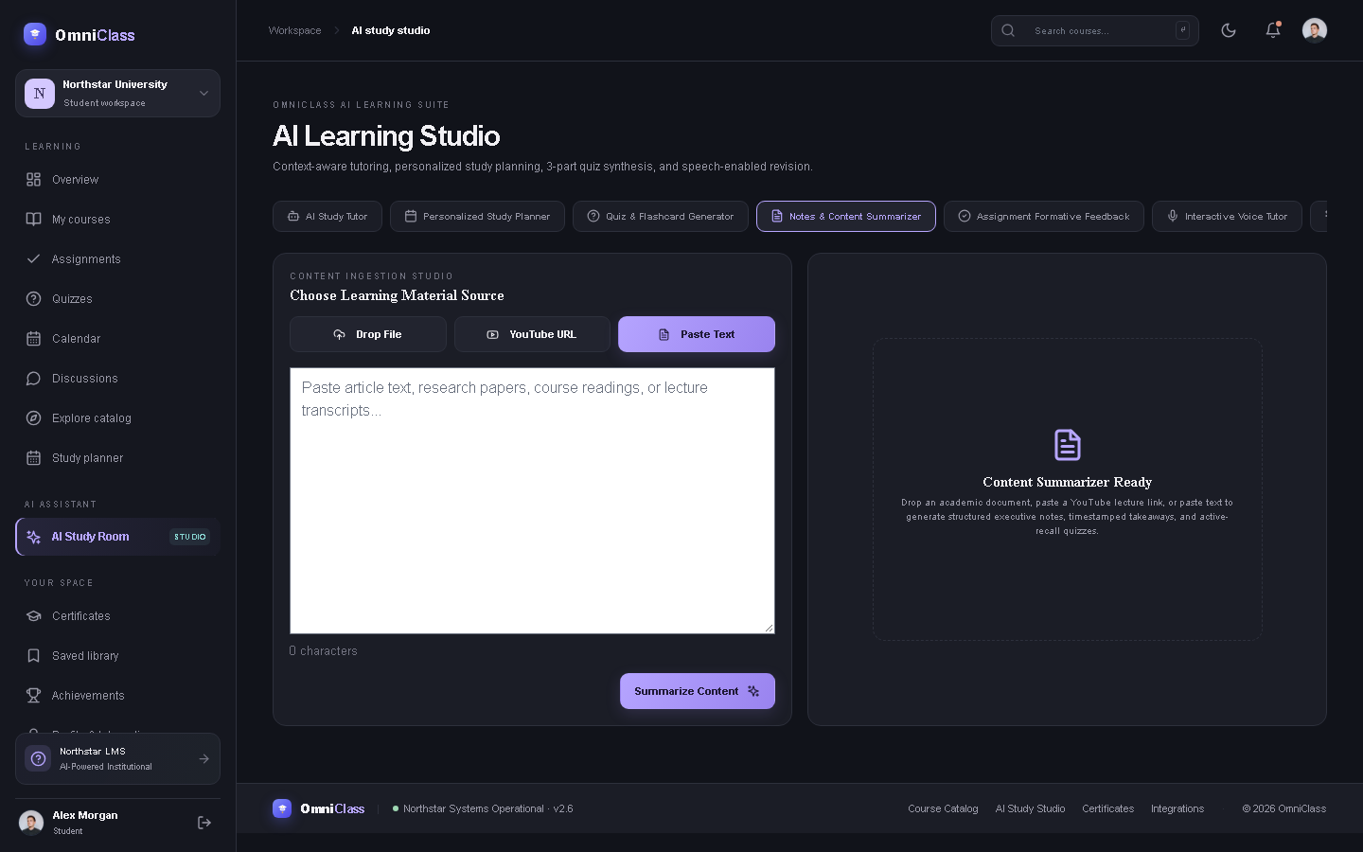
OMNICLASS LMS | FULL STACK MAJOR PROJECT CAPSTONE
Notes Summarizer (YouLearn Style) & Active Recall Quiz
Multimodal content synthesis powering 3-mode note extraction and categorized active recall flashcards.
SUMMARIZER & QUIZ
Multimodal Synthesis Suite
• 3-Mode Content Input: Drag-and-drop document upload (.pdf, .docx, .ppt), YouTube video URL parsing, and manual text paste.
• 1-Click AI Quiz Synthesis: Converts extracted summaries directly into active recall testing modules.
• 3-Part Cognitive Partitioning: 15 questions categorized into Conceptual Foundations, Applied Analysis, and Problem Solving.
• Interactive Flashcard Engine: Double-sided flip cards testing core formulas, design patterns, and vocabulary.
• Instant Mastery Score: Automatic grading with detailed explanatory rationale for every question.
OmniClass: Next-Generation Learning Management System | Quillance Infotech Student Project Brief | Slide 8 of 18

Slide 9
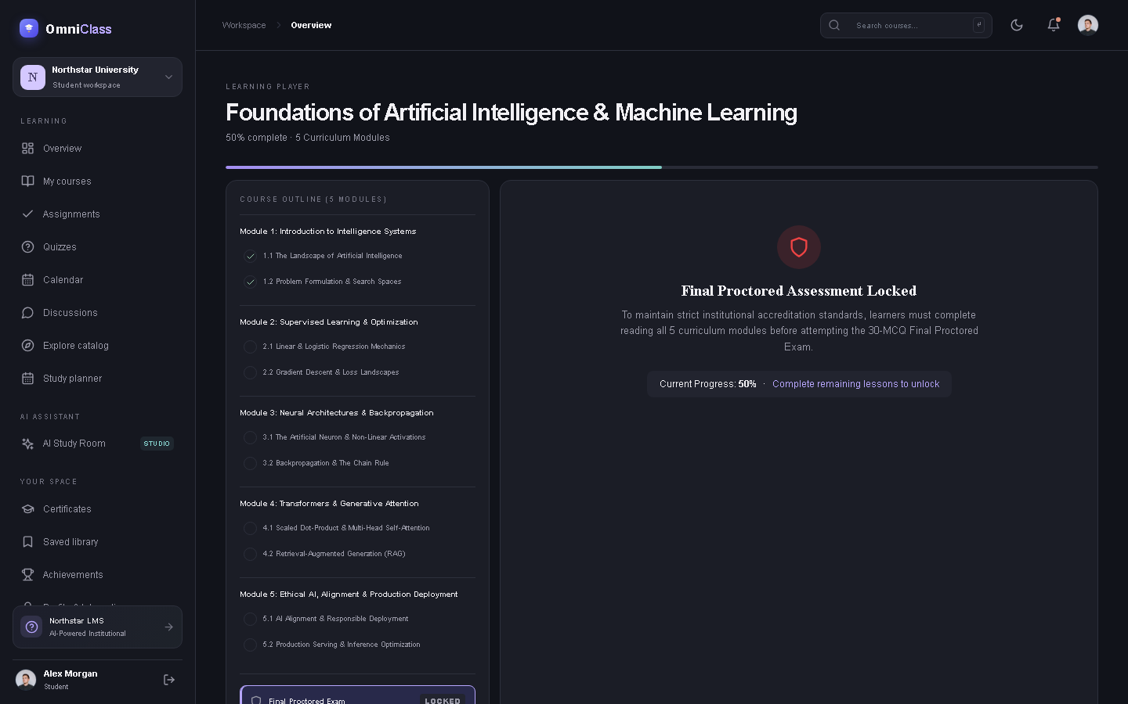
OMNICLASS LMS | FULL STACK MAJOR PROJECT CAPSTONE
30-MCQ Final Proctored Exam Engine
Institutional-grade summative evaluation requiring strict passing criteria to earn certified completion credentials.
PROCTORED EVALUATION
Proctored Exam Architecture
• Comprehensive Course Scope: 30 multiple-choice questions rigorously testing all 5 curriculum modules.
• Strict 70% Passing Threshold: Students must score at least 21/30 to unlock their completion certificate.
• Sequential Module Prerequisite: Exam unlocks only after reading progress reaches 100% across all 5 modules.
• Automated Anti-Tamper Grading: Server-side answer evaluation against cryptographic question keys.
• Attempt Auditing: Records score history, timestamps, attempt counters, and proctoring status in MongoDB.
OmniClass: Next-Generation Learning Management System | Quillance Infotech Student Project Brief | Slide 9 of 18

Slide 10
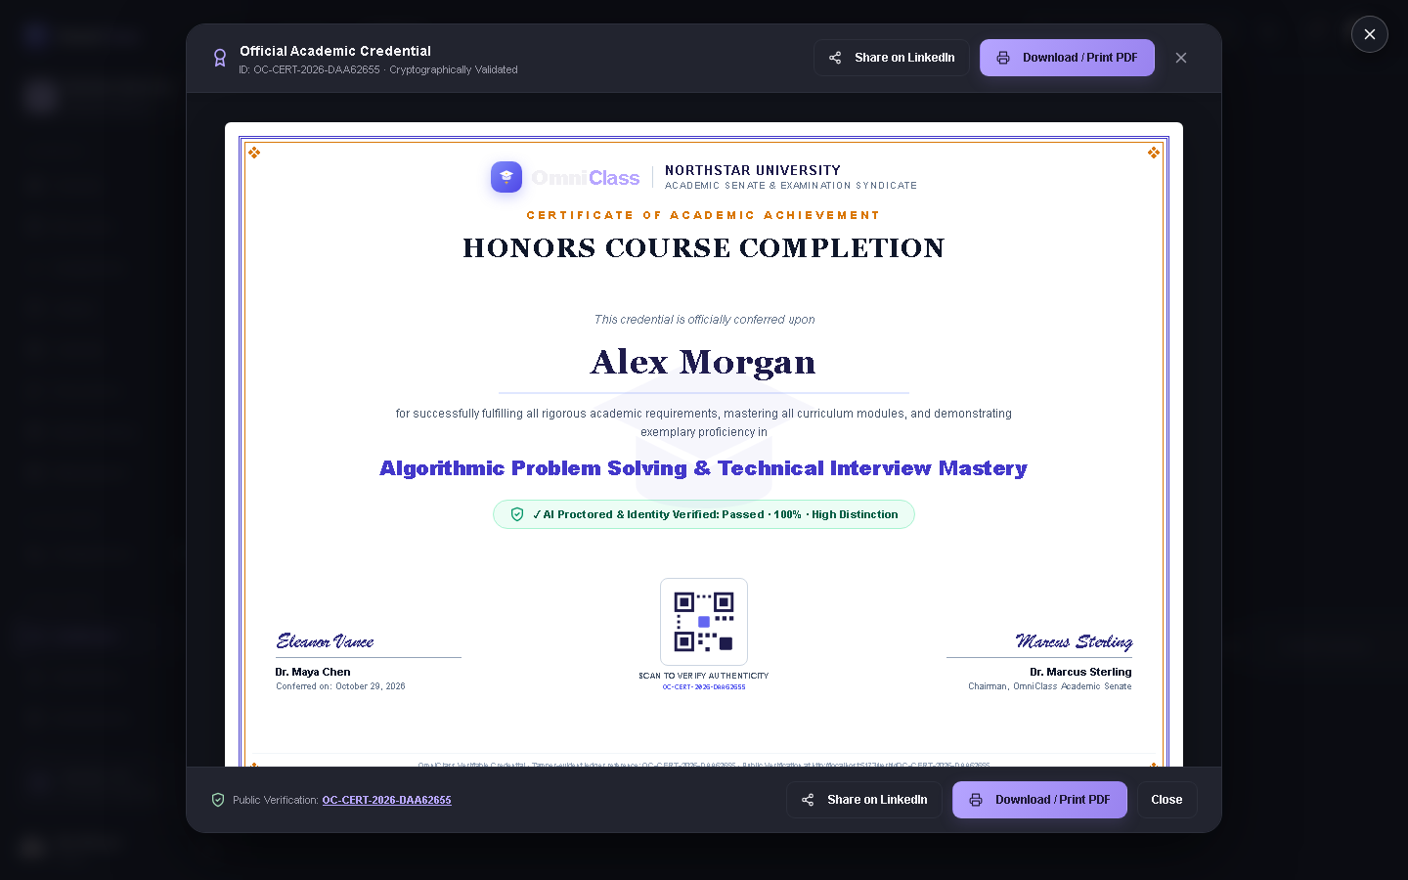
OMNICLASS LMS | FULL STACK MAJOR PROJECT CAPSTONE
Verifiable A4 Landscape Digital Certificates
Tamper-evident completion credentials featuring live QR codes, digital signatures, and LinkedIn sharing.
A4 CERTIFICATE MODAL
Credential Engine Highlights
• A4 Landscape Visual Elegance: Sophisticated gold filigree borders, university seal, and modern academic typography.
• Authentic Issuance Metadata: Learner's full name, exact course title, completion date, grade distinction, and instructor signature.
• Scannable QR Verification: Direct URL linking to public cryptographic verification route (/verify/:certificateCode).
• PDF Download Ready: Custom @media print CSS optimized for crisp vector landscape A4 exports.
• 1-Click LinkedIn Sharing: Pre-filled certification dialog containing platform authority, license number, and verification URL.
OmniClass: Next-Generation Learning Management System | Quillance Infotech Student Project Brief | Slide 10 of 18

Slide 11
OMNICLASS LMS | FULL STACK MAJOR PROJECT CAPSTONE
Public Verification Ledger & LeetCode Integration
Transparent public credential auditing paired with verifiable external technical portfolio claims.
PUBLIC LEDGER
PROFILE VERIFICATION
Public Verification Ledger (/verify/:code)
• Zero-Login Public Access: Employers and recruiters can verify certificate validity without creating an account.
• Cryptographic Integrity: Matches unique certificateCode against primary database records.
• Proctored Status Transparency: Displays proctoring audit details, score breakdown, and issuing authority seal.
• Revocation Support: Instantly displays revoked status if credential was administratively suspended.
LeetCode GraphQL Profile Validation
• Live Stats Extraction: Queries LeetCode public API for total solved counts, Easy/Medium/Hard problems, and contest rating.
• Expiring Challenge Token: Generates unique challenge tokens (omniclass-verify-XXXXXX) to prove profile ownership.
• Connected Accounts: Functioning connection indicators for GitHub, LinkedIn, and verified LeetCode portfolios.
• Custom Banner Upload: Adjusts learner's uploaded .jpg/.png cover banner to fit the profile canvas perfectly.
OmniClass: Next-Generation Learning Management System | Quillance Infotech Student Project Brief | Slide 11 of 18

Slide 12
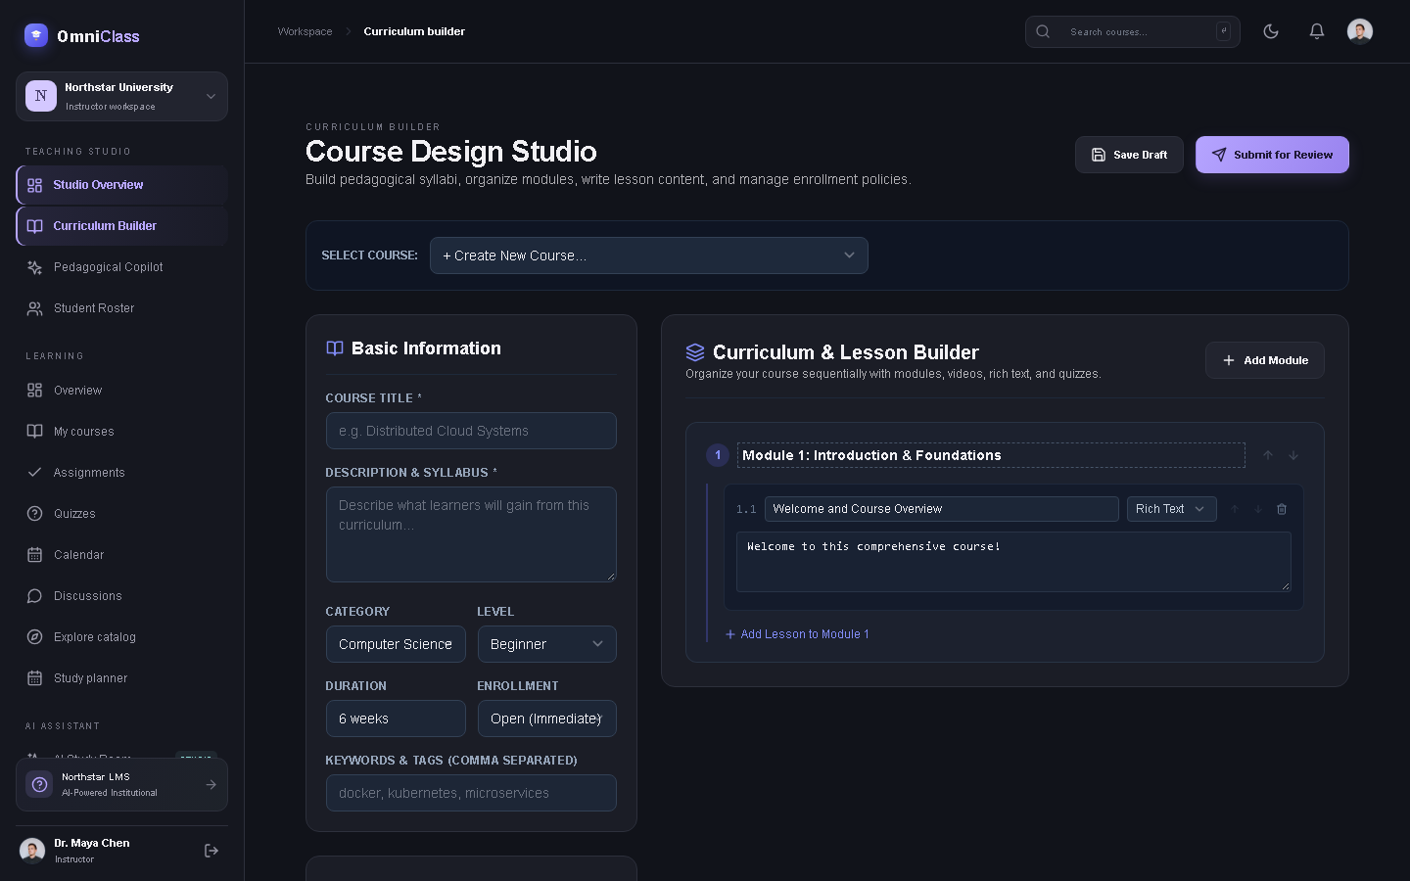
OMNICLASS LMS | FULL STACK MAJOR PROJECT CAPSTONE
Faculty Studio: Course Builder & Evaluation Queue
Integrated curriculum drafting studio supporting 5 sequential modules, markdown lessons, and rubrics.
INSTRUCTOR STUDIO
Faculty Authoring Capabilities
• Visual Course Authoring: Define title, category, difficulty tier, duration, and Pro course pricing (₹1,999 INR).
• 5-Module Curriculum Builder: Author rich markdown lessons, embed code cards, and attach supplementary PDFs.
• Formative Assignment Management: Set deadlines, maximum point values, and clear grading rubric criteria.
• Centralized Submissions Queue: Inspect student repository links, review live demos, and input formative feedback.
• Student Cohort Analytics: Monitor student progress velocity and identify learners requiring academic support.
OmniClass: Next-Generation Learning Management System | Quillance Infotech Student Project Brief | Slide 12 of 18

Slide 13
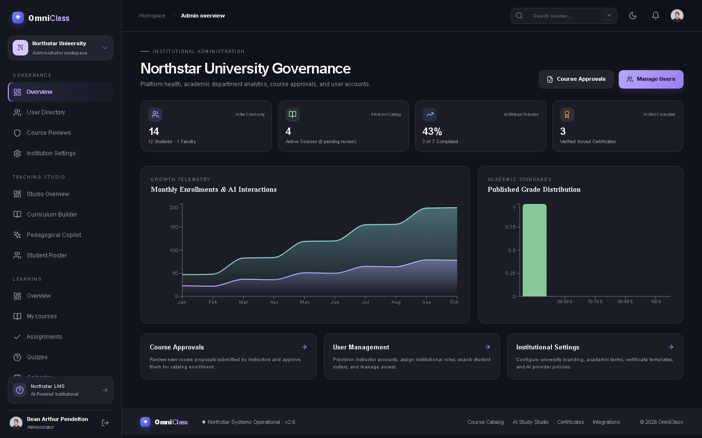
OMNICLASS LMS | FULL STACK MAJOR PROJECT CAPSTONE
Institutional Governance: Admin Dashboard Suite
University-wide governance oversight covering real-time KPIs, course approvals, and user directory management.
ADMIN GOVERNANCE
Administrative Governance Tools
• System Health & KPIs: Live monitoring of total registered learners, faculty rosters, published courses, and completion rates.
• Course Moderation Queue (/admin/approvals): Audit newly drafted instructor curricula before public catalog activation.
• User Directory Management (/admin/users): Search users, promote student to instructor/admin, and toggle account status.
• Institutional Settings (/admin/settings): University branding, accreditation notices, and digital certificate signatory titles.
• Enterprise Security: Session invalidation via sessionVersion counters and rate-limiting protection.
OmniClass: Next-Generation Learning Management System | Quillance Infotech Student Project Brief | Slide 13 of 18

Slide 14
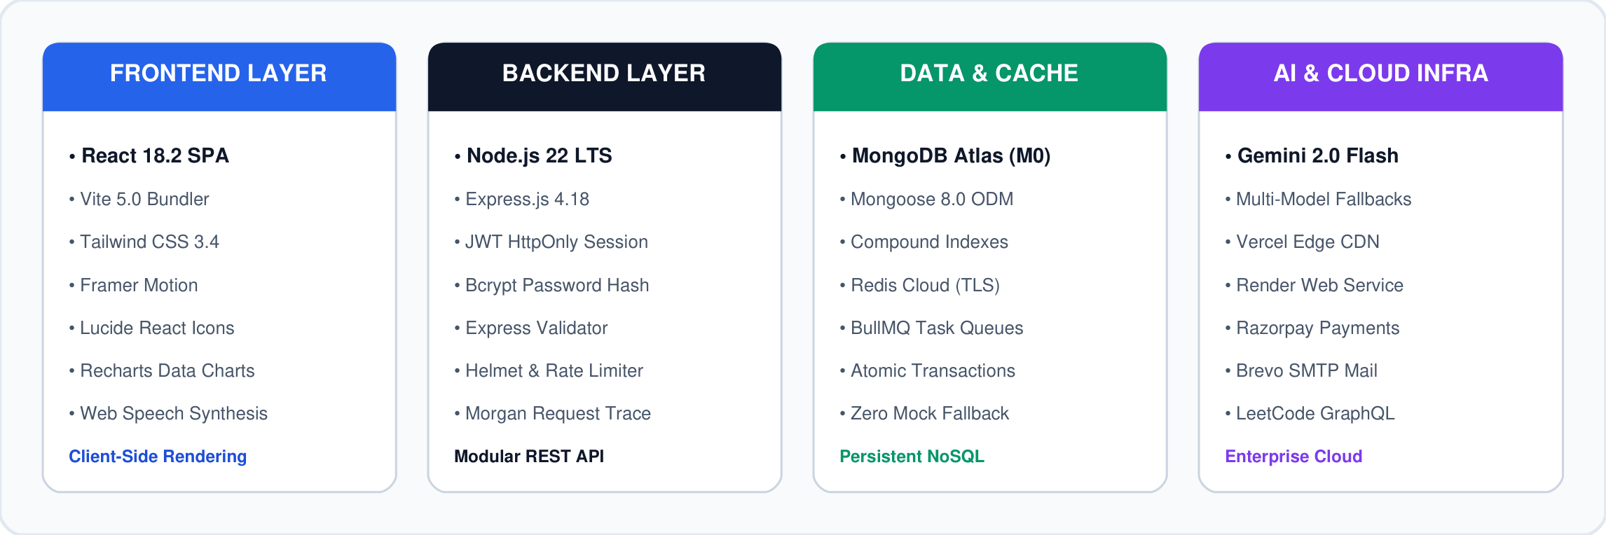
OMNICLASS LMS | FULL STACK MAJOR PROJECT CAPSTONE
Technology Stack: Robust, Scalable & Modern
Modern full-stack technologies selected for developer velocity, real-time token streaming, and data integrity.
OmniClass: Next-Generation Learning Management System | Quillance Infotech Student Project Brief | Slide 14 of 18

Slide 15
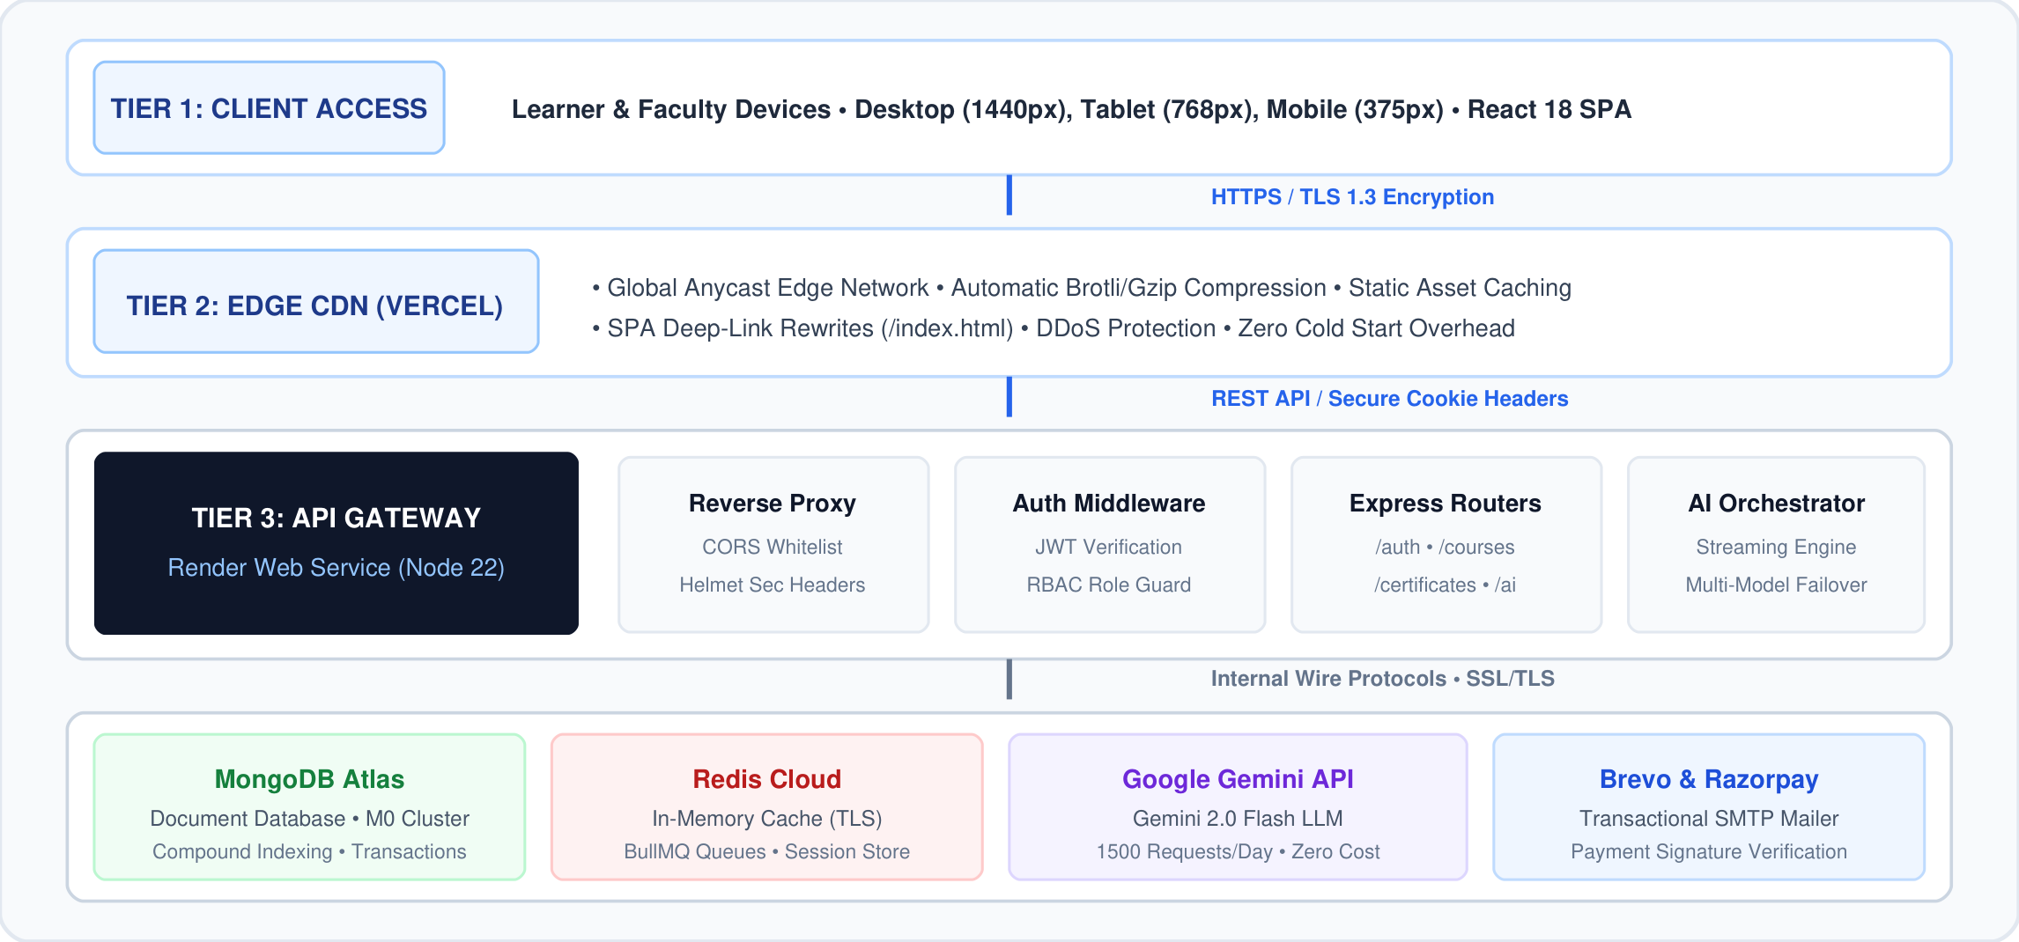
OMNICLASS LMS | FULL STACK MAJOR PROJECT CAPSTONE
Enterprise 4-Tier Cloud System Architecture
High-performance deployment mapping Client Devices -> Vercel Edge CDN -> Render API Server -> Managed Cloud Services.
OmniClass: Next-Generation Learning Management System | Quillance Infotech Student Project Brief | Slide 15 of 18

Slide 16
OMNICLASS LMS | FULL STACK MAJOR PROJECT CAPSTONE
Database Schemas & Data Persistence Integrity
MongoDB Atlas NoSQL schema models with Mongoose ODM compound indexing, enforcing zero mock reliance.
USER SCHEMA
COURSE SCHEMA
CREDENTIAL SCHEMA
User & Auth Model
• name, email (unique, lowercase)
• passwordHash (bcrypt 12 salt rounds)
• role: ['student', 'instructor', 'admin']
• theme: ['dark', 'light', 'system']
• sessionVersion: incremented on reset
• integrations: github, linkedin, leetcode
• verificationChallenge & expiry
Course & Modules Model
• title, slug (unique index)
• instructor, institutionId refs
• isPro (boolean), price (INR)
• status: ['draft', 'published']
• modules: [5 structured modules]
• content: rich markdown & resources
• finalExam: 30 MCQs & 70% threshold
Enrollment & Certificate
• userId, courseId, institutionId
• progress: 0 to 100% dynamic
• completedModuleIds array
• finalExamScore & passed (boolean)
• certificateCode (unique serial)
• learnerName, courseTitle, grade
• proctoredStatus: verified, timestamp
OmniClass: Next-Generation Learning Management System | Quillance Infotech Student Project Brief | Slide 16 of 18

Slide 17
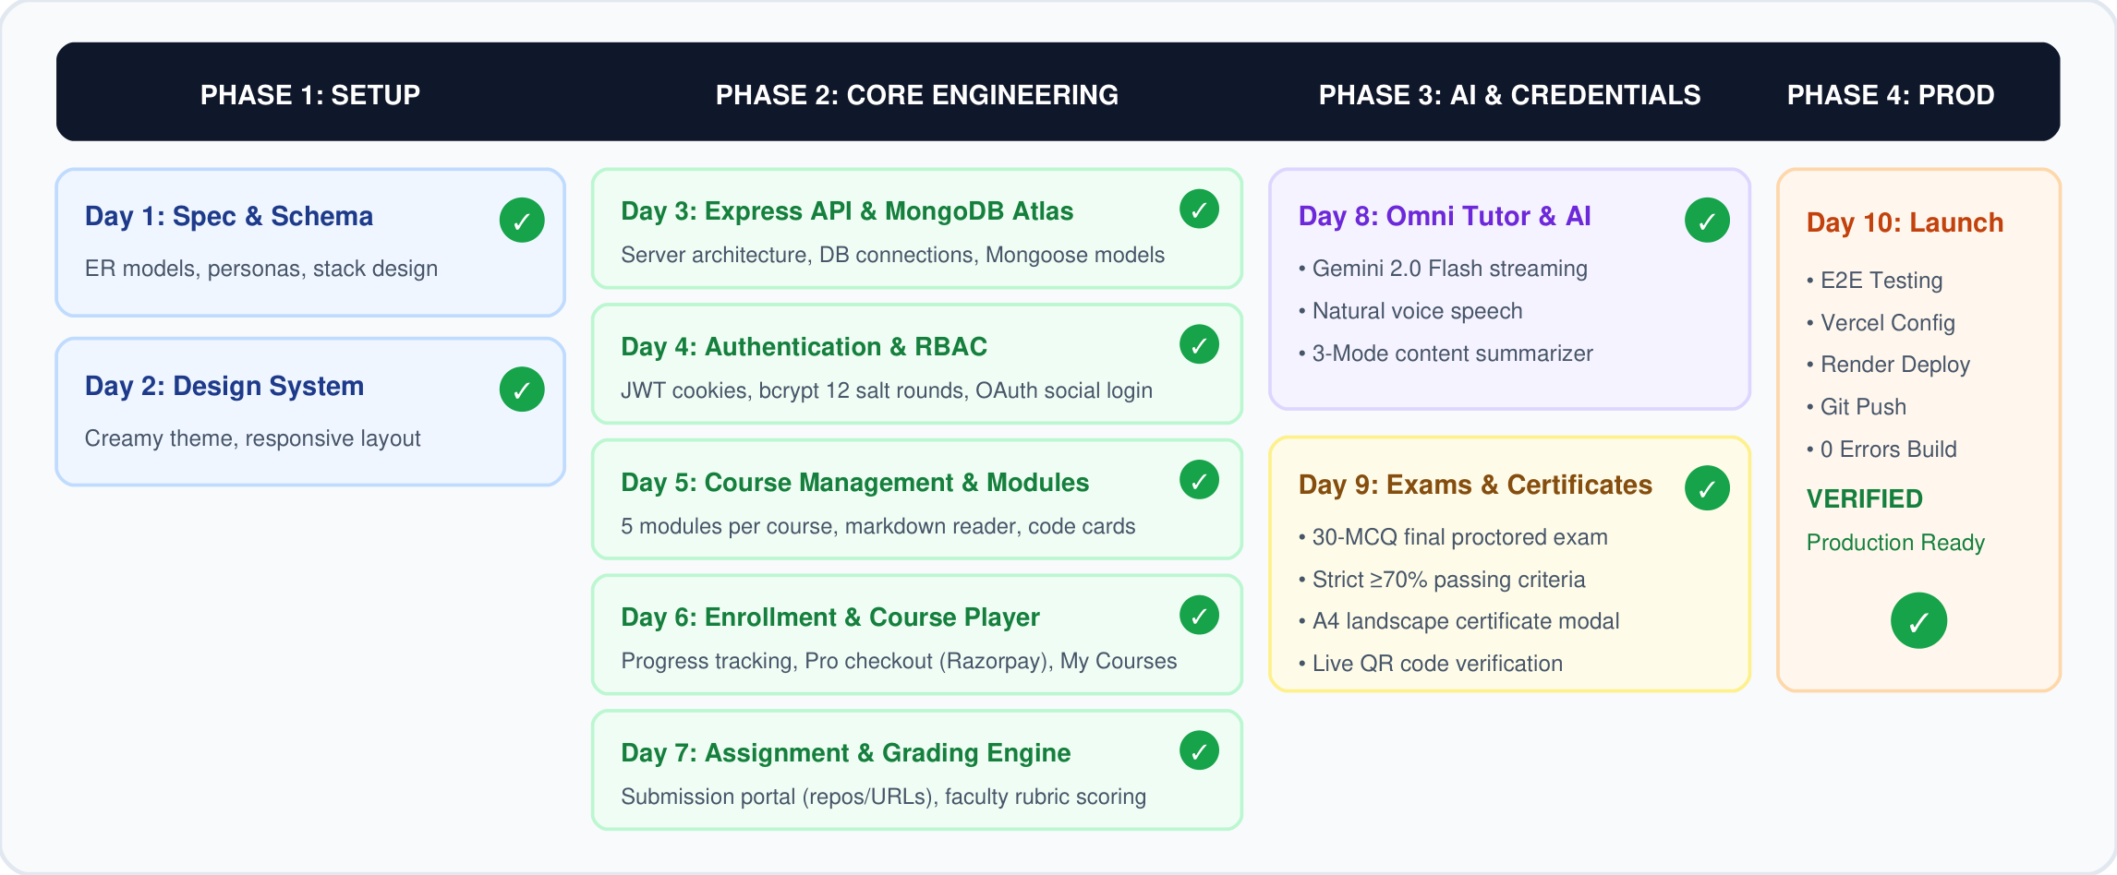
OMNICLASS LMS | FULL STACK MAJOR PROJECT CAPSTONE
10-Day Engineering Roadmap: All Milestones Verified
10-Day execution roadmap from architecture specification to production hardening (100% completed).
OmniClass: Next-Generation Learning Management System | Quillance Infotech Student Project Brief | Slide 17 of 18

Slide 18
MAJOR PROJECT EVALUATION STANDARD: A+
OmniClass: Project Outcomes & Achievements
Enterprise-grade engineering exceeding academic requirements with live cloud persistence and zero mock dependencies.
✔ 100% Live DB State
Zero mock fallbacks. Full MongoDB Atlas persistence across courses, 5 modules, users, quizzes, and certificates.
✔ Applied AI Excellence
Real-time Google Gemini 2.0 Flash integration with typewriter streaming, natural voice synthesis, and 3-mode summarization.
✔ Cryptographic Rigor
Automated 30-MCQ proctored exams, A4 landscape certificates with live QR verification and 1-click LinkedIn sharing.
✔ Production Deployed
Modular monorepo with production configs for Vercel Edge CDN and Render Web Service, pushed to GitHub.
Thank You! • GitHub: https://github.com/Shaik673/OmniClass.git • Questions & Answers

