Slide 1
# WELCOME .....
DOCTOR VISIT ANALYSIS PROJECT

Slide 2
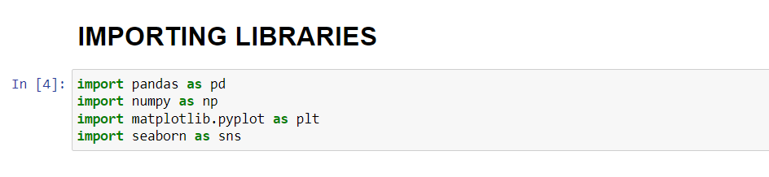
IMPORTANT LIBRARIES NEEDED FOR THE ANALYSIS OF DATASET.

Slide 3
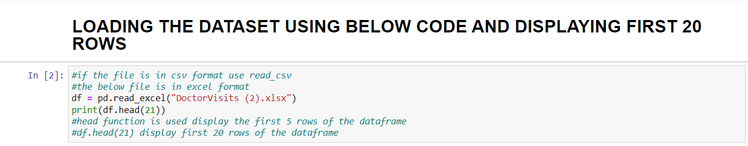
2. LOADING DATASET
INPUT :

Slide 4
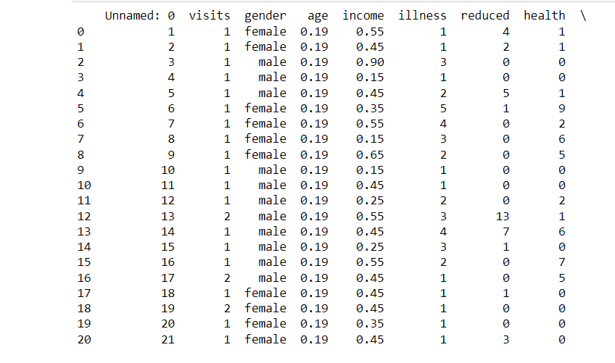
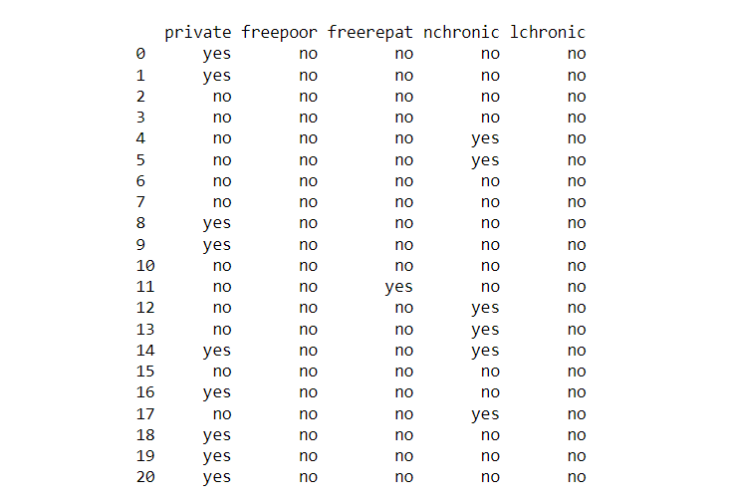
DATASET DISPLAYED SUCCESSFULLY
OUTPUT :

Slide 5
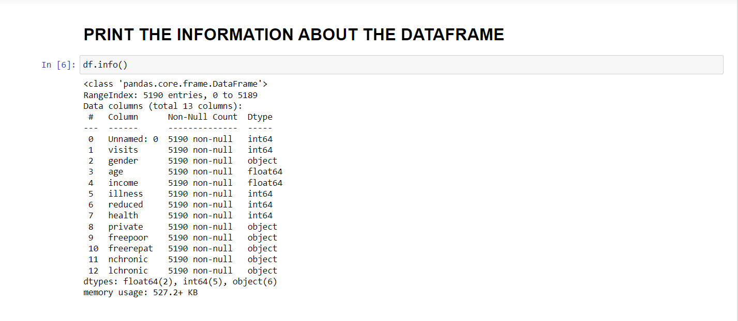
3. INFORMATION ABOUT THE DATAFRAME.

Slide 6
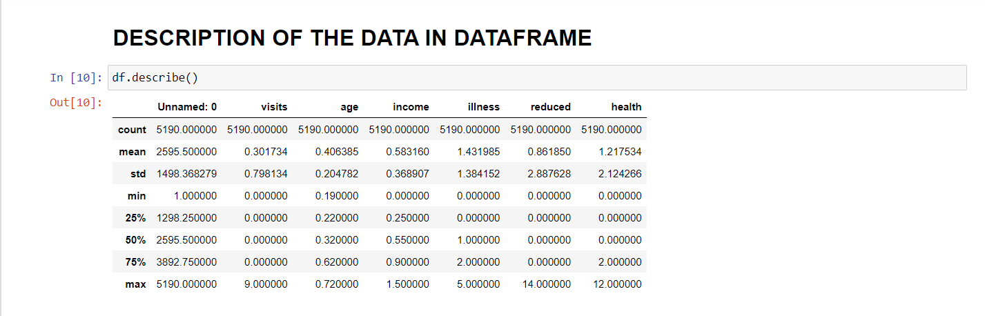
4. DESCRIPTION OF THE DATA .

Slide 7
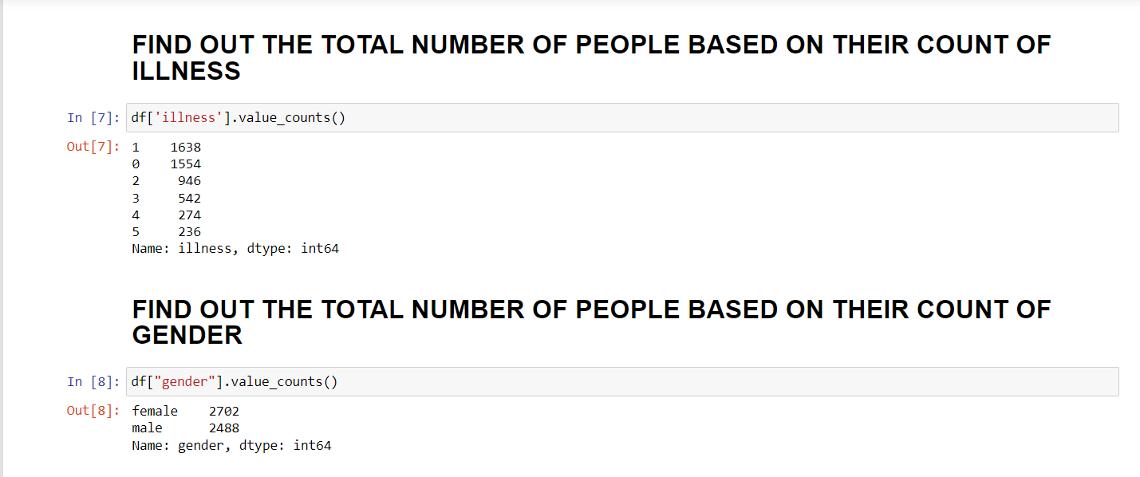
5. NUMBER OF PEOPLE ON THEIR COUNT OF ILLINESS AND ON THE COUNT OF GENDER .

Slide 8
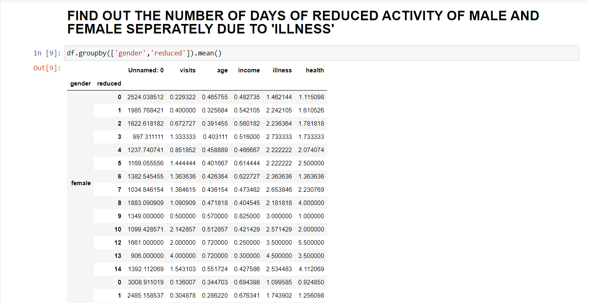
6. REDUCED ACTIVITY OF MALE AND FEMALE .

Slide 9
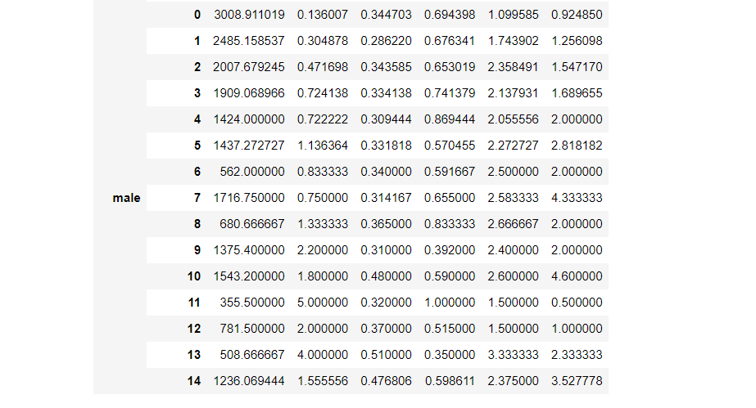
6th POINT CONTINUE.

Slide 10
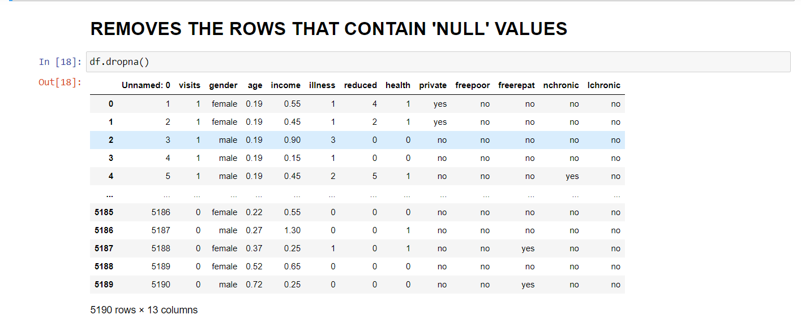
7. REMOVING ‘NULL’ VALUES .

Slide 11
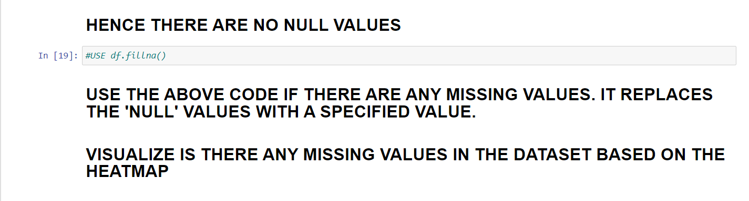
7th POINT CONTINUE .

Slide 12
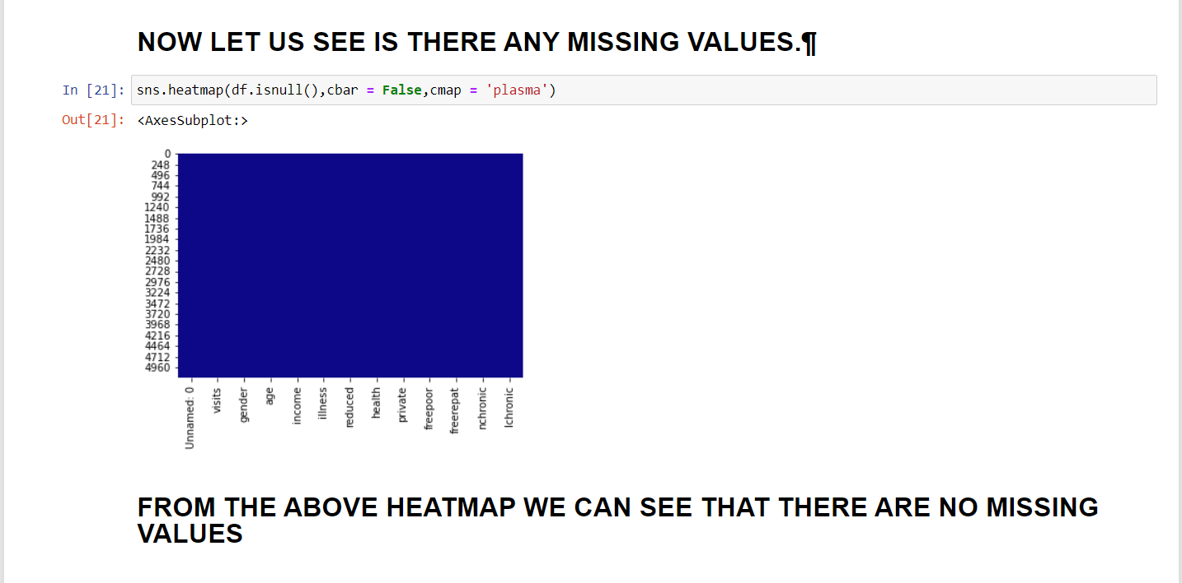
8. VISUALIZING MISSING VALUES USING HEATMAP .

Slide 13
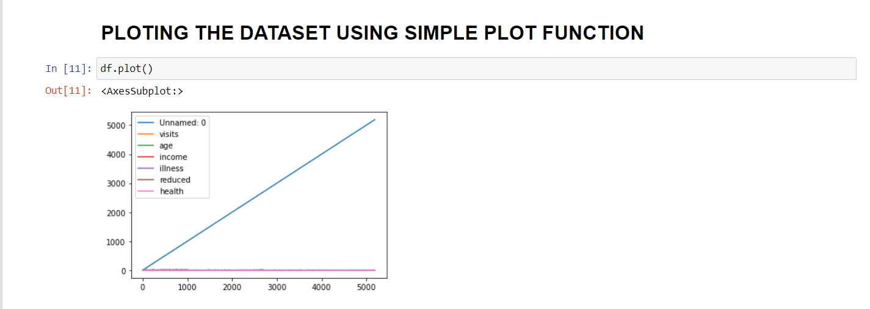
9. PLOT USING SIMPLE PLOT FUNCTION .

Slide 14
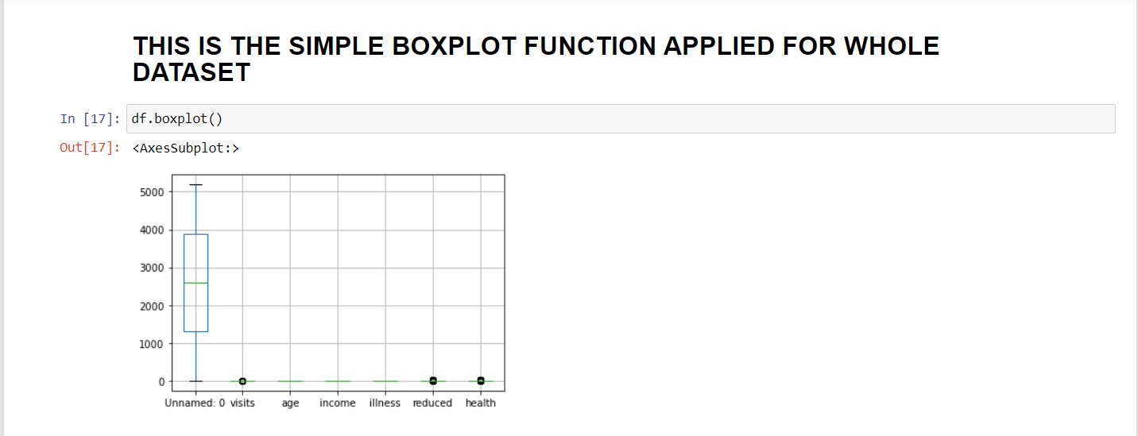
10. PLOTTING SIMPLE BOXPLOT FOR WHOLE DATSET .
CAN’T GET MUCH CLARETY ABOUT DATASET .

Slide 15
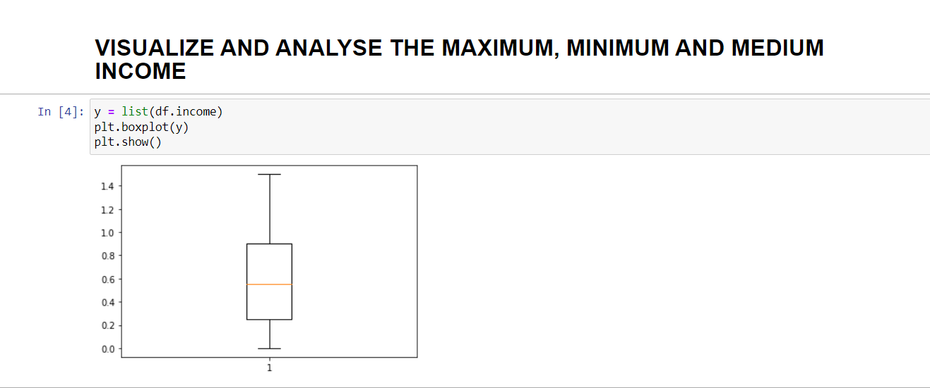
11. ANALYSIS FOR INCOME USING BOXPLOT .
THIS GRAPH IS JUST FOR INCOME . WE CAN PLOT IT FOR EVERY COLUMN IN THE DATASET .

Slide 16
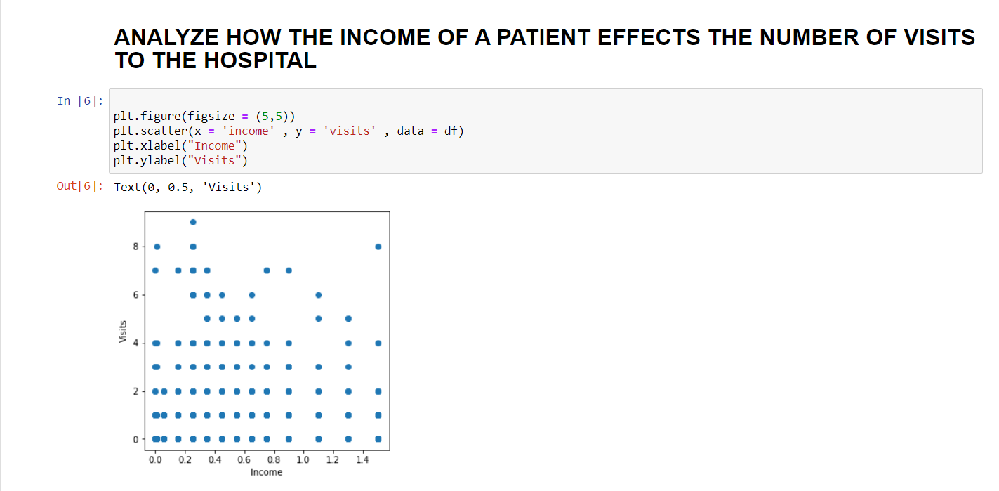
12. VISUALIZING IT USING SCATTER PLOT .

Slide 17
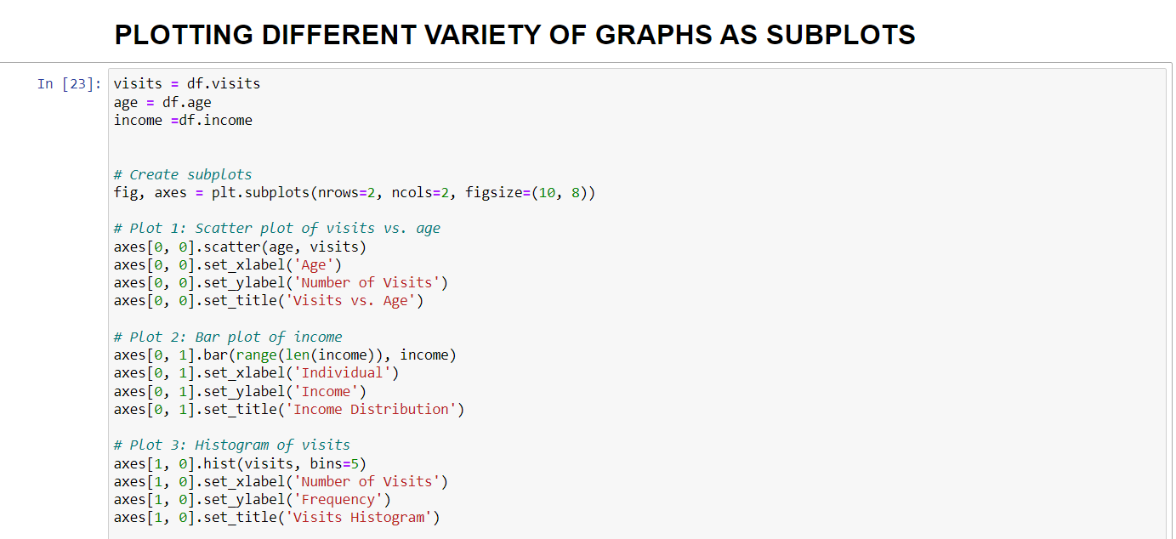
13. GRAPHS AS SUBGRAPHS .
INPUT :

Slide 18
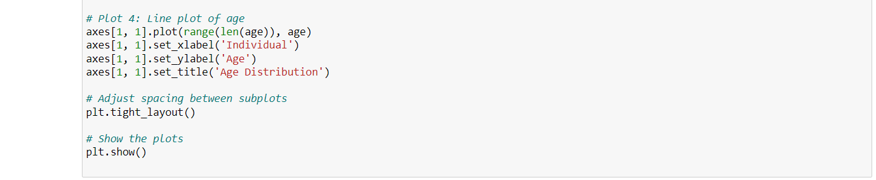
13th POINT CONTINUE :
INPUT :

Slide 19
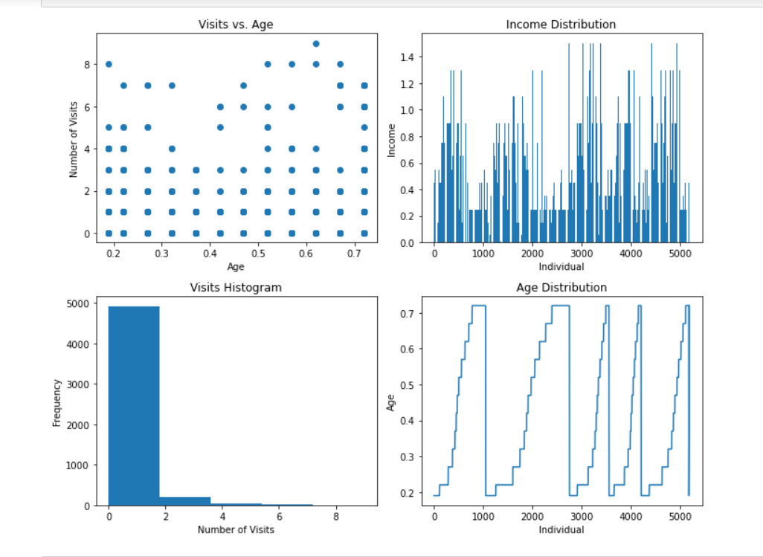
OUTPUT :
13th POINT CONTINUE :

Slide 20
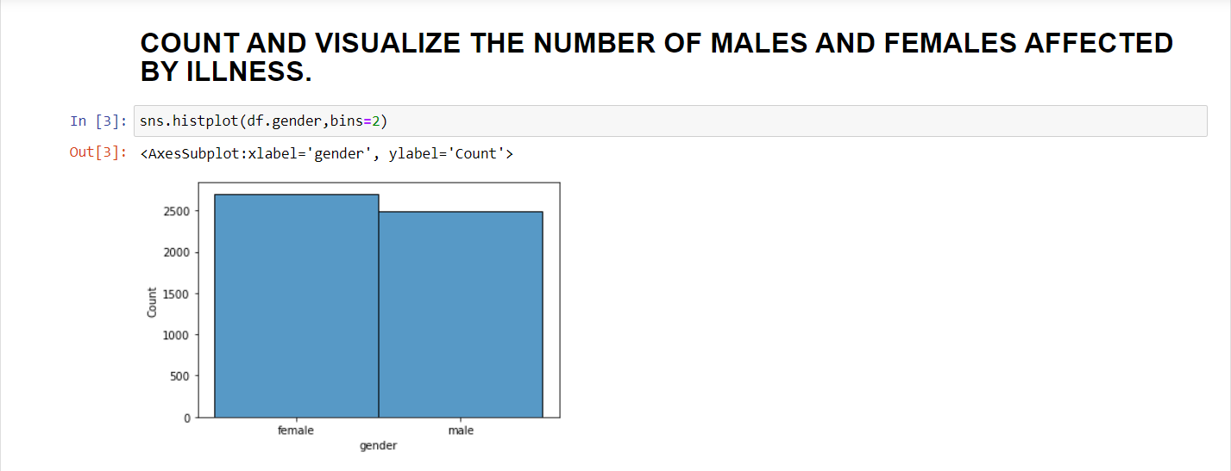
14.VISUALIZE USING HISTPLOT .

Slide 21
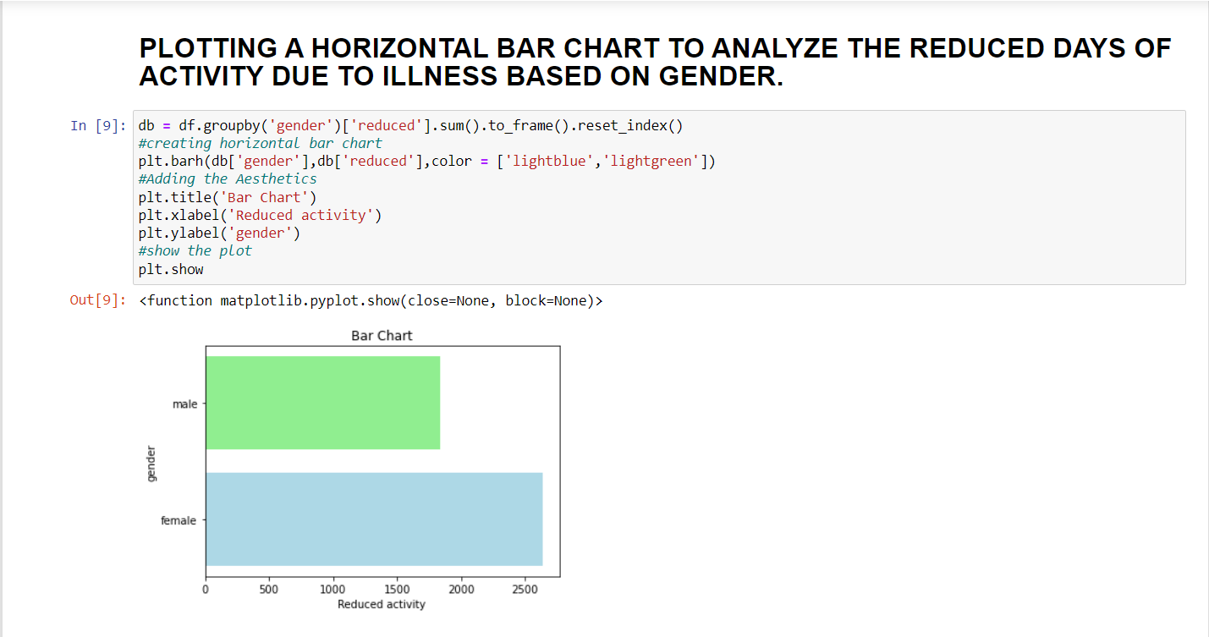
15. PLOTTING THE HORIZONTAL BAR CHART FOR REDUCED ACTIVITY AND GENDER .

Slide 22
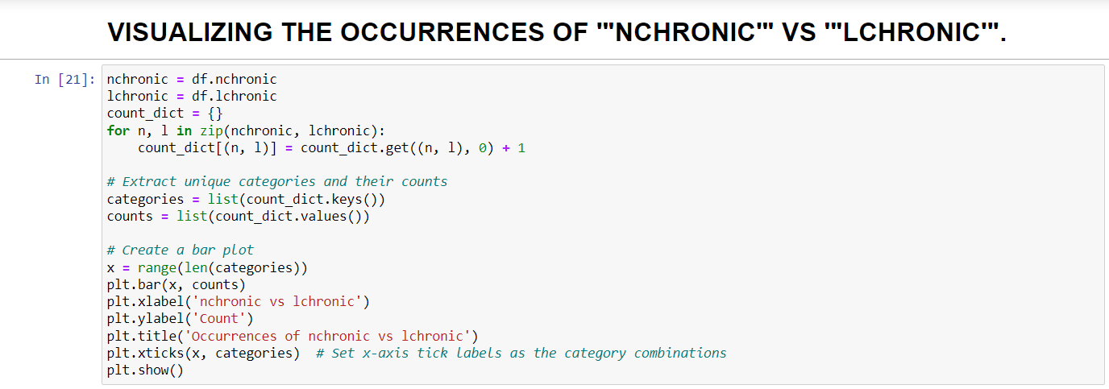
16. VISUALIZING THE OCCURRENCES OF “NCHRONIC” AND “LCHRONIC”
INPUT :

Slide 23
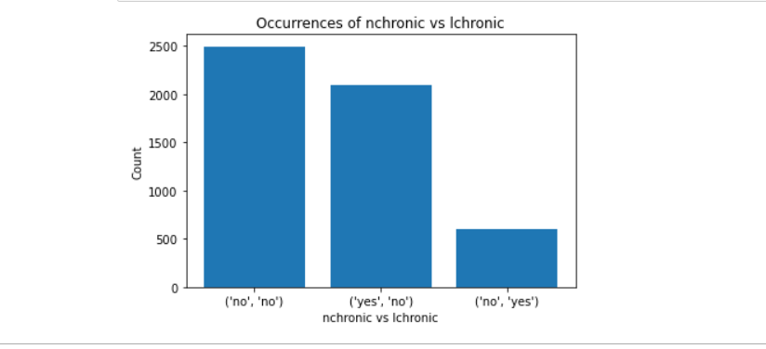
16th POINT CONTINUE :
OUTPUT :

Slide 24
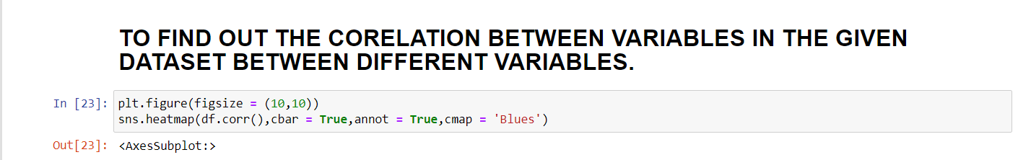
17. CORELATION BETWEEN DIFFERENT VARIABLES IN THE GIVEN DATASET .
INPUT :

Slide 25
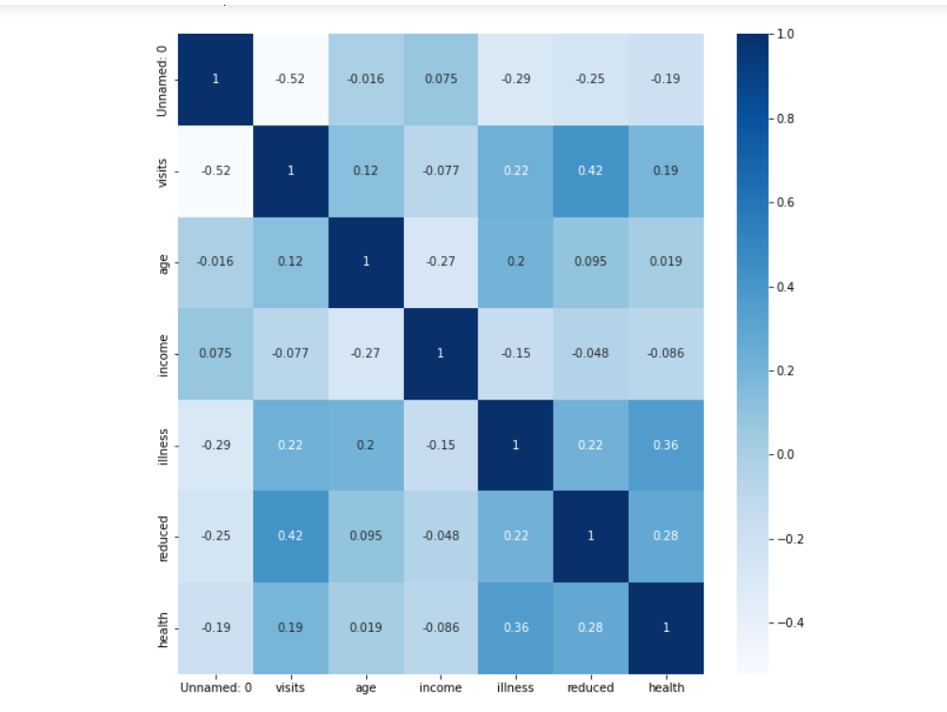
OUTPUT :
17th POINT CONTINUE :

Slide 26
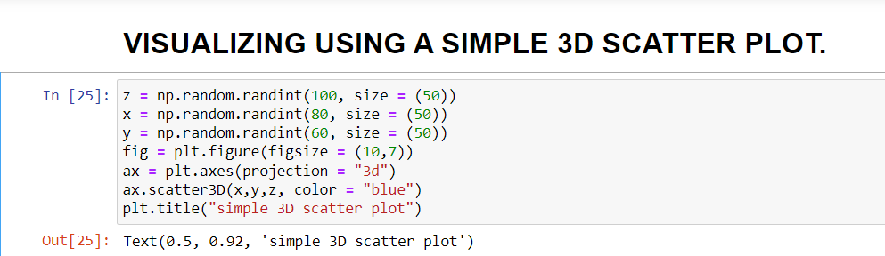
18. SIMPLE 3D SCATTER PLOT .
INPUT :

Slide 27
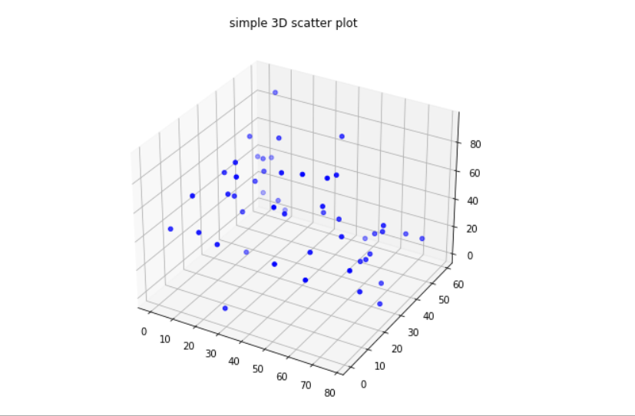
18th POINT CONTINUE :
OUTPUT :

Slide 28
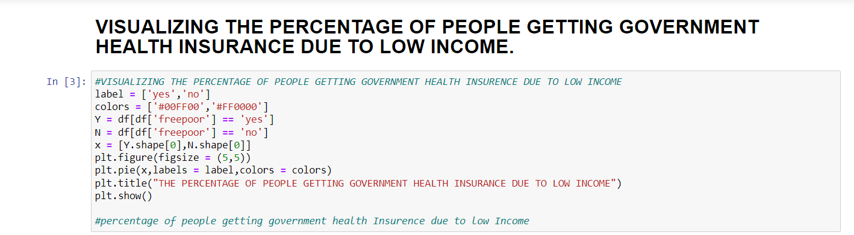
19. HEALTH INSURANCE DUE TO LOW INCOME.
INPUT :

Slide 29
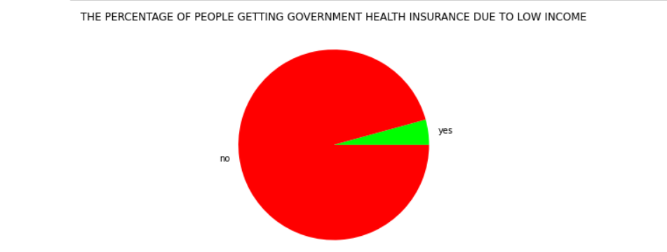
19th POINT CONTINUE :
OUTPUT :

Slide 30
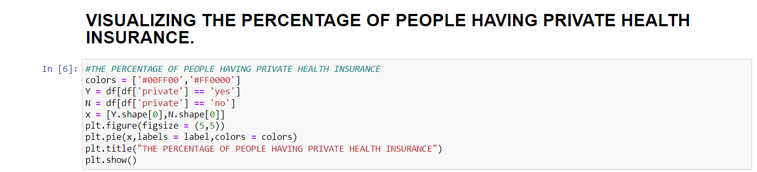
20. PEOPLE HAVING PRIVATE HEALTH INSURANCE .
INPUT :

Slide 31
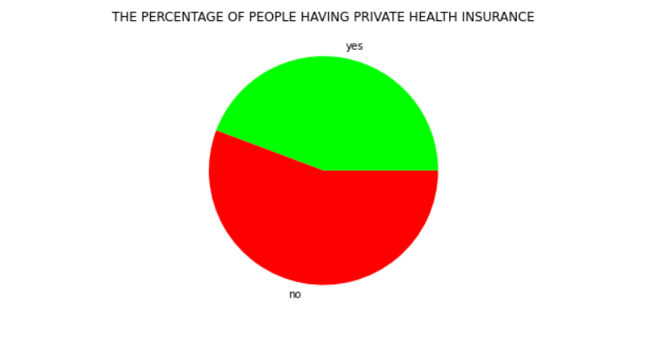
20th POINT CONTINUE :
OUTPUT :
PERCENTAGE OF PEOPLE HAVING PRIVATE HEALTH INSURANCE .

Slide 32
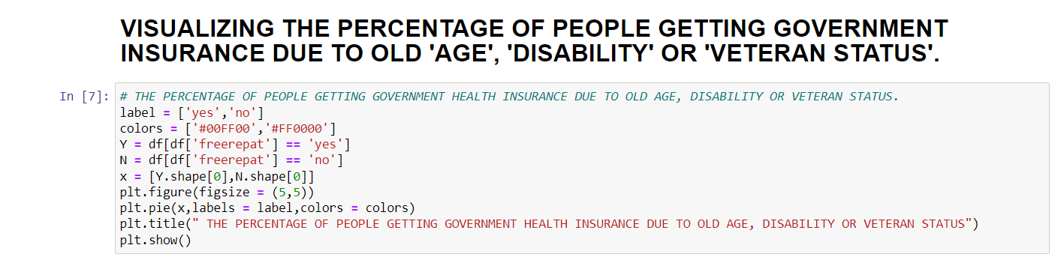
21. GOVERNMENT HEALTH INSURANCE DUE TO AGE AND DISABILITIES.
INPUT :

Slide 33
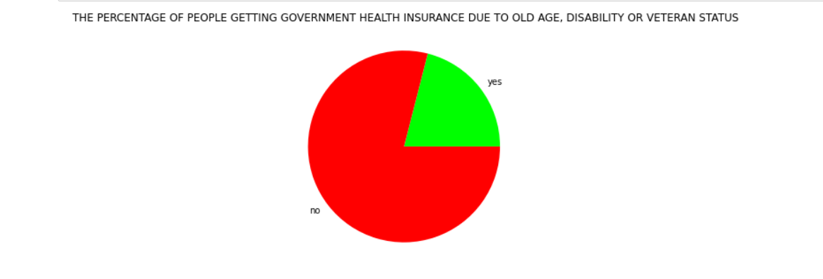
20th POINT CONTINUE :
OUTPUT :

Slide 34
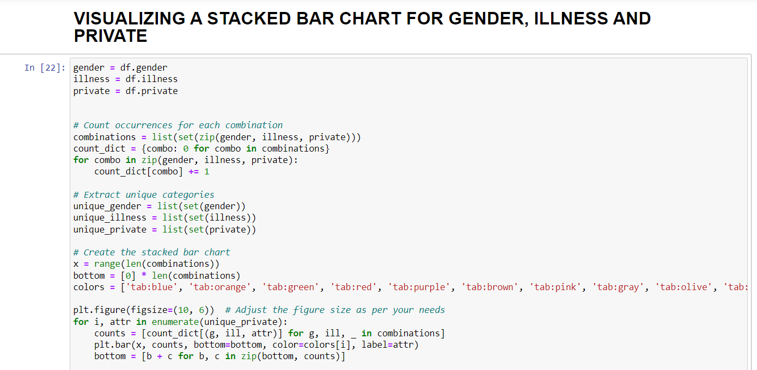
22. USING A STACKED BAR CHART .
INPUT :

Slide 35
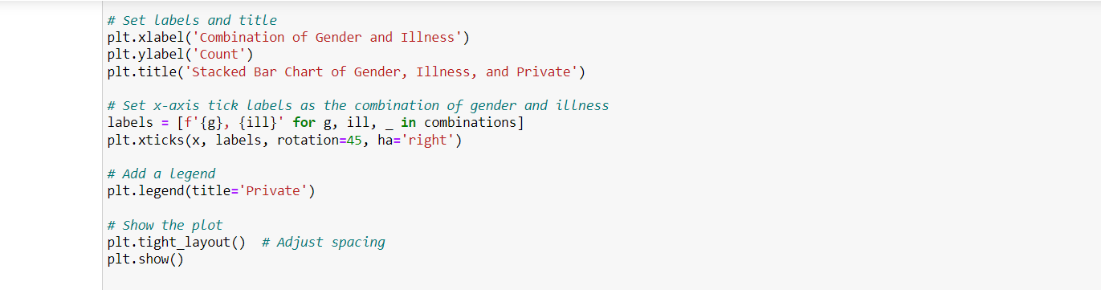
22nd POINT CONTINUE .
INPUT :

Slide 36
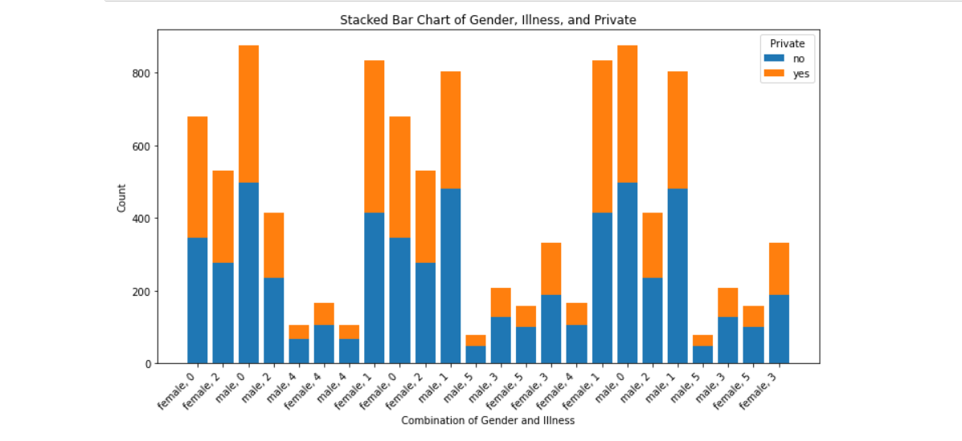
22nd POINT CONTINUE
OUTPUT :

Slide 37
THANK YOU……
BY
SHAIK ISMAIL HUSSAIN
20G31A3123

