Slide 1
Audio to text conversion using Amazon Transcribe Service with Lambda.
SHAIK ABUBAKAR SIDIQ
2000039008

Slide 2
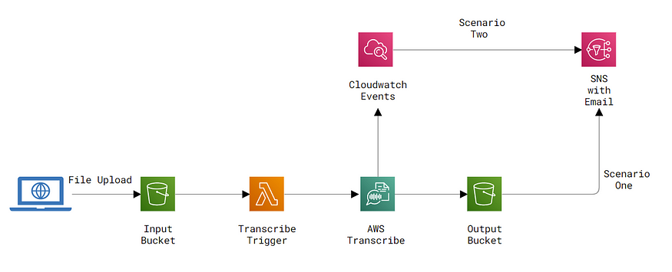
Overall Architecture

Slide 3
AWS Transcribe
AWS Transcribe is the speech-to-text solution provided by Amazon Web Services which has renowned to be very quick and have high accuracy.AWS Transcribe under the hood uses a deep learning process names ASR (automatic speech recognition) to convert the audio to text quickly and more accurately. It also has a separate service inside named Amazon Transcribe Medical to be used for medical documentation applications as well.
AWS Transcribe has a well-created API where programs can automate transcribe jobs of converting audio files to text files. But once you start a transcribing job since it may take time depending on the file, AWS Transcribe will not send the output in the same request as a response. Since that we need to either poll continuously to check whether the transcribe job is completed or we are going to need to have some kind of event triggers to identify the status of the job. In this article, we are going to explore two kinds of such event triggers that will make it be possible to automate transcribe from start to end. Below is a brief overview of what we are going to accomplish in this article.

Slide 4
AWS LAMBDA
Create a Lambda function using python to trigger AWS Transcribe whenever a new file is uploaded to the input S3 bucket.
Send an email with the transcription job details when the transcription is completed using S3 events.
Send an email with the transcription job details when the transcription is completed using CloudWatch events.
Scenario One — Send email using S3 Events
Scenario Two — Send email using CloudWatch Events

Slide 5
We can either choose scenario one or two to receive email notifications. Now without any more explanations let’s dive into the implementation. Following services will be created in AWS in the following order.
IAM role for Lambda to trigger Transcribe
Lambda function
Input and output S3 buckets
SNS topic

Slide 6
Create IAM Role for Lambda function with Transcribe Permissions
Since our Lambda function is going to trigger AWS Transcribe on behalf of our self we need to give permission to the Lambda function to call Transcribe service. For that let’s create a new IAM role that will be used by our Lambda function.
Go to IAM Dashboard, select Create a role, and as AWS Service, select Lambda.
Next from the policies select below two policies for our IAM role.
CloudWatchLogsFullAccess
AmazonTranscribeFullAccess
Next, provide a role name and create the new role.

Slide 7
Create Lambda function for trigger Transcribe Job
Next, let’s create the Lambda function which will trigger the AWS Transcribe when we upload a new file to our input S3 bucket(which we will create in the next step).
Go to Lambda dashboard and Create function. Select Python as the Runtime and on the Execution role select the role we created above.

Slide 8
The following steps will be followed when the Lambda function is triggered.
The function will be triggered by an S3 event. So first we will extract the details of the S3 bucket and the file that triggered the event.
Next, we will create a job name that is required by Transcribe API. In order to be unique, we attach UUID to the end of the file name.
Next, we are calling start_transcription_job with the required parameters. Here for OutputBucketName, we need to specify the output S3 bucket which we are going to create next. So for now you can remove that field completely.

Slide 9
Creating Input S3 Bucket and S3 Event to trigger Lambda function
Next, let’s start to create our S3 buckets. We are going to create two buckets, first, let’s create our input bucket where our audio files will be uploaded.
After creating the S3 bucket go to properties and Event Notifications. Here is where we configure the S3 event to trigger the Lambda function we created whenever a new object is added to this bucket.
Click on Create event notification and then provide a name. On Event types select All object create events. This will make sure to create an event when either a new object is uploaded, a rename happened on an existing object or a new object is copied directly to the bucket.

Slide 10
For the Destination select the Lambda function we created. Now this will make sure that whenever a new file is created in this bucket our Lambda function will be triggered which will trigger AWS Transcribe.
Creating Output S3 Bucket and Grant Permission to Write
Now let’s start creating our output S3 bucket where the results from our AWS Transcribe will be available. Here we need to provide write access to our lambda function so it can write the output result on this bucket. First, create a new S3 bucket.
Then first we need to create a new policy specifying write access to this S3 bucket. Go to the IAM dashboard and navigate to Policies. Then click on Create Policy and select JSON and add the following Policy.

Slide 11
Next in order to grant our created role for Lambda for write to S3 bucket. For this go back again to Lambda role we created earlier and attach this newly created policy to it.
As the last step make sure to edit the Lambda function we created with the OutputBucketName as the new S3 bucket name we created now. The name should be only the bucket name without any prefixes. (ex:- transcribe-output)

Slide 12
Thank You

