Slide 1

EXPLORATORY DATA ANALYSIS PROJECT ON :-
MAKAAN

Slide 2

About me
Name :- Shaik Sabeer Ahamed
Batch :- 239-G
Educational Qualification :- B.Tech(CIVIL)
I chose Data Science as my career because it is one such field that has a lot of skills to learn and explore. It is regarded as one of the best IT job of 21st century and future demand role.

Slide 3
Agenda
Web Scraping
Business Problem Understanding
Objective of the Project
Exploratory Data Analysis:
Data cleaning
Data manipulation
Data Summary
Uni-Variate analysis steps
Bi-Variate analysis steps
MultiVariate analysis steps
Key-business questions
Conclusions
Q & A
Experience and challenges working on web scraping

Slide 4

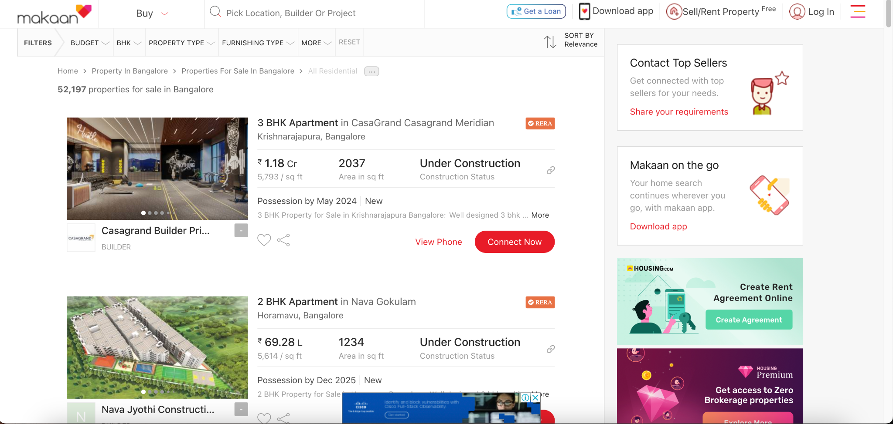
Web Scraping – Details
Website used is MAKAAN

Slide 5
URL and Libraries Used
Makaan URL : https://www.makaan.com/
Libraries Used :
Pandas
NumPy
Regular Expressions
Matplotlib
Seaborn
Beautiful Soup
Requests

Slide 6
Objectives of the Project
Motto of this project is to get knowledge about the residential sales condition in different Cities.
Comparing the factors of buying a residence in different localities of a particular City
Comparing the factors of buying a residence between the Cities.

Slide 7
Process :-
Data Mining : It is a process used to extract usable data from a larger set of any raw data.
Data Parsing : We have used BeautifulSoup to navigate and extract data from HTML documents.
Data Framing : After extraction of Data we can convert the it in the form of Tabular form that comprises Rows and Columns.
Data Cleaning : Data cleaning is a process done after the Framing of Data.This part includes removing unnecessary data,replacing the data, filling null values,finding duplicates in data and dealing with other errornessin the data.
→ With the help of above mentioned techniques I have created 1060 rows and 8 columns and made it a proper Dataset.

Slide 8
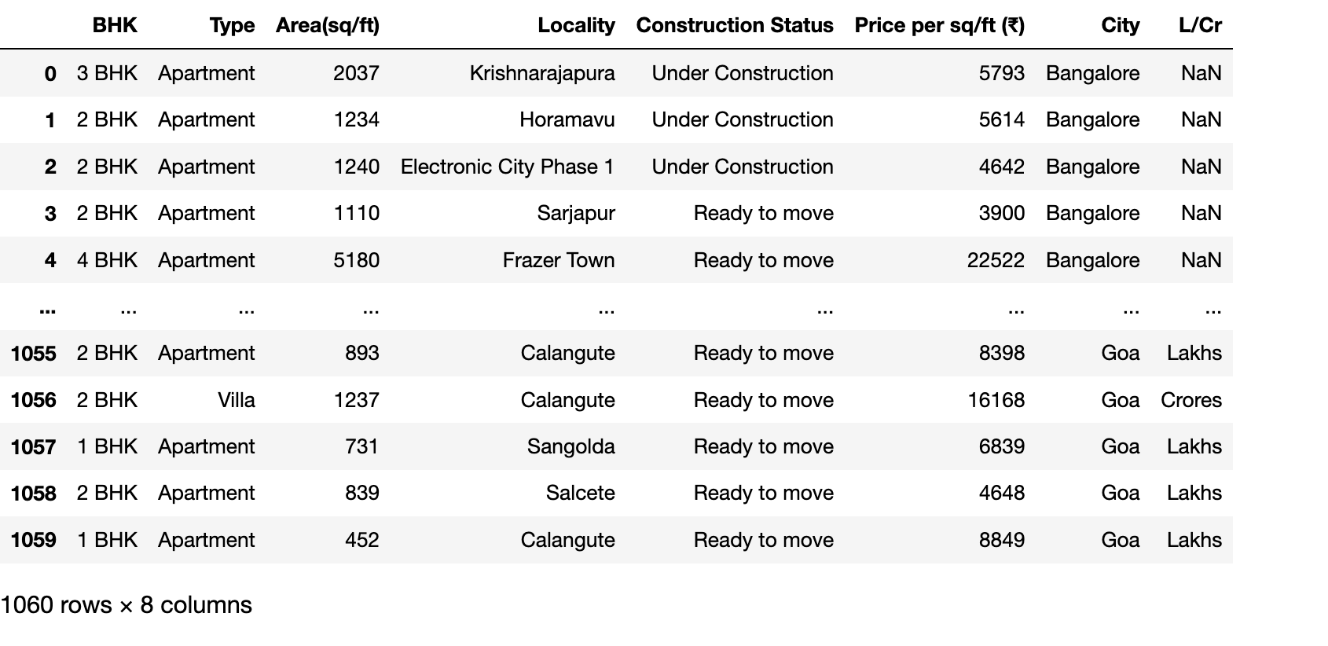
Before Data Cleaning and Data Manipulation

Slide 9
Data Cleaning
Handling Null Values
Replacing
Dealing with Duplicate Values
Data Manipulation
Type Conversion
Creating a New Column
Reindexing
Deleting a Column
Changing values in a column

Slide 10
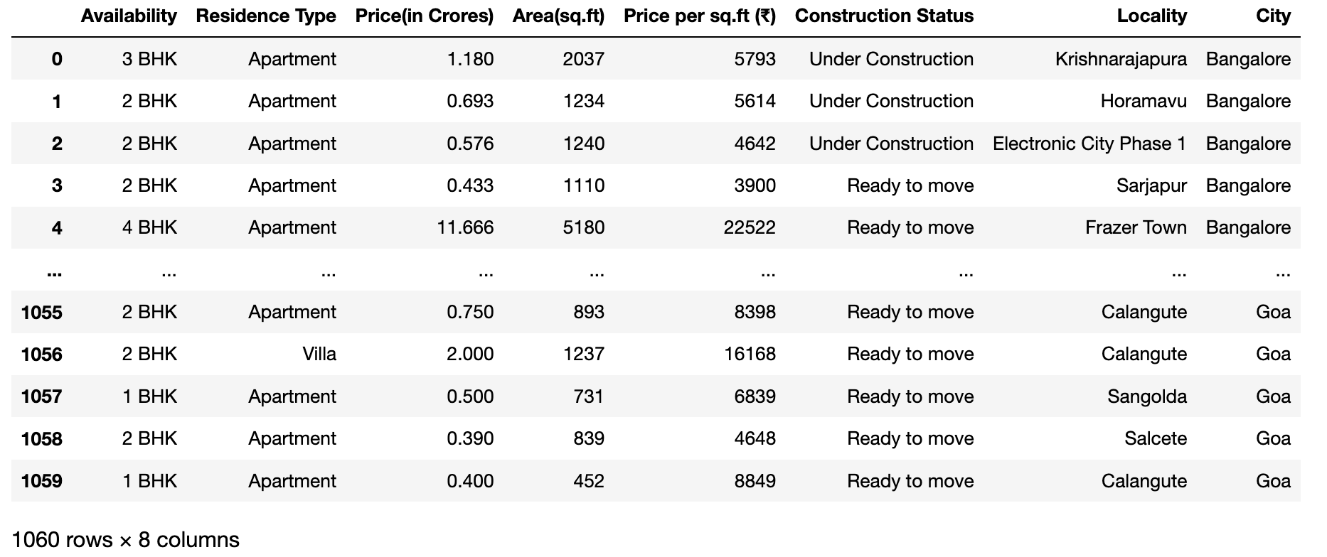
Clean Dataset

Slide 11
Summary of the Data
Makaan is a real estate site that acts as a medium between their consumers for discovering, renting, buying, selling, financing a home, and digitally enabling them throughout their journey.
Data collection is done on random cities in India which include Bangalore, Delhi, Goa and Mumbai.
For each City the Data we gathered is regarding the aspects that are related to buy a residence.
Dataset comprises of information about the Type of residence, Availability, Price of residence (in Crores),Area (in sq.ft), Price per sq.ft, Construction Status, Locality of the residence and the City in which it is present.

Slide 12
Information about Columns in the Dataset
→ Availability : It gives data about availability of BHK’s.
→ Residence Type :It shows the type of housing available for sale.
→ Price(in Crores) :It displays the price of the respective housing in Crores
→ Area(sq.ft) :It shows us the Area of Residence in square feet
→ Price per sq.ft (₹) :It displays the Price per square feet in INR.
→ Construction Status :It shows us whether the Property status is under construction,ready to move,new or resale.
→ Locality :It addresses the locality of residence in the city.
→ City : It shows in which city of India is the property present.
'

Slide 13
Real-time Scenarios
→ What are High and Low cost localities in Bangalore ?
→ High and Low expensive localities in Mumbai on basis of Price per sq.ft?
→ Compare the price range between the Cities.
→ What is the average price of residence in each City ?
→ Find the Correlation between the Numerical Values ?
→ What is the Construction Status in each City ?
→ How does ‘Price per sq.ft’ and ‘Area’ contrast between the Cities ?
→ How does the ‘Price’ and ‘Price per sq.ft’ alter from each City.Explain ?
→ Represent different factors through Outliers ?

Slide 14
What is Exploratory Data Analysis(EDA) ?
→ Exploratory Data Analysis is analysing and investigating data sets and summarizing them through Statistical Graphs and other Data Visualisation methods.It is shortly referred as ‘EDA’.
→ There are mainly three types of EDA:
Univariate Analysis
Bivariate Analysis
Multivariate Analysis

Slide 15
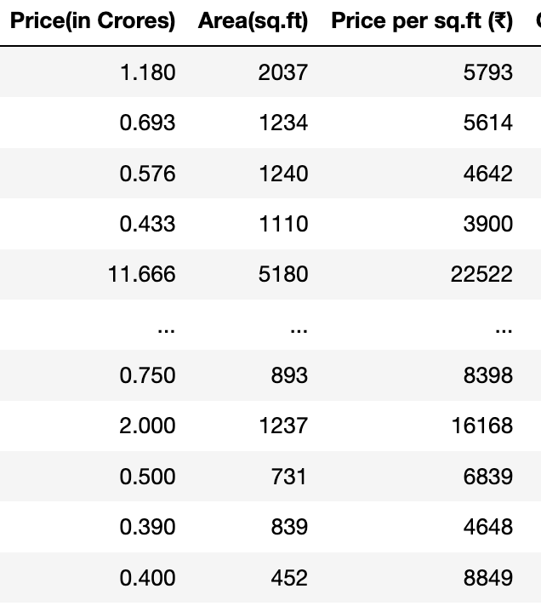
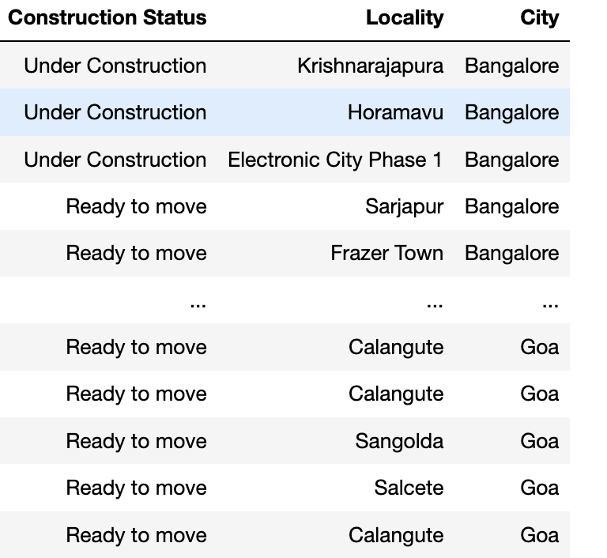
Univariate Analysis
→ Univariate analysis is basically the simplest form to analyze data. ‘Uni’ means ‘one’ and this means that the data has only one kind of variable.
→ Univariate Analysis is done on two kinds of data ‘Categorical’ and ‘Numerical’.
→ In most cases , for plotting Univariate Analysis we use :
Pie Chart , Count plot and Bar plot if Categorical data
Scatter plot,Box plot and Histograms if Numerical data
Numerical Data :
Categorical Data :

Slide 16
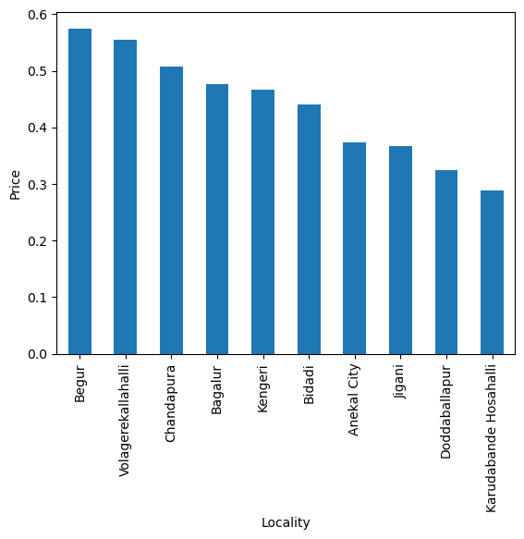
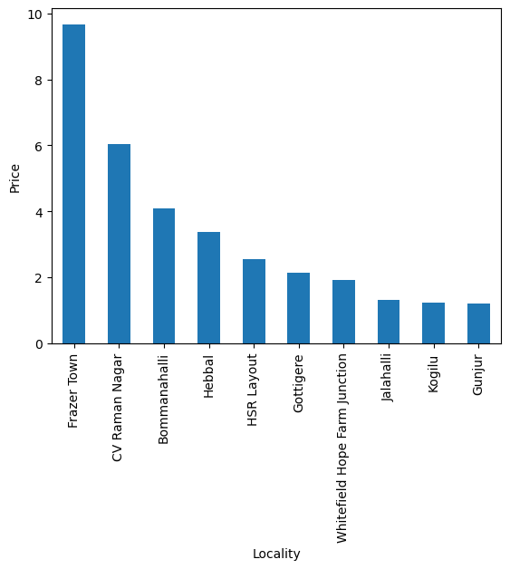
Top 10 highest and lowest price on average in Localities of Bangalore
Lowest :- Highest:-

Slide 17
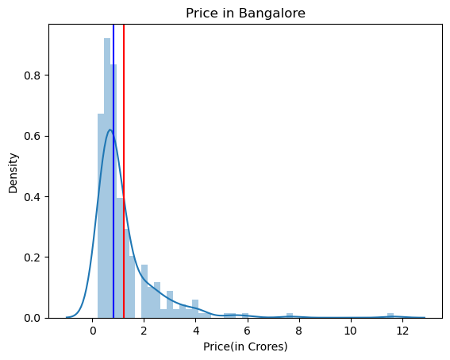
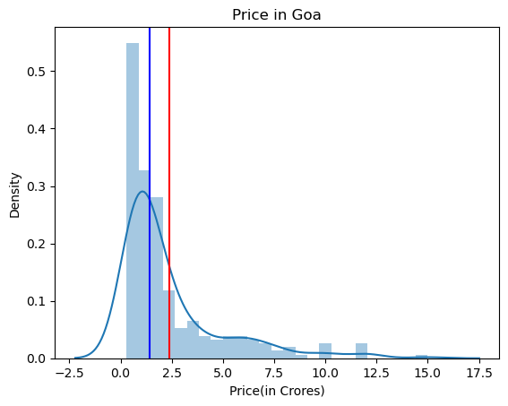
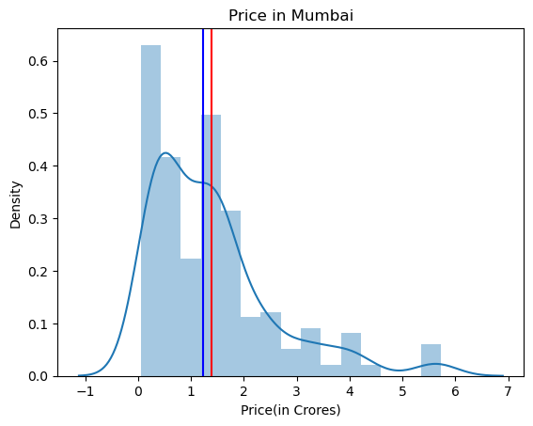
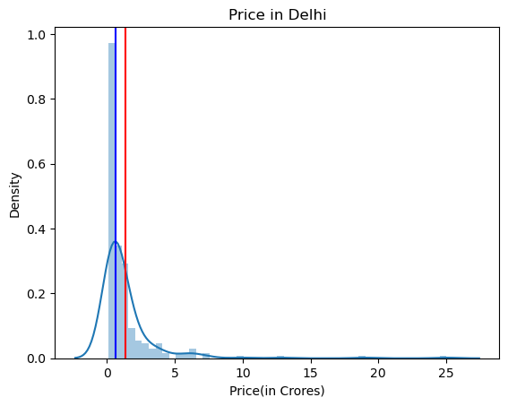
Comparing Price Range between Cities
Blue line → Median Red line→ Mean

Slide 18
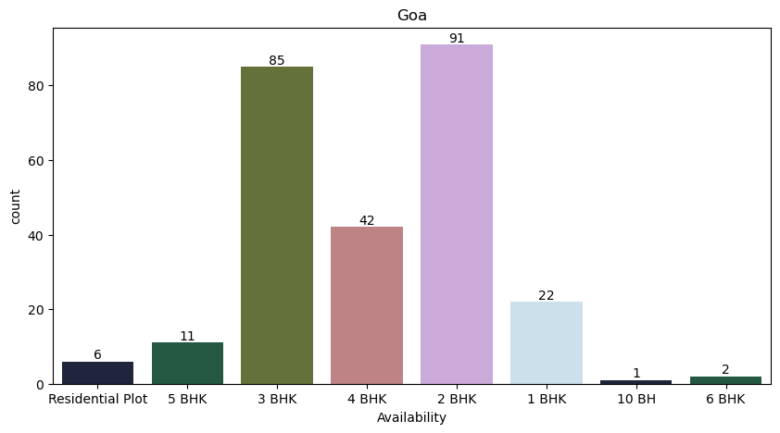
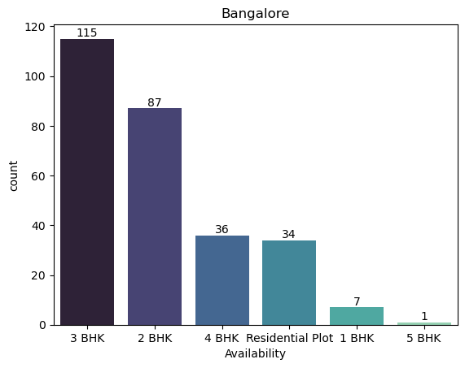
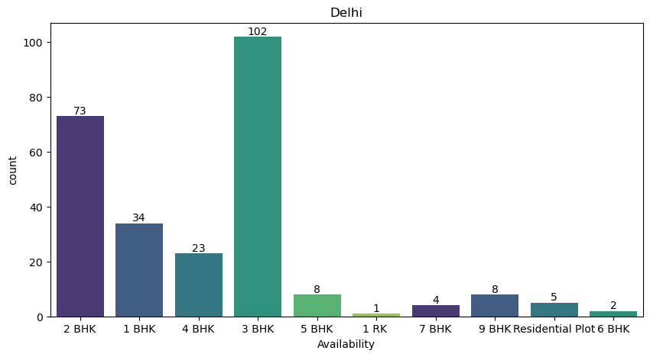
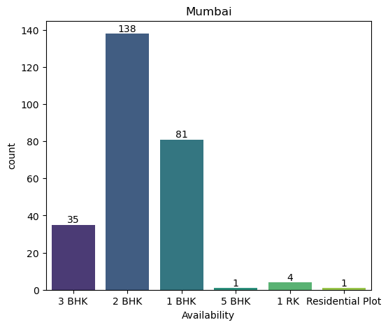
Availability in Different Cities

Slide 19
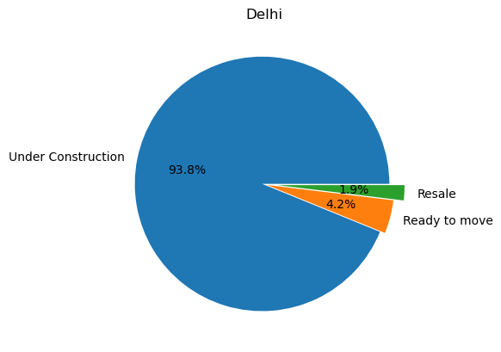
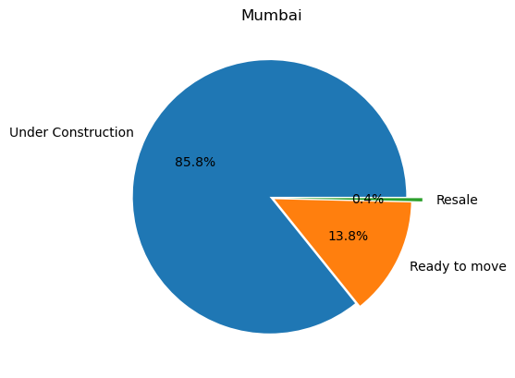
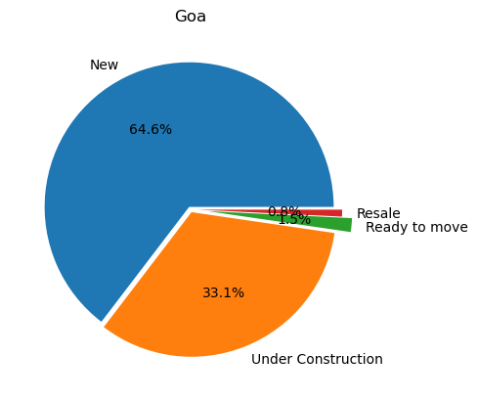
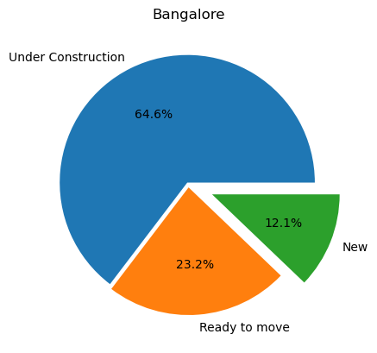
Construction Status (%) in each City

Slide 20
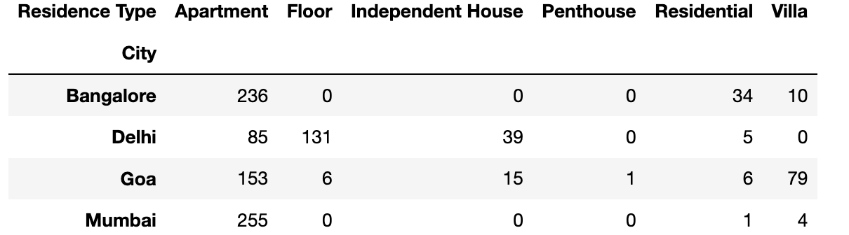
Bivariate Analysis
→ Bivariate Analysis allows you to investigate the relationship between two variables. It is useful to determine whether there is a correlation between the variables and, if so, how strong the connection is.
→ Bivariate Analysis includes Categorical vs Numerical,Numerical vs Numerical, Categorical vs Categorical.
→ For Bivariate Analysis we use plots like Barchart(Numerical vs Categorical) , Linechart & Heatmap (Numerical vs Numerical) and Barchart with Crosstab(Categorical vs Categorical).

Slide 21
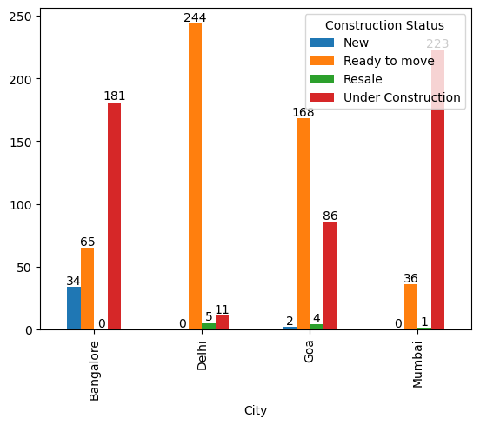
Construction Status (count) in each City

Slide 22
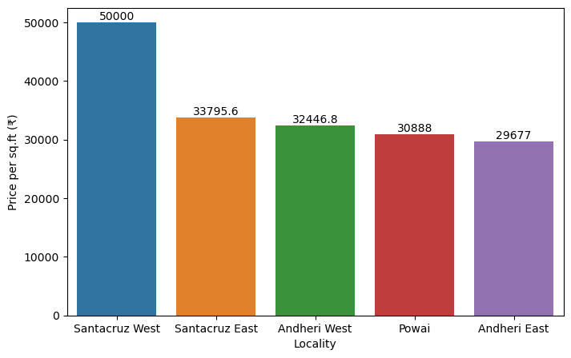
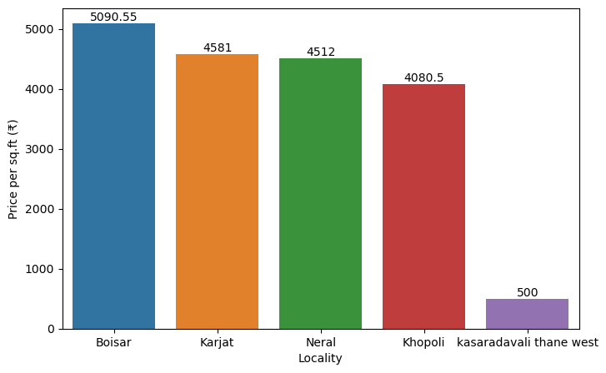
Top 5 high and low cost Localities on basis of Price per sq.ft in Mumbai
Highest:- Lowest:-

Slide 23
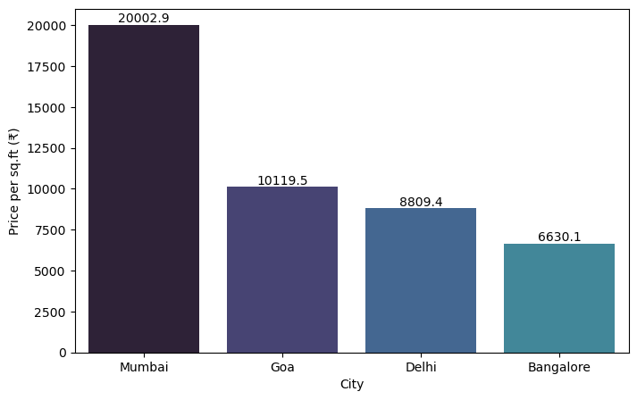
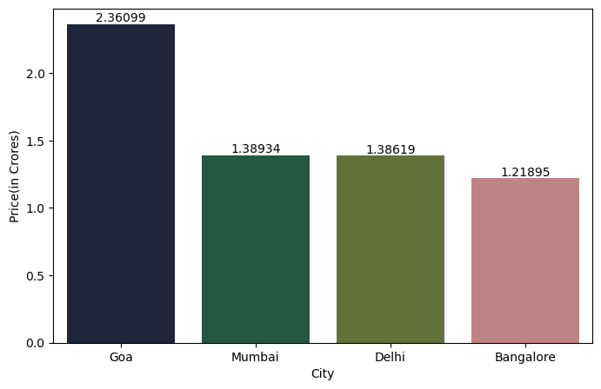
Contrast between Price and Price per sq.ft on average in Cities

Slide 24
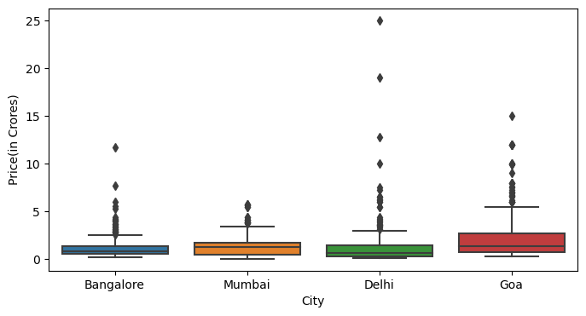
Outlier Representation on Price Basis

Slide 25
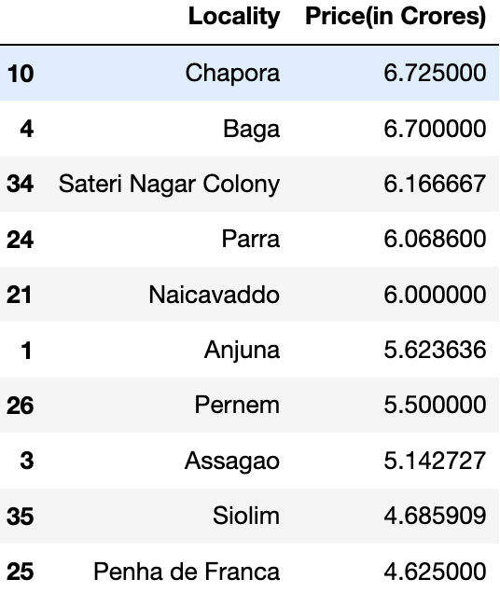
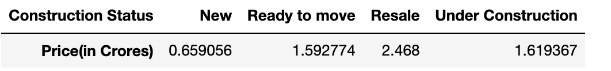
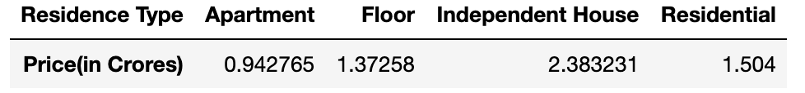
Multivariate Analysis
→ Multivariate Analysis is defined as a process involving multiple dependent variables resulting in one outcome. This explains that the majority of the problems in the real world are Multivariate.
→ Values can be obtained by groupby() and pivot_table() functions.
→ For Multivariate Analysis we can use Pairplot , ScatterPlot(with hue), Lineplot.
→ Multivariate Analysis helps in finding the Correlation between multiple Numerical Values.
groupby()
pivot_table()

Slide 26
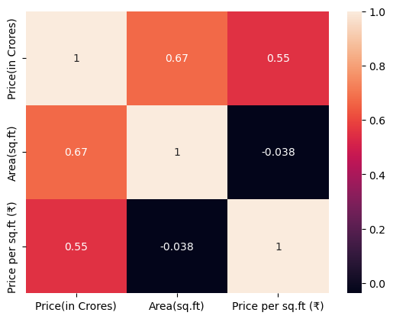
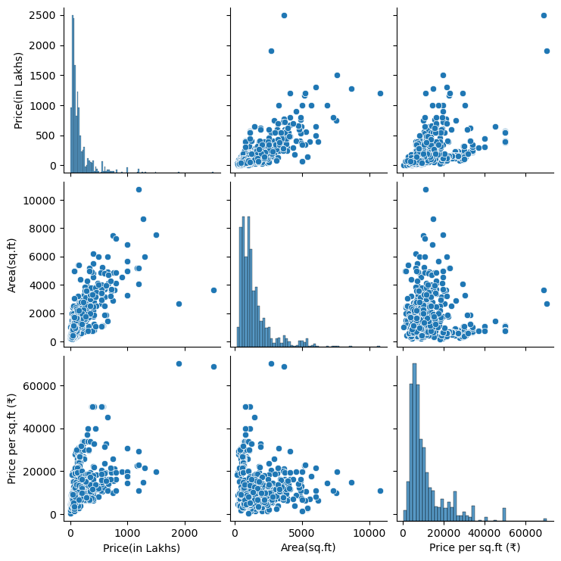
Correlation representation through heatmap and pairplot

Slide 27
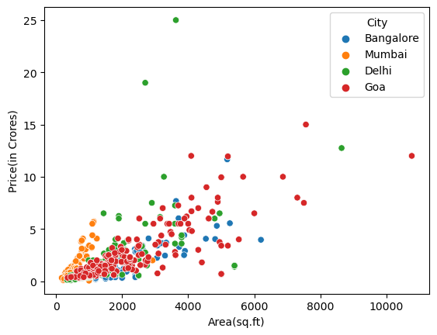
Price vs Area by ‘City’

Slide 28
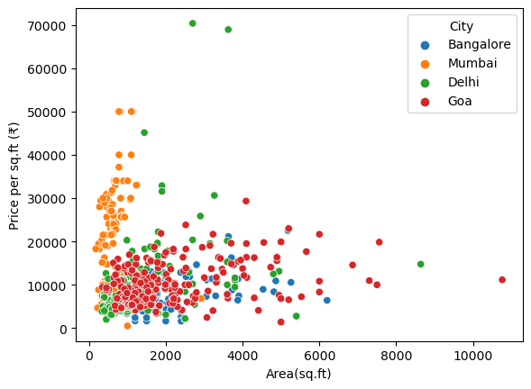
Price per sq.ft vs Area by ‘City’

Slide 29
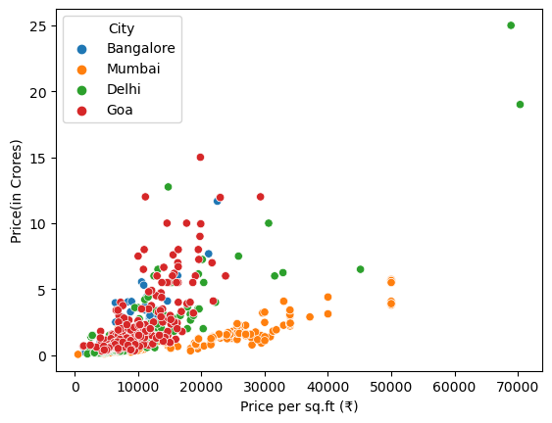
Price per sq.ft vs Price by ‘City’

Slide 30
Challenges
→ Web Scraping part of ‘MAKAAN’ website was bit tough, because the data was so huge and html tags and attributes.
→ As multiple cities were considered, framing the possible real time scenarios between the cities and localities within a city.

Slide 31
Conclusion
→ Price in each city differ because of ‘Area’ and ‘Price per sq.ft’.
→ Prices within a city also differ in parts of locality due to demand of that locality.
→ Delhi city has less ‘Area’ for residence but ‘Price’ is too high.
→ Bangalore city has more Types of Residence compared to other cities.
→ Goa has advantage in buying a residence because even if the Price is in medium range because the area for residence is more compared to other cities.
→Price per sq.ft is more in Mumbai city compared in the City.

Slide 32

THANK YOU

