Slide 1

Mutual Fund Analytics — Capstone Project
Author: Sk Ali Abbas
This presentation summarizes the end-to-end analytics delivered for a mutual fund portfolio evaluation: architecture, data pipeline, performance & risk analytics, investor cohorts, and interactive Power BI dashboards.

Slide 2

Problem Statement & Objectives
Problem: Limited, fragmented analytics for multi-manager mutual funds—insufficient performance attribution and investor segmentation.
Primary objective: Build a reproducible analytics pipeline to measure fund performance, risk, and investor behavior.
Deliverables: Cleaned datasets, performance & risk metrics (CAGR, Sharpe, Sortino, VaR, CVaR), cohort analyses, and interactive Power BI dashboards.
Success criteria: Transparent methodology, reproducibility, and actionable insights for portfolio managers and compliance.

Slide 3


Project Architecture
1
2
3
4
Data Ingestion
ETL & Normalization
Feature Store
Analytics & Modeling
Batch & streaming pulls from custodians, fund administrators, pricing vendors.
Return series, factor exposures, investor-level transactions, derived metrics.
Validation, corporate actions, NAV interpolation, timezone alignment.
Performance, risk engines, cohort algorithms, backtests.
5
Visualization & Delivery
Power BI dashboards, automated reports, API endpoints for queries.

Slide 4
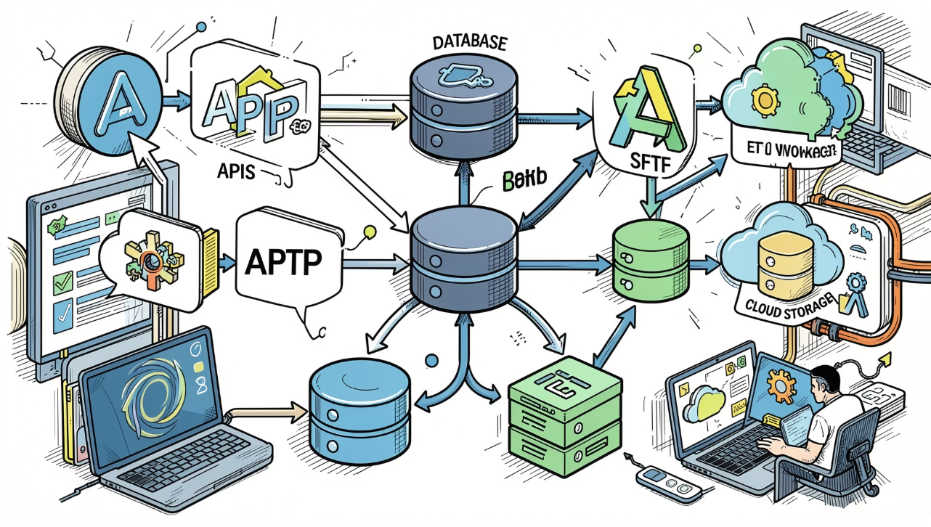
Data Sources & Pipeline
Primary sources: Fund NAVs, holdings, trades, corporate actions, benchmark returns, macro factors, and investor transaction logs.
Ingestion: API pulls (pricing vendors), SFTP (administrators), scheduled jobs.
Transformations: De-duplication, corporate action adjustments, return calculations (log & arithmetic), missing-value strategies.
Storage: Parquet on cloud object store + analytical SQL layer for ad hoc queries.
Governance: Schema registry, data quality checks, lineage tracking.

Slide 5
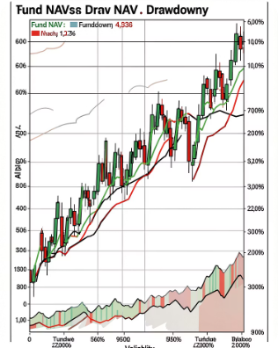
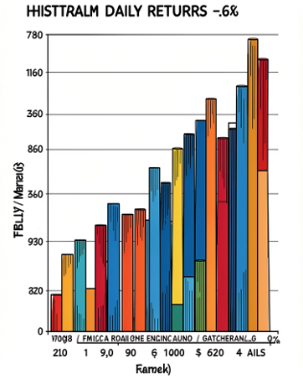
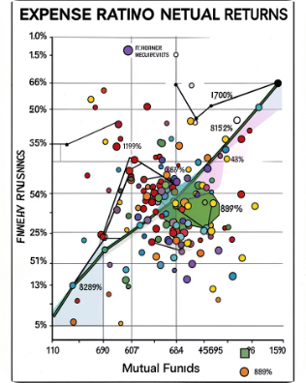
Exploratory Data Analysis — Key Findings
Return Profiles
Distributional Characteristics
Costs & Net Returns
Funds show heterogeneous return trajectories; top quartile exhibits higher volatility but superior long-run CAGR.
Return distributions are leptokurtic with skew; tail risk is material across funds—motivating CVaR analysis.
Higher expense ratios correlate with lower net returns after fees; outliers identified for deeper attribution.

Slide 6
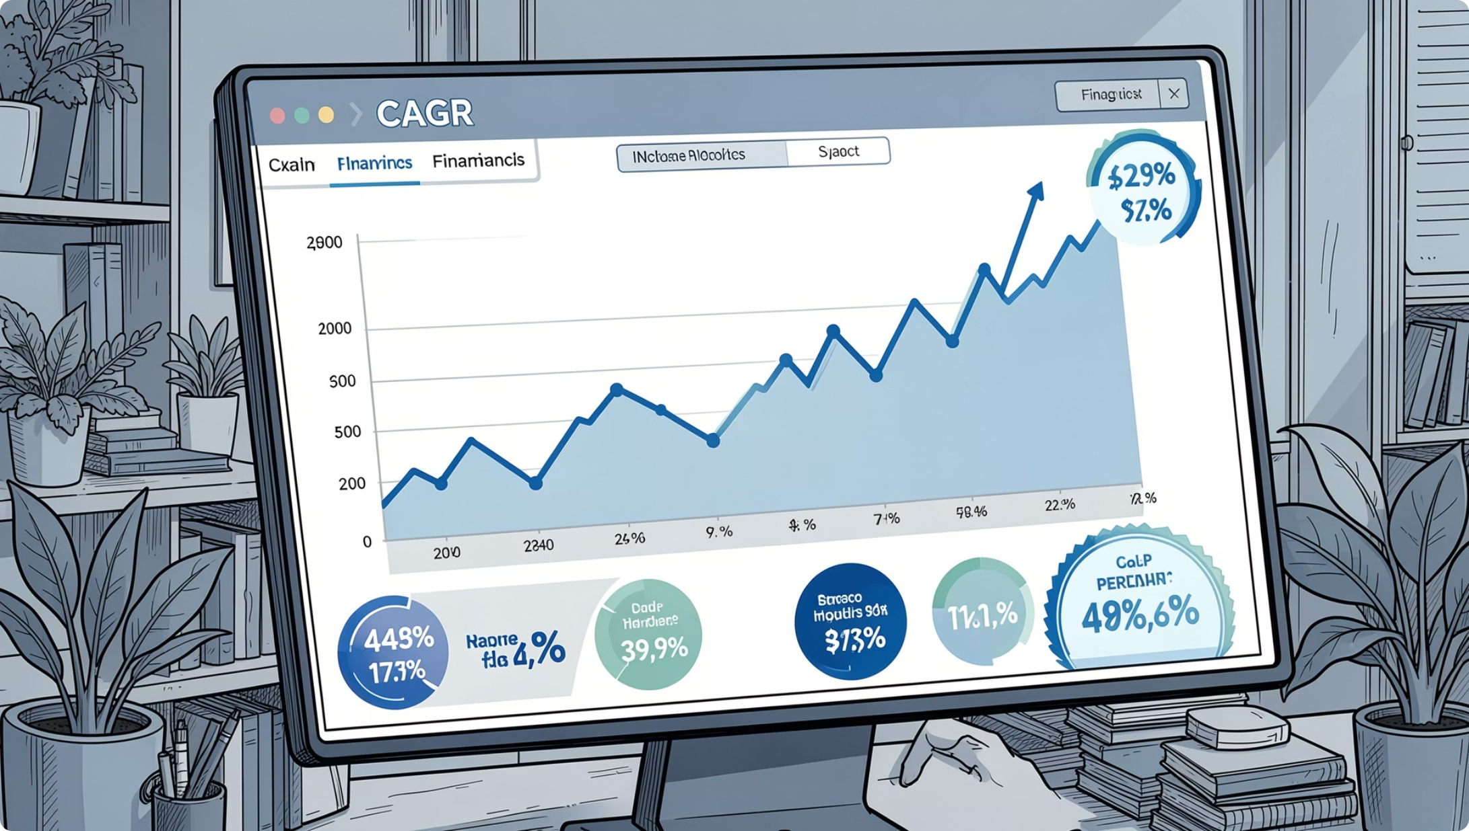

Fund Performance Metrics
We computed standard, risk-adjusted metrics to compare funds on a consistent basis:
CAGR — Annualized growth from inception periods; benchmarks included for excess return.
Sharpe Ratio — Excess return per unit volatility (annualized), using risk-free rate alignment.
Sortino Ratio — Downside-focused risk-adjusted return emphasizing downside deviation.
Method note: Returns are net of fees where available; all ratios annualized and computed on daily return series.

Slide 7
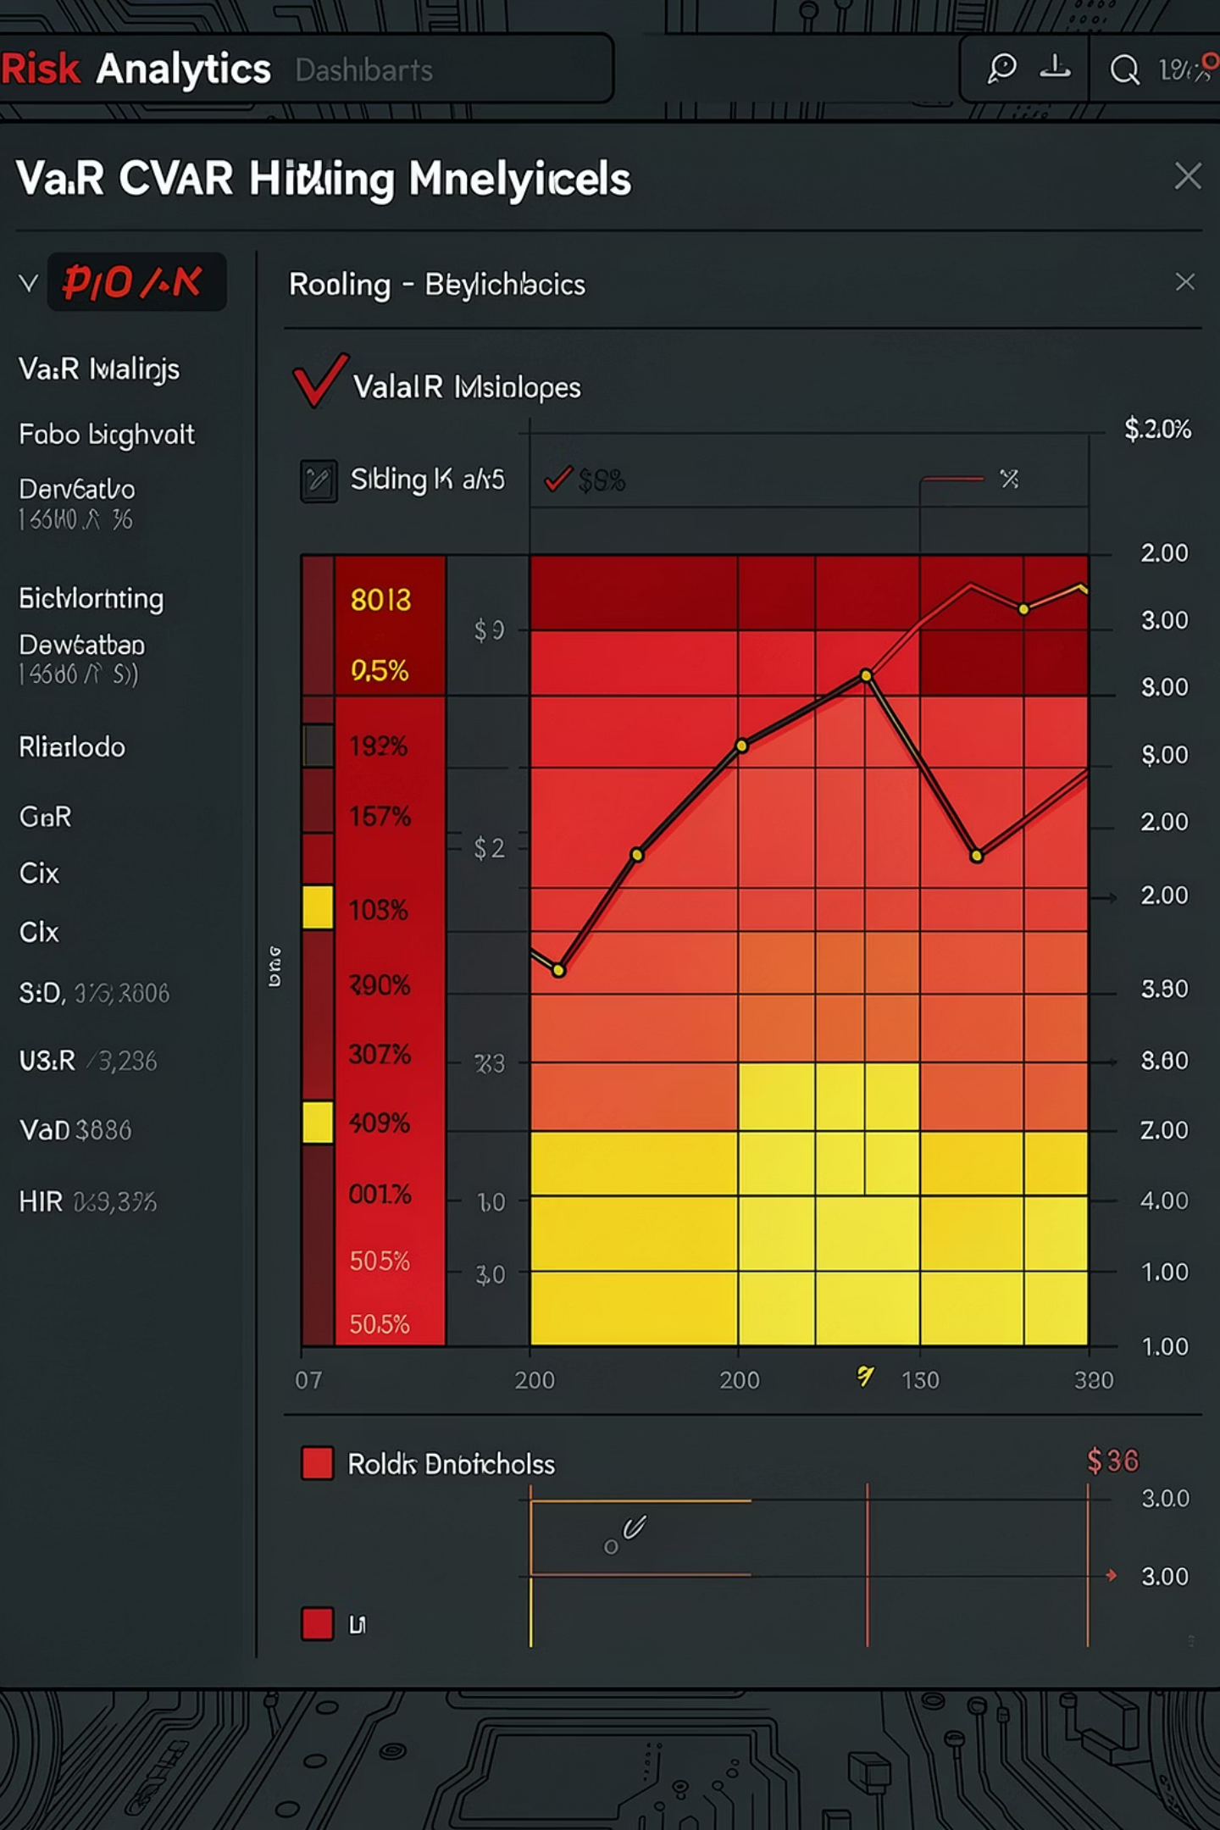
Risk Analytics
Value at Risk (VaR)
Conditional VaR (CVaR)
Rolling Sharpe
Parametric and historical 1-day and 10-day VaR at 95% and 99% confidence intervals for each fund.
Expected shortfall measured to capture tail loss severity beyond the VaR threshold.
6-month and 12-month rolling Sharpe ratios to track performance regime shifts and persistence.
Insight: Several top-CAGR funds show elevated CVaR — high returns accompanied by concentrated tail exposure.

Slide 8


Investor Analytics & Cohort Analysis
Segmented investors by vintage, AUM tier, and behavior to understand retention and contribution:
Cohorts by Onboarding Month: Retention and net flows tracked at 1, 6, and 12 months.
Contribution Analysis: Pareto of investors vs returns — top 10% of investors account for majority of assets under management.
Behavioral Signals: Churn correlated with negative rolling performance and high realized drawdowns.
Actionable: Flag cohorts with early outflows for targeted engagement and communication.

Slide 9
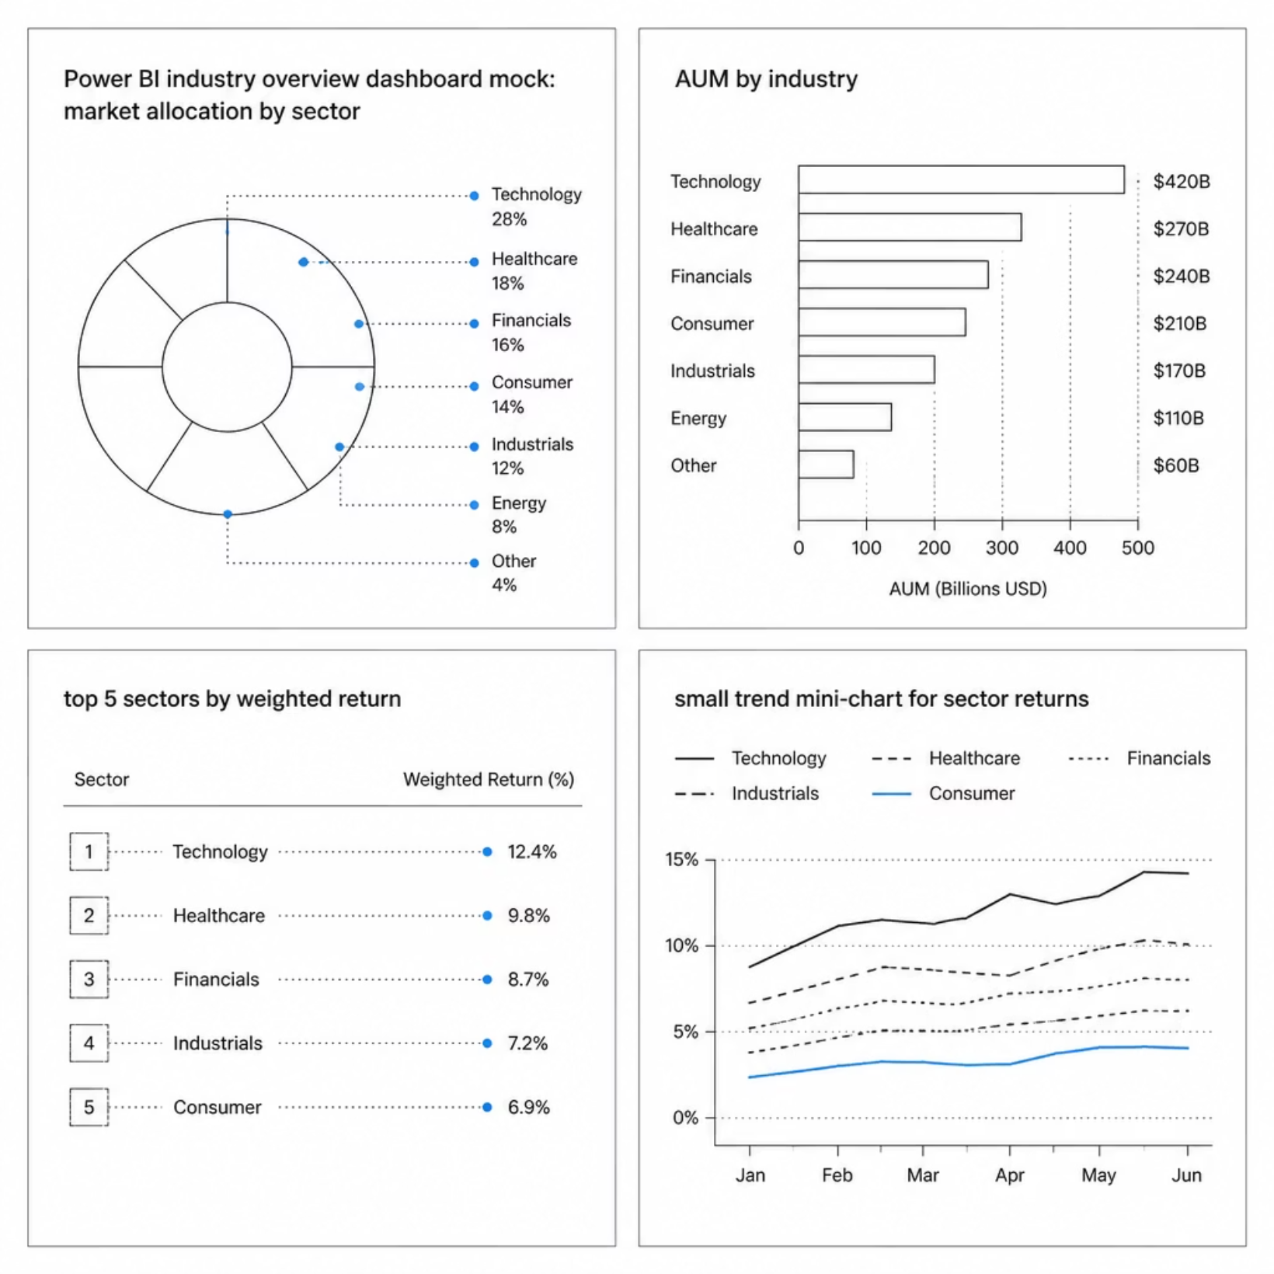
Power BI — Industry Overview (Dashboard)
Dashboard highlights:
Sector allocation heatmap with weighted returns.
Top contributors by AUM and performance attribution.
Interactive slicers: date range, fund family, and region for drill-downs.
Design note: Visuals emphasize clarity for rapid decision-making — filters persist across pages for consistent analysis.

Slide 10
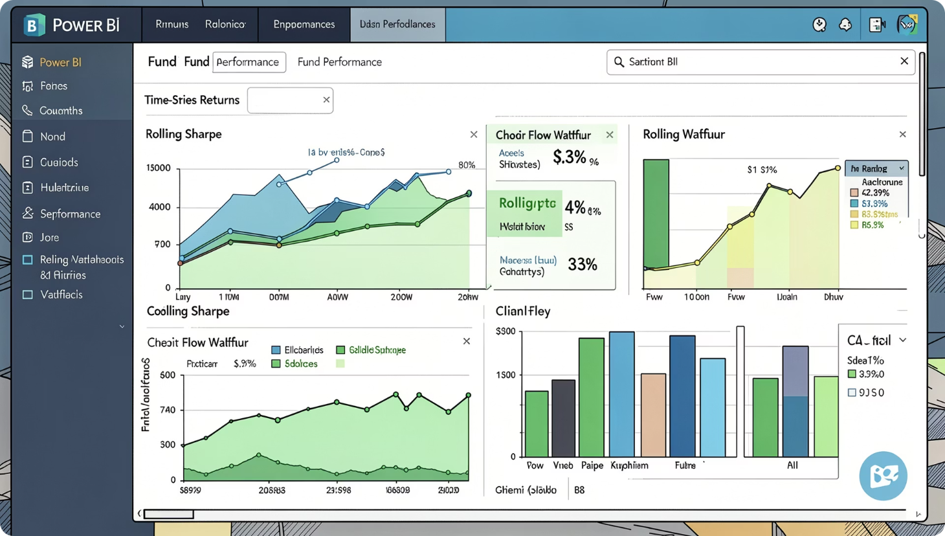

Power BI — Fund Performance & Investor Analytics
Key pages included in the dashboard:
Fund overview: CAGR, Sharpe, Sortino, expense ratios and net flows table.
Risk center: VaR/CVaR comparatives, drawdown decomposition, rolling metrics.
Investor page: cohort retention curves, contribution waterfall, and segment-level KPIs.
Embedded bookmarks and narrative captions guide stakeholders through recommended views during presentations.

