Slide 1

ZOMATO ANALYSIS PROJECT
PRESENTATION BY:
N AHAMAD BUQARI
S ASHIK
S ASIF
SHUBHAM MORE
SANDHYA
SACHIN YADAV
YASHODIP PATIL

Slide 2
ZOMATO ANALYSIS PROJECT
AGENDA:
• INTRODUCTION
• DATASET OVERVIEW
• KPI
• ANALYSIS
• RECOMMENDATIONS
• CONCLUSION

Slide 3
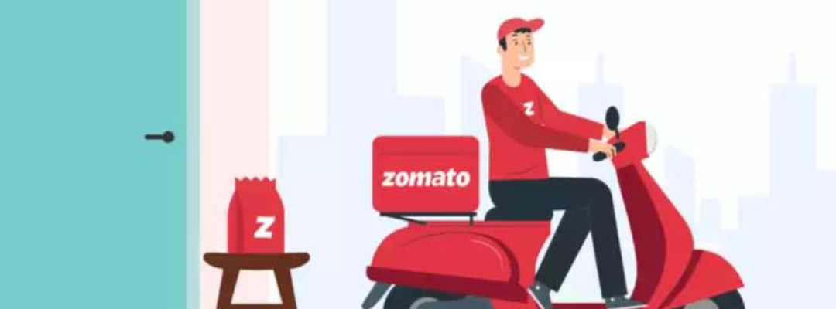
ZOMATO ANALYSIS PROJECT
INTRODUCTION:
• Zomato is an online food delivery
and restaurant discovery platform.
• It generates large volumes of data
on restaurants,cuisines,pricing and
ratings.
• This project analyzes Zomato data
to understand restaurant performance
and customer behaviour.
• It focuses on identifying popular
cuisines,high-demanded cities,rating
trends etc.
.

Slide 4
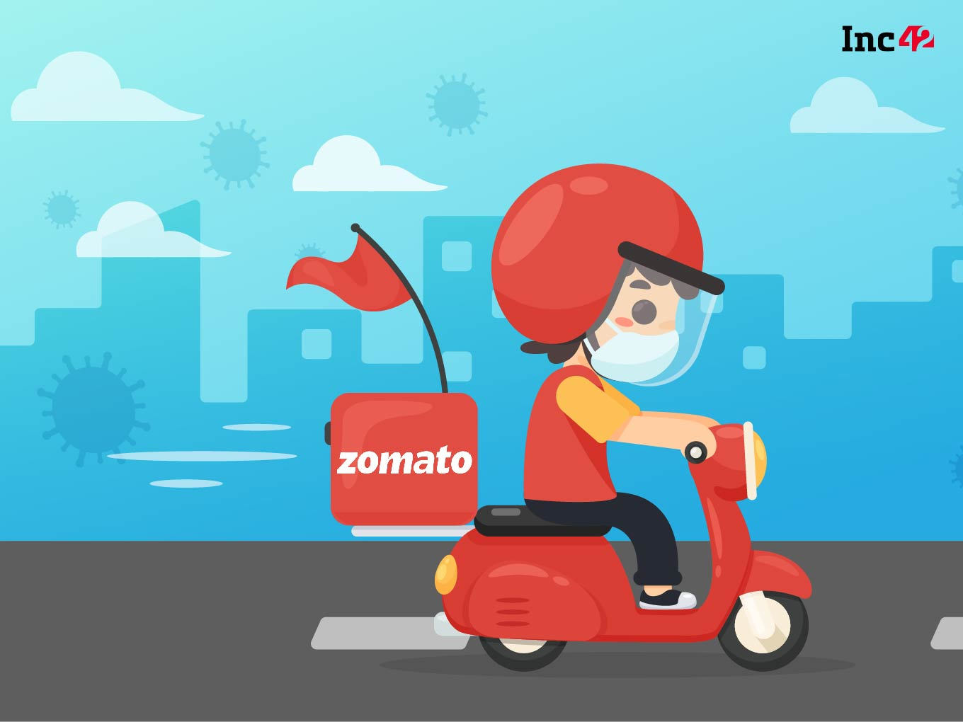
ZOMATO ANALYSIS PROJECT
DATASET OVERVIEW:
• Restaurant ID
• Restaurant Name
• Country
• City
• Has Table Booking
• Cuisine Type
• Average Cost for Two
• Ratings
• Online Delivery Availability
• Votes

Slide 5
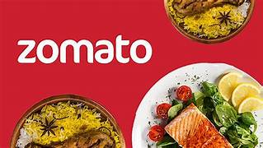
ZOMATO ANALYSIS PROJECT
KPI:
• Total country
• Total City
• Restaurant Count
•Total Cuisines
•Average Rating

Slide 6
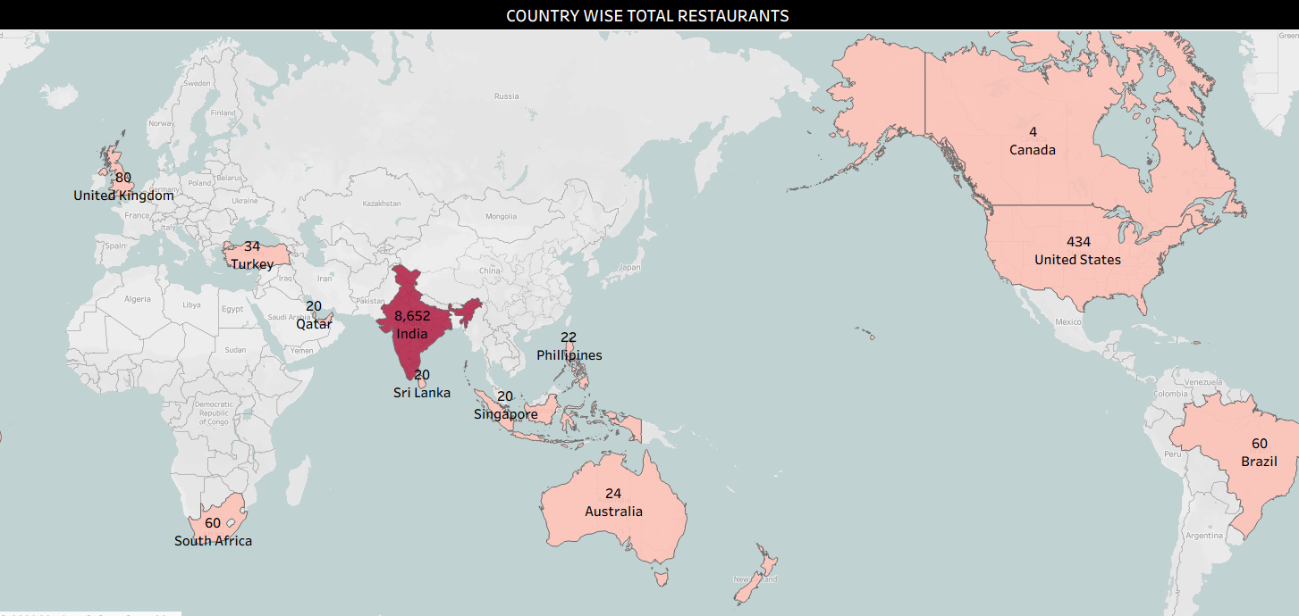
ZOMATO ANALYSIS PROJECT
COUNTRY-MAP:
• Here we can see Country-wise
Total restaurants.
• India has highest number of
Restaurants with total of 8,652.
• Canada has least restaurants
With total of 4.

Slide 7
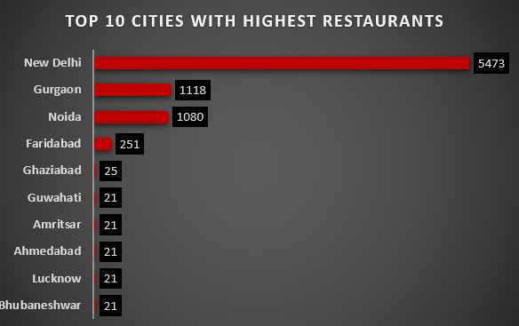
ZOMATO ANALYSIS PROJECT
CITY-WISE TOTAL RESTAURANTS:
• Here we can see top 10 cities
based on total number of
restaurants.
.
• New has highest number of
Restaurants with total of 5473.

Slide 8
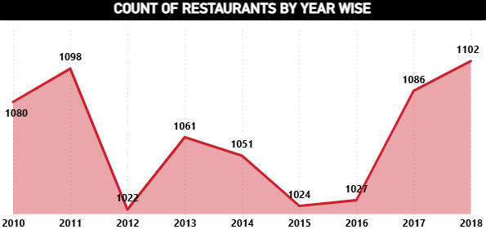
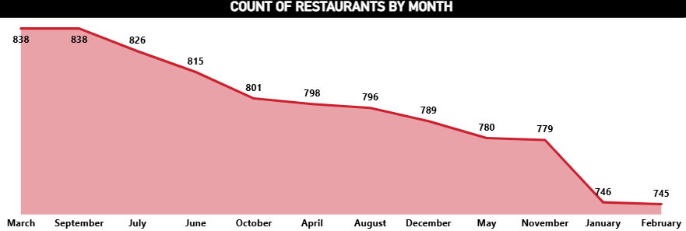
ZOMATO ANALYSIS PROJECT
CALENDER-WISE TOTAL RESTAURANTS:
• Here we can see year wise
total number of restaurants
in the first visual.
•In the second visual we
have month wise total
restaurants.

Slide 9
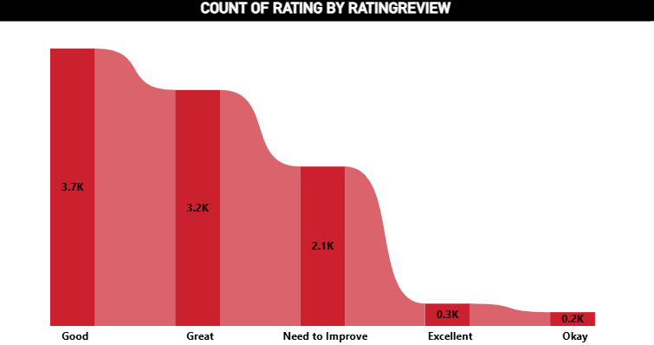
ZOMATO ANALYSIS PROJECT
COUNT OF RESTAURANTS ON AVG RATING:
• Most of the Restaurants have
rating between (2.0-3.0) reflecting
generally positive customer
experiences on Zomato.
• A smaller percentage of restaurants
are highly rated (4-5).

Slide 10
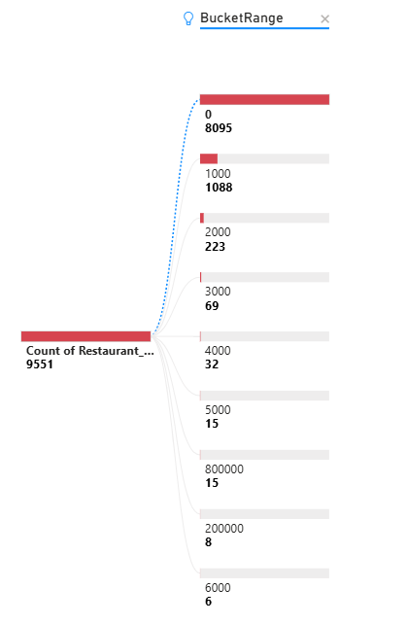
ZOMATO ANALYSIS PROJECT
RESTAURANT COUNT ON AVG COST FOR TWO:
• Most of the Restaurants have
Price range between (0-1000).
• A smaller range of restaurants
have price range between
(5000-6000).
•Price Range between(200000-
800000) is the most expensive
restaurants.

Slide 11
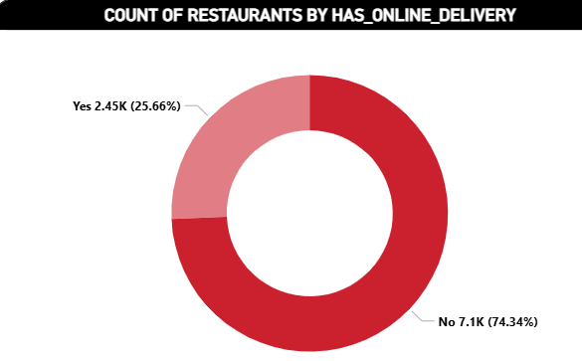
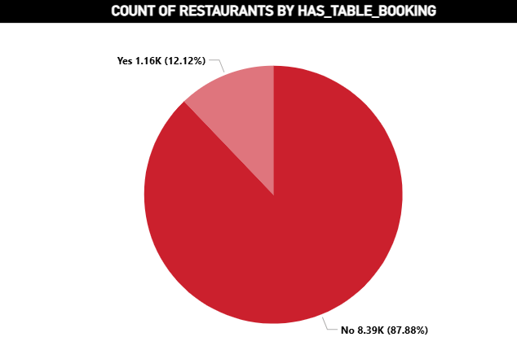
ZOMATO ANALYSIS PROJECT
PERCENTAGE OF RESTUARNTS ON HAS TABLE BOOKING AND HAS ONLINE DELIVERY:
•Percentage of Restaurants with no online
Delivery is 74.34%.
•Percentage of Restaurants with online
Delivery is 25.66%.
•Percentage of Restaurants with no Has
Table booking is 87.88%.
•Percentage of Restaurants with Has
Table booking is 12.12%.

Slide 12
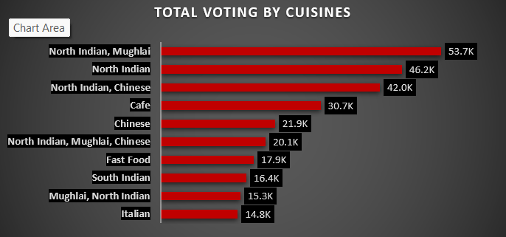
ZOMATO ANALYSIS PROJECT
CUISINES WISE SUM OF VOTES:
•Here we have taken
top 10 cuisines based
on sum of Voting.
•North Indian,Mughlai
has highest number of
votes.

Slide 13
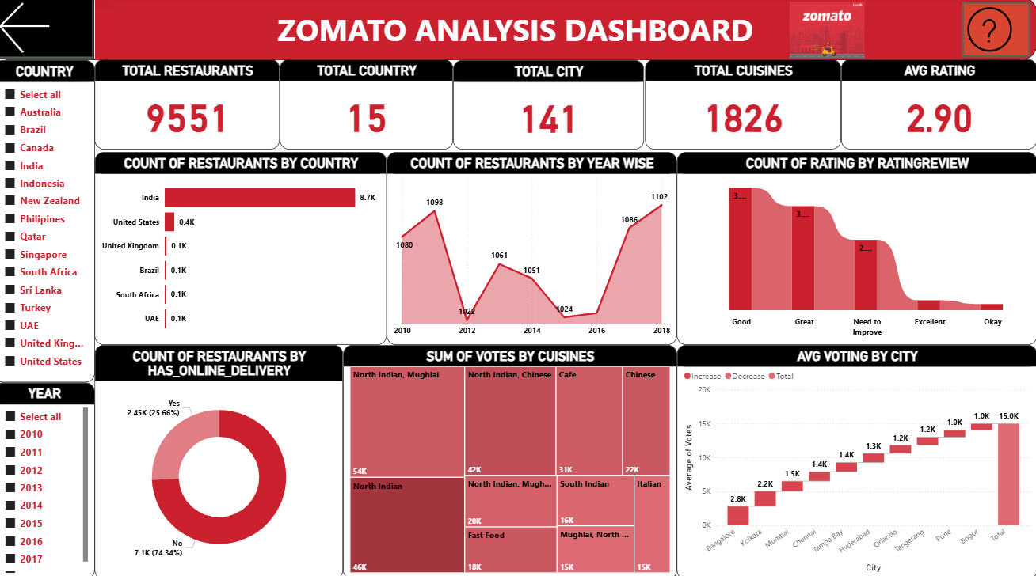
ZOMATO ANALYSIS PROJECT

Slide 14
ZOMATO ANALYSIS PROJECT
RECOMMENDATION:
• Focus expansion on high-demand locations with fewer restaurants.
• Promote top-rated and popular cuisines to increase customer engagement.
• Encourage more restaurants to enable online delivery services.
• Use customer ratings and reviews to improve restaurant quality and service.

Slide 15
ZOMATO ANALYSIS PROJECT
CONCLUSION:
•The analysis helps understand customer preferences and restaurant performance.
• Location, cuisine, and pricing strongly influence ratings and demand.
• Online delivery availability improves restaurant reach and customer engagement.
• Overall, the project shows how data analysis supports better business decisions for Zomato.

Slide 16
THANK YOU

