Slide 1
Pattern Recognition and Machine learning
Project :Facial Analytics for BMI Prediction and Gender
Classification
Done by:
Asif CS22B2005
D.Yathin CS22B2032
B.V.Praveen CS22B2033

Slide 2
Project Overview
Introduction:
This project aims to predict Body Mass Index (BMI) from images using a deep learning model (CNN).
The model uses front and side body images to classify individuals into BMI categories: Underweight, Normal, and Overweight.
Objective:
Develop a CNN model to predict BMI categories.
Preprocess the dataset and images.
Train and evaluate the model's performance.

Slide 3
Problem Statement
Predicting BMI is important for assessing the health of individuals. Traditional methods of
calculating BMI involve weight and height, but image-based models can potentially add more
context and accuracy.
Challenges Faced
Data Collection: Sourcing a suitable dataset with labeled front and side images.
Data Preprocessing: Image resizing, normalization, and correct BMI scaling were complex.
Model Optimization: Finding the right balance between the two tasks using loss weights.
Overfitting: Regularization techniques were employed to mitigate overfitting.

Slide 4
Data Preprocessing
Dataset:
person.csv: Contains id, weight, height, and other features.
BMI Calculation: Using weight and height, the BMI is calculated and categorized.
Images: Front and side body images are loaded for each person, and missing files are handled by using placeholder images.
Steps:
Convert weight (pounds to kilograms) and height (inches to meters).
Calculate BMI using the formula: BMI=Weight/(height)^2 .
Categorize BMI into three classes: Underweight, Normal, and Overweight.
Use the first 10,000 rows for training and testing.

Slide 5
The Model Architecture
CNN Model:
A Convolutional Neural Network (CNN) is built to classify BMI from front and side images.
Input:
Two inputs: Front and side images of size (128x128x3).
Layers:
Conv2D Layer: Extracts spatial features from the image.
MaxPooling2D Layer: Reduces the spatial dimensions while retaining important features.
Flatten Layer: Converts 2D feature maps into a 1D vector.
Dense Layer: Fully connected layers for combining extracted features and performing classification.

Slide 6
CNN Layers Breakdown
Front Image Branch:
Conv2D(32 filters) -> MaxPooling2D -> Flatten -> Dense(128 units)
Side Image Branch:
Conv2D(32 filters) -> MaxPooling2D -> Flatten -> Dense(128 units)
Combined Branch:
Concatenate both branches.
Dense Layer (128 units) -> Output Layer (Softmax activation, 3 categories for BMI)

Slide 7
Model Training and Evaluation
Training:
Epochs: 10
Batch Size: 32
Optimizer: Adam
Loss Function: Categorical Cross-Entropy (since it's a multi-class classification problem)
Evaluation:
Metrics:
Accuracy (for classification)
Mean Absolute Error (MAE)
Mean Squared Error (MSE)
R-Squared (R²)
Pearson Correlation Coefficient (for comparing predicted vs actual classes)
Accuracy: Training accuracy and test accuracy reported.

Slide 8
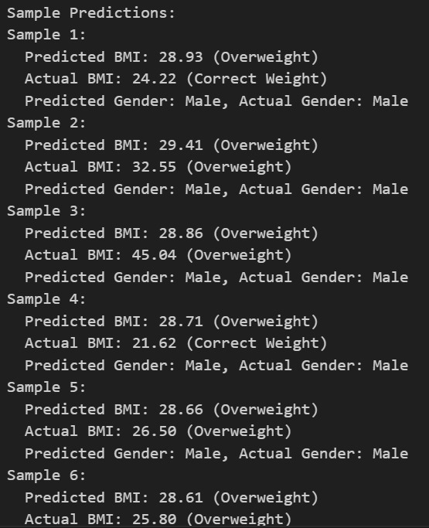
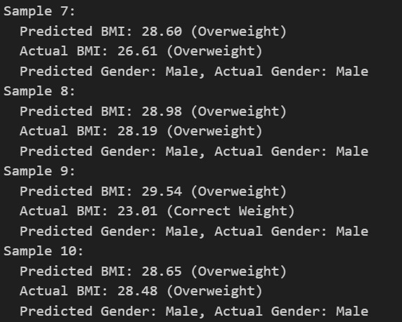
Testing Results

Slide 9
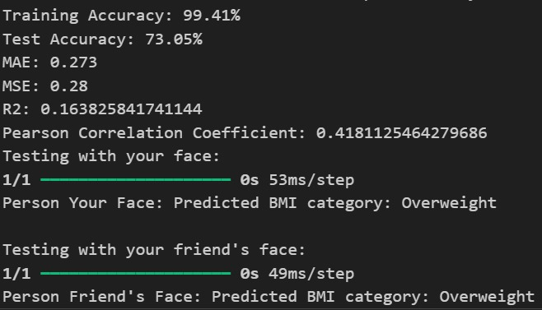
Results

Slide 10
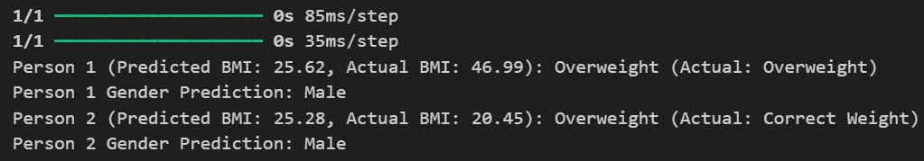
Old Model Result

Slide 11
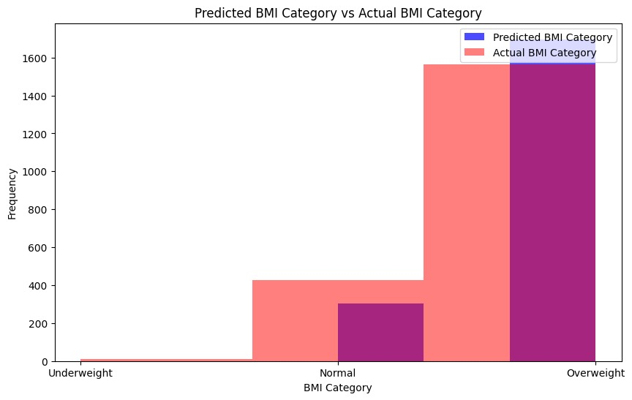
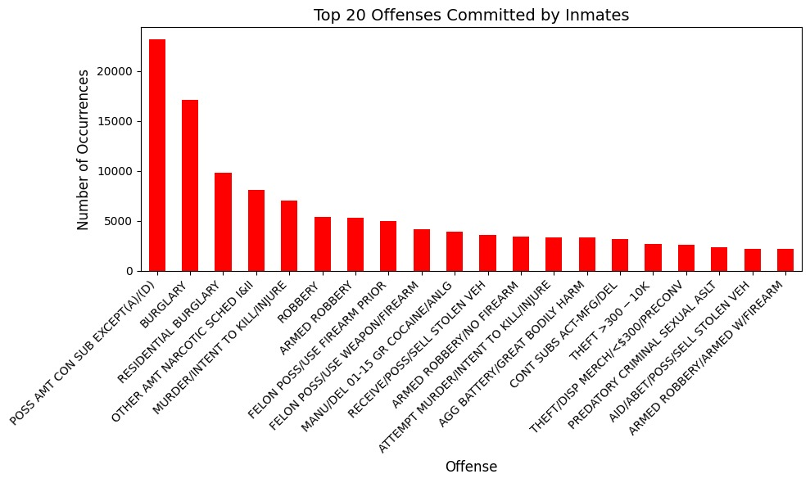
Plots

Slide 12
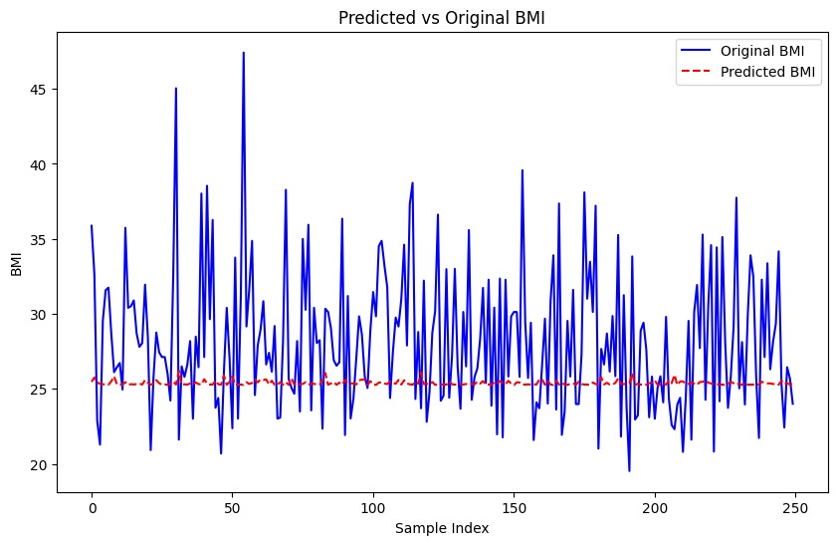
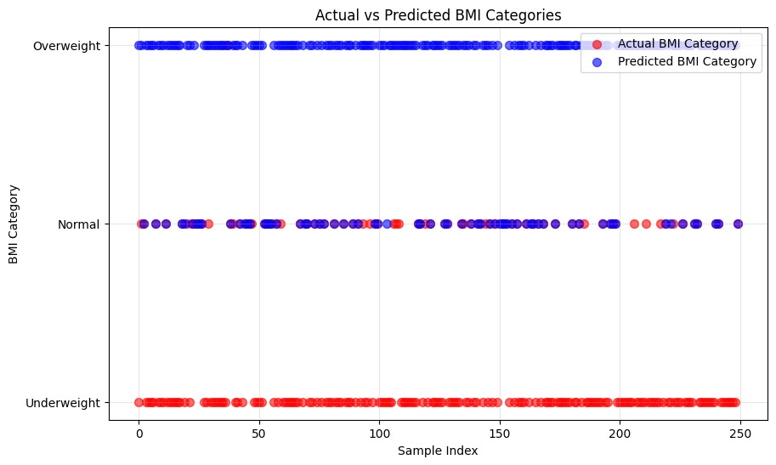
Graphs

Slide 13
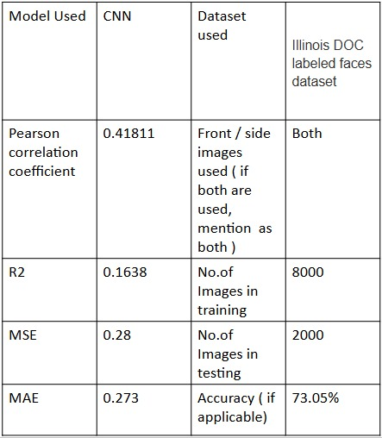
Brief Summary of our Model

Slide 14
Conclusion
Summary:
A CNN model was developed and successfully trained to predict BMI categories from front and side images.
The model showed good performance, with high test accuracy and low error metrics.
Future Work:
Improve model performance with more data or fine-tuning.
Experiment with different architectures or pre-trained models.
Explore other features (e.g., age, gender) for more accurate predictions.
Impact:
The model can be useful in health tech applications, such as fitness tracking and health assessments.

