Slide 1
PARKINSON’S DISEASE DETECTION USING DEEP LEARNING TECHNIQUES

Slide 2
OBJECTIVE
The cardinal objectives of this paper are
To manifest an overarching survey of research papers in different modalities to detect PD.
To provide an array of various comparisons between different techniques of data pre-processing, feature extraction and classifiers.
To implement various Deep learning algorithms and compare them to conclude which one gives the best results.
The scope to implement an ensemble approach for better prediction of PD.

Slide 3
ABSTRACT:
Parkinson ’s disease (PD) is considered a malison for mankind for several decades. Its detection with the help of an automated system is a subject undergoing intense study. This entails a need for incorporating a Deep learning model for the early detection of PD. For discovering a full proof model, the cardinal prerequisite is to study the existing computational intelligent techniques in the field of research used for PD detection. Many existing models focus on singular modality or have a cursory analysis of multiple modalities. This encouraged us to provide a comparative literature study of four main modalities signifying major symptoms used for early detection of PD, namely, tremor at rest, bradykinesia, rigidity, and, voice impairment. State- of-the-art deep learning

Slide 4
implementations namely Mobile net is implemented.
Keywords: Parkinson’s Disease, Deep Learning.

Slide 5
INTRODUCTION
Parkinson’s disease (PD) is a long-termed, neurological disorder that causes a person to lose control over several body functions including speech. It is the second most common neurodegenerative disease after Alzheimer’s disease. The loss of nerve cells in the part of the brain called the substantial nigra causes PD. These nerve cells or neurons create an organic chemical named dopamine which acts as a neurotransmitter between the parts of the brain and central nervous system that helps to control and co-ordinate body movements. Although this disease can be diagnosed at an early stage [6], its long term treatment is not yet discovered. The clinical diagnosis of the patient by the doctor was focused on his/her sense and experience, based on his/her knowledge and studying previous

Slide 6
cases of PD from large databases in the hospitals. But with the advent of strong tools like Artificial Intelligence and Deep Learning, this took a subtle turn [7], various state-of-the-art Deep learning tools and techniques analysed the high dimensions of data in the datasets which made the work of prediction simple. The primary symptoms of PD were the motor dysfunctions, which involved tremors of limbs, hand, legs, and jaws, bradykinesia or slowness of movement, rigidity in limbs which is observable in the PD affected patient’s gait and postural instability [8] [9]. Furthermore, there are several other symptoms like loss of memory and depression which are termed as non-motor symptoms [10] [11]. PD can be diagnosed, but its effective treatment is a challenging task. There is no definitive cure discovered for PD or either to show its progression, but there are various rating methods like

Slide 7
Unified Parkinson’s Disease Rating Scale (UPDRS) and MDS-UPDRS [12], which helps to estimate the severity of t h e disease. Sometimes there is a possibility that patients do not cooperate with the doctors while examination [13] which causes imprecise and inaccurate results. So, the usage of automated tools like deep learning would ease the task of clinicians and would improve the diagnosis accuracy.

Slide 8
LITERATURE SURVEY:
1. akmak, Y. O¨. ; O¨ lc¸ek, S.C.; O¨ zsoy, B.; Go¨kc¸ay, D.” Quantitative Measurement of Bradykinesia in Parkinson’s Disease Using Commercially Available Leap Motion.” Biosignals, Proceedings of the 11th International Joint Conference on Biomedical Engineering Systems and Technologies; Funchal: Madeira, Portugal, 2018; Volume 3, pp. 227–232. 2018.
Parkinson’s Disease (PD) is a neurodegenerative disease caused by the depletion of dopamine in the brain. Tremor, bradykinesia, rigidity and postural stability are the four major symptoms. Like other symptoms, bradykinesia causing unnatural stillness/slowness in motions affects the daily life of the patients. The levels of these symptoms are clinically assessed by a scoring system based on Unified

Slide 9
Parkinson's Disease Rating Scale (UPDRS). However, UPDRS relies on the visual observations of physicians rather than a test based on quantitative measurements. This makes it not only difficulty to repeat but also subjective. Because of these two major disadvantages, researchers build custom devices for their studies. But this leads to the
reliability issues and non-standard measurements. Thus, 24 PD patients were bilaterally UPDRS III (motor subsection) scored and recorded for finger motion (pinching) by using commercially available off-the-shelf (COTS) product called Leap Motion. The various features extracted from recordings and UPDRS III scores were analyzed for correlation. After the analysis, a linear model was created to estimate UPDRS III score. The study revealed that Leap Motion, a COTS device, can be used to estimate bradykinesia of a patient with PD

Slide 10
2. Adams, WR. “The detection of hand tremor through the characteristics of finger movements while typing.” Posted August 5, 2018. bioRxiv 385286; doi:https://doi.org/10.1101/385286. Accessed online September 17, 2018., 2018.
Parkinson’s Disease (PD) is a neurodegenerative movement disease affecting over 6 million people worldwide. Current diagnosis is based on clinical and observational criteria only, resulting in a high misdiagnosis rate. Approximately 75% of people with PD have hand tremor, which can precede clinical diagnosis by up to 6 years. Previous studies have shown that early PD can be accurately detected from keystroke features while typing, and this study investigated whether tremor can be detected as well. Typing data from 76 subjects, with and without PD, including 27 with PD and 15

Slide 11
with tremor, was analysed and showed that hand tremor in PD can be detected from keystroke features. This novel technique has not been used before and was able to achieve an overall sensitivity of 67% and a specificity of 80% and was also able to differentiate PD tremor from essential tremor. This means that the diagnosis of early PD through typing can achieve the clinical requirement of at least two cardinal features being present (bradykinesia and tremor). Less than half a page of typing is needed, the technique does not require any specialised equipment, and can take place in the patient’s home as they type normally on a computer.

Slide 12
3. Lonini, L., Dai, A., Shawen, N. et al. “Wearable sensors for Parkinson’s disease: which data are worth collecting for training symptom detection models.” npj Digital Med 1, 64 (2018) doi:10.1038/s41746-018-0071-z., 2018.
Deep learning algorithms that use data streams captured from soft wearable sensors have the potential to automatically detect PD symptoms and inform clinicians about the progression of disease. However, these algorithms must be trained with annotated data from clinical experts who can recognize symptoms, and collecting such data are costly. Understanding how many sensors and how much labeled data are required is key to successfully deploying these models outside of the clinic. Here we recorded movement data using 6 flexible wearable sensors in 20 individuals with PD over the course of multiple clinical assessments conducted on 1 day and repeated 2

Slide 13
weeks later. Participants performed 13 common tasks, such as walking or typing, and a clinician rated the severity of symptoms (bradykinesia and tremor). We then trained convolutional neural networks and statistical ensembles to detect whether a segment of movement showed signs of bradykinesia or tremor based on data from tasks performed by other individuals. Our results show that a single wearable sensor on the back of the hand is sufficient for detecting bradykinesia and tremor in the upper extremities, whereas using sensors on both sides does not improve performance. Increasing the amount of training data by adding other individuals can lead to improved performance, but repeating assessments with the same individuals—even at different medication states—does not substantially improve detection across days. Our results suggest that PD symptoms can be detected during a variety of activities and are best modeled by a dataset incorporating many individuals.

Slide 14
4. Yao, L., Brown, P., Shoaran, M., “Resting Tremor Detection in Parkinson’s Disease with Deep Learning and Kalman Filtering.”, 2018 IEEE Biomedical Circuits and Systems Conference (BioCAS). doi:10.1109/biocas.2018.8584721, 2018.
Adaptive deep brain stimulation (aDBS) is an emerging method to alleviate the side effects and improve the efficacy of conventional open-loop stimulation for movement disorders. However, current adaptive DBS techniques are primarily based on single-feature thresholding, precluding an optimized delivery of stimulation for precise control of motor symptoms. Here, we propose to use a Deep learning approach for resting-state tremor detection from local field potentials (LFPs) recorded from subthalamic nucleus (STN) in 12 Parkinson’s patients. We compare

Slide 15
the performance of state-of-the-art classifiers and LFP-based biomarkers for tremor detection, showing that the high-frequency oscillations and Hjorth parameters achieve a high discriminative performance. In addition, using Kalman filtering in the feature space, we show that the tremor detection performance significantly improves (F_{(1,15)}=32.16, p<0.0001). The proposed method holds great promise for efficient on-demand delivery of stimulation in Parkinson’s disease.

Slide 16
5. Di Biase, Lazzaro et al., “Quantitative Analysis of Bradykinesia and Rigidity in Parkinson’s Disease.”, Frontiers in neurology vol. 9 121. doi:10.3389/fneur.2018.00121, 2018.
Background In the last decades, several studies showed that wearable sensors, used for assessing Parkinson’s disease (PD) motor symptoms and recording their fluctuations, could provide a quantitative and reliable tool for patient’s motor performance monitoring.Objective The aim of this study is to make a step forward the capability of quantitatively describing PD motor symptoms. The specific aims are: identify the most sensible place where to locate sensors to monitor PD bradykinesia and rigidity, and identify objective indexes able to discriminate PD OFF/ON motor status, and PD patients from healthy subjects (HSs).Methods Fourteen PD patients (H&Y stage

Slide 17
1–2.5), and 13 age-matched HSs, were enrolled. Five magneto-inertial wearable sensors, placed on index finger, thumb, metacarpus, wrist, and arm, were used as motion tracking systems. Sensors were placed on the most affected arm of PD patients, and on dominant hand of HS. Three UPDRS part III tasks were evaluated: rigidity (task 22), finger tapping (task 23), and prono-supination movements of the hands (task 25). A movement disorders expert rated the three tasks according to the UPDRS part III scoring system. In order to describe each task, different kinematic indexes from sensors were extracted and analyzed. ResultsFour kinematic indexes were extracted: fatigability; total time; total power; smoothness. The last three well-described PD OFF/ON motor status, during finger-tapping task, with an index finger sensor. During prono-supination task, wrist sensor was able to differentiate PD OFF/ON motor condition.

Slide 18
EXISTING SYSTEM:
In the existing system, the condition is usually diagnosed by a neurologist based on a review of your symptoms and a physical exam. A Datscan to visualize your brain's dopamine system may help confirm diagnosis. Blood tests and other imaging tests, such as an MRI scan, don't diagnose Parkinson's.
DISADVANTAGES:
Detection of Parkinson’s disease is difficult.
Results are not accurate.
It takes more time to give results.
High time resolution.
High variation in results.
Low efficiency.

Slide 19
PROPOSED SYSTEM:
Mobile net of deep learning approaches is used in the intended method to classify whether or not there is a Parkinson’s disease. As image analysis-based methods for classifying Parkinson’s disease. Therefore, accurate classification is crucial for the correct treatment, which will be made feasible by applying the method we have suggested. Below is a block schematic of the suggested method.

Slide 20
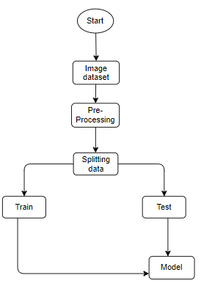
BLOCK DIAGRAM:

Slide 21
ADVANTAGES:
Low time resolution.
High efficiency.
Low variation in results.
Complexity is low.
Detection of Parkinson’s disease is easy.
Prediction results are accurate.

Slide 22
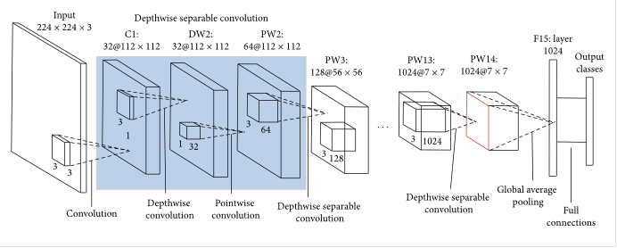
MOBILE NET:
As the name applied, the MobileNet model is designed to be used in mobile applications, and it is Tensor Flow’s first mobile computer vision model.
MobileNet uses depthwise separable convolutions. It significantly reduces the number of parameters when compared to the network with regular convolutions with the same depth in the nets. This results in lightweight deep neural networks.
A depthwise separable convolution is made from two operations.
Depthwise convolution.
Pointwise convolution.
MobileNet is a class of CNN that was open-sourced by Google, and therefore, this gives us an excellent starting point for training our classifiers that are insanely small and insanely fast.

Slide 23
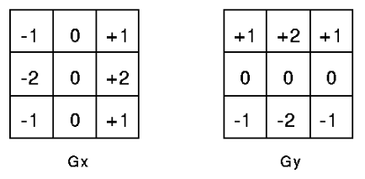
The speed and power consumption of the network is proportional to the number of MACs (Multiply-Accumulates) which is a measure of the number of fused Multiplication and Addition operations.
Depth wise Convolution:
This convolution originated from the idea that a filter’s depth and spatial dimension can be separated- thus, the name separable. Let us take the example of Sobel filter, used in image processing to detect edges.

Slide 24
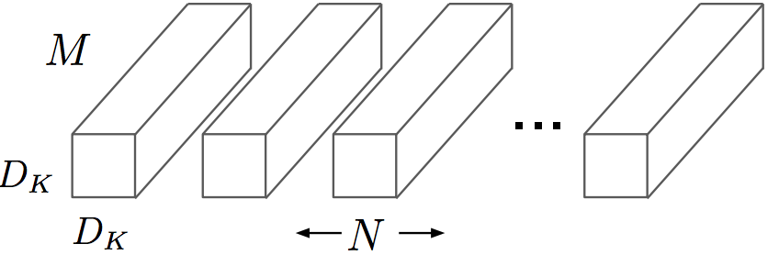
You can separate the height and width dimensions of these filters. Gx filter can be viewed as a matrix product of [1 2 1] transpose with [-1 0 1].
We notice that the filter had disguised itself. It shows it had nine parameters, but it has 6. This has been possible because of the separation of its height and width dimensions.
Pointwise convolution:
Convolution with a kernel size of 1x1 that simply combines the features created by the depthwise convolution. Its computational cost is
M * N * Df².

Slide 25
The main difference between MobileNet architecture and a traditional CNN instead of a single 3x3 convolution layer followed by the batch norm and ReLU. Mobile Nets split the convolution into a 3x3 depth-wise conv and a 1x1 pointwise conv, as shown in the figure.

Slide 26
SYSTEM SPECIFICATIONS:
SOFTWARE CONFIGURATIONS:
Technology : Deep Learning, Python
Libraries using : Pandas, Matplotlib, Numpy, Sklearn, Seaborn
Version : Python 3.6+
Server side scripts : Python
IDE : Jupyter notebook

Slide 27
HARDWARE CONFIGURATIONS:
RAM : 4 or 8GB, 64 bit os.
Processor : I3/Intel processor
Operating system : Windows 7,8,9,10

Slide 28
USE CASE DIAGRAM:
A use case diagram in the Unified Modeling Language (UML) is a type of behavioral diagram defined by and created from a Use-case analysis. Its purpose is to present a graphical overview of the functionality provided by a system in terms of actors, their goals (represented as use cases), and any dependencies between those use cases. The main purpose of a use case diagram is to show what system functions are performed for which actor. Roles of the actors in the system can be depicted.

Slide 29
UML DIAGRAMS
UML stands for Unified Modeling Language. UML is a standardized general-purpose modeling language in the field of object-oriented software engineering. The standard is managed, and was created by, the Object Management Group.
The goal is for UML to become a common language for creating models of object-oriented computer software. In its current form UML is comprised of two major components: a Meta-model and a notation. In the future, some form of method or process may also be added to; or associated with, UML.
The Unified Modeling Language is a standard language for specifying, Visualization, Constructing and documenting the artifacts of software system, as well as for business modeling and other non-software systems.

Slide 30
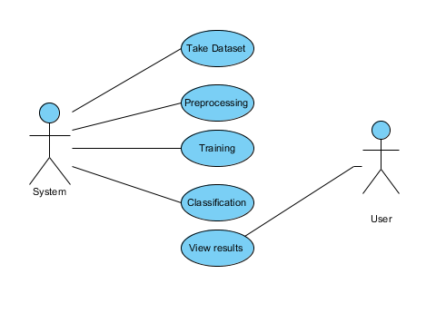

Slide 31
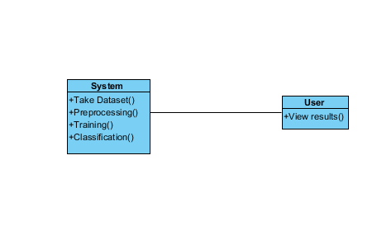
CLASS DIAGRAM:
In software engineering, a class diagram in the Unified Modeling Language (UML) is a type of static structure diagram that describes the structure of a system by showing the system's classes, their attributes, operations (or methods), and the relationships among the classes. It explains which class contains information.

Slide 32
SEQUENCE DIAGRAM:
A sequence diagram in Unified Modeling Language (UML) is a kind of interaction diagram that shows how processes operate with one another and in what order. It is a construct of a Message Sequence Chart. Sequence diagrams are sometimes called event diagrams, event scenarios, and timing diagrams.

Slide 33
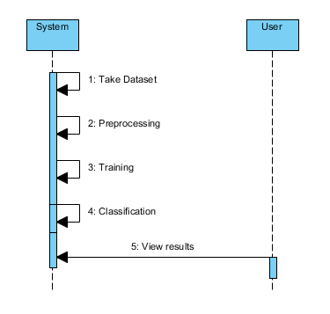

Slide 34
COLLABORATION DIAGRAM:
In collaboration diagram the method call sequence is indicated by some numbering technique as shown below. The number indicates how the methods are called one after another. We have taken the same order management system to describe the collaboration diagram. The method calls are similar to that of a sequence diagram. But the difference is that the sequence diagram does not describe the object organization whereas the collaboration diagram shows the object organization.

Slide 35
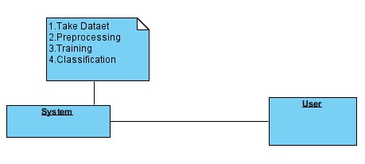

Slide 36
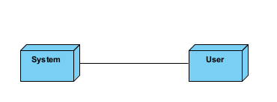
DEPLOYMENT DIAGRAM
Deployment diagram represents the deployment view of a system. It is related to the component diagram. Because the components are deployed using the deployment diagrams. A deployment diagram consists of nodes. Nodes are nothing but physical hard wares used to deploy the application.

Slide 37
ACTIVITY DIAGRAM:
Activity diagrams are graphical representations of workflows of stepwise activities and actions with support for choice, iteration and concurrency. In the Unified Modeling Language, activity diagrams can be used to describe the business and operational step-by-step workflows of components in a system. An activity diagram shows the overall flow of control.

Slide 38
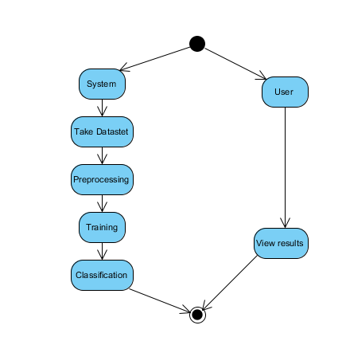

Slide 39
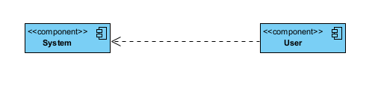
COMPONENT DIAGRAM
A component diagram, also known as a UML component diagram, describes the organization and wiring of the physical components in a system. Component diagrams are often drawn to help model implementation details and double-check that every aspect of the system's required function is covered by planned development.

Slide 40
ER DIAGRAM:
An Entity–relationship model (ER model) describes the structure of a database with the help of a diagram, which is known as Entity Relationship Diagram (ER Diagram). An ER model is a design or blueprint of a database that can later be implemented as a database. The main components of E-R model are: entity set and relationship set.
An ER diagram shows the relationship among entity sets. An entity set is a group of similar entities and these entities can have attributes. In terms of DBMS, an entity is a table or attribute of a table in database, so by showing relationship among tables and their attributes, ER diagram shows the complete logical structure of a database. Let’s have a look at a simple ER diagram to understand this concept.

Slide 41
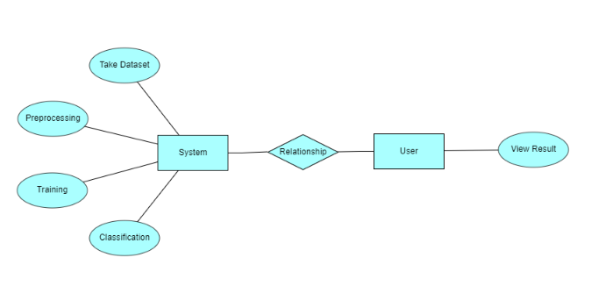

Slide 42
DFD DIAGRAM:
A Data Flow Diagram (DFD) is a traditional way to visualize the information flows within a system. A neat and clear DFD can depict a good amount of the system requirements graphically. It can be manual, automated, or a combination of both. It shows how information enters and leaves the system, what changes the information and where information is stored. The purpose of a DFD is to show the scope and boundaries of a system as a whole. It may be used as a communications tool between a systems analyst and any person who plays a part in the system that acts as the starting point for redesigning a system.

Slide 43
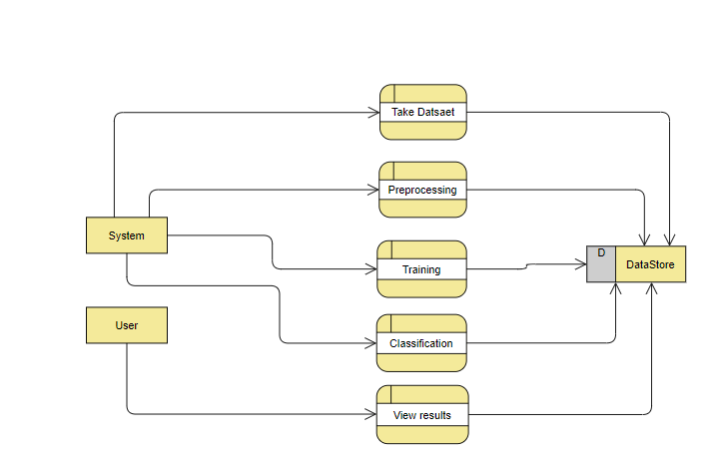

Slide 44
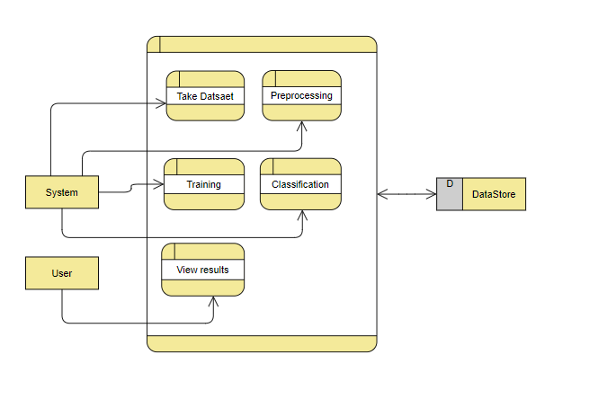

Slide 45

RESULT AND DISCUSSION
Home

Slide 46
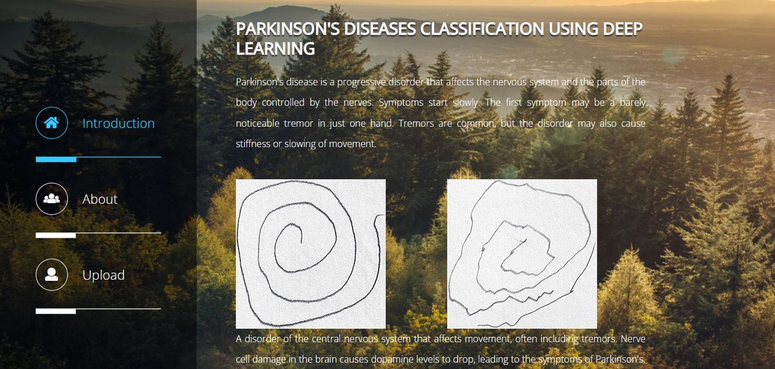
About

Slide 47

Imageupload

Slide 48

Result 1

Slide 49

Result 2

Slide 50
CONCLUSION:
Through the use of transfer learning, we were able to identify photographs of Parkinson’s difficulties and categories them into those that were or were not afflicted by the ailments. Here, we've used the dataset of photos for Parkinson’s disease classification that will be trained using the Mobile Net transfer learning method and classified as different forms of Parkinson’s diseases. After training, we use an image and classify it to test the system.

Slide 51
REFERENCES
akmak, Y. O¨. ; O¨ lc¸ek, S.C.; O¨ zsoy, B.; Go¨kc¸ay, D.” Quantitative Measurement of Bradykinesia in Parkinson’s Disease Using Commercially Available Leap Motion.” Biosignals, Proceedings of the 11th International Joint Conference on Biomedical Engineering Systems and Technologies; Funchal: Madeira, Portugal, 2018; Volume 3, pp. 227–232. 2018.
Adams, WR. “The detection of hand tremor through the characteristics of finger movements while typing.” Posted August 5, 2018. bioRxiv 385286; doi:https://doi.org/10.1101/385286. Accessed online September 17, 2018., 2018.
Lonini, L., Dai, A., Shawen, N. et al. “Wearable sensors for Parkinson’s disease: which data are worth collecting for training symptom detection models.” npj Digital Med 1, 64 (2018) doi:10.1038/s41746-018-0071-z., 2018.

Slide 52
4. Yao, L., Brown, P., Shoaran, M., “Resting Tremor Detection in Parkinson’s Disease with Deep Learning and Kalman Filtering.”, 2018 IEEE Biomedical Circuits and Systems Conference (BioCAS). doi:10.1109/biocas.2018.8584721, 2018.
5. Di Biase, Lazzaro et al., “Quantitative Analysis of Bradykinesia and Rigidity in Parkinson’s Disease.”, Frontiers in neurology vol. 9 121. doi:10.3389/fneur.2018.00121, 2018.
6. Berus, L., Klancnik, S., Brezocnik, M., & Ficko, M., “Classifying Parkinson’s Disease Based on Acoustic Measures Using Artificial Neural Networks.’, Sensors, 19(1), 16. doi:10.3390/s19010016, 2018.
7. Opara J, Malecki A, Malecka E, Socha T., “Motor assessment in Parkinson’s disease.”, Ann Agric Environ Med 24:411–415. https://doi.org/10.5604/12321966.1232774, 2017.

