Slide 1

Title: Resolve360 – Civic Issue Management System for Municipal & Electricity Services
Under The Supervision of
Dr. K. Kranthi Kumar Ph.D;
Professor
Presented By
T. Venkata Koteswara Rao – 23BQ1A12D2 Sk. Mouyin Imran – 23BQ1A12B6 R. Vidya Shankar – 23BQ1A12A7 V. Dileep – 23BQ1A12E2 K. Anook Babu – 24BQ5A1222
Department of Information Technology
Vasireddy Venkatadri Institute of Technology
Peddakakani Mandal, Nambur, Guntur-522508

Slide 2
CONTENTS OUTLINE
Abstract
Introduction
Proposed System with Architecture
Functional Requirements
Non Functional Requirements
Goals of implementations
System Requirements
Software Configuration (Technology Stack)
Hardware Configuration (Computer Resource)
Tools & Technologies
Conclusion

Slide 3
ABSTRACT
Municipal and electricity departments frequently face civic problems such as uncollected garbage, damaged roads, drainage issues, and malfunctioning streetlights. Existing complaint systems are often manual, fragmented, and lack transparency, resulting in delayed resolution and poor accountability.
Resolve360 is a civic issue management platform designed to enable citizens to report municipal and electricity-related problems using images and location data. The system verifies submitted reports, detects duplicate complaints, and assigns issues to the appropriate department for faster handling. Citizens can track complaint status in real time, while department officers update progress through a dedicated dashboard.
The platform is developed using React, HTML, and CSS for the frontend, Spring Boot and Java for backend services, and MongoDB for data storage. By streamlining reporting and resolution workflows, Resolve360 improves operational efficiency, strengthens transparency, and supports effective coordination between citizens and public service departments.

Slide 4
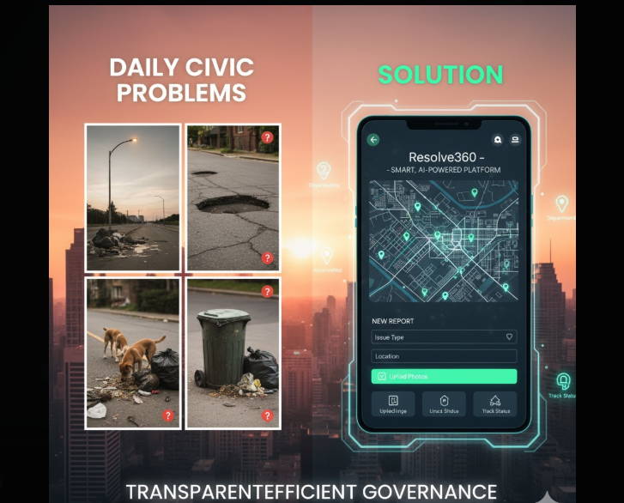
INTRODUCTION
Resolve360 is a civic issue reporting and management system focused on municipal and electricity services.
Bridges the gap between citizens and public service departments
Provides real-time issue tracking and transparency
Uses image-based reporting with location verification
Supports two user roles: Citizen and Department Officer
Enables faster resolution of civic complaints

Slide 5
PROPOSED SYSTEM WITH ARCHITECTURE
Citizens upload issue images along with location details
System verifies reports and checks for duplicate complaints
Issues are assigned to the appropriate department (Municipality or Electricity)
Department officers update work status in real time
Citizens receive progress notifications and resolution updates

Slide 6
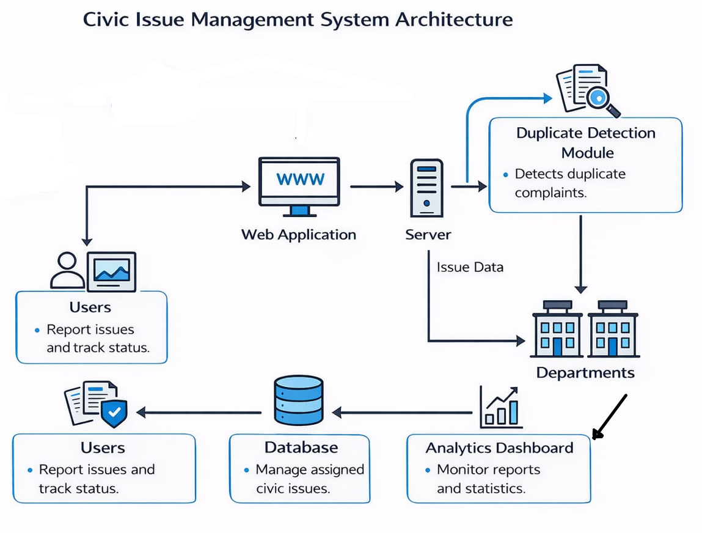















Slide 7
FUNCTIONAL REQUIREMENTS
Key System Functionalities
User registration and secure login
Automatic role identification (Citizen / Department Officer)
Upload municipal or electricity-related issue images
View issue status in real time
Department officers can update complaint status
All users can view verified and resolved issues

Slide 8
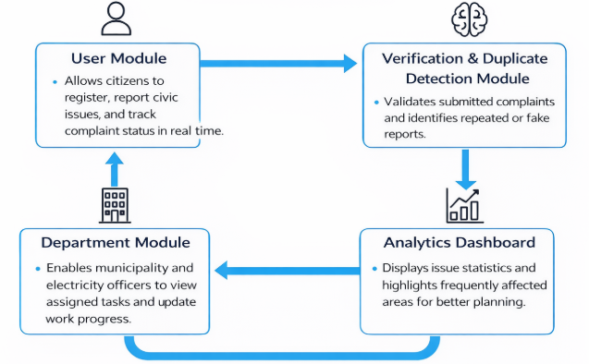
MODULES
1)User Module – Allows citizens to register, report issues, and track complaint status.
2)Department Module – Enables municipality and electricity officers to view tasks and update progress.
3)Verification & Duplicate Detection Module – Validates complaints and identifies repeated submissions.
4)Analytics Dashboard – Displays issue statistics and highlights frequently affected areas.

Slide 9
NON-FUNCTIONAL REQUIREMENTS
Quality Attributes of the System
Access Security – Prevents unauthorized access.
Availability – Keeps the system running during normal use.
Confidentiality – Protects user data.
Reliability – Ensures stable, error-free operation.
Usability – Easy to learn and use.
Integrity – Maintains accurate data.

Slide 10
GOALS OF IMPLEMENTATION
PROJECT OBJECTIVES (As per the project objectives)
1. Develop a simple and user-friendly system
Design an intuitive and well-structured interface that allows citizens to report municipal and electricity issues easily, even with minimal technical knowledge, while reducing the learning curve and improving user experience.
2. Provide a practical solution for civic issue reporting and management
Offer a digital and automated approach for handling complaints such as garbage overflow, damaged roads, drainage problems, and malfunctioning streetlights to improve operational efficiency and transparency.
3. Ensure accurate verification and faster resolution of issues
Verify submitted complaints, detect duplicate reports, and assign cases to the appropriate departments to ensure reliable reporting and quick action.
4. Ensure system clarity, efficiency, and ease of use
Design a clear and modular system architecture that supports smooth processing, easy maintenance, and quick task completion for both citizens and department officers.

Slide 11
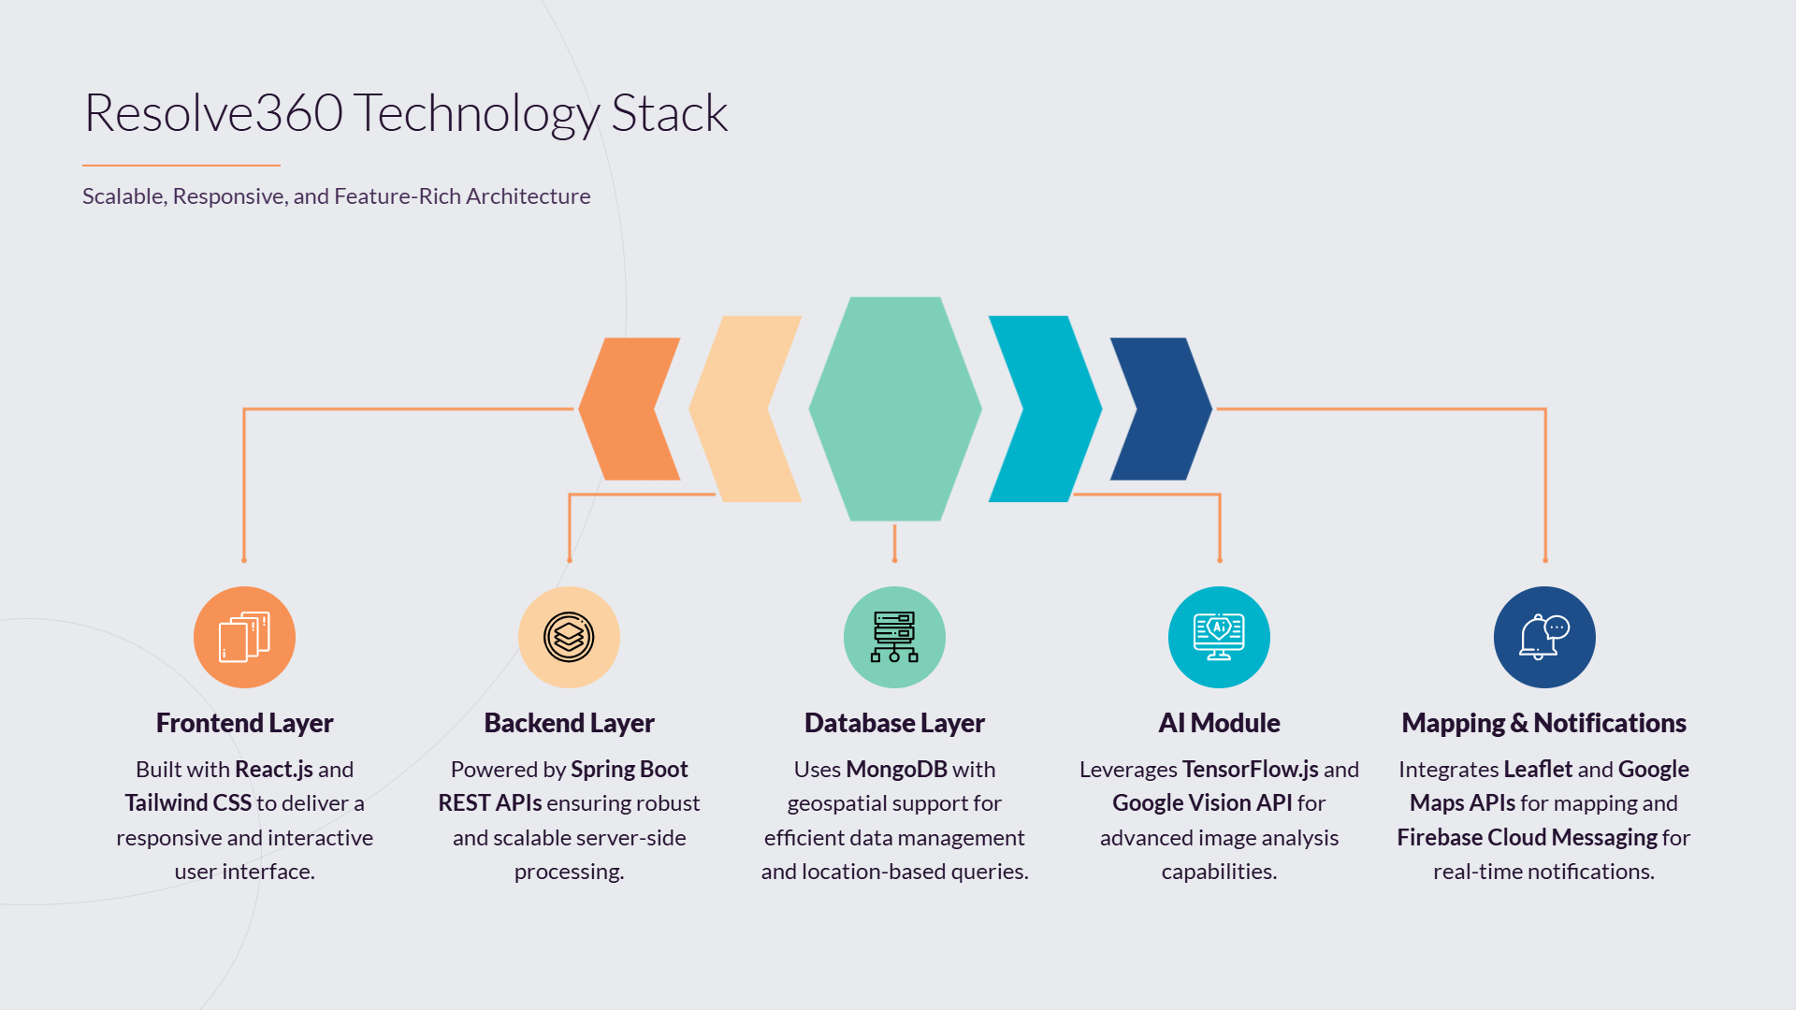
SYSTEM SPECIFICATIONS
SOFTWARE REQUIREMENTS (With Versions) | HARDWARE REQUIREMENTS
Operating System: Windows 11 | Processor: 12th Gen Intel(R) Core(TM) i5
Frontend: React.js, HTML5, CSS3 | RAM: Minimum 8 GB
Backend: Spring Boot 3.x, Java 17 | Storage: SSD (Minimum 30 GB)
Database: MongoDB 6.0 | System Architecture: 64-bit
Maps API: OpenLayers | Internet Connection: Required

Slide 12
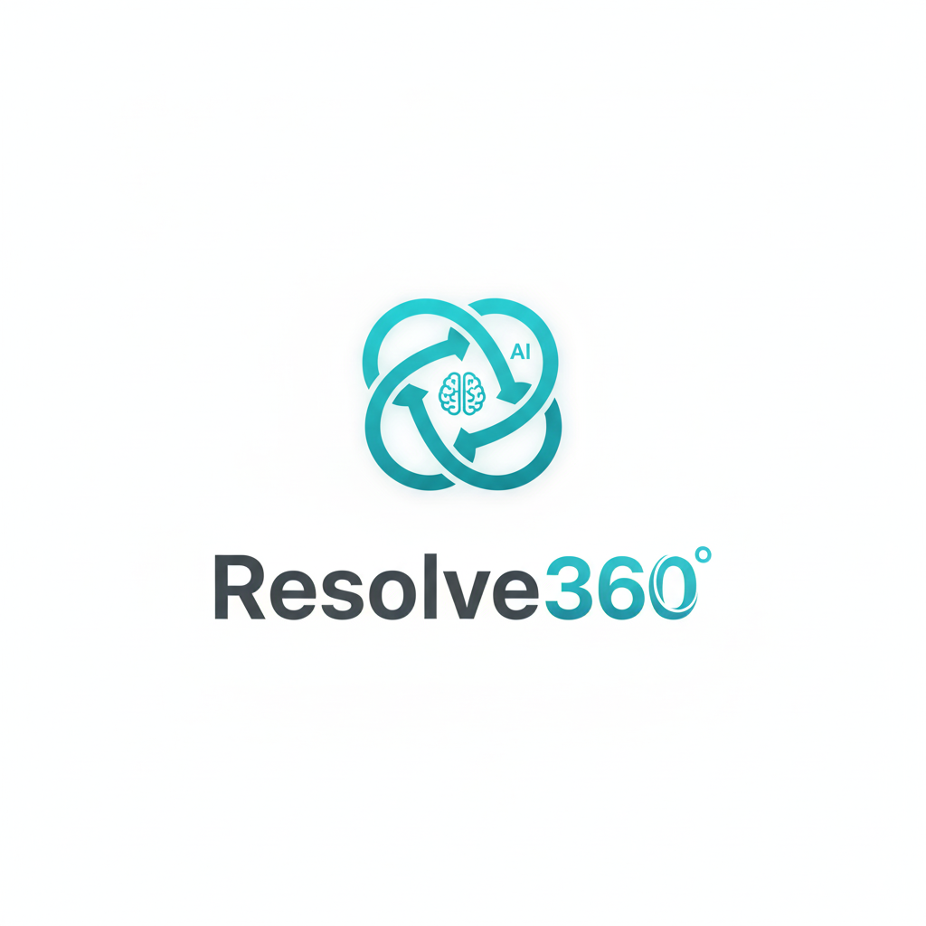
TOOLS & TECHNOLOGIES
AI Image Verification – Used to analyze uploaded civic issue images and confirm whether they genuinely represent municipal or electricity-related problems, helping reduce false complaints and improve system reliability.
Duplicate Detection Algorithms – Applied to compare new submissions with existing records using image features and location data so that repeated complaints about the same issue are identified and handled efficiently.
Analytics & Prediction Models – Used to process historical complaint data to find frequently affected areas and support better planning and prioritization by department officers.
Web Hosting Environment – Provides stable deployment of the web application and backend services, ensuring continuous availability and smooth access for users and departments.

Slide 13

CONCLUSION
Resolve360 is designed based on detailed requirement analysis and follows professional software standards. The system ensures reliability, usability, and transparency in handling municipal and electricity-related complaints. By integrating verification mechanisms and real-time status updates, Resolve360 helps citizens and departments work together effectively for faster and more accountable civic service delivery.

Slide 14
Thank You…! & Any Questions…!

