Slide 1
DAA PROJECT IMPLEMENTION
Module-:Program Level Ojective Setting
Submitted By : Team The Code Rangers
Md Nabeel Hisham - AP23110011196
Sai Puppala - AP23110011172
P Pavan Kumar - AP23110011201
Sk.Abdullah - AP23110011186
Mahaboob Basha - AP23110011216
Sk.Mohammad - AP23110011178
BTECH|CSE-Q|SEMESTER-3|2023-27

Slide 2
Introduction to Project
This project module manages records for various "programs," where each program is defined by its unique ID, code, name, and description. The application supports basic CRUD (Create, Retrieve, Update, Delete) operations on these records, with functionalities for sorting and searching. The data is stored in a text file for persistence, ensuring that program records remain accessible across sessions. This project demonstrates effective data management techniques, basic algorithm comparisons, and efficiency evaluation for sorting and searching operations.

Slide 3
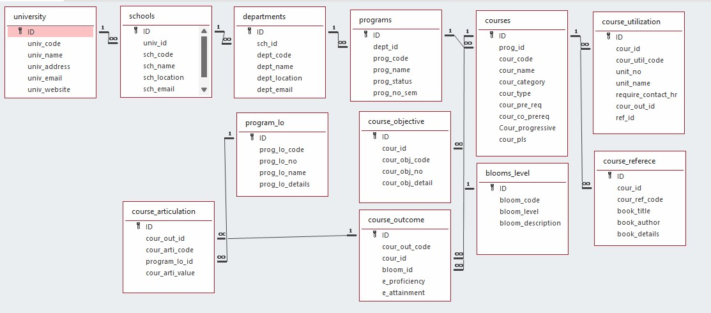

Architecture Diagram

Slide 4
Module Description : Program Level Objective Setting
This C module is designed to handle a simple program management system that stores, retrieves, updates, and manages data on various programs. It provides functionalities for CRUD (Create, Read, Update, Delete) operations, sorting, searching, and algorithm comparisons. The module includes error handling, file storage, and terminal output formatting with colors to enhance readability. Each function follows a structured approach, ensuring efficient data management
● ____________---___111File and Data Management: Loads program records from a file at startup and saves data for persistence, with options for creating, updating, viewing, and deleting records.
● -----_ Search and Sort Functionalities: Allows users to search by program code or name, and to sort records using Bubble Sort or Selection Sort, with options to compare the performance of these algorithms.
User-Friendly Interface: Offers a menu-driven interface with input validation, clear guidance on options, and help information, ensuring smooth navigation and ease of use.

Slide 5
Program_lo Setting:Field/table details
Field Name | Data type
ID | integer
Program_lo_code | String
Program_lo_name | String
Program_lo_details | String

Slide 6
Program level objective setting:Programming Details
File name:Program_setting.txt
Function/method name
Create: The_code_rangers_create_program
Update: The_code_rangers_ update_program
Retrieve: The_code_rangers_ retrieve_programs
Delete: The_code_rangers_ delete_program
Sorting: The_code_rangers_sort_by_field
Searching: The_code_rangers_search_by_field

Slide 7
Program_lo :Programming Details
Comparison(both searching and Sorting):
For
Searching- The_code_rangers_ compare_searching_algorithms
For Sorting- The_code_rangers_ compare_sorting_algorithms
Time Complexity(both searching and Sorting):
For Searching/sorting- The_code_rangers_ display_time_complexity

Slide 8
Program_lo :Programming Details
Algorithm Details(pseudocode or steps)(both searching and Sorting):
■ For Searching/Sorting: The_code_rangers_ display_pseudocode
File name(for storing the details)
File name to be used is:- Programs_setting .txt

Slide 9
Program_lo : Sorting Algorithm used
Bubble Sort:
Algorithm:
Step-1: Ask user to choose a field to sort by (code or name).
Step-2:loop from 0 to program_count-1
Step-3:loop from 0 to program_count-i-1
Step-4:swap elements if program_arr[j]>program_arr[j+1]
Step-5: Continue until no swaps are needed (array is sorted)
Step-6: Print success message and the sorted list.

Slide 10
Program_lo : Sorting Algorithm used
Selection Sort :
Algorithm:
Step-1: Ask user to choose a field to sort by (code or name).
Step-2:loop from 0 to program_count-1
Step-3: set min_index = I
Step -4:loop from i+1 to program_count
Step-5: if programs[j]<program[j+1] then replace the values of min_index to j
Step-6: swap prorams[i] = programs[min_index]
Step-7: continue the program until complete array to be sorted
Step-8: print success message

Slide 11
Program_lo : Time Complexity of Sorting Algorithm
Sl.No | Algorithm Name | Complexity of Algorithm
01 | Bubble Sort | O(n^2)
02 | Selection Sort | O(n^2)

Slide 12
Program_lo : Searching Algorithm used
Linear Search:
Algorithm:
Step-1: User Input for Search Criteria
Step-2: Input the Search Value
Step-3: Iterate Through the Program List
Step-4: Check for Match
Step-5: Handle Not Found Case

Slide 13
Program_lo : Searching Algorithm used
Binary search:
Algorithm:
Steps:
Step-1:Set low to 0
Step-2: Set high to program_cont-1
Step-3: while low is less than or equal to high,repeat steps for 4 to 6
Step-4: Calculate Midpoint as mid = (low+high)/2
Step-5:Update Search Range
Step-6:Repeat Steps 2-5, Continue the process until the target is found or the search range is exhausted.
Step-7:Target Not Found:
If the loop exits without finding the target, return an indication that the target is not in the array (e.g., -1).

Slide 14
Program_lo : Time Complexity of Searching Algorithm
Sl.No | Algorithm Name | Complexity of Algorithm
01 | Linear search | O(n)
02 | Binary Search | O(log n)

Slide 15
Overview Code[overview of searching,Sorting,CRUD and Storage options]
// 1. CRUD Operations
void addProgram() { /* Create: Adds new program details */ }
void viewProgram() { /* Read: Displays a single program */ }
void editProgram() { /* Update: Modifies program details */ }
void deleteProgram() { /* Delete: Removes program from the list */ }
// 2. Sorting (e.g., by program name or credits)
void sortPrograms() {
// Sorts list of programs alphabetically or by credits
std::sort(programs.begin(), programs.end(), [](const Program &a, const Program &b) {
return a.name < b.name; // Sort by name
});
}
// 3. Searching (e.g., by program name)
Program* searchProgram(const std::string &name) {
for (auto &program : programs) {
if (program.name == name)
return &program; // Return pointer to found program
}
return nullptr; // Not found
}

Slide 16
// 4. Storage Options
void saveToFile() {
// Opens file in write mode // Saves each program to file in structured format
}
void loadFromFile() {
// Opens file in read mode // Loads program data, reconstructing objects into list
// Main Function: Control Flow
int main() {
loadFromFile(); // Load programs on start
int choice;
do {
// Display Menu and get user choice
switch (choice) {
case 1: addProgram(); break;
case 2: viewProgram(); break;
case 3: editProgram(); break;
case 4: deleteProgram(); break;
case 5: sortPrograms(); break;
case 6: /* searchProgram("name"); */ break;
}
} while (choice != 0);
saveToFile(); // Save programs on exit
return 0;
}

Slide 17
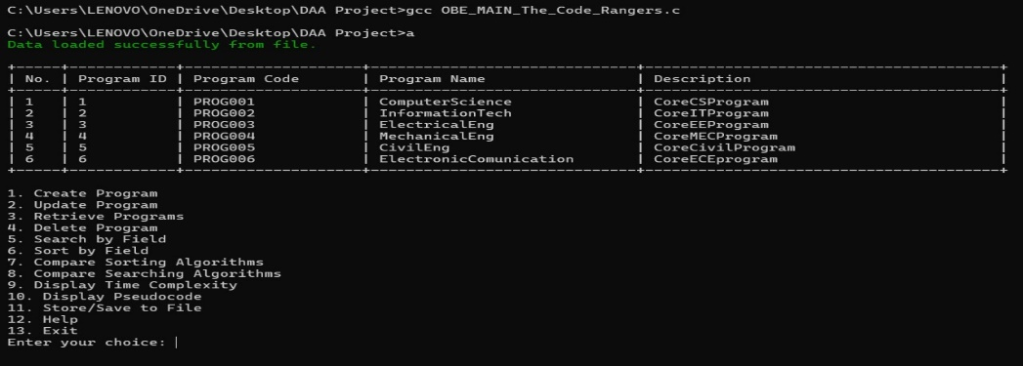
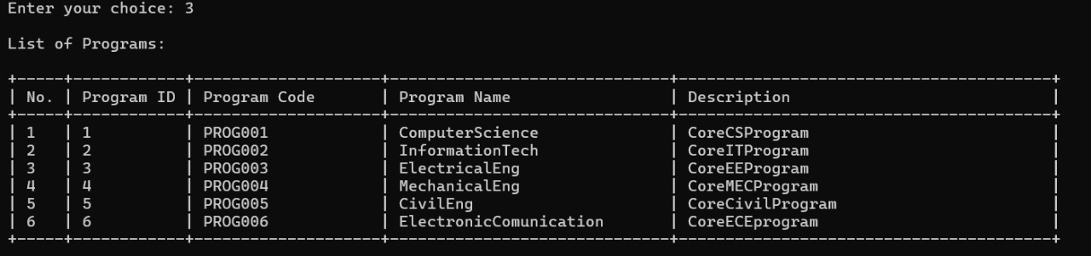
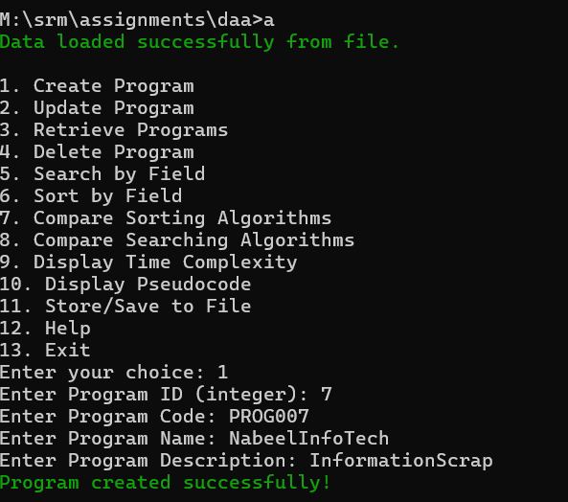
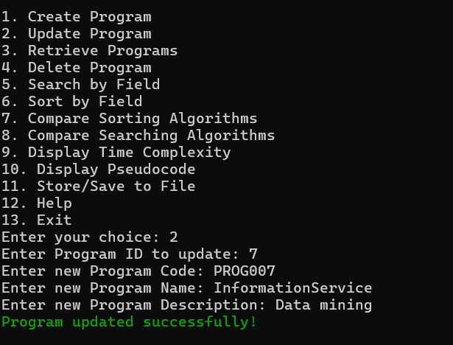
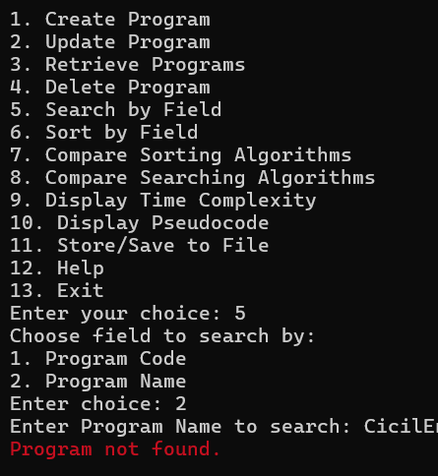
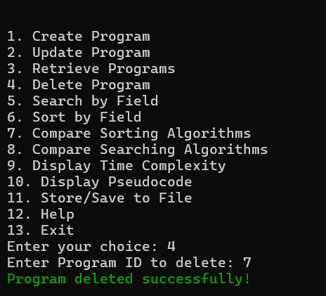
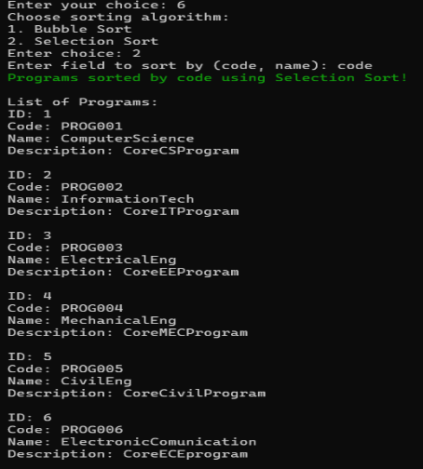
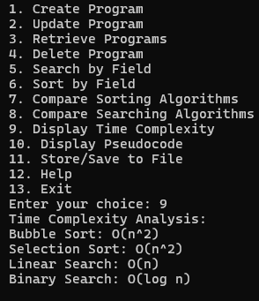
Screen Shots[*Screen shot of CRUD,Sorting,Searching,Comparison(both sorting & Searching & store

Slide 18
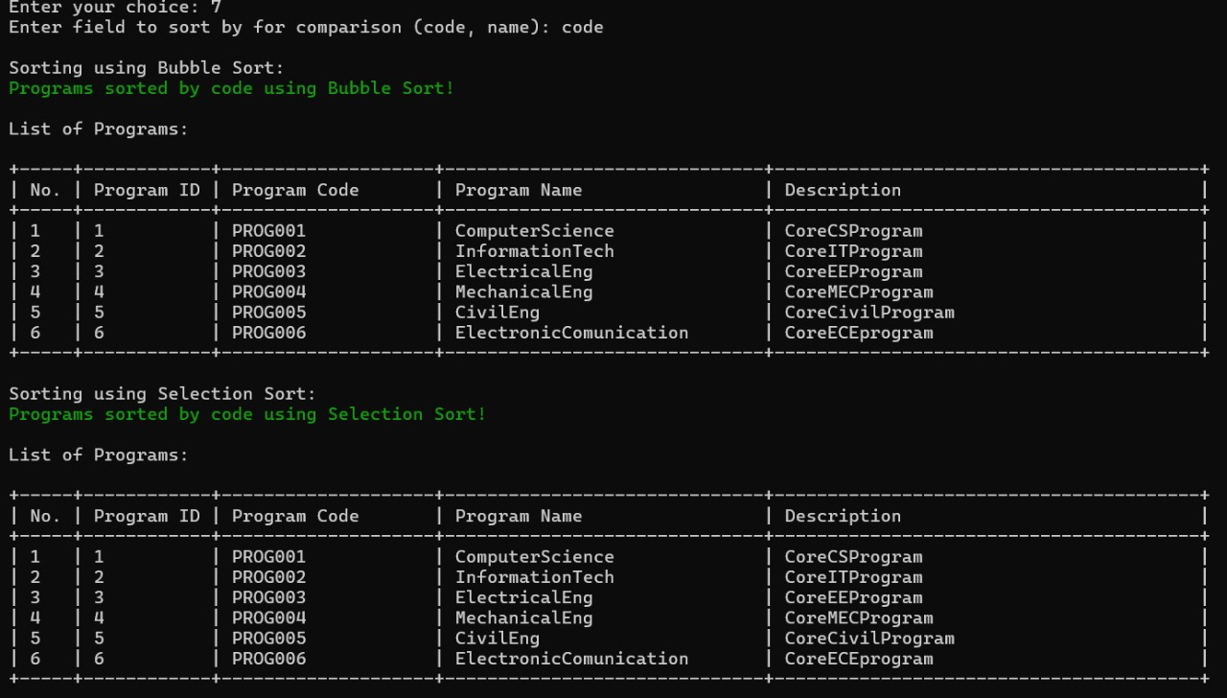
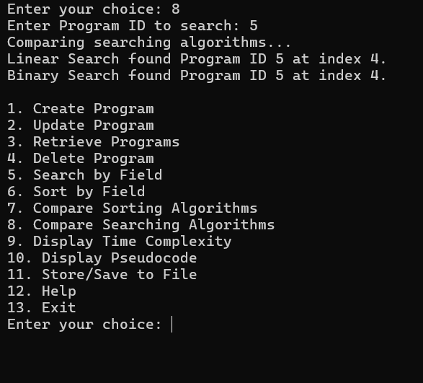
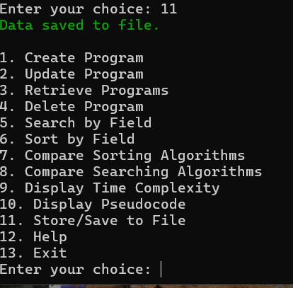
Screen Shots
Compiled Successfully!!!

Slide 19
Conclusion
The Program Management module provides an effective solution for managing program records, with functionalities for CRUD operations and efficient data retrieval via sorting and searching. By comparing sorting and searching algorithms, this project demonstrates the importance of choosing the right algorithm for performance optimization. The module’s modular structure, alongside file-based data persistence, ensures a reliable and maintainable system for program management.

Slide 20
Thank You!

