Slide 1
An Interactive Quantum Error Correction Simulator
A configurable environment for simulating multiple quantum noise models and evaluating QEC performance
AMRITA VISHWA VIDYAPEETHAM
Presented by
K. Devendra Reddy – CH.SC.U4CSE24021
Shaik Muzzammil – CH.SC.U4CSE24041
D. Guna Samhith – CH.SC.U4CSE24016

Slide 2
Problem Statement
Quantum noise introduces errors into quantum computations, which affects their reliability and the effectiveness of Quantum Error Correction (QEC).
Quantum errors: quantum systems are sensitive to noise, which can corrupt quantum states.
Effect on computation: these errors reduce the accuracy and reliability of the results.
QEC performance: how well QEC works depends on the noise condition and the correction technique.
Need for evaluation: a simulation environment is needed to study QEC under different noise conditions.
Interactive Quantum Error Correction Simulator
2

Slide 3
Literature Review (1–5)
No. | Title | Author(s) | Year | Main focus
1 | An Efficient Simulation of Quantum Error Correction Codes | R. Padma Priya, A. Baradeswaran | 2018 | QCAD-based simulation of QEC using bit-flip and phase-flip errors and recovery methods.
2 | Testing Quantum Fault Tolerance on Small Systems | D. Willsch, M. Willsch, F. Jin, H. De Raedt, K. Michielsen | 2018 | Tests fault-tolerant quantum computing with simulations and an IBM quantum processor under different error conditions.
3 | Correcting Coherent Errors with Surface Codes | Sergey Bravyi, Matthias Englbrecht, Robert König, Nolan Peard | 2018 | Studies surface-code QEC under coherent errors and compares with Pauli-noise approximations.
4 | Logical Performance of 9 Qubit Compass Codes in Ion Traps with Crosstalk Errors | Dripto M. Debroy, Muyuan Li, Shilin Huang, Kenneth R. Brown | 2020 | Evaluates QEC codes under dephasing, gate overrotation and crosstalk in ion-trap systems.
5 | Simulating Quantum Error Correction beyond Pauli Stochastic Errors | Jordan Hines, Corey Ostrove, Kenneth Rudinger, Stefan Seritan, Kevin Young, Robin Blume-Kohout, Timothy Proctor | 2026 | Simulates coherent and non-Pauli errors using detector error models for QEC performance analysis.
Interactive Quantum Error Correction Simulator
3

Slide 4
Literature Review (6–10)
No. | Title | Author(s) | Year | Main focus
6 | Testing a Quantum Error-Correcting Code on Various Platforms | Qihao Guo, Yuan-Yuan Zhao, Markus Grassl, Xinfang Nie, Guo-Yong Xiang, Tao Xin, Zhang-Qi Yin, Bei Zeng | 2020 | Implements a two-qubit code for detected amplitude damping on optical, IBM Q and NMR platforms.
7 | Simulation and Performance Analysis of QEC with a Rotated Surface Code under a Realistic Noise Model | Mitsuki Katsuda, Kosuke Mitarai, Keisuke Fujii | 2024 | Simulates a distance-5 rotated surface code under realistic stochastic and coherent noise.
8 | Demonstrating Multi-Round Subsystem QEC Using Matching and Maximum Likelihood Decoders | Neereja Sundaresan et al. | 2023 | Demonstrates multi-round QEC and syndrome decoding with matching and maximum-likelihood decoders.
9 | Simulation of Thermal-Relaxation Noise for Quantum Error Correction | Sean R. Garner, Nathan M. Myers, Meng Wang, Samuel Stein, Chenxu Liu, Ang Li | 2026 | Develops accurate simulation methods for thermal-relaxation noise and evaluates QEC performance.
10 | Comparative Performance Analysis of QEC Codes under Simulated Depolarizing Noise using Qiskit | Gurpreet Kaur, Satveer Kour, Sandeep Kaur, Satinder Kaur | 2026 | Compares 3-qubit bit-flip, phase-flip and Shor codes under depolarizing noise using Qiskit Aer.
Interactive Quantum Error Correction Simulator
4

Slide 5
Problems Identified
1. Limited coverage of noise conditions
Studies look at specific error models (bit-flip, phase-flip, coherent errors, crosstalk, thermal relaxation, depolarizing) and evaluate QEC only for particular combinations of scheme and noise.
2. Difficulty comparing QEC performance
Different papers use different codes, noise models and simulation approaches, so their results are hard to compare directly.
3. No common framework for QEC experimentation
There is no single environment in which several QEC configurations can be tried and compared.
Interactive Quantum Error Correction Simulator
5

Slide 6
Objectives
1. Multi-model noise simulation
Build a simulator that supports several quantum noise models with configurable noise probabilities.
2. Before / after performance comparison
Compare performance before and after QEC under different noise conditions.
3. Configurable QEC experimentation
Give users one interactive environment to experiment with selected QEC codes and noise models.
Interactive Quantum Error Correction Simulator
6

Slide 7
Architecture: a worked example
3-qubit bit-flip code, bit-flip noise, 10% probability
User Input
3-qubit Bit-Flip QEC + Bit-Flip noise + 10% probability
Quantum Circuit
Start with one qubit: |ψ⟩ = |0⟩
QEC Encoding
|0⟩ → |000⟩ (three physical qubits protect the information)
Noise Model
A bit flip hits the 2nd qubit: |000⟩ → |010⟩
Error Detection / Syndrome
The qubits are not all equal; the syndrome points to the 2nd qubit
Error Correction
Apply an X gate to the 2nd qubit: |010⟩ → |000⟩
Decoding
|000⟩ → |0⟩ (back to the original information)
Measurement
Result = 0, so the original information is recovered
Performance Analysis
Compare error rate, fidelity and success rate with and without QEC
Interactive Quantum Error Correction Simulator
7

Slide 8
Phase 2 · Methodology
1. Reference scope — the exact noise channels (bit-flip X, phase-flip Z, depolarizing on ID gates) and QEC codes of our Python program all_with_noise_prob.py, extended with the Shor [[9,1,3]] code that corrects any single arbitrary error.
2. Simulation engine — a from-scratch state-vector simulator in TypeScript: exact gate matrices, seeded mulberry32 RNG (fully reproducible), and projective stabilizer measurements sampled quantum-trajectory style on every qubit.
3. Syndrome + decoding — each stabilizer generator is measured projectively; the syndrome string is matched against an auto-generated single-error lookup table (nearest-syndrome fallback), exactly reproducing the Python syndrome table 01→q0, 11→q1, 10→q2.
4. Full circuit construction — the complete pipeline circuit (data qubits + ancilla qubits + classical register) is generated from the chosen code for the circuit view, the PDF exports and the 3D lab; a column-packing layout keeps every circuit compact, complete and readable.
5. Statistics layer — Monte Carlo up to 25,000 shots plus N-shot distribution runs that tally measurement counts, logical error/success rates, state-fidelity averages, comparison charts and runtime.
6. Verification — an 86-assertion test suite: Monte Carlo matches the analytic curve (1−p)³+3p(1−p)², all 27 Shor single-error cases recover with F = 100%, and the error-propagation rules are verified gate by gate.
Interactive Quantum Error Correction Simulator
8

Slide 9
Phase 2 · System Architecture — Real-Time Prototype
Browser UI
7 tabs — Overview · Simulator Lab · 3D Quantum Lab · Performance Lab · Learn · Reference · About
QEC ENGINE — state-vector simulator (one click = one full run)
Outputs
11-row output summary · measurement distribution · comparison charts · large circuit view · Bloch spheres · 3D error propagation
Encode
Noise
Syndrome
Correct
Decode
Measure
Noise: X / Z / depolarizing (p/3 each) on every qubit · Syndrome: projective Pauli checks into ancillas
Decoder: syndrome → correction lookup (X / Z recovery) · Readout: fidelity + logical outcome
Inputs
QEC code ([[3,1,3]] / [[9,1,3]])
Noise channel + probability p
Input state |ψ⟩ (θ, φ)
Manual error injection
RNG seed
Exports
PDF report + circuit image + step log
Circuit PNG · JSON · CSV
All seeded & reproducible
Verified engine — 86 test assertions green (client-side, no server)
Interactive Quantum Error Correction Simulator
9

Slide 10
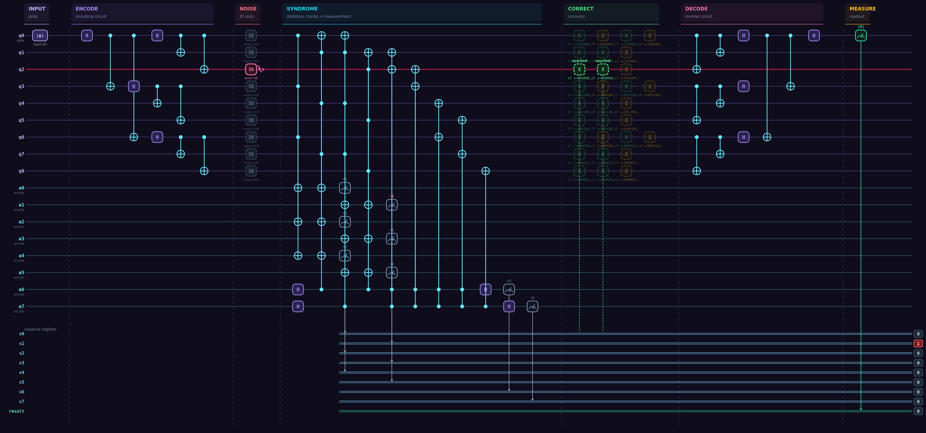
Phase 2 · The Flow — Full Pipeline Circuit
Selected inputs: Shor 9-Qubit Code · X error injected on q2 · Depolarizing noise p = 0.10 · seed 42 — captured live from the prototype (Simulator Lab → Run Shot).
Noise stage: the ID slot on q2 is hit by the injected bit-flip (red wire + X marker) — the same role the ID gates play in all_with_noise_prob.py.
Syndrome stage: eight stabilizer checks run into the ancillas — Z1Z2 returns −1, syndrome bits [0 1 0 0 0 0 0 0] uniquely locate q2 WITHOUT reading the data.
Correct stage: the decoder applies X on q2 (highlighted "applied") → decode → final measurement returns |0⟩ with fidelity 100% vs 0% bare — one arbitrary error fully absorbed.
Interactive Quantum Error Correction Simulator
10

Slide 11
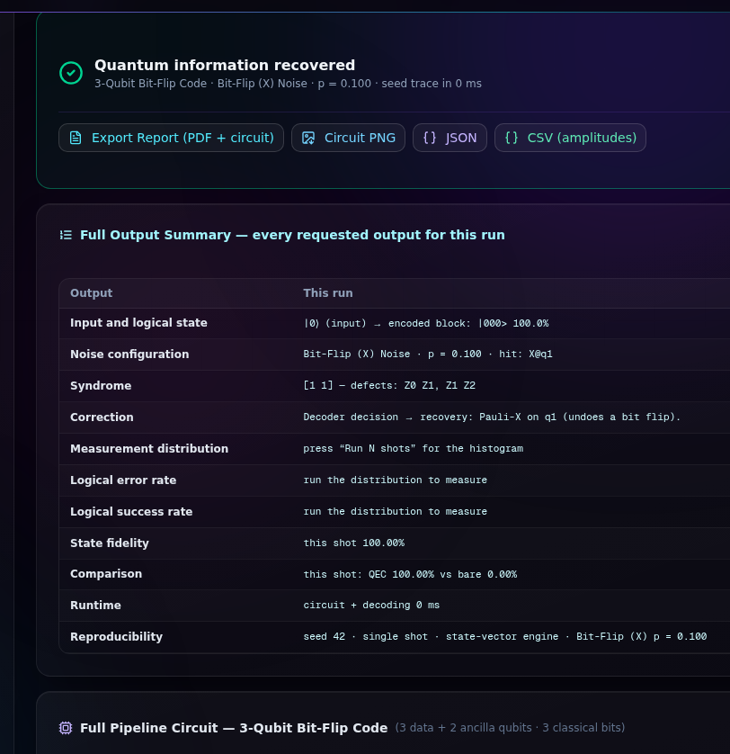
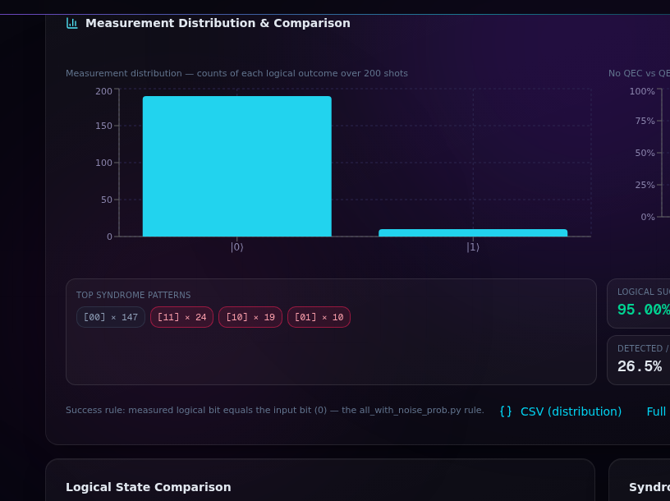
Phase 2 · Results — Simulation Outputs
Single shot: X error on q1 fully corrected — fidelity 100% with QEC vs 0% bare. 200-shot run: logical success 95.00% · logical error 5.00% · detected/corrected 26.5% · runtime 254 ms (1.27 ms/shot) · every value recomputed live in the browser.
Interactive Quantum Error Correction Simulator
11

Slide 12
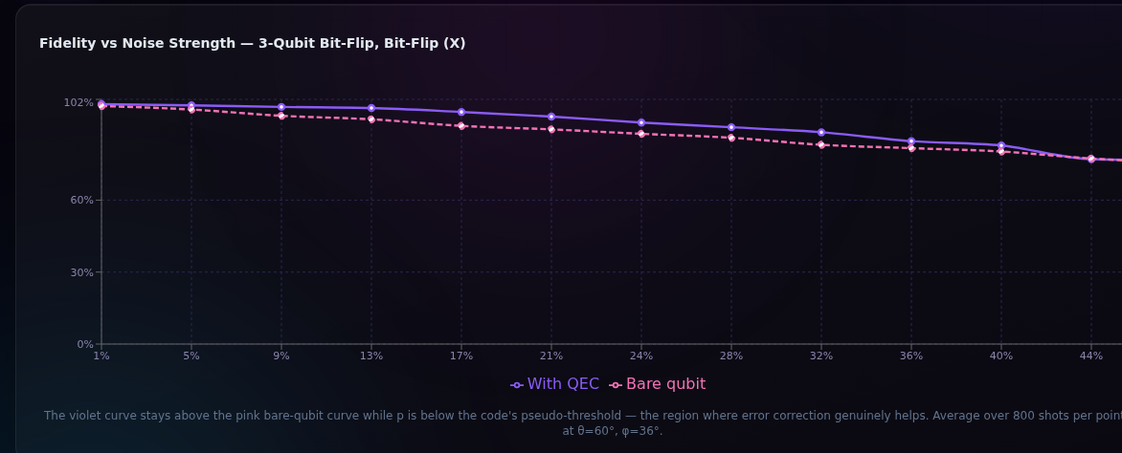
Phase 2 · Comparative Analysis, along with References
Code [[n,k,d]] | Corrects | Best against | Observed behaviour in the prototype
3-Qubit Bit-Flip [[3,1,3]] | 1 bit-flip (X) | Bit-flip noise | Success (1−p)³ + 3p(1−p)² ≈ 97.2% at p = 0.1; Z errors are invisible to it.
3-Qubit Phase-Flip [[3,1,3]] | 1 phase-flip (Z) | Phase-flip noise | H-conjugate of the bit-flip code; X errors are invisible to it.
Shor [[9,1,3]] | 1 arbitrary (X, Y, Z) | Depolarizing noise | All 27 single-error cases corrected (F = 100%); beats the bare qubit below its ≈ 2% pseudo-threshold.
References
• P. W. Shor, "Scheme for reducing decoherence in quantum computer memory," Phys. Rev. A 52, R2493 (1995).
• A. R. Calderbank and P. W. Shor, "Good quantum error-correcting codes exist," Phys. Rev. A 54, 1098 (1996).
• A. M. Steane, "Error correcting codes in quantum theory," Phys. Rev. Lett. 77, 793 (1996).
• D. Gottesman, "Stabilizer Codes and Quantum Error Correction," PhD thesis, Caltech (1997).
• M. A. Nielsen and I. L. Chuang, Quantum Computation and Quantum Information, Cambridge University Press (2010).
Sweep (800 shots/point): the QEC curve stays above the bare curve until the pseudo-threshold — measured live in Performance Lab.
Interactive Quantum Error Correction Simulator
12

