Slide 1

PHASE 1 · PROJECT PROPOSAL
PHASE 2 · PROTOTYPE CONTINUES INSIDE
Interactive Quantum Error Correction Simulator
A configurable environment for simulating quantum noise models and evaluating QEC performance — scoped exactly to our Python reference program (Qiskit + Aer).
2 QEC codes
3 noise models
Monte Carlo engine
Live Bloch-sphere lab
END-TO-END PIPELINE — 8 STAGES
01
›
02
›
03
›
04
›
05
›
06
›
07
›
08
User Input
Encoding
Noise Model
Syndrome
Correction
Decoding
Measurement
Performance
AMRITA VISHWA VIDYAPEETHAM
K. Devendra Reddy · CH.SC.U4CSE24021|Shaik Muzzammil · CH.SC.U4CSE24041|D. Guna Samhith · CH.SC.U4CSE24016
Interactive QEC Simulator — Phase 1 + Phase 2
AMRITA VISHWA VIDYAPEETHAM

Slide 2
PHASE 1 · INTRODUCTION
Why quantum computers need error correction
A qubit stores information in a superposition that no-cloning forbids us to back up. Real hardware flips values (X), flips phases (Z) and mixes both (depolarizing) — without correction, quantum data melts within a handful of gates.
⚡
The enemy — noise
❄
The trick — redundancy
⛨
The proof it works
Bit-flip (X) turns |0> into |1>. Phase-flip (Z) turns |+> into |->. Depolarizing applies a random Pauli X/Y/Z with probability p/3 each. Our reference program implements exactly these three channels on the ID gate.
The 3-qubit repetition family spreads ONE logical qubit across three physical qubits (alpha|000> + beta|111>). Parity checks locate an error WITHOUT reading — and destroying — the data.
With a single X error on any qubit, syndrome 01/11/10 points at the culprit, an X correction undoes it, and the decoded qubit returns with 100% fidelity — verified live in our prototype.
X/Y/Z · p/3 · ID gate
alpha|000> + beta|111>
syndrome 01/11/10 · 100% fidelity
✓
Verdict logic of the Python reference program
QEC STATUS: MATCHED — bit-flip noise tested with the 3-qubit Bit-Flip QEC · NOT MATCHED — the code is not matched to this noise · DEPOLARIZING — tested with the selected code

Slide 3
PHASE 1 · OBJECTIVES
Three objectives carried from the proposal
1
Multi-model noise simulation
⚿
Scope — exactly all_with_noise_prob.py
Implement the three canonical channels — bit-flip (X), phase-flip (Z) and depolarizing — with a configurable probability p, applied to every qubit of the encoded block exactly like build_noise_model() in our Python program.
QEC codes
2 — 3-qubit Bit-Flip, 3-qubit Phase-Flip
Noise models
3 — Bit-Flip (X), Phase-Flip (Z), Depolarizing
Noise point
ID gate
2
Before / after comparison
Shots
1,000 (Python) / up to 25,000 (browser)
Evaluate the SAME noise on a bare qubit and on the encoded logical qubit: fidelity, error rate, improvement factor, detection statistics, plus probability sweeps that expose each code’s pseudo-threshold.
Metric
final bit == input bit (counts) / fidelity (browser)
3
Configurable QEC experimentation
Both QEC codes ([[3,1,3]] bit-flip and phase-flip) combinable with all three noise models, any input state |psi>, manual error injection and a reproducible RNG seed.
ⓘ
Nothing outside this scope appears in the prototype — every lab is limited to these options by design.

Slide 4
PHASE 1 · LITERATURE SURVEY
Ten studies that frame this project
10 PAPERS · 2018 – 2026
# | Title (short) | Authors | Year | Focus
1 | An Efficient Simulation of Quantum Error Correction Codes | R. Padma Priya, A. Baradeswaran | 2018 | QCAD-based simulation of QEC with bit-flip and phase-flip errors.
2 | Testing Quantum Fault Tolerance on Small Systems | D. Willsch et al. | 2018 | Fault-tolerance tests on simulators and an IBM processor.
3 | Correcting Coherent Errors with Surface Codes | S. Bravyi et al. | 2018 | Surface-code QEC under coherent errors.
4 | Logical Performance of 9-Qubit Compass Codes in Ion Traps with Crosstalk | D. M. Debroy et al. | 2020 | QEC under dephasing, over-rotation and crosstalk.
5 | Simulating QEC beyond Pauli Stochastic Errors | J. Hines et al. | 2026 | Coherent and non-Pauli errors via detector error models.
6 | Testing a Quantum Error-Correcting Code on Various Platforms | Q. Guo et al. | 2020 | A two-qubit code for detected amplitude damping.
7 | Simulation and Performance Analysis of QEC with a Rotated Surface Code under a Realistic Noise Model | M. Katsuda et al. | 2024 | Distance-5 surface code under stochastic and coherent noise.
8 | Demonstrating Multi-Round Subsystem QEC Using Matching and Maximum-Likelihood Decoders | N. Sundaresan et al. | 2023 | Multi-round QEC and syndrome decoding.
9 | Simulation of Thermal-Relaxation Noise for Quantum Error Correction | S. R. Garner et al. | 2026 | Accurate thermal-relaxation simulation for QEC.
10 | Comparative Performance Analysis of QEC Codes under Simulated Depolarizing Noise using Qiskit | G. Kaur et al. | 2026 | 3-qubit bit-flip, phase-flip and Shor codes under depolarizing noise — our reference-program lineage.
◆
Our prototype unifies the survey’s common denominator: simulate the canonical channels, compare with-vs-without QEC, report reproducible metrics.

Slide 5
PHASE 1 · METHODOLOGY & ARCHITECTURE
The worked example that anchors the design
⚗
Reference scenario — 3-qubit Bit-Flip QEC
▶
Worked run — X on q1, p = 10%
⚡
|000> -> noise -> |010>
⌕
syndrome (1,1)
1
input_bit -> prepare |psi> (X gate if 1)
2
ENCODE: CX(0,1), CX(0,2) -> alpha|000> + beta|111>
⚒
correction X(q1) -> |000>
3
NOISE: id(error_qubit) + NoiseModel on ID gate (X / Z / depol, prob p)
✓
decoded -> |0> — FIDELITY 100%
4
SYNDROME: q3 checks q0,q1 ; q4 checks q1,q2
5
MEASURE syndrome -> c0,c1
6
CORRECT (if_test): 01 -> X(q0) · 11 -> X(q1) · 10 -> X(q2)
q0
q1
q2
0
1
0
7
DECODE: CX(0,1), CX(0,2)
corrupted
8
MEASURE c2 -> compare with input_bit
the exact Phase-1 example, now executable live in the prototype’s Overview tab
✦
AerSimulator.run(qc, shots=1000) -> counts -> interpretation -> performance analysis -> syndrome table -> circuit printout.

Slide 6
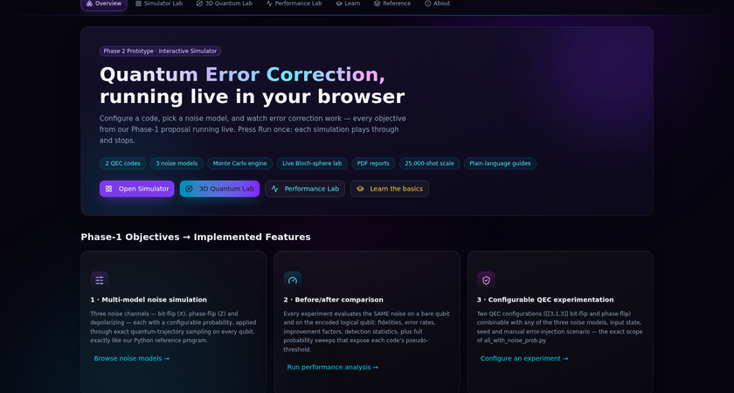
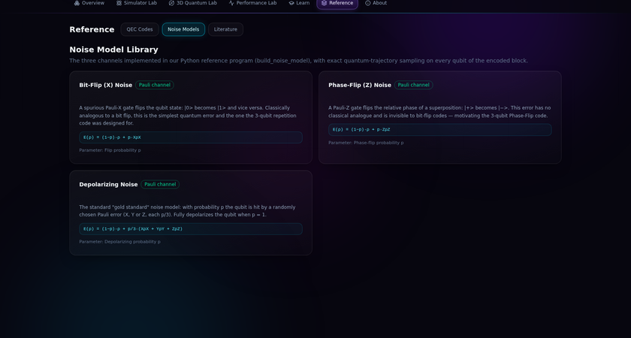
02
PHASE 2 · THE PROTOTYPE
The simulator, running live in the browser
A Next.js client-side web application — every value computed by a from-scratch state-vector engine, scoped to the two codes and three channels of the Python program.
Overview — objectives, compact how-it-works walkthrough, quick navigation
Simulator Lab — manual X on q1: syndrome (1,1), correction applied, F = 100% vs bare 0%
✦
7 tabs
⚙
2 codes x 3 noises
✦
25,000-shot Monte Carlo
↓
PDF/JSON/CSV exports
✓
55-assertion engine tests

Slide 7
PHASE 2 · METHODOLOGY (1/2)
How the prototype was built
✿
Build flow
▦
One engine, no mocks
Every tab renders engine output — amplitudes, syndromes, fidelities and trajectories are computed on click, seeded and reproducible (seed shown in the UI). Reload with the same seed and the exact same noise plays again.
1
Scope lock — analyse all_with_noise_prob.py; accept only its 2 codes and 3 channels into every dropdown.
2
Engine first — implement a from-scratch TypeScript state-vector simulator (gates, CNOT, projective Pauli measurement, partial trace, fidelity, Bloch readout).
3
Port the program — bit_flip_qec and phase_flip_qec become encoding circuits + stabilizer checks + syndrome-to-correction tables; build_noise_model becomes quantum-trajectory sampling of X, Z and depolarizing channels.
4
Labs on top — Simulator Lab (single shot), Performance Lab (Monte Carlo + sweeps + showdown), 3D Quantum Lab (Bloch-sphere visualizers), Learn/Reference/About.
▤
Matched vs unmatched pairing
Bit-Flip code: X-noise MATCHED (100% recovery) · Z-noise invisible · depol partial
5
Verify — a 55-assertion engine suite: correction correctness, syndrome mapping, sampling rates, MC vs analytic theory.
Phase-Flip code: Z-noise MATCHED (100% recovery) · X-noise undetectable · depol partial

Slide 8
PHASE 2 · METHODOLOGY (2/2) — THE FLOW
The flow: one run, end to end
01
02
03
04
User Input
Encoding
Noise Model
Syndrome
→
→
→
CX ladder spreads |psi> across 3 qubits
X / Z / depolarizing sampled per qubit
code · noise · p · state · seed
Z0Z1 and Z1Z2 parity checks
05
06
07
08
Correction
Decoding
Measurement
Performance
→
→
→
01->q0 · 11->q1 · 10->q2 lookup
inverse CX ladder to 1 qubit
logical readout + fidelity
Monte Carlo over N shots
WHERE YOU SEE IT
▶
Simulator Lab
◆
Performance Lab
◉
3D Quantum Lab
↓
Exports
one shot, every intermediate state
thousands of shots, curves
the same pipeline on the Bloch sphere
PDF / JSON / CSV of everything
✦
Same pipeline as all_with_noise_prob.py — input -> encode -> id-gate noise -> syndrome -> if_test correction -> decode -> measure — extended with a bare-qubit baseline for the before/after comparison.

Slide 9
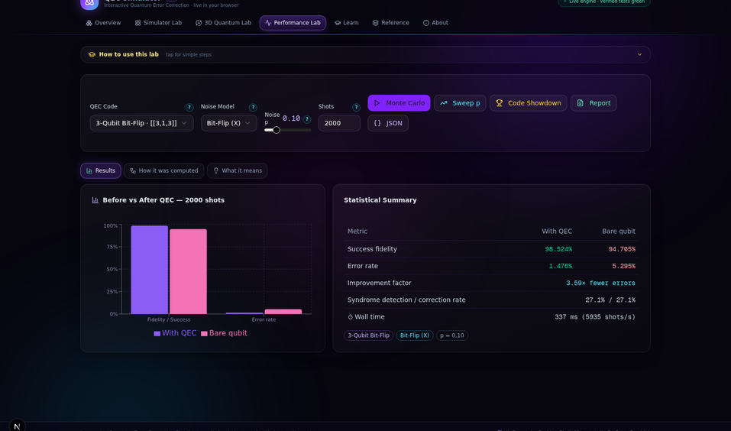
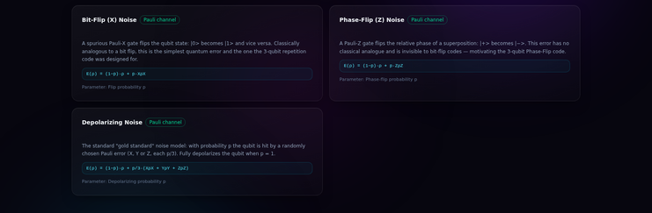

PHASE 2 · RESULTS (1/2)
Simulated runs — noise models at work
3 SIMULATED RUNS · BROWSER ENGINE
⚡ Single shot — X on q1: syndrome (1,1) flags two parity checks, decoder applies X(q1), recovery F = 100%
⌇ Monte Carlo, 2,000 shots — bit-flip code under X noise p=0.10: 98.52% with QEC vs 94.71% bare (3.59x fewer errors), 5,935 shots/s live in the browser
☂ Reference — the three implemented channels: Bit-Flip (X), Phase-Flip (Z), Depolarizing
syndrome detection
27.1%
·
correction rate
27.1%
·
engine time
337 ms
·
✓
zero server calls

Slide 10
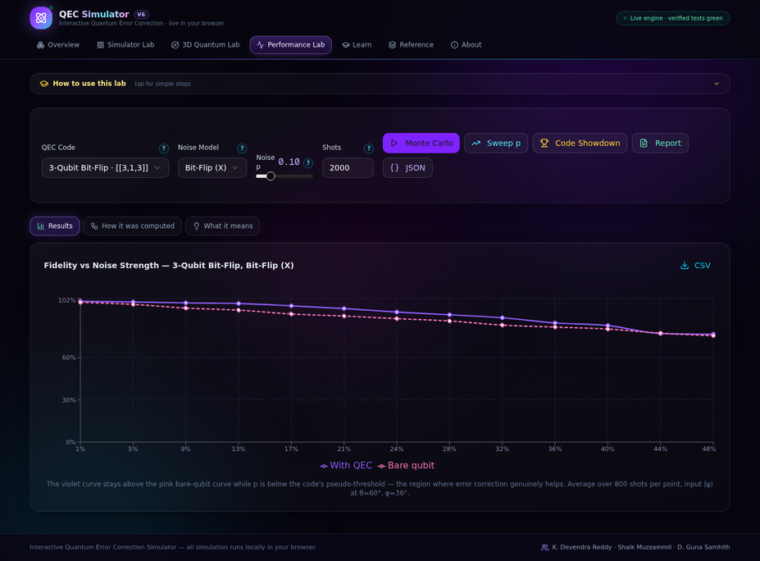
PHASE 2 · RESULTS (2/2)
Sweeps expose the physics
SWEEP 1%..50% · 800 SHOTS / POINT
▦
Measured highlights
MONO · SEED-REPRODUCIBLE
Matched pairing
F = 100% after correction
Bit-Flip code + X noise
Monte Carlo vs theory
0.972 predicted / 0.970 measured
(1-p)^3 + 3p(1-p)^2 at p=0.10
Improvement @ p=0.10
3.59x fewer errors
Bit-Flip code
Mismatched pairing
undetectable — honest 0.45x
Phase-Flip code + X noise
Sweep crossover
~42% at theta=60 deg
Bit-Flip code pseudo-threshold
Code Showdown @ p=0.10
matched code wins
Bit-Flip 4.33x vs Phase-Flip 0.45x
↗ Fidelity vs noise strength (1%..50%) — the bit-flip code stays above the bare qubit until the pseudo-threshold crossover (~42%); 800 shots per point
⚠
Honest physics: the prototype does not hide failures — pairing the phase-flip code with X noise measurably hurts, exactly as the syndrome algebra predicts.

Slide 11
PHASE 2 · COMPARATIVE ANALYSIS + REFERENCES
Codes under identical noise, and the literature behind it
2 CODES × 3 CHANNELS
PHYSICAL QUBITS
CODE
FIXES
X-NOISE P=0.10
Z-NOISE P=0.10
DEPOLARIZING P=0.05
3-Qubit Bit-Flip
3
1 bit-flip (X)
MATCHED — 100% recovery, 3.6-4.3x improvement
invisible to syndrome (no harm at low p)
helps (partial recovery)
[[3,1,3]]
3-Qubit Phase-Flip
3
1 phase-flip (Z)
undetectable logical flip — 0.45x
MATCHED — 100% recovery
helps (partial recovery)
[[3,1,3]]
ⓘ
Values from the prototype’s Code Showdown / Monte Carlo at the same seed discipline; improvement = bare error rate / QEC error rate.
▤
References
10 STUDIES
01
Padma Priya & Baradeswaran · 2018 — An Efficient Simulation of Quantum Error Correction Codes. QCAD-based simulation of QEC with bit-flip and phase-flip errors.
06
Guo et al. · 2020 — Testing a Quantum Error-Correcting Code on Various Platforms. A two-qubit code for detected amplitude damping.
02
Willsch et al. · 2018 — Testing Quantum Fault Tolerance on Small Systems. Fault-tolerance tests on simulators and an IBM processor.
07
Katsuda et al. · 2024 — Simulation and Performance Analysis of QEC with a Rotated Surface Code under a Realistic Noise Model. Distance-5 surface code under stochastic and coherent noise.
03
Bravyi et al. · 2018 — Correcting Coherent Errors with Surface Codes. Surface-code QEC under coherent errors.
08
Sundaresan et al. · 2023 — Demonstrating Multi-Round Subsystem QEC Using Matching and Maximum-Likelihood Decoders. Multi-round QEC and syndrome decoding.
04
Debroy et al. · 2020 — Logical Performance of 9-Qubit Compass Codes in Ion Traps with Crosstalk. QEC under dephasing, over-rotation and crosstalk.
09
Garner et al. · 2026 — Simulation of Thermal-Relaxation Noise for Quantum Error Correction. Accurate thermal-relaxation simulation for QEC.
05
Hines et al. · 2026 — Simulating QEC beyond Pauli Stochastic Errors. Coherent and non-Pauli errors via detector error models.
10
Kaur et al. · 2026 — Comparative Performance Analysis of QEC Codes under Simulated Depolarizing Noise using Qiskit. 3-qubit bit-flip, phase-flip and Shor codes under depolarizing noise — our reference-program lineage.

Slide 12
PHASE 2 · THE FLOW — DEPLOY & USE
From repository to live simulator
↑
Deployment flow
MAIN BRANCH → PRODUCTION
git push (main)
›
GitHub repository
›
Vercel import (auto-detect Next.js)
›
next build (1-2 min)
›
◯
live URL
No env vars · no database · zero server compute — every push to main redeploys automatically.
⌇
User flow
7 TABS · ONE PIPELINE
Overview
›
Simulator Lab
›
3D Quantum Lab
›
Performance Lab
›
Exports
how it works
run a shot
Bloch sphere walkthrough & flight
Monte Carlo + sweeps
PDF / JSON / CSV
▣
Deliverables
▸
Quantum_error_correction_Phase1+Phase2.pptx
▸
QEC-Simulator-Report.pdf
▸
QEC-Simulator-Prototype.zip
Interactive Quantum Error Correction Simulator — Phase 1 + Phase 2
AMRITA VISHWA VIDYAPEETHAM
this deck
merged Phase 1 + Phase 2 report
deployable source + README deploy guide

