Slide 1

Build & Crew
A project/dissertation submitted in partial fulfilment of the requirements for the degree of
Bachelor of Technology in Computer Science and Engineering
by
Sk.Nayima Khatun
Hall Ticket No. 22641A0591
T.Sravya
Hall Ticket No. 22641A0595
S.Swetha
Hall Ticket No. 22641A0587
A.Ajay
Hall Ticket No. 22641A05A8
Under the guidance of
Mr. Ch.Aravind Kumar
Assistant Professor
Department of Computer Science and Engineering
Vaagdevi College of Engineering
(UGC Autonomous, Accredited by NBA & NAAC with “A”)
Bollikunta, Khila Warangal (Mandal), Warangal Urban – 506005(T.S)
2025-2026

Slide 2
Overview
1.Abstract
2.Introduction 11.Results
3.Problem Statement 12.Conclusion and Future Scope
4.Literature Review 13.References
5.Existing System
- Disadvantages
6.Proposed System
- Advantages
7.System Requirements
- Functional Requirements
- Non-functional Requirements
9.Modules Description
10.Designing
-Entity-Relationship Diagram
-Use case Diagram

Slide 3
Abstract
Build & Crew provides a centralized platform streamlining the process of acquiring construction materials and connecting with relevant workers.
In this users can search for specific materials, locate nearby dealers, obtain estimated pricing, and access contact information.
Similarly, users can browse available workers, view their hourly rates, and obtain contact details. This application aims to simplify and expedite the often complex process of construction resource management.
This comprehensive solution aims to simplify and enhance the construction planning and execution process.

Slide 4
Introduction
In the rapidly evolving construction industry, efficient procurement of materials and skilled labor is paramount to the success of any project.
This application offers users to access wide range of construction materials that are available nearby and their can also connect with the skilled workers.
With a friendly interface users can easily search for materials, find nearby dealers, view estimated prices, access dealer contact information, the users can also search for workers and can view their contact information.
By integrating these essential features into a single platform, the application aims to enhance efficiency, reduce delays, and optimize costs for construction projects.

Slide 5
Problem Statement
Finding construction materials and hiring workers is often inefficient. Manual searches and fragmented information lead to delays, higher costs, and a lack of transparency in pricing. Current methods do not provide a unified, real-time solution. There is a need for a platform that simplifies these processes, offers real-time updates, and provides easy access to reliable information for materials and workers.

Slide 6
Literature Review
Digital platforms are increasingly transforming the construction industry by streamlining access to materials and skilled labour. Studies have shown that construction supply chains often suffer from inefficiencies due to lack of centralized access (Awolaja et al., 2020). Applications that integrate material sourcing with real-time location-based services significantly improve procurement processes (Li et al., 2019).
Additionally, providing transparent access to workers’ contact details and hourly rates supports better workforce management (Zhang & Fang, 2021). Your application effectively combines these aspects by offering users a unified platform to search for materials, view nearby dealers with pricing, and contact skilled workers, making it a practical tool for modern construction needs.

Slide 7
Existing system and its disadvantages
Users typically have to manually search for construction materials and workers. Like visiting multiple stores or contacting various dealers for materials
Users may need to reach out to multiple sources to gather necessary information.
Users may face challenges in making informed decisions due to lack of current data.
Disadvantages:
The manual process of searching and gathering information is inefficient and time-consuming.
Inefficiencies and lack of transparent pricing can lead to higher costs for materials and labor.
The disjointed nature of the current system complicates the procurement process, making it harder for users to coordinate materials and labor.

Slide 8
Proposed system and its advantages
Unified Platform: One place to search for construction materials and workers.
Easy-to-Use Interface: Simple and clear design for quick access.
Transparent Pricing: Clear and consistent prices for materials and workers.
Advantages:
Users can search for materials and workers from anywhere.
Saves time by showing nearby dealers instead of manual searching and users can compare prices instantly instead of visiting different dealers.
Clear and consistent prices for materials and workers.

Slide 9
System Requirements
Functional Requirements:
User Management: Signup, login, logout, and password reset.
Homepage: Displays construction materials and workers.
Search : Search materials by name and workers by skill.
Dealer Details: Show dealer info, estimated price of Material, and contact details.
Worker Details: Show worker profile, per day rate, and contact details.
Security: Only logged-in users can book or order.

Slide 10
System Requirements
Non-Functional Requirements :
Performance
Security
Scalability
Compatibility
Reliability

Slide 11
Methodology
Modules:
Materials: Searchable catalog with pricing and availability.
Workers: Skill-based profiles with booking and availability.
Dealers: Listings with contact info and material offerings.
Data Handling: JSON used for efficient, reusable storage and easy updates.
Testing: Conducted unit, integration, UI, and validation tests for smooth user experience.
Future Scope: Scalable to add categories, location filters, and reviews.

Slide 12
Modules Description
User Module: user registration and user login
Materials Module : Search functionalities, Results display, Material details .
Dealers Information Module : It has Dealer listings, Dealer details.
Workers Module : Workers listing, search functionalities, Workers details, User reviews and ratings.

Slide 13
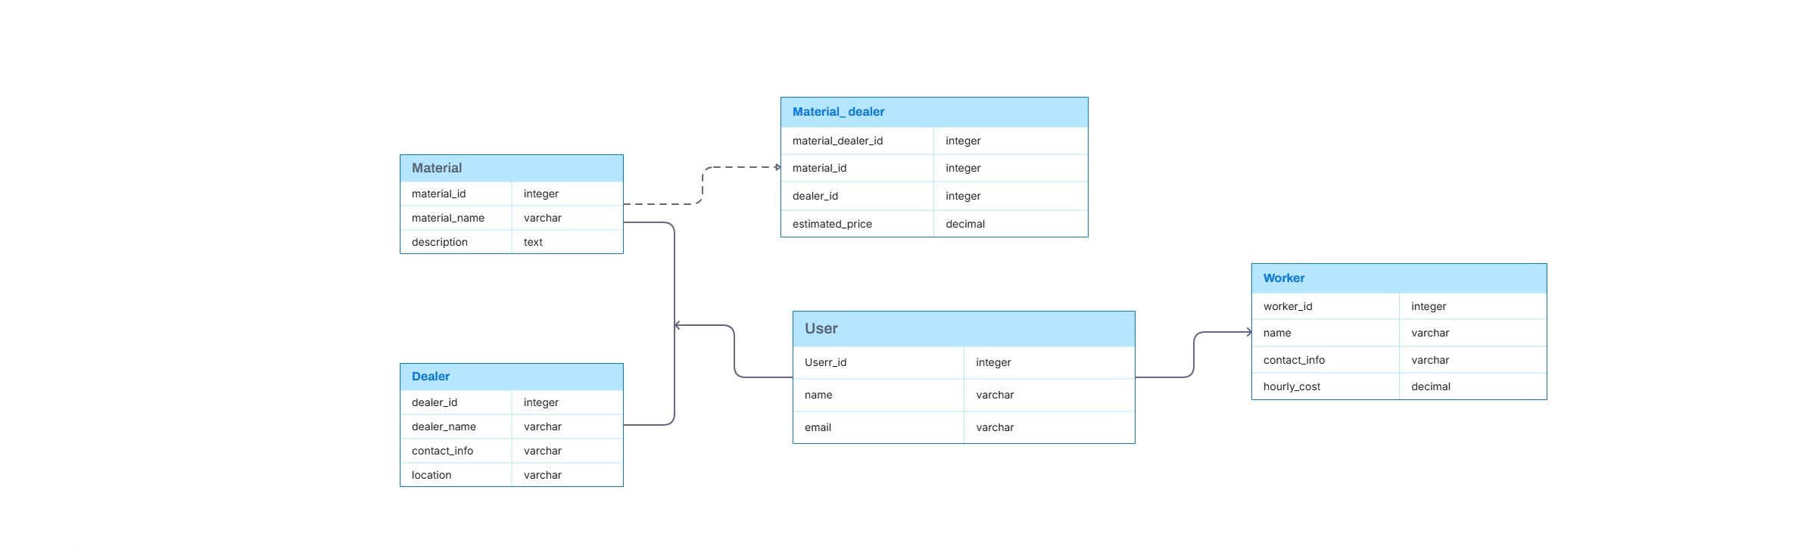
Designing
Data Flow Diagrams
Entity Relationship(ER) Diagram

Slide 14
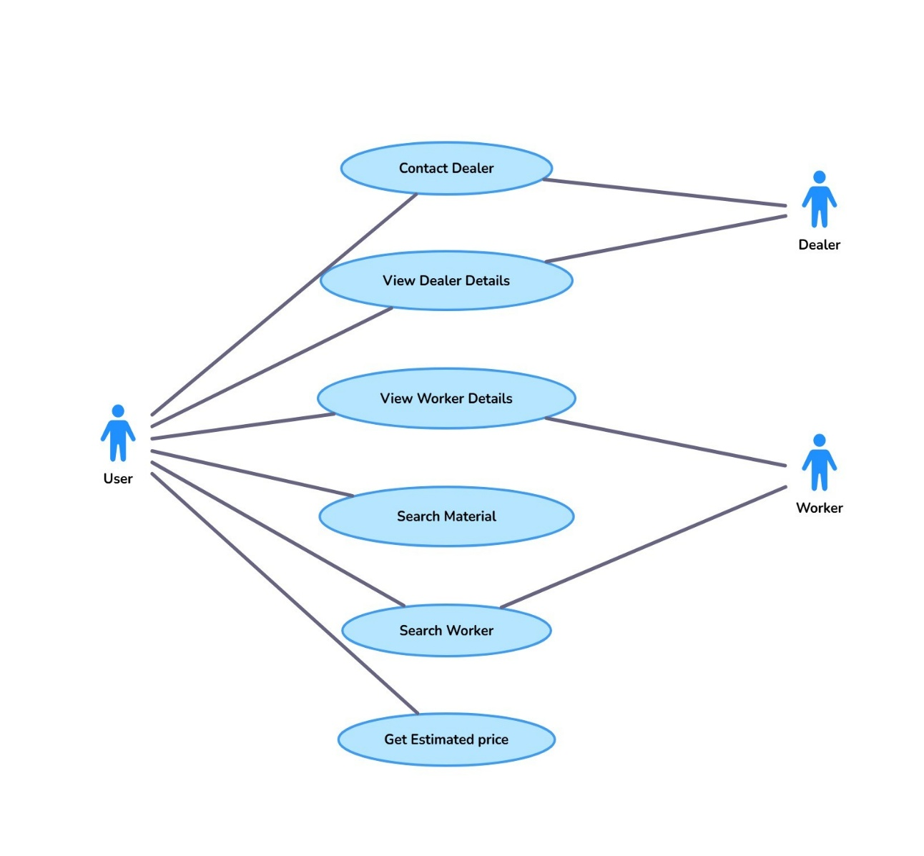
UML Diagrams
Sequence Diagram
UseCase Diagram

Slide 15
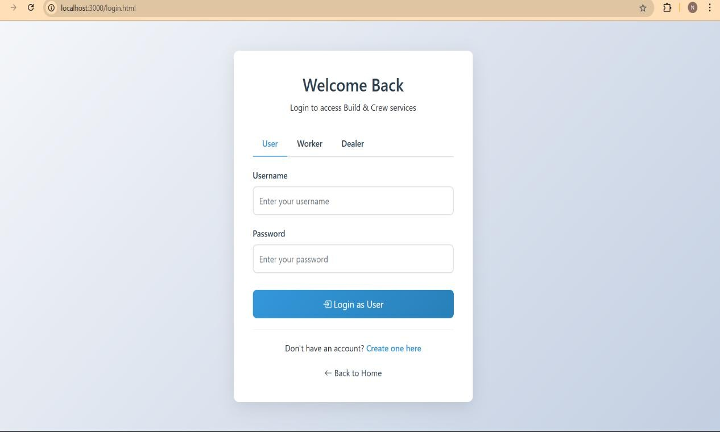
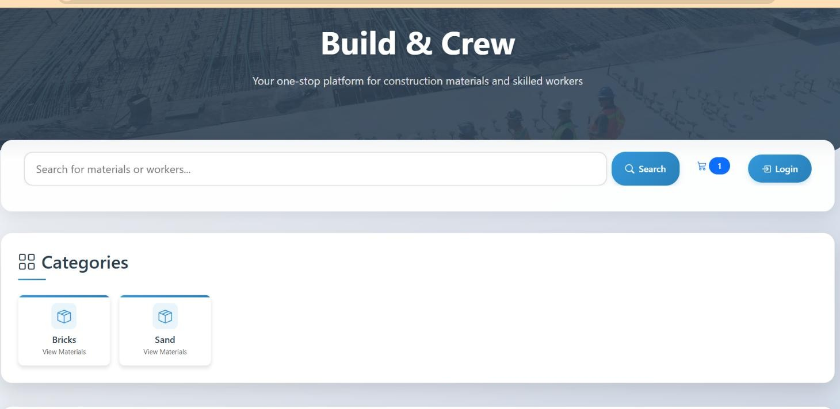
Results
Login Page
Home Page

Slide 16
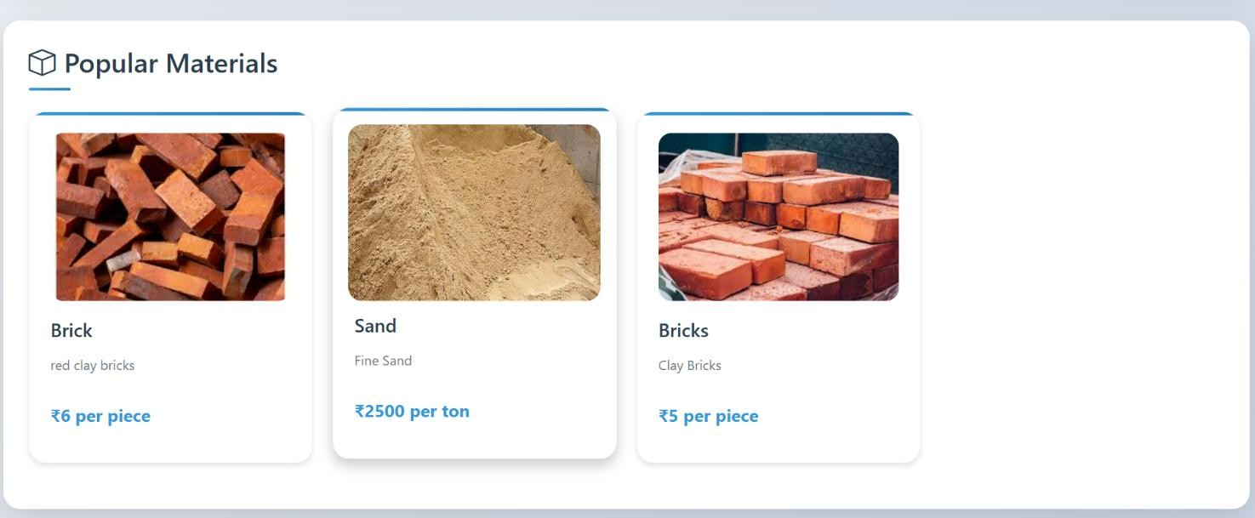
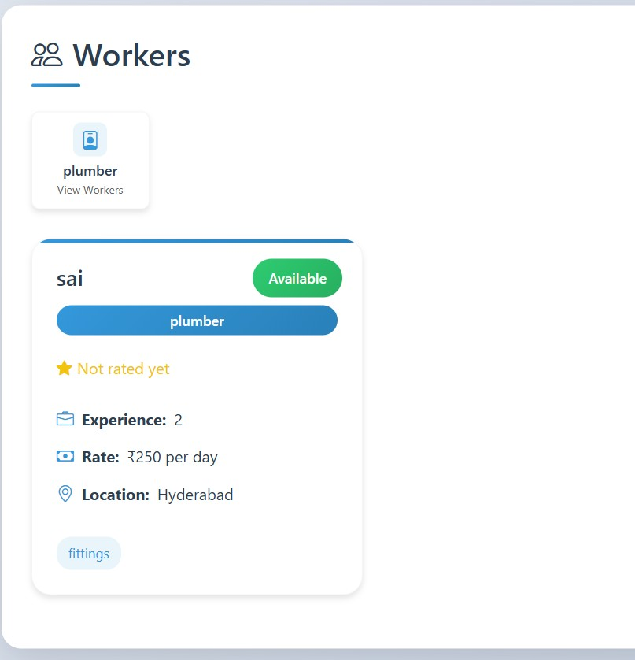
Results
Main page

Slide 17
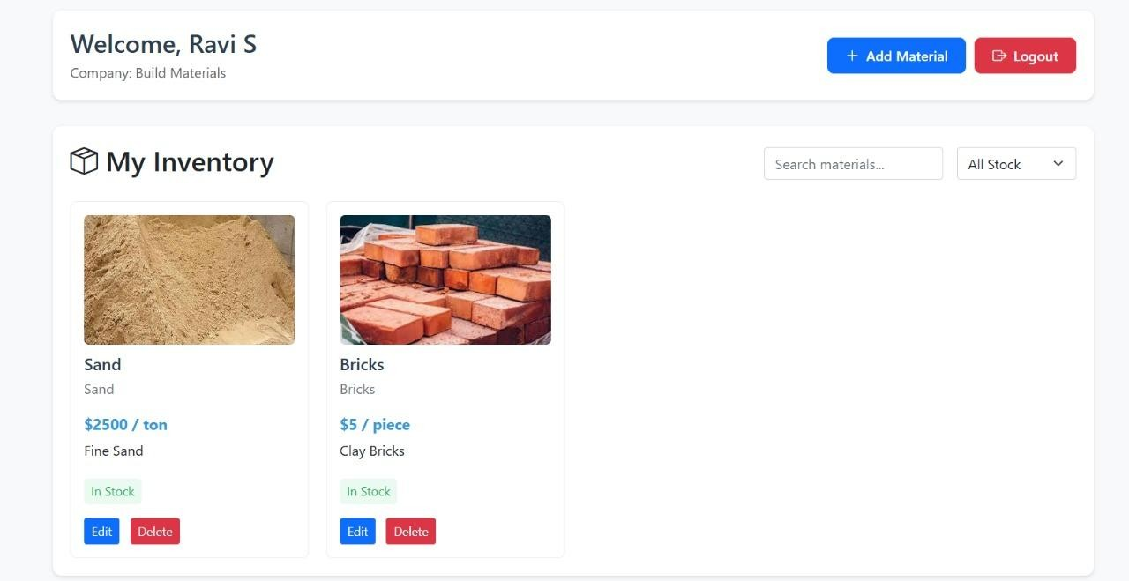
Results
Dealers Dashboard

Slide 18
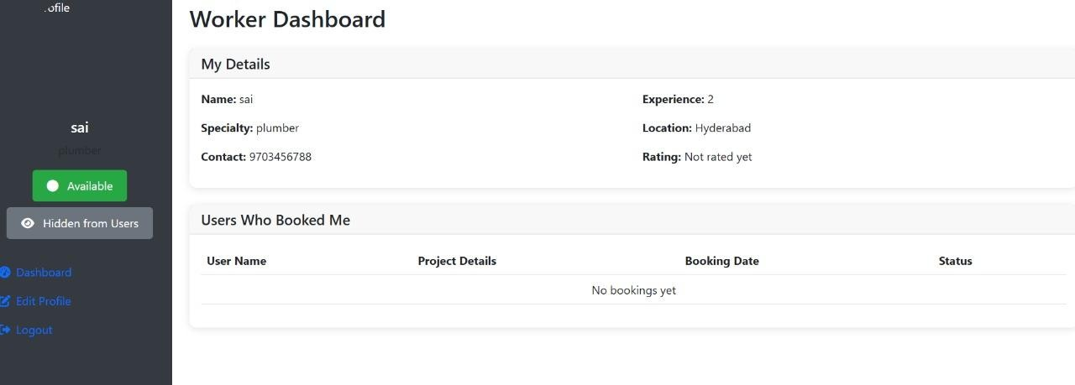
Results
Workers Dashboard

Slide 19
Conclusion & Future Scope
Build & Crew simplifies the construction process by connecting users directly with the materials and workers they need.
By consolidating essential resources, the application eliminates the complexities of sourcing materials and labor. This leads to increased efficiency, reduced project delays, and cost savings.

Slide 20
References
Authors -Alaa Alshwaikh, Jeehan AlShabani, Kawthar Tooq, Ehab Juma Adwan, Yusuf Almalki “A Mobile application prototype of materials procurement for the Bahraini construction industry”, 08 April 2022.

Slide 21
Thank You!!!

